Slide 1
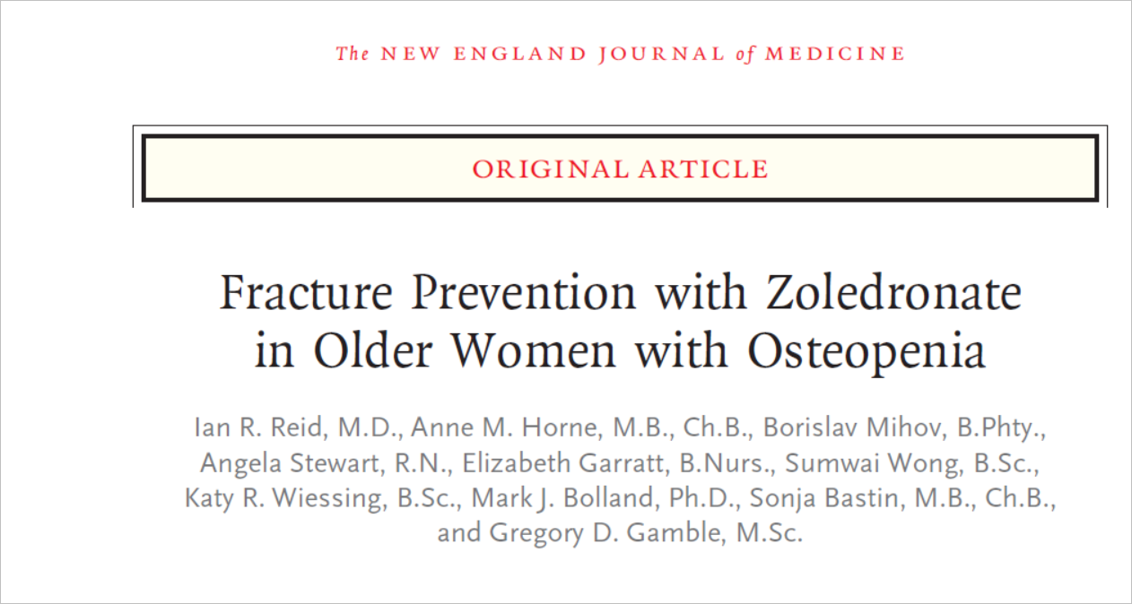
Published on October 1, 2018
Asha Mathai

Slide 2
Background
Bisphosphonates are the principal class of medications used in the management of postmenopausal osteoporosis
Prevention of fractures with bisphosphonates has been shown most clearly in patients with osteoporosis,
Whether bisphosphonates are efficacious in patients with osteopenia alone is uncertain.
Trial reported by Cummings et al. did not show a significantly lower risk of clinical fractures with alendronate than with placebo among women with osteopenia
In contrast, pooled results from trials of risedronate suggested fracture prevention among patients who had osteopenia

Slide 3
Methods
Randomized, double-blind, placebo- controlled trial to determine the efficacy
Women were recruited with the use of electoral registers from the Auckland region of New Zealand
Randomly assigned in a 1:1 ratio

Slide 4
Four infusions of either zoledronate at a dose of 5 mg (zoledronate group) or normal saline (placebo group), packaged in identical containers, at 18-month intervals
Funding for the trial was provided by the Health Research Council of New Zealand.
The trial medication was supplied by Novartis.
Neither entity had any other role in the trial

Slide 5
PICOT
P:Ambulatory postmenopausal women 65 years of age or older, with a T score of −1.0 to −2.5 at either the total hip or the femoral neck on either side
I: Zolendonic acid
C: Placebo (normal saline)
O:Time to first occurrence of a fragility fracture
T: September 2009 through October 2011 with follow up of 6 yrs

Slide 6
Was the study population clearly defined ?
Inclusion criteria
Female subjects aged >65 years
>5 years postmenopausal
Life-expectancy >5 years.
Total hip T-score at either hip is between -1.0 and -2.5

Slide 7
Exclusion criteria
- Renal impairment (eGFR <30 mL/minute)
- Active liver disease
- Concurrent major systemic disease
Active malignancy within the last 2 years
- Metabolic bone disease
- Regular use of hormone replacement therapy within the previous 1 year
- Treatment with bisphosphonates in the previous 1 year
- Current treatment with oral glucocorticoid drugs in a dose ≥2.5 mg/day
- BMD of lumbar spine (L1-L4) <-3.0

Slide 8
Were the outcome measures clearly defined ?
PRIMARY OUTCOME
Time to first occurrence of a fragility fracture
SECONDARY OUTCOME
occurrence of a symptomatic (clinical) fracture
occurrence of a vertebral fracture
change in height
mortality.

Slide 9
Exploratory end points
occurrence of nonvertebral fragility fracture, symptomatic vertebral fracture, hip fracture, and forearm or wrist fracture

Slide 10
Statistical analysis
Two groups of 921 women in each
To detect a hazard ratio for fragility fracture of 0.7 favoring zoledronate over placebo
Assuming an event rate of 16% and a standard deviation 0.65.13
80% Power
P value 0.05

Slide 11
How serious was the risk of bias?

Slide 12
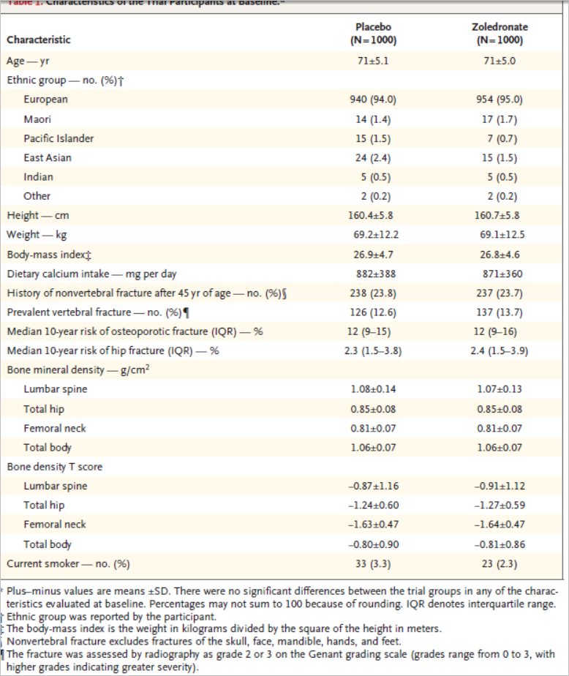
Did intervention and control groups begin the study with similar prognosis?

Slide 13
Were patients randomized?
Randomly assigned in 1:1 ratio
Variable block size that was prepared by the trial statistician.

Slide 14
Was randomization concealed?
yes

Slide 15
Were patients similar at baseline with respect to known prognostic factors?
Yes

Slide 16
Was prognostic balance maintained as the study progressed?
Were patients, caregivers, collectors of the outcome data, adjudicators of outcome and data analysts aware of the group allocation?
No

Slide 17
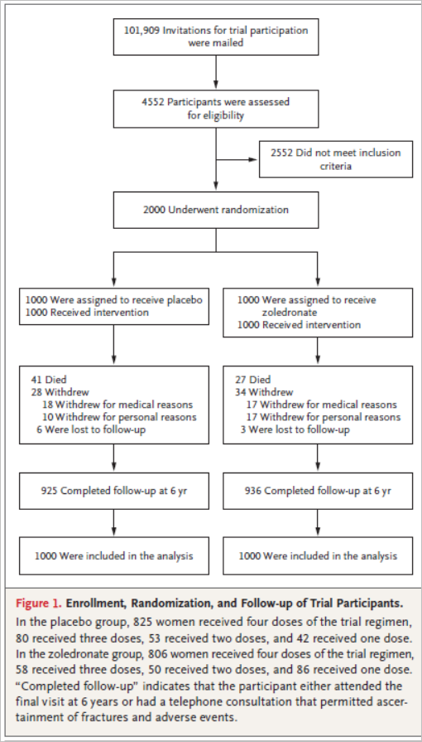
Were the groups prognostically balanced at the study’s conclusion?
Was follow up complete?

Slide 18
Was the trial stopped early for benefit?
No
Were patients analyzed in the groups that they were randomized?
Yes

Slide 19
Did the investigators guard against unwarranted conclusion on inferiority?
Was the effect of the standard treatment preserved?
Did the investigators analyse patients based on the treatment they received and the groups to which they were assigned?
Yes

Slide 20
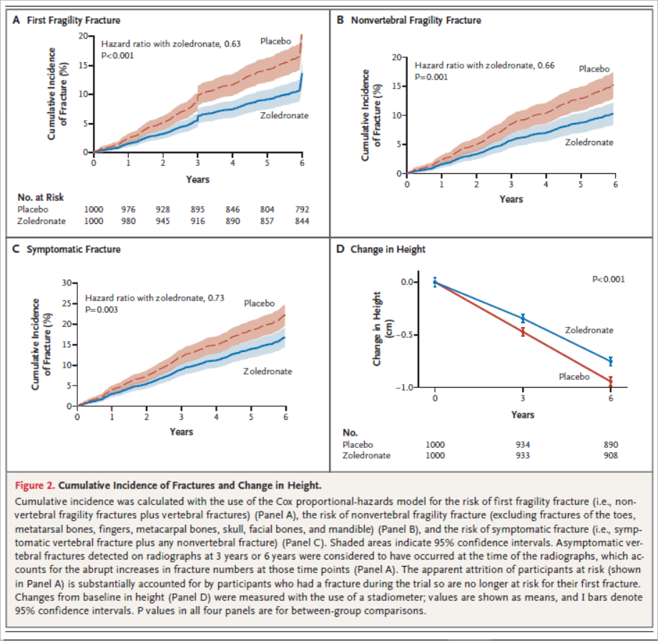
What are the results?

Slide 21
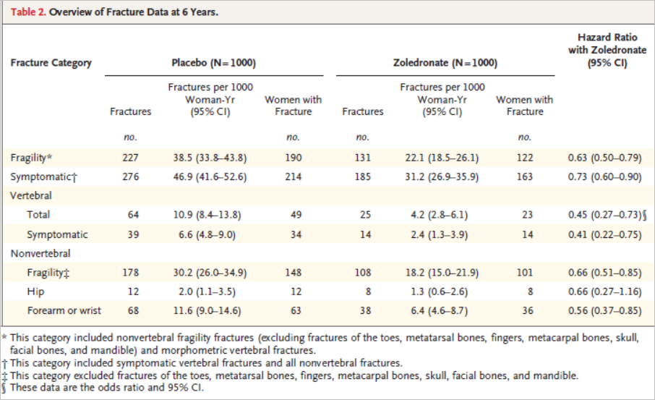

Slide 22
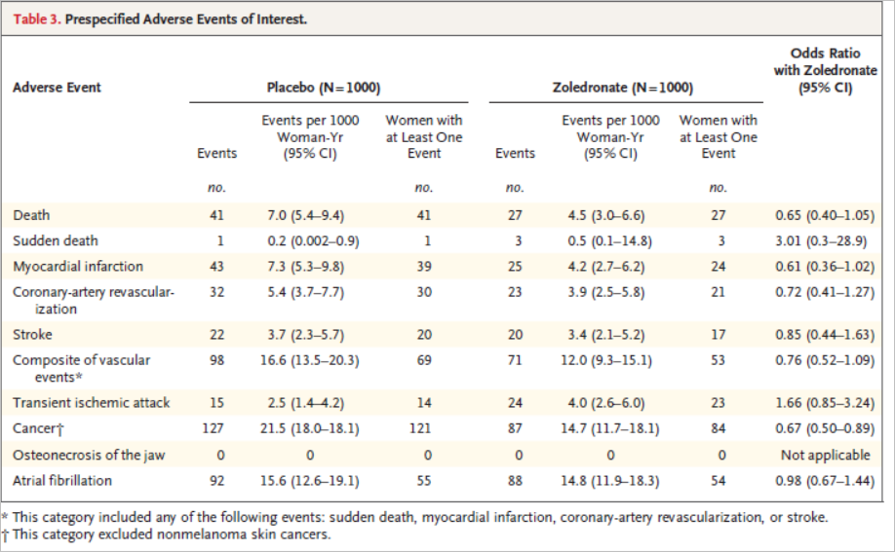

Slide 23
How precise was the estimate of the treatment effect?
Hazard ratio with zoledronate- 0.63
95% confidence interval, 0.50 to 0.79; P<0.001

Slide 24
How can I apply the results to my patients?
Were the study patients similar to my patients?
Race different
Comorbidities may be different

Slide 25
Were all patient important outcomes considered?
yes

Slide 26
Are the likely benefits of the novel treatment worth the potential harm?
NNT
Number of women that would need to be treated for 6 years to prevent the occurrence of a fragility fracture in 1 women - 15
To prevent the occurrence of a single fragility fracture - 10

Slide 27
Limitation
Comorbidities not mentioned
Fracture ? Pathological ? Trivial fall

Slide 28
Conclusions
The risk of nonvertebral or vertebral fragility fractures was significantly lower in women with osteopenia who received zoledronate than in women who received placebo.

