Slide 1
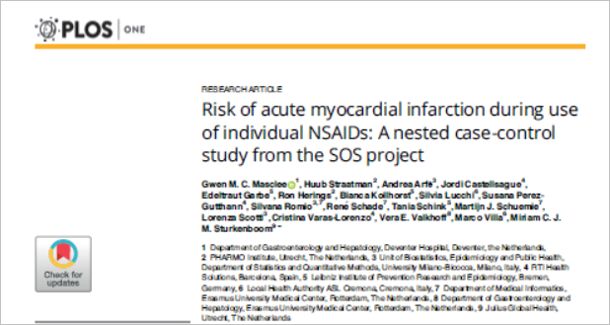
Asha Mathai

Slide 2
Background
Non-steroidal anti-inflammatory drugs (NSAIDs) are widely used to reduce inflammation and provide pain relief.
They act via reversible, competitive inhibition of cyclo-oxygenase (COX)
selective COX-2 inhibitors (coxibs) which after successful market introduction were considered with cardiovascular safety resulting in the voluntary withdrawal of rofecoxib in 2004
increased cardiovascular events may be related to a dysbalance in COX-1 and COX-2 inhibition properties favoring thrombosis by vasoconstriction and platelet aggregation

Slide 3
Reviews by the United States Food and Drug Administration and the European Medicines Agency (EMA) concluded that coxibs increase the risk of CV events
Studies showed increased arterial thrombosis risk for non-selective (ns) NSAIDs, particularly when used in high doses and for long-term
Previously published meta-analyses of clinical trials or from observational studies reported on increased risks of composite cardiovascular endpoints for only a few traditional NSAIDs and coxibs

Slide 4
Methods
Population based nested case-control study within a cohort of new NSAID users
Data for this study was obtained from
six different longitudinal population-based health care databases from four European countries (GePaRD from Germany (GE), OSSIFF and SISR from Italy (IT), IPCI and PHARMO from the Netherlands (NL) and THIN from the United Kingdom (UK))
covering a source population of around 32 million subjects.

Slide 5
AIM
To assess and summarize the risk of acute myocardial infarction (AMI) associated with the use of a large variety of individual NSAIDs

Slide 6
P: patients aged > 18 years who received at least one new NSAID prescription
Cases: prescription for NSAID
Controls: No NSAID prescription
O: first hospitalization with a discharge diagnosis code of AMI or a first diagnosis of AMI
Time: 1 January 1999 to 31 December 2011

Slide 7
Study Cohort
Inclusion:
patients aged > 18 years who received at least one new NSAID prescription
Needed to have at least one year of continuous database history
Exclusion
any NSAID prescription in the year before
Cancer diagnosis during the one year preceding cohort entry

Slide 8
Outcomes
Primary outcome:
First hospitalization with a discharge diagnosis code of AMI or a first diagnosis of AMI during follow-up

Slide 9
NSAID USE
Exposure to individual NSAIDs was obtained from prescriptions or from outpatient drug dispensings claims.
Duration was obtained
  by dividing the total units by the daily number of units prescribed
  based on the country specific defined daily dose (DDD) values
Recency of exposure to individual NSAIDs was classified using the interval between index date and the end of the most recent NSAID use before the index date:
1) 14 days before index date classified as ‘current’ use
2) between 15 and 183 days before index date as ‘recent’
3) >184 days before index date as ‘past’

Slide 10
Duration of current use
very short (1–6 days)
short (7–29),
medium (30–89)
long > 90
Dose of current exposure to each individual NSAID was classified using the ratio of prescribed daily dose (PDD) compared to DDD in order to allow for comparison across NSAIDs
daily dose was categorized
low dose (<0.8 PDD/DDD)
normal dose (0.8– 1.2 PDD/DDD)
high dose > 1.3 PDD/DDD)

Slide 11
Statistical Analysis
To estimate the risk for AMI among current use of an individual NSAID in comparison to past use of any NSAID, odds ratios were calculated using conditional logistic regression analyses.

Slide 12
Priori risk factors
history of ischemic heart disease (excluding AMI)
history of stroke; heart failure; diabetes mellitus type 2; hyperlipidemia; smoking
use of ACE inhibitors, antithrombotic agents, low-dose aspirin, beta blockers, calcium channel blockers, diuretics, glucocorticoids, nitrates, oral contraceptives, platelet aggregation inhibitors, lipid lowering drugs and postmenopausal hormone therapy)
potential confounders (obesity, osteoarthritis and use of anticoagulants).

Slide 13
Are the results valid?
Did the cases and the control group have the same risk (chance) for being exposed in the past?
  Were the cases and the control similar with respect to the indication or circumstances that would lead to the exposure?

Slide 14
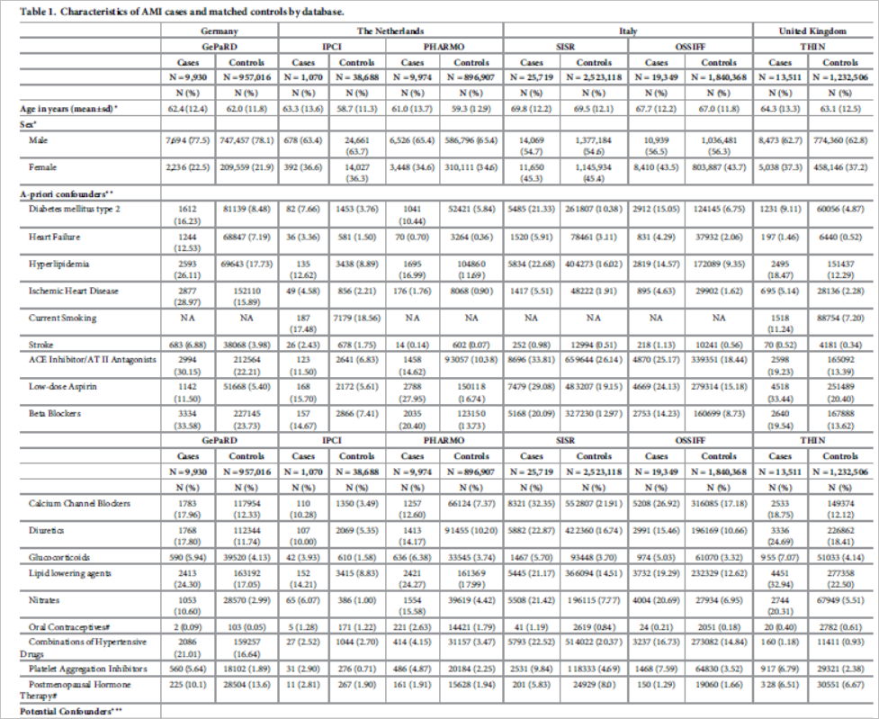

Slide 15
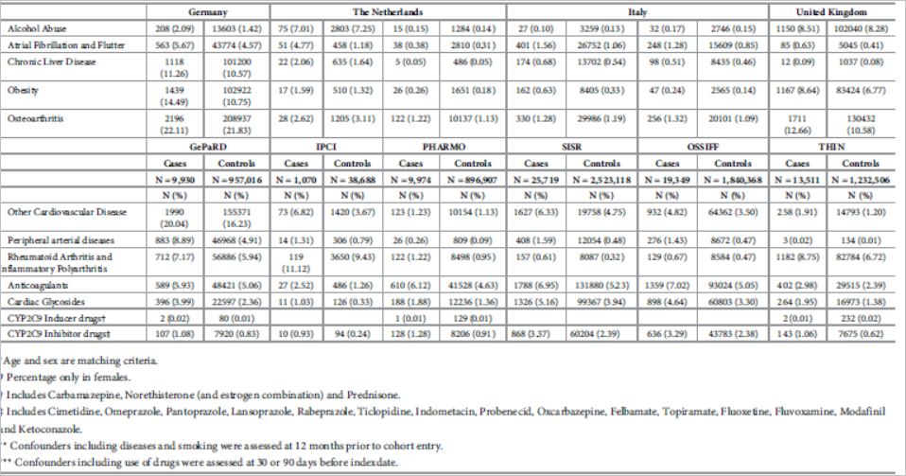

Slide 16
Were the circumstances and the methods for determining exposure similar for cases and controls?
  Yes

Slide 17
What are the results?
How strong is the association between exposure and outcome?
study cohort comprised 8,535,952 new NSAID users
101,227 patients developed an AMI after cohort entry.
79,553 (78.6%) cases could be matched to at least one control

Slide 18
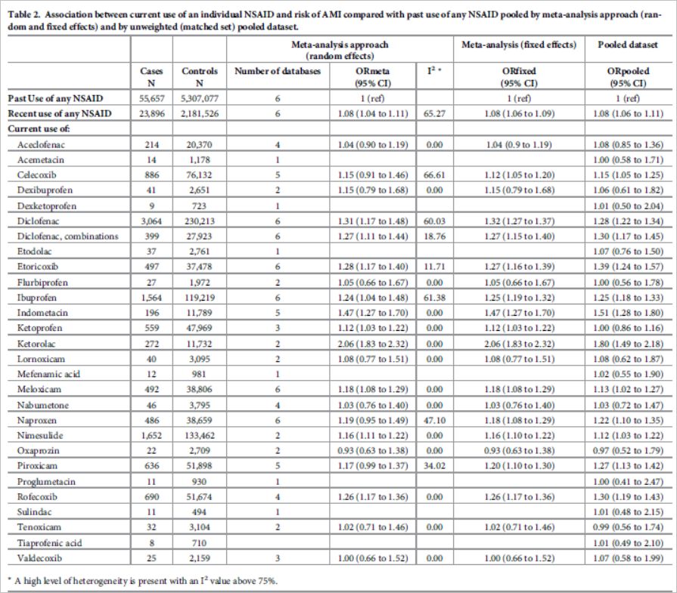

Slide 19
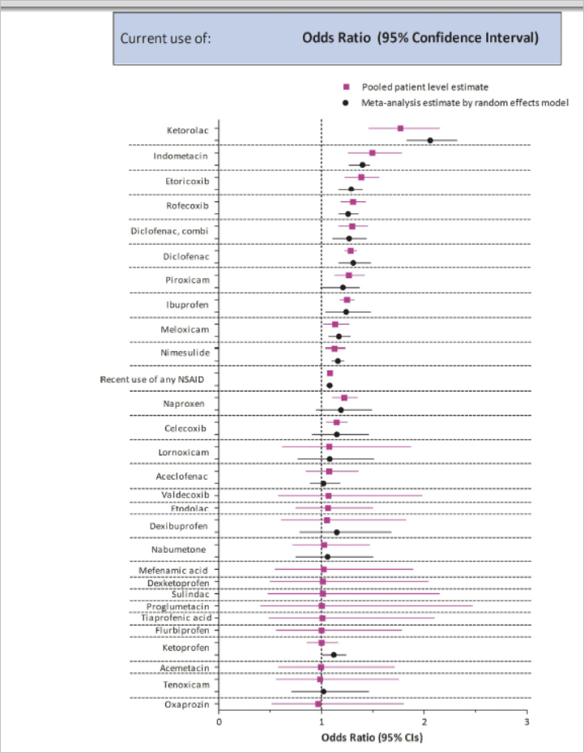

Slide 20
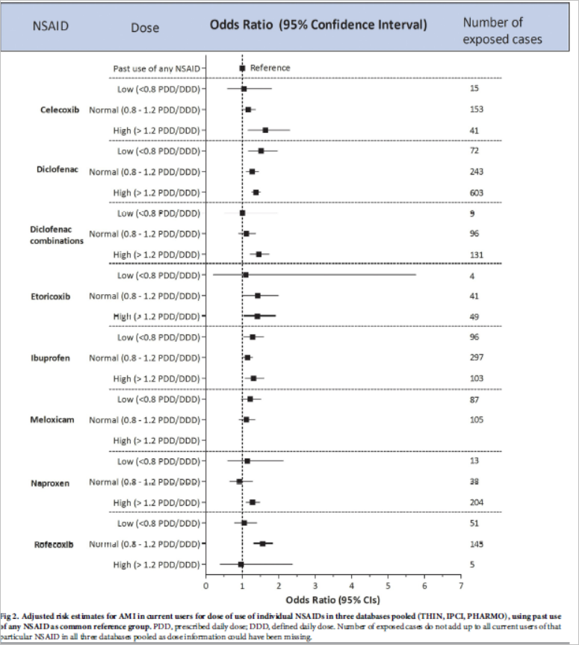

Slide 21
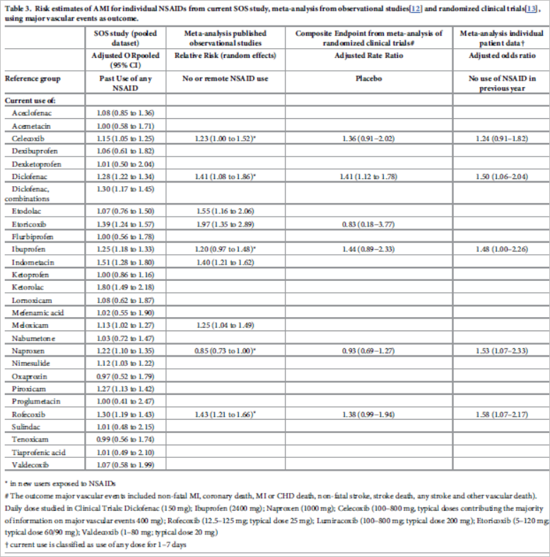

Slide 22
How precise is the estimate of risk?
  Pooled data for recent use of NSAIDS
  OR- 1.08
  Confidence interval (1.06- 1.11)

Slide 23
How can I apply the results to my patient care?
Were the study patients similar to patients in my practice?
Probably similar
Except race and Increased comorbidities
Was the duration of follow up adequate?

Slide 24
Is the exposure similar to what might occur in my patient?
  Possibly
What is the magnitude of the risk?
  1.08 increased risk of AMI
Are there benefits that offset the risks of the exposure?

