Slide 1


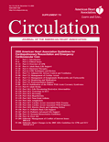

Slide 2
Scenario
You are the medical and education director of a regional emergency medical system with both basic and advanced life support capabilities.
A qualitative update and revision is due as a result of the publication of substantially revised American Heart Association guidelinesfor Advanced Cardiac Life Support.
Several of your colleagues have asked you about possible changes to the resuscitation protocols for cardiac arrest, and particularly the use of new line drugs such as vasopressin and amiodarone in preference to epinephrine and lidocaine, drugs that your paramedics are used to using.

Slide 3
Your paramedic ambulances do not stock either vasopressin or amiodarone, nor do your training and recertification programs include them. Incorporating these interventions will require considerable effort to implement.
You decide to look at the new guidelines in detail before committing yourself making a major revision in your protocols. A quick search of the National Guidelines Clearing House site (http://www.guideline.gov/) using the phrase “cardiac life support” leads you to a summary of the AHA 2005 ACLS update and identifies the November 29, 2005 and December 13, 2005 issues of Circulation as the source of the detailed elaboration of the guides.

Slide 4
Guidelines
Electrical therapies
CPR techniques and devices
Adjuncts for airway control
Management of cardiac arrest
Management of symptomatic bradycardia
Monitoring and medications
Post resuscitation support
Stabilisation of patient with ACS
Adult Stroke Life threatening electrolyte abnormalities
Toxicology in ECC
Drowning
Hypothermia
Near fatal asthma
Anaphylaxis
Cardiac arrest associated with trauma
Cardiac arrest associated with pregnancy
Electric shock
Paediatric BLS
Paediatric advanced life support
Neonatal resuscitation guidelines
First aid

Slide 5
SCOPE AND PURPOSE

Slide 6
The overall objective(s) of the guideline is (are) specifically described
• Health intent : Yes
Expected benefit or outcome:
  All guidelines did not have objectives clearly written eg: Mangement of acute severe asthma. However they were all modifications from the main life support.
  However : post resuscitation guidelines: objectives well written
  Others
Targets: Adults, paediatric, disease category mentioned clearly

Slide 7
The health question(s) covered by the guideline is (are) specifically described
Yes
Target population : STEMI, Stroke, arrest identification mentioned
Interventions: Medications and doses mentioned
Outcome: Mentioned

Slide 8
The population (patients, public, etc.) to whom the guideline is meant to apply is specifically described.
Target population, gender and age: Adult and paediatric
Clinical condition severity/stage of disease: Identification of stroke, clinically significant hyperkalemia mentioned
Excluded populations: Guidelines apply to all populations

Slide 9
STAKEHOLDER INVOLVEMENT

Slide 10
The guideline development group includes individuals from all relevant professional groups
Members of the guideline development group, supposed to have following information is included:
name
discipline/content expertise
institution
geographical location
a description of the member’s role in the guideline development group
Included people from
American Heart Association (AHA)
European Resuscitation Council (ERC)
Heart and Stroke Foundation of Canada (HSFC)
Australian and New Zealand Committee on Resuscitation (ANZCOR)
- Australian Resuscitation Council
- New Zealand Resuscitation Council
Resuscitation Councils of Southern Africa (RCSA)
Inter American Heart Foundation (IAHF)
Resuscitation Council of Asia (RCA)

Slide 11
The views and preferences of the target population have been sought.
No

Slide 12
The target users of the guideline are clearly defined.
Clear description of intended guideline audience
Mentioned clearly to identify arrest, STEMI, stroke
• Description of how the guideline may be used by its target audience
Cardiac arrest protocols mentioned clearly

Slide 13
RIGOUR OF DEVELOPMENT

Slide 14
Systematic methods were used to search for evidence
Named electronic database(s) or evidence source(s) where the search was performed
minimum electronic databases to be searched
  Cochrane database for systematic reviews
  Central Register of Controlled Trial [http://www.cochrane.org/],
  MEDLINE [http://www.ncbi.nlm.nih.gov/PubMed/],
  EMBASE (www.embase.com)
  master reference library collated by the American Heart Association (AHA).
Time periods : Not mentioned
Search terms used : Not mentioned

Slide 15
The criteria for selecting the evidence are clearly described.
description of the inclusion criteria-
target population -
characteristics -
study design -
comparisons -
outcomes -
language-
Context-
description of the exclusion criteria-

Slide 16
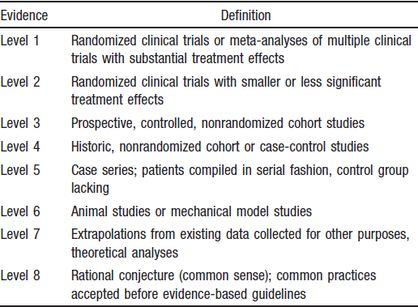
The strengths and limitations of the body of evidence are clearly described.
Descriptions of how the body of evidence was evaluated for bias and how it was interpreted by members of the guideline development group

Slide 17
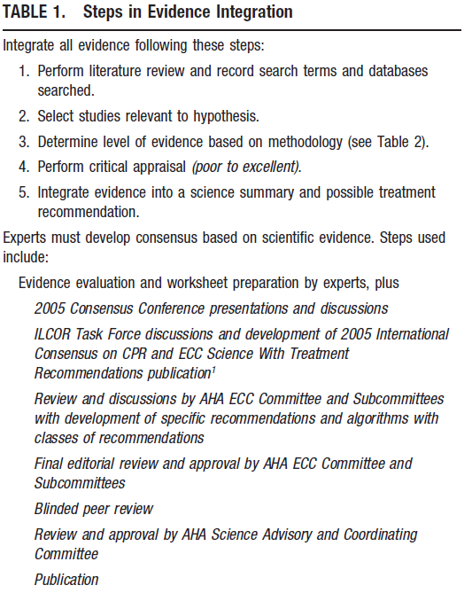
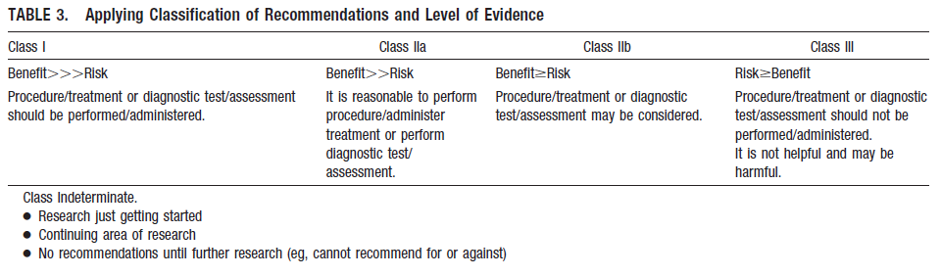
The methods for formulating the recommendations are clearly described
Description of the recommendation development process
outcomes of the recommendation development process

Slide 18
The health benefits, side effects, and risks have been considered in formulating the recommendations.
-Guidelines were for life saving measures

Slide 19
There is an explicit link between the recommendations and the supporting evidence.
Yes
Mentioned only for the new additions in the recommendations

Slide 20
The guideline has been externally reviewed by experts prior to its publication.
-Purpose and intent of the external review :No
-Methods taken to undertake the external review : Blinded peer review
-Description of the external reviewers : No
-Outcomes/information gathered from the external review : No
-Description of how the information gathered was used to inform the guideline development process and/or formation of the recommendations: No

Slide 21
A procedure for updating the guideline is provided
No

Slide 22
CLARITY OF PRESENTATION

Slide 23
The recommendations are specific and unambiguous
Yes

Slide 24
The different options for management of the condition or health issue are clearly presented.
Yes

Slide 25
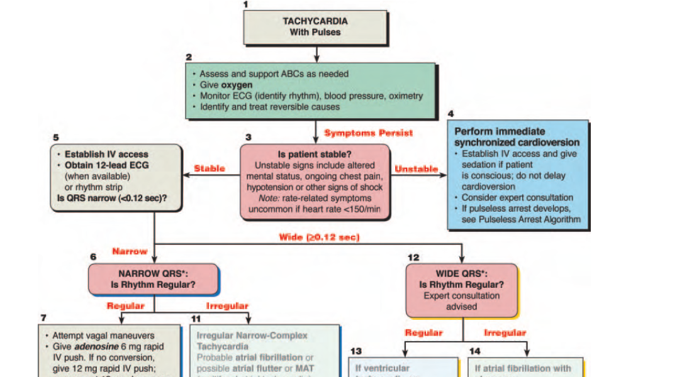
Key recommendations are easily identifiable
Yes
.

Slide 26
APPLICABILITY

Slide 27
The guideline describes facilitators and barriers to its application
Yes
-Greatest challenge and highest priority : training of lay rescuers and healthcare providers in simple, high-quality CPR skills that can be easily taught, remembered, and implemented to save lives.
-difficult to perform clinical trials with sufficient power to demonstrate improved long-term outcomes as out of hospital cardiac arrest survival rates: 6%
-Informed consents: difficult to obtain

Slide 28
The guideline provides advice and/or tools on how the recommendations can be put into practice
Yes
Training: a planned and practiced response, rapid recognition of SCA, prompt provision of bystander CPR, and defibrillation within 5 minutes of collapse
Monitoring: implement processes of continuous quality improvement that include monitoring the quality of CPR delivered at the scene of cardiac arrest, other process-of-care measures (eg, initial rhythm, bystander CPR, and response intervals), and patient outcome up to hospital discharge.

Slide 29
The potential resource implications of applying the recommendations have been considered
Yes
Not mentioned clearly regarding availability of defibrillators
Availability of trainees

Slide 30
The guideline presents monitoring and/or auditing criteria.
No

Slide 31
EDITORIAL INDEPENDENCE

Slide 32
The views of the funding body have not influenced the content of the guideline.
No

Slide 33
Competing interests of guideline development group members have been recorded and addressed.
Each speaker’s COI statement was projected on a dedicated screen during every presentation, question, and discussion period.
The COI policy is described in detail in an editorial in this supplement

Slide 34

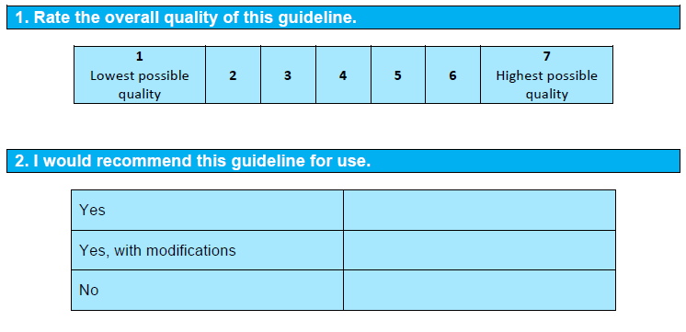

Slide 35
Thank you

