Slide 1
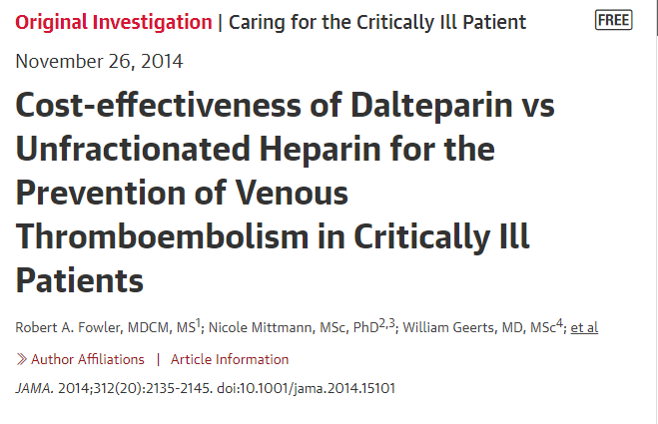
Anusha .S

Slide 2
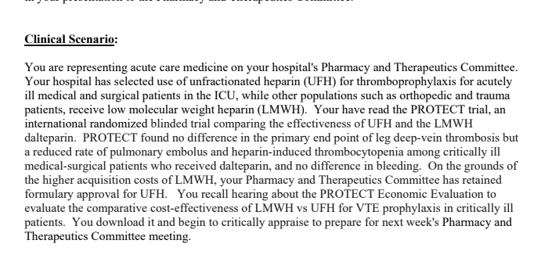

Slide 3
Thromboprophylaxis is a key component of care for critically ill
patients because of their high risk of venous thromboembolism (VTE)
and because heparin is an effective and safe prevention strategy.

Slide 4

A recent multicenter blinded, randomized trial (PROTECT [Prophylaxis
for Thromboembolism in Critical Care Trial]) compared the
effectiveness of the 2 most common pharmocoprevention strategies,
administration of low-molecular-weight heparin (LMWH) and
unfractionated heparin (UFH).

Slide 5
OBJECTIVE
To compare the clinical and economic outcomes of the LMWH dalteparin compared with UFH for the prevention of VTE in critically ill medical-surgical patients

Slide 6
Analysis plan was prespecified as part of the economic evaluation of the PROTECT protocol before trial completion and unblinding
PROTECT was an international randomized trial in which patients, clinicians, and adjudicators were blinded.

Slide 7
P: critically ill medical-surgical patients
Comparator 1:once daily subcutaneous dalteparin (5000 U) with placebo
Comparator 2: twice-daily subcutaneous UFH (5000 U)
May 2006 to June 2010, 3746 patients were enrolled in PROTECT, with all costs collected during the same period; 1873 were allocated to dalteparin, and 1873 to UFH. No patients were lost to follow-up

Slide 8
inclusion
Exclusion
patients were at least 18 years old
weighed at least 45 kg
had an expected intensive care unit (ICU) stay of 72 hours or more
were eligible to receive LMWH or UFH.
absolute contraindications to pharmacologic thromboprophylaxis
had allergy to study drug
had an established indication for therapeutic anticoagulation or a particular agent

Slide 9
The primary clinical outcome : any VTE (all limb DVT, pulmonary embolus, and non limb thromboses).
Secondary clinical outcomes: episodes of DVT, pulmonary embolus, major bleeding, and heparin-induced thrombocytopenia avoided.
Tertiary clinical outcomes included death in ICU and in hospital
However, PROTECT was designed and powered to evaluate differences in the rate of thrombotic events between 2 thrombosis prevention strategies, not differences in life expectancy

Slide 10
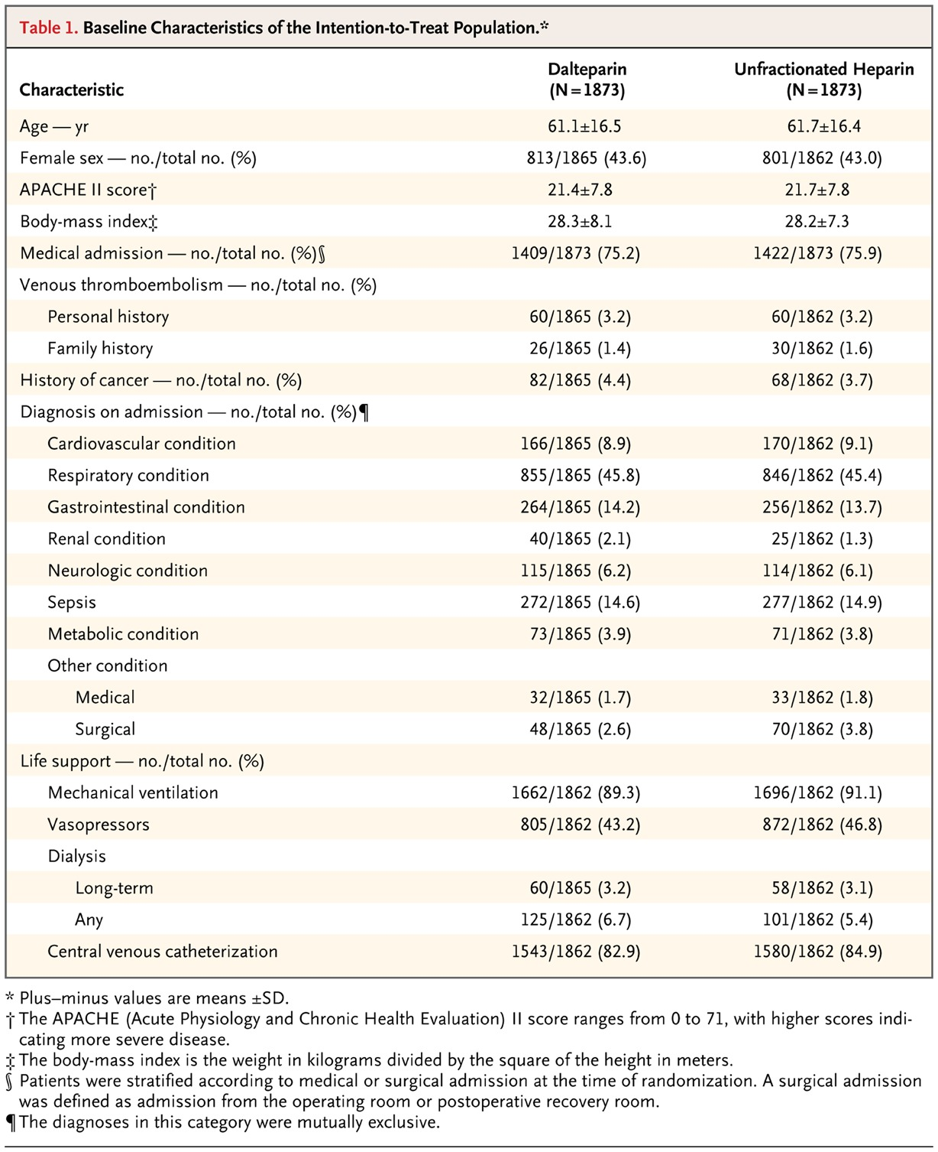

Slide 11
Patient costs were collected for 2344 patients
1169 in the LMWH group, 1175 in UFH group
enrolled in a subset of 23 of the 67 hospitals in 5 of 6 countries participating in PROTECT (Canada, 12; Australia, 5; United States, 3; Saudi Arabia, 2; Brazil 1)

Slide 12
Did the investigators adopt a sufficiently broad viewpoint?
Yes
Developed lists of costs by performing a systematic review of the VTE and critical care cost-effectiveness literature.
The steering committee reviewed evidence underlying the relative importance of cost variables
Performed a pilot study to determine feasible and optimal mechanisms of determining these costs for PROTECT patients in different health care systems

Slide 13
Costs were captured in the following categories :
Drugs
laboratory tests
Personnel
diagnostic testing
procedures and operations
bleeding and blood product transfusion services
infrastructure

Slide 14
Analytic Plan
The a priori planned base-case cost-effectiveness ratio was the ratio of incremental costs per incremental effects of LMWH over UFH during the period of hospitalization.

Slide 15
Analytical plan :
At the patient level, individual variable costs were multiplied by the frequency or event rates for medications administered, laboratory and radiological tests incurred, other diagnostic or therapeutic procedures performed, transfusions received, per-day personnel costs, and ICU or ward costs.
Total costs for each of the LMWH and UFH groups were calculated by summing each individual patient cost.

Slide 16
Incremental costs were taken as the difference in per-patient costs between groups.

Slide 17
directly calculated the incremental cost difference and generated 95% CIs
Statistical significance for differences among a priori comparisons was set at P = .05 (2-sided)
---------------------------------------------------------------------------------------
All individual costs were updated to reflect end-of-trial costs
Country- and year-specific costs were then converted to 2013 dollars, accounting for annual inflation and then converting to US currency

Slide 18
Are results reported separately for relevant patient subgroups?
Yes
medical vs surgical
illness severity by Acute Physiology and Chronic
Health Evaluation II score
body mass index
baseline receipt of vasopressors or inotropes

Slide 19
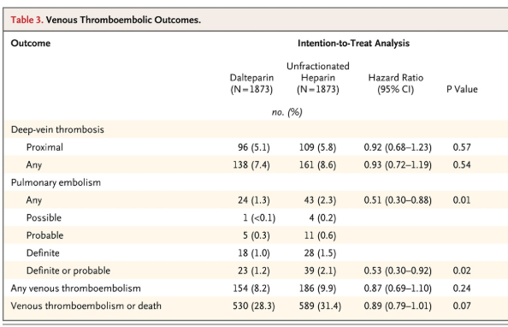
CLINICAL OUTCOME

Slide 20
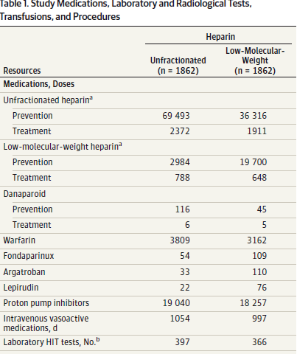

Slide 21
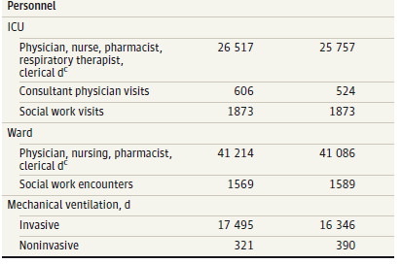
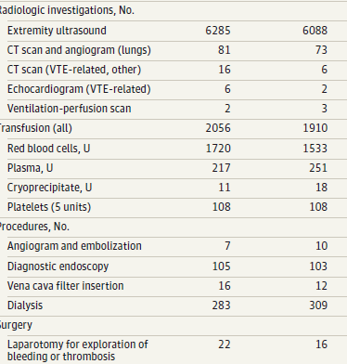
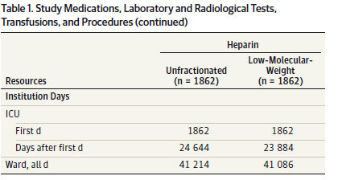

Slide 22
Were the costs measures accurately ?
Yes – pilot study , corrected any flaws , institution specific costs included
Did investigators consider the timing of costs and outcomes?
?adjusted to US dollars as of june 2013

Slide 23
What were the incremental costs and effects of each strategy?

Slide 24
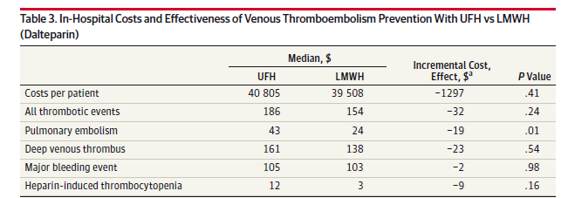

Slide 25
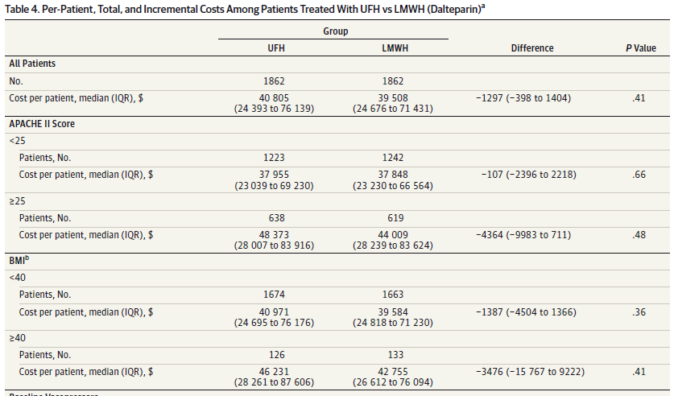

Slide 26
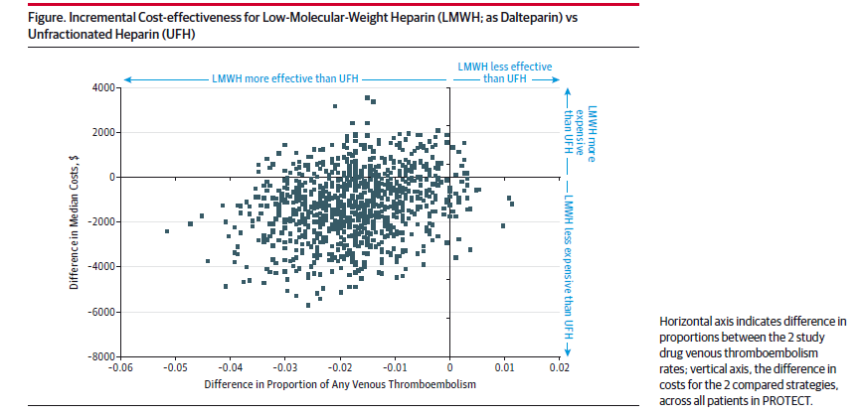

Slide 27
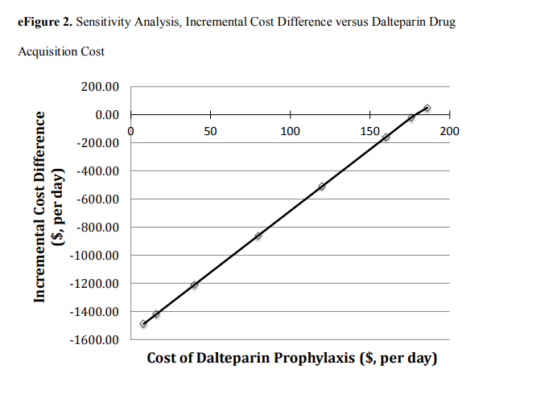
Sensitivity analysis

Slide 28
How much does allowance for uncertainty change the results?
Are the treatment benefits worth the harms and the costs?
Can I expect similar costs in my setting?

Slide 29
