Slide 1

Asha Mathai

Slide 2
Background
Active surveillance (AS) is a viable management option for men who are newly diagnosed with prostate cancer.
Wide range of intensity in the monitoring regimens of AS protocols like
    Digital rectal examination (DRE) and PSA measurements every 3 months with yearly biopsies
    Semiannual DRE and PSA with biopsies performed every 3 to 4 years

Slide 3
Data from recent Prostate Testing for Cancer and Treatment (ProtecT) trial
Median follow-up of 10 years
1% of patients had died due to their cancer compared with 9% of patients who died of other causes
No significant difference noted with regard to overall survival between men undergoing radical treatment and those under AS.8
Trial implemented an “active monitoring” strategy that included only PSA testing and no biopsy, which is less “intense” than all AS protocols we modeled.

Slide 4
Methods
Markov state transition patient-level microsimulation model with a monthly cycle length
In the model, men were diagnosed at age 65 years, and outcomes from each of the 3 strategies were simulated.
Patients with low-risk prostate cancer (PSA level ≤10 ng/mL and Gleason score ≤7) entered the model
Men then were tracked until death from cancer or background causes.
US Social Security Administration 2009 life tables were used to model background mortality risk and discounted utilities and costs at an annual rate of 3%.

Slide 5
In the base case analysis , 3 variants of AS protocols
Each variant of AS modeled involved DRE, PSA, and biopsy
Low-intensity AS
DRE and PSA testing quarterly for 24 months and then semiannually thereafter,
confirmatory biopsy at 12 months and then triennially thereafter
bone scans for any man whose PSA increased to >20 ng/mL.
Medium-intensity AS
PSA and DRE testing semiannually and biopsy biennially
High-intensity AS
PSA and DRE testing semiannually and biopsy annually.
Immediate treatment strategy
radical prostatectomy,external-beam radiotherapy, and BT.

Slide 6
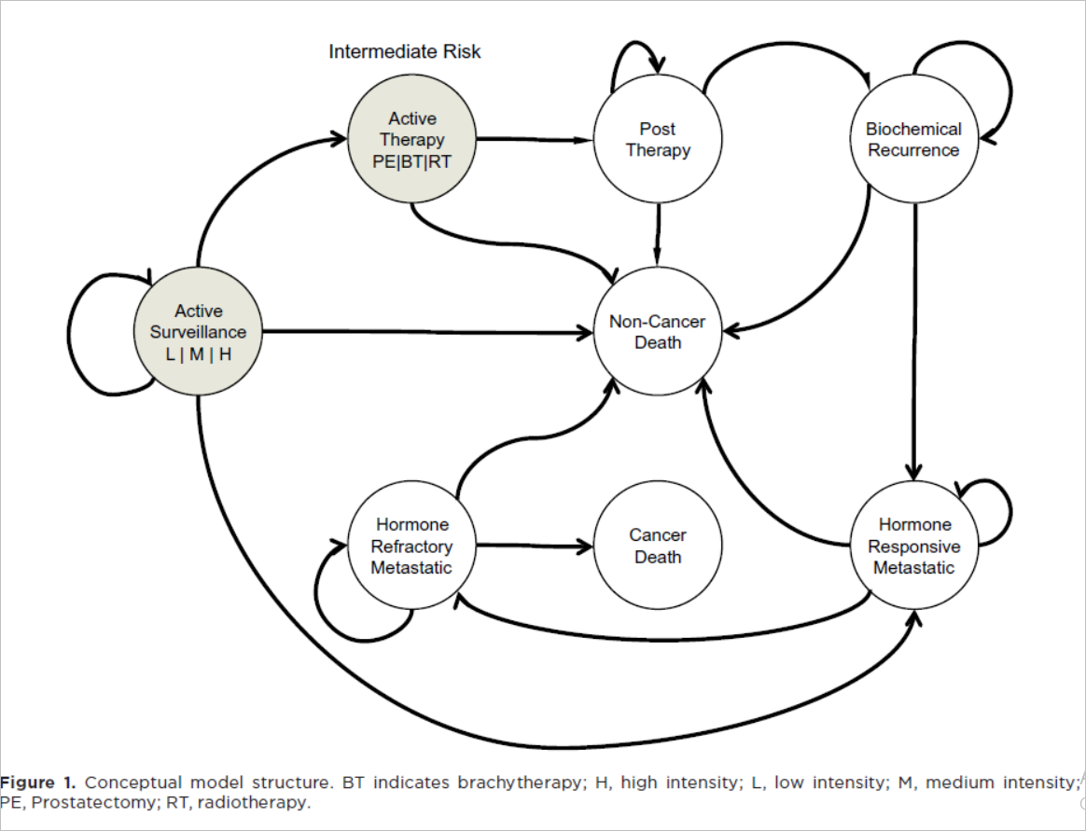

Slide 7
Are the recommendations valid?

Slide 8
Did they consider all relevant patient groups, management options and possible outcomes?
  Yes

Slide 9
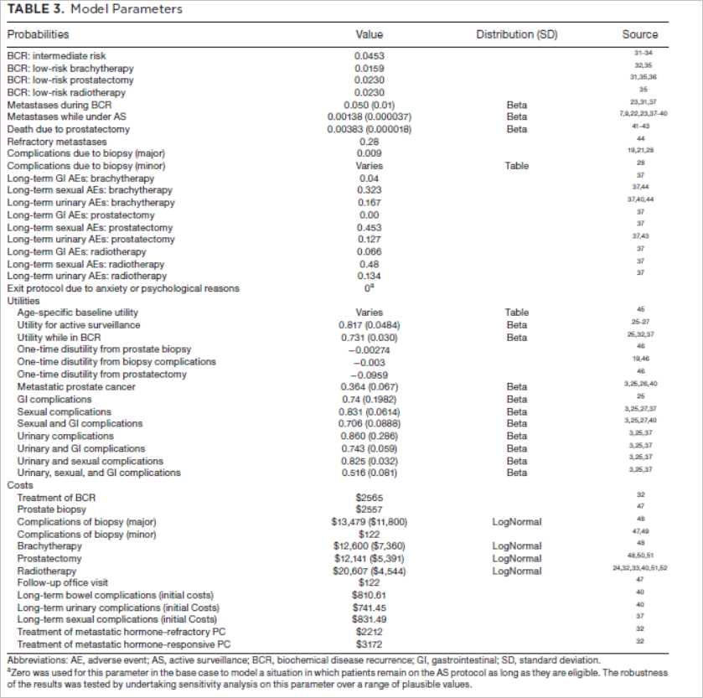

Slide 10
Are there systematic reviews of the evidence that estimate the relative impact of management options on relevant outcomes?
  No

Slide 11
Is there an appropriate specification of values and preferences associated with each of the outcomes?
  Based on previously published data, arbitrary measures were used.

Slide 12
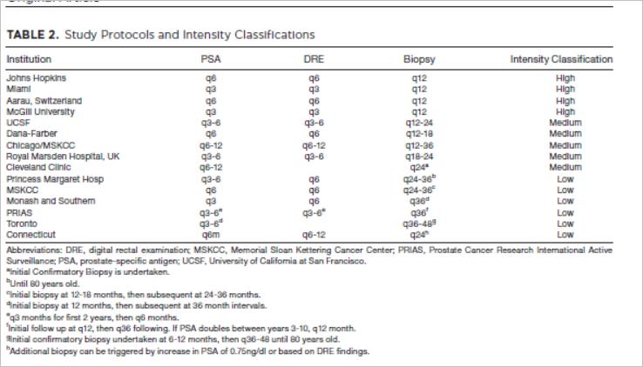
Do the authors indicate the strength of their recommendations?
They have mentioned the intensity classification based on published data
But quality of evidence not mentioned

Slide 13
What are the results ?

Slide 14
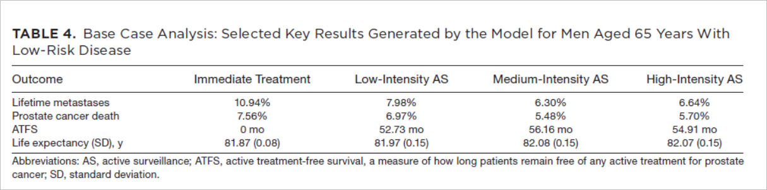
What are the results?

Slide 15
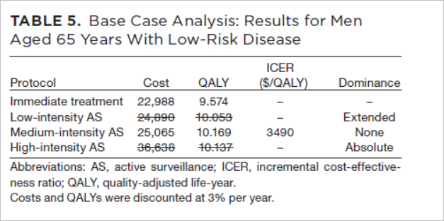
What are the results?

Slide 16
What are the results?
Medium intensity AS was found to be the most effective strategy, yielding 10.169 QALYs with cost of ($25,065) with an incremental cost-effectiveness ratio of $3490

Slide 17
Sensitivity analysis
For the parameters of frequency of metastases, utility for being in an AS protocol, or departure from protocol due to anxiety, 1-way sensitivity analyses done to determine threshold values.
In probabilistic sensitivity analysis, medium-intensity AS was found to have an 86.9% probability of being the most cost-effective strategy at a willingness-to-pay (WTP) criterion of $50,000 per QALY

Slide 18
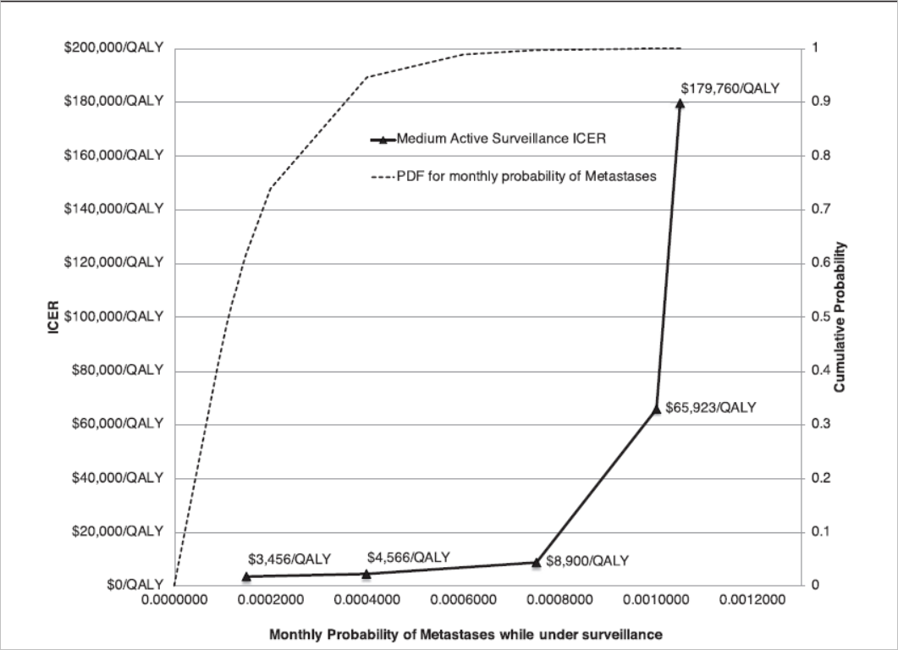
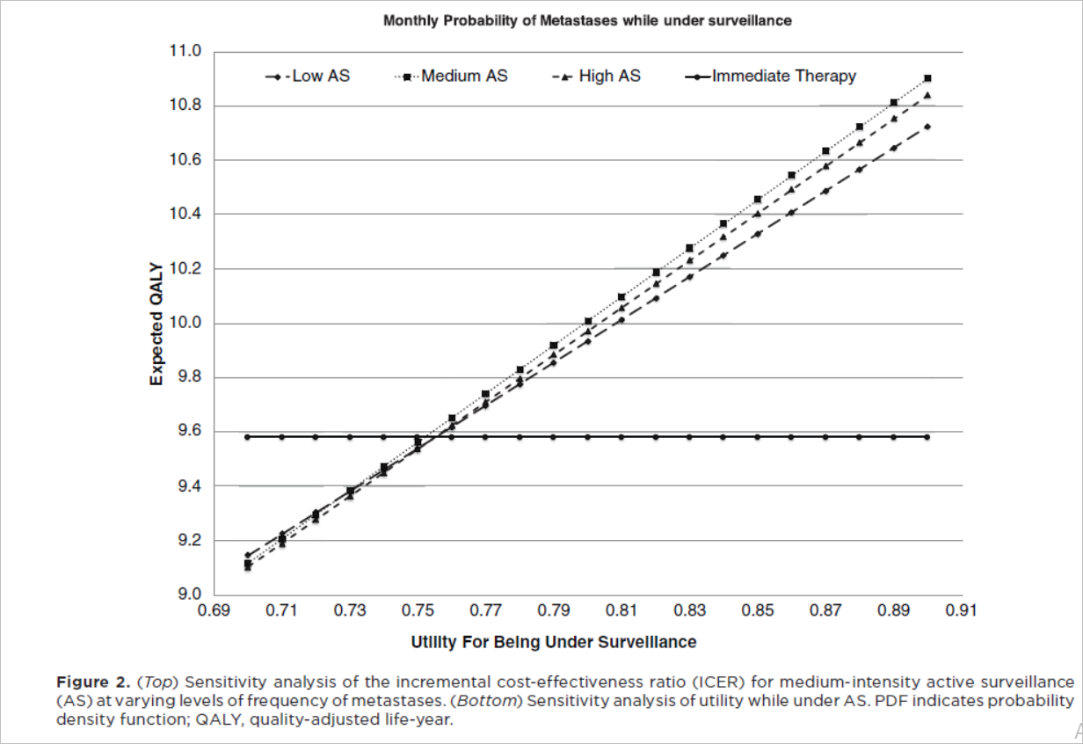

Slide 19
What are the key recommendations?
In patients with low-risk prostate cancer, AS with biennial biopsy appears to be highly cost-effective

Slide 20
Will the recommendations help you in caring for your patients?
Do the recommendations make sense in your practice setting?
  Yes

