Slide 1
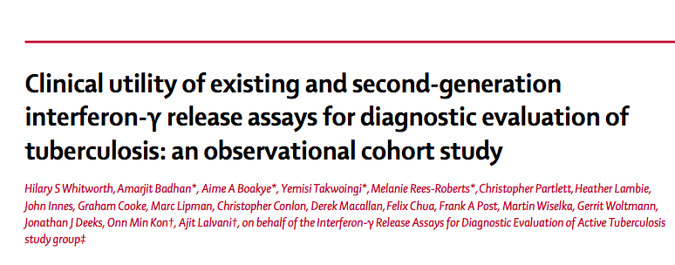

Slide 2
Background
The clinical utility of interferon-γ release assays (IGRAs) for diagnosis of active tuberculosis is unclear, although they are commonly used in countries with a low incidence of tuberculosis.
This study aimed to resolve this clinical uncertainty by determining the accuracy and utility of commercially available and second-generation IGRAs in the diagnostic assessment of suspected tuberculosis in a low-incidence setting.

Slide 3
Methods
Multicentre prospective cohort
P: Adults with suspected tuberculosis in routine secondary care in England.
Test 1: Second-generation (incorporating novel M tuberculosis antigens) IGRAs
Test 2 : Commercially available (T-SPOT.TB and QuantiFERON-TB Gold In-Tube [QFT-GIT])
Standard : Culture Positivity / Predefined case definition (composite of clinicoradiological features + PPD)
O: Active tuberculosis
T: 6-12 months

Slide 4
Inclusion criteria:
  Patients presenting with signs and symptoms to 5 centres in England, in whom TB is suspected by primary practioner.
Exclusion criteria
  Age < 16
  Unwillingness to provide consent

Slide 5
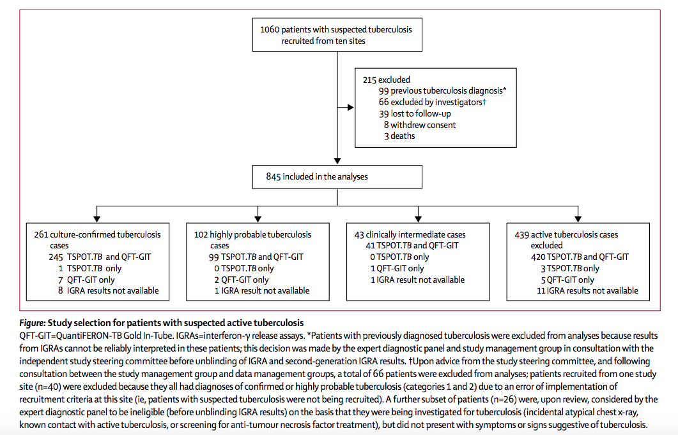

Slide 6
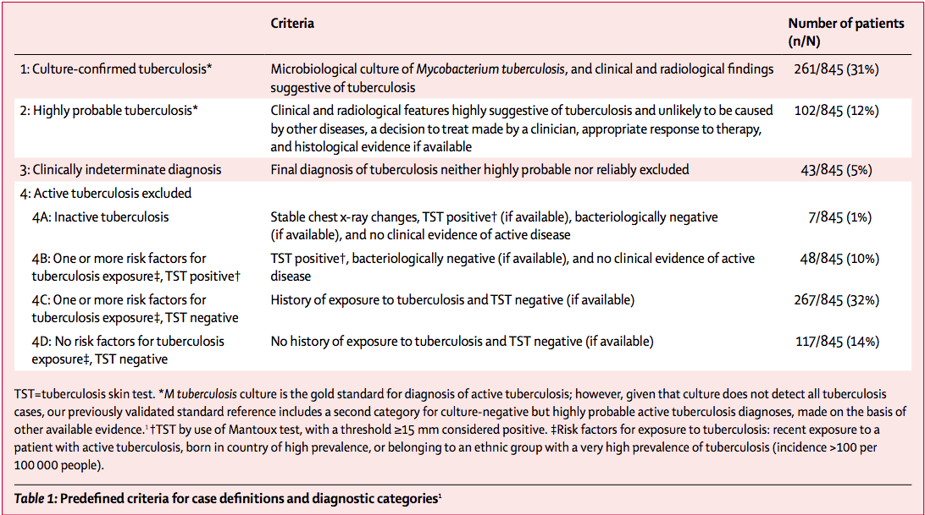

Slide 7
How serious is the risk of bias?
Did participating patients constitute a representative sample presenting with a diagnostic dilemma?
  Yes
Did the investigators compare the test to an appropriate , independent reference standard?
  Yes

Slide 8
Were those interpreting the test and reference standard blind to the other results?
  The clinicians were not blinded to the results
Did all patients receive the same reference standard irrespective of the results of the test results?
  Gold standard – Study has used composite case definition criteria if culture positivity was not available.

Slide 9
What are the results?

Slide 10
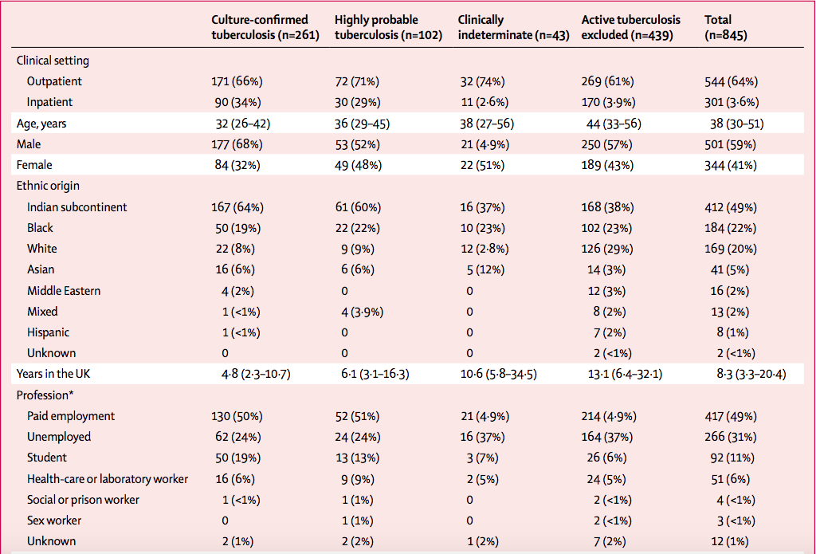

Slide 11
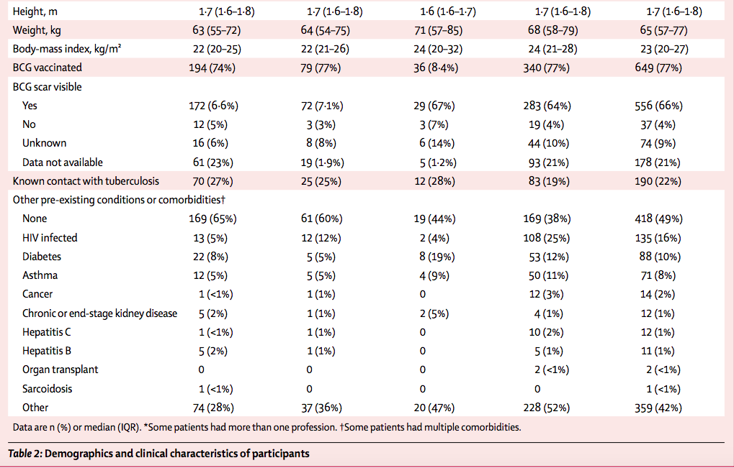

Slide 12
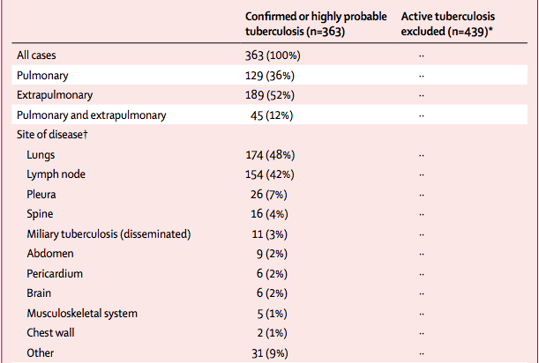
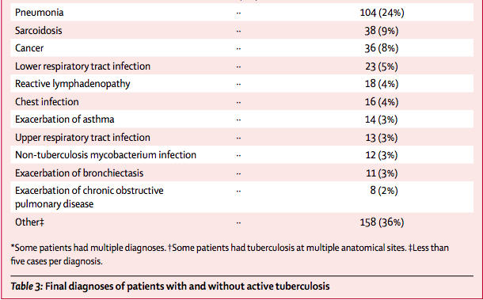

Slide 13
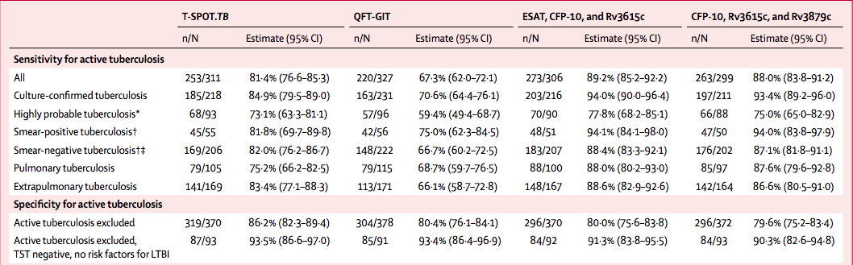

Slide 14
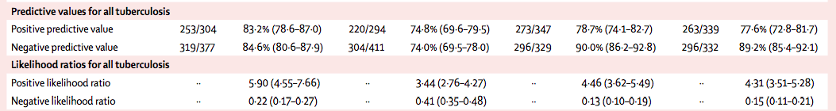
What likelihood ratios were associated with the range of possible test results?

Slide 15
How can I apply the results to patient care?
Will the reproducibility of the test results and its interpretation be satisfactory in my clinical setting?
  No
Are the study results applicable to patients in my practice?
  No, Not applicable in high prevalence areas like our set up.

Slide 16
Will the test results change my management strategy?
  No
Will patients be better off as a results of the test?

Slide 17
