Slide 1
Critical appraisal of a screening test
KJJ

Slide 2
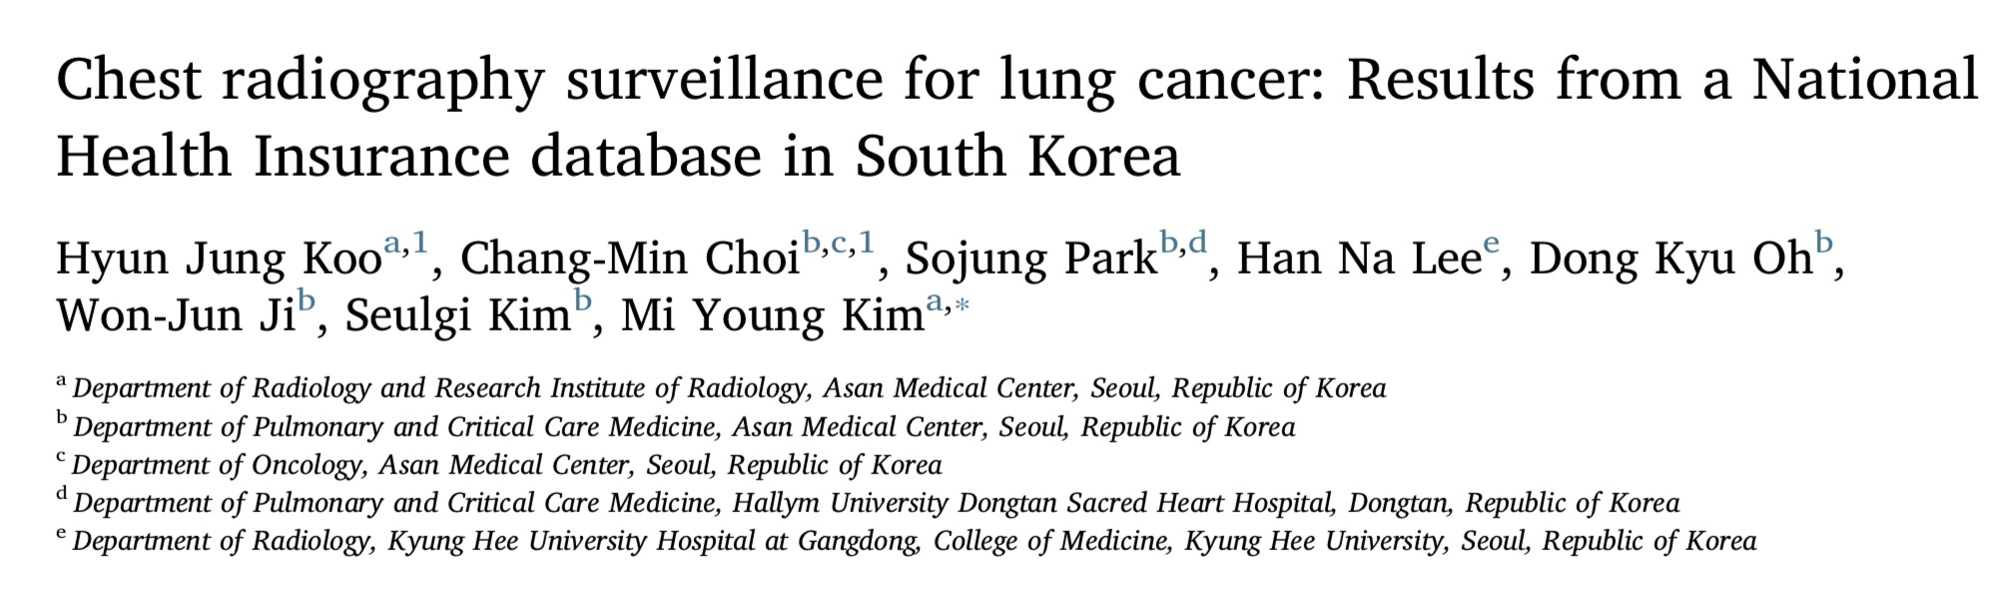

Slide 3

Background
Lung cancer is the leading cause of cancer related mortality in developed countries
In Asia, half of female lung cancers occur in people who haven’t smoked

Slide 4
Study Design - PICO
Patients : Participants over the age of 18 years who diagnosed as lung cancer
Intervention : CXR surveillance
Control :No surveillance
Outcome : Stage of cancer
Time Period : Jan 2004 - Dec 2013
Cross sectional study

Slide 5
Study Design
Cross sectional study design
Data from Korean National Health and Nutrition Examination survey (KHNANES)

Slide 6
How serious is the risk of bias?
Is there randomized control trial evidence addressing the impact of the
intervention in asymptomatic people ?
Yes, shows no evidence (Martin et al, JAMA, 2011)

Slide 7
What are the recommendations, and will they help you in caring for patients?
Were the data identified, selected, and combined in an unbiased fashion?
No
Excluded:
  Age at diagnosis > 80
  Age at diagnosis <40
  Intervel between CXR and diagnosis >3 years

Slide 8
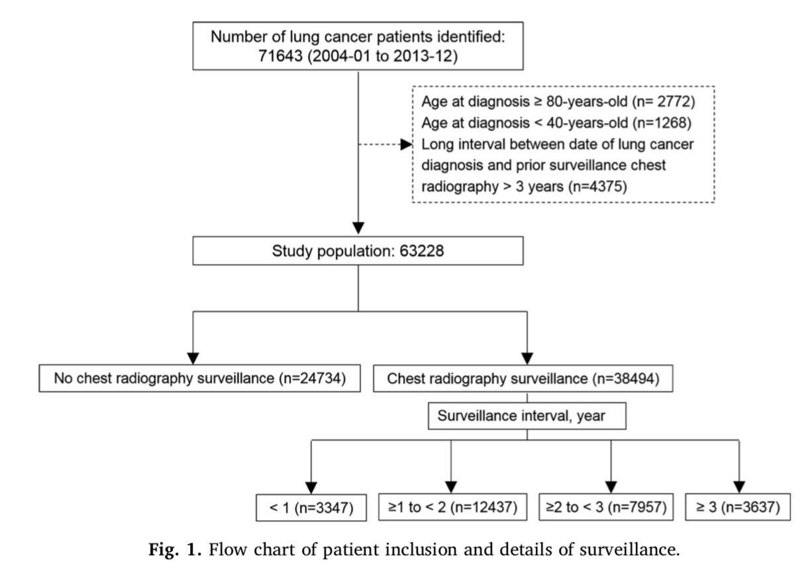

Slide 9
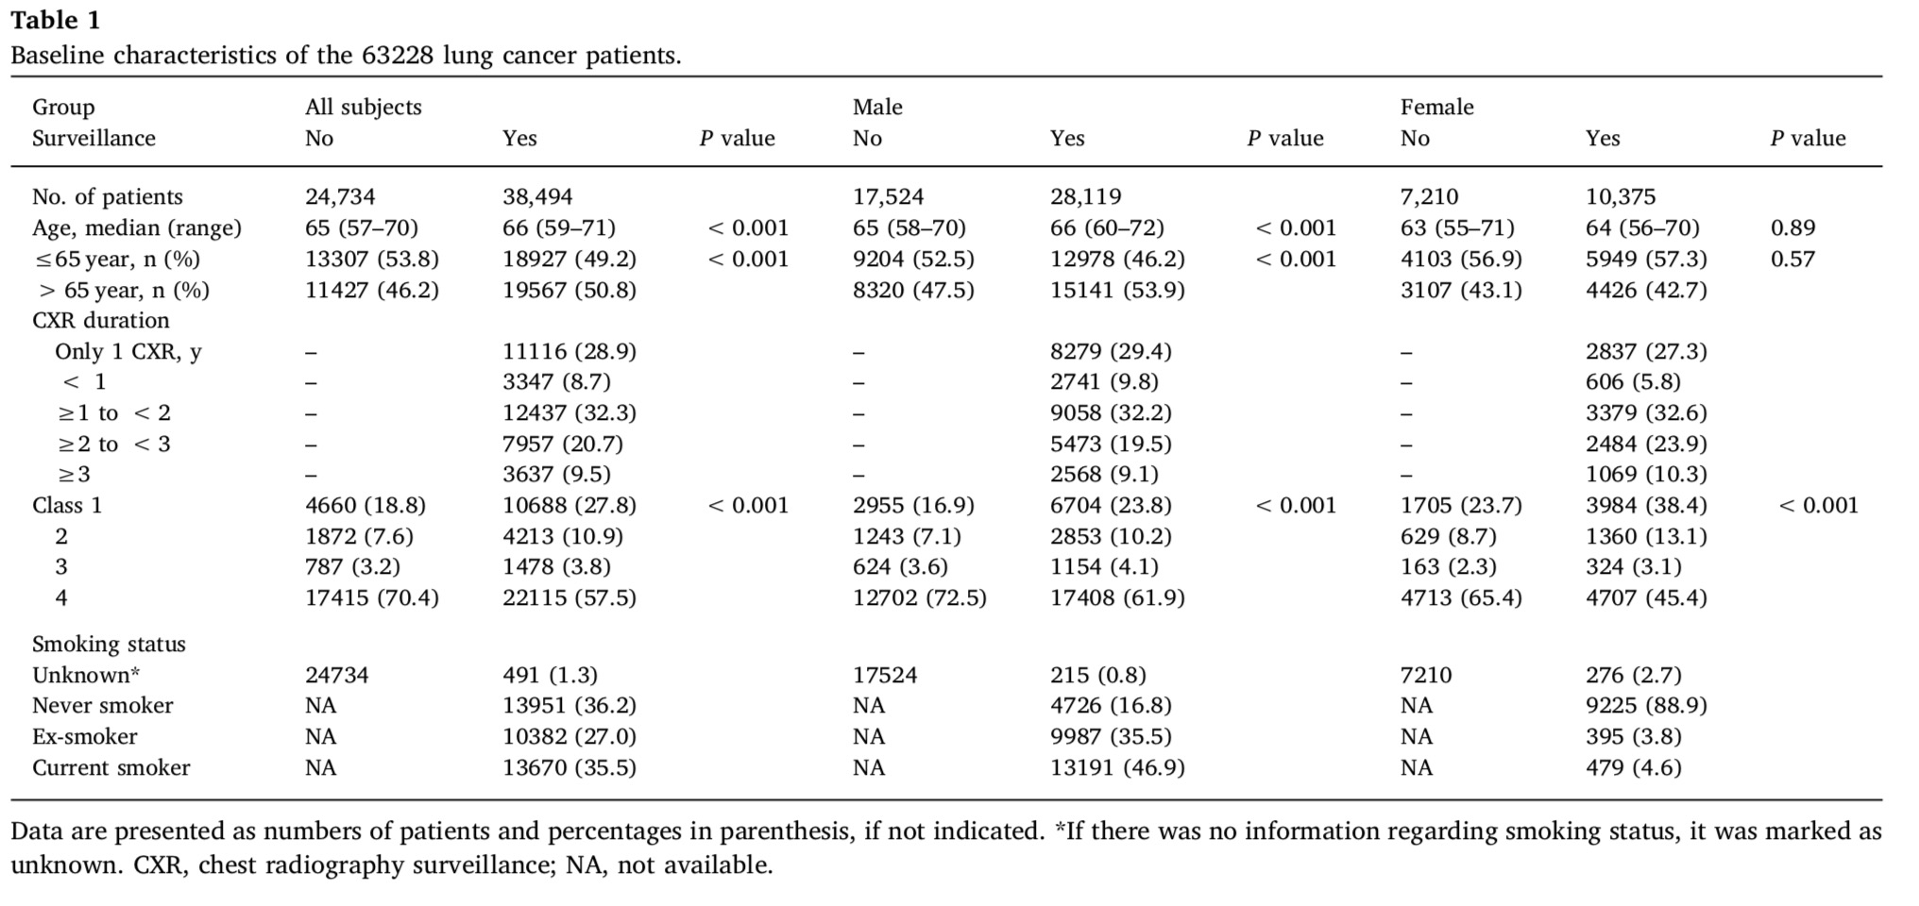

Slide 10
Validity of the study
Study population: well defined
Outcomes: clearly defined
Randomization: Not done
Blinding: Not done
Sample size calculation: not done
Intention treat analysis: N/A
Baseline characteristics: Not well matched

Slide 11
What are the benefits?

Slide 12
Stage | Surveillance | No Surveillance
1 | 10688 | 4660
2 | 4213 | 1872
3 | 1478 | 787
4 | 22115 | 17415
 | 38494 | 24734

Slide 13
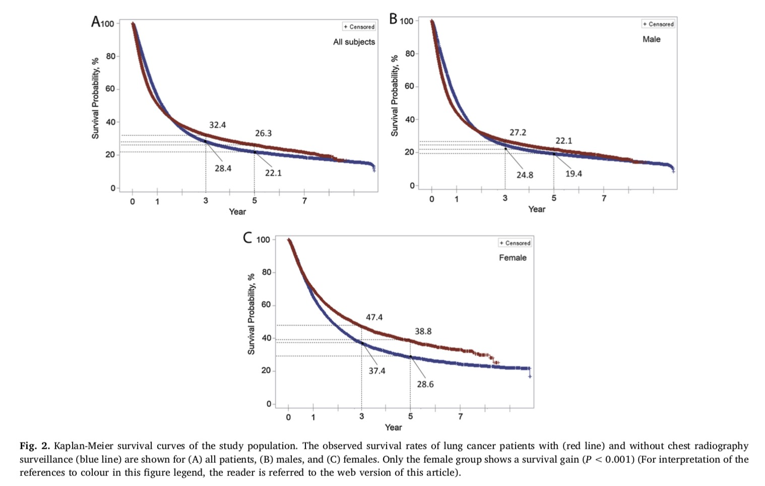

Slide 14
What are the harms?
Exposure to X ray - negligible
There is no group of patients with no cancer - we cannot calculate how many were over diagnosed

Slide 15
How do benefits and harms compare in different people and with different screening strategies?
Not applicable due to reasons mentioned above

Slide 16
What is the effect of individuals’ values and preferences?
Smokers may prefer regular screening

Slide 17
What is the effect of uncertainty associated with the evidence?
Very high

Slide 18
What is the cost-effectiveness?
Cost Effectiveness Analysis not done
Next study must include a cost effectiveness model also
Maybe needed to weigh QALYs gained and to plan screening programmes

Slide 19
Thank You

