Slide 1
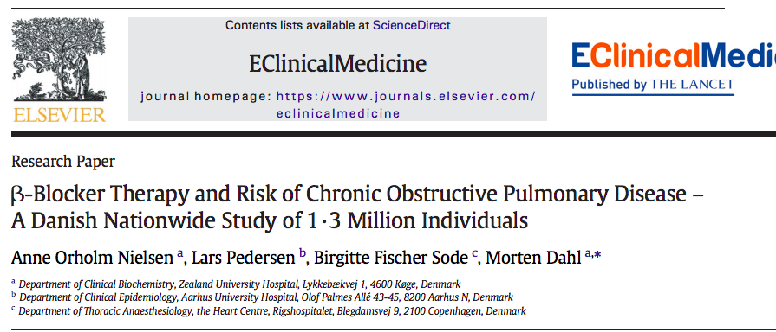

Slide 2
Background
The possible association between β-adrenoceptor antagonists (β-blockers) and risk of COPD is controversial.
The objective of the present study was to test whether β-blocker use is associated with susceptibility to the disease

Slide 3
Retrospective cohort
  3,01,542 new users of β-blockers
  1,000,633 new users of any other antihypertensive drugs
Followed in the Danish National Patient Registry for incident admissions for COPD and COPD death between 1995 and 2015.

Slide 4
P: Patients aged 30–90 years without any history of COPD requiring an antihypertensive drug
Group 1 : Novel BB use
Comparator group : Any other class of anti-HTN drug
  O: Risk of COPD Hospitalisation, COPD related death
T: 1995 – 2015

Slide 5
Inclusion criteria:
  Age: 30-90
  No prior history of COPD
  Need for anti hypertensive drug : Either BB or other drug group
Exclusion:
  History of COPD

Slide 6
Statistical Analysis
Hazard ratios (HR) for risk of COPD hospitalization and death from COPD in users of β-blockers were calculated using Cox regression models with adjustment for known confounders: age, sex, calendar year, comorbidities, income level, employment status, and marital status.
In the analyses of risk of COPD hospitalization, death is censored.

Slide 7
How serious was the risk of bias?
Was the sample of patients representative?
  Restricted to one specific population.

Slide 8
Were patients classified into prognostically similar groups?

Slide 9
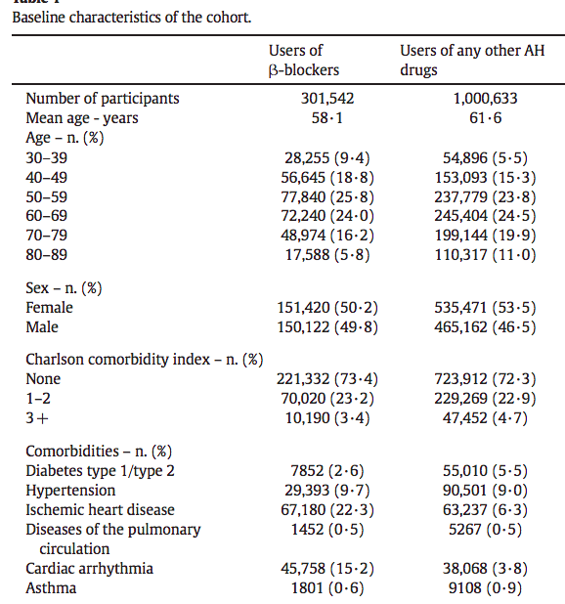
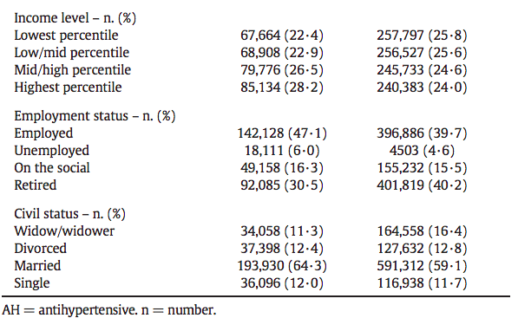

Slide 10
Was follow up sufficiently complete?
Retrospective cohort

Slide 11
Were outcome criteria objective and unbiased?
Yes

Slide 12
What are the results?
How likely are the results over time?

Slide 13

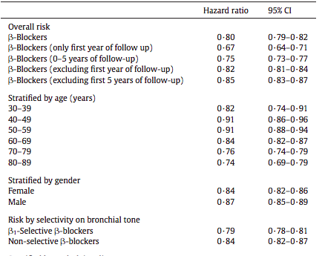
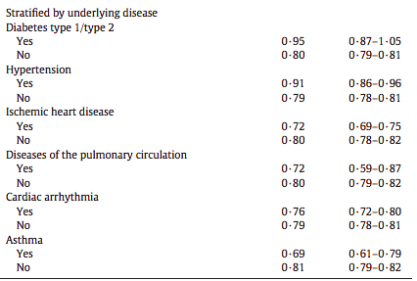

Slide 14
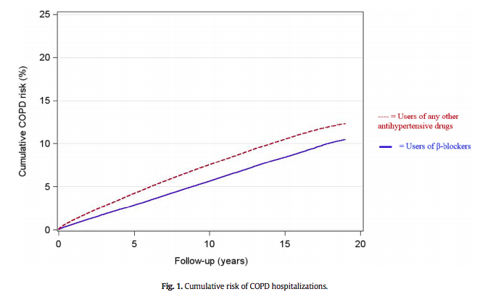

Slide 15
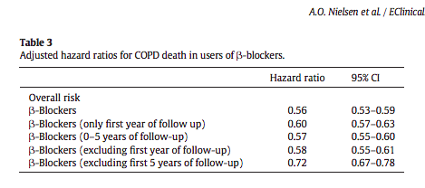

Slide 16
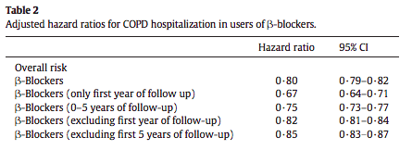
How precise are the estimates of likelihood?
Narrow confidence intervals
Precise estimate

Slide 17
How can I apply the results to patient care?
Were the study patients and their management similar to those in my practice?
  Besides racial difference, rest of the charactersistics are similar.
Was follow up sufficiently long?
  yes

Slide 18
Can I use the results in management of patients in management of patients in my practice?
Yes

