Slide 1
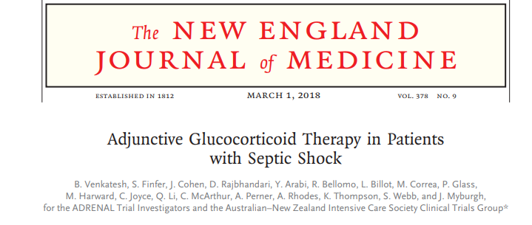
ADRENAL TRIAL
Anusha .S

Slide 2
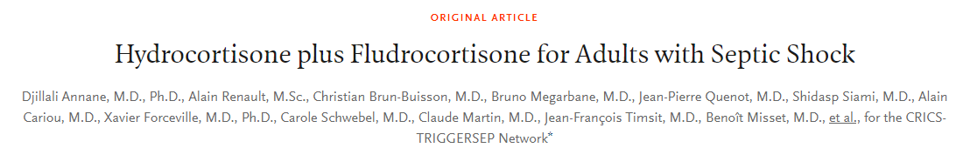
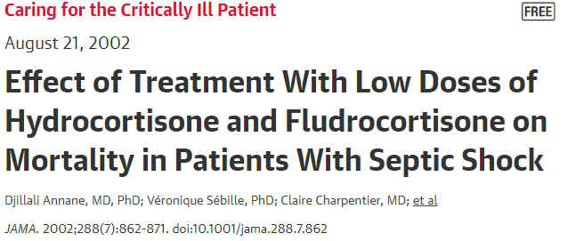
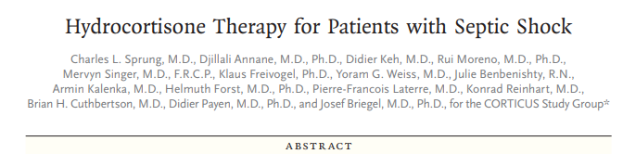
Background :
Role of steroids in Septic shock – Ambiguous Evidence so far .

Slide 3
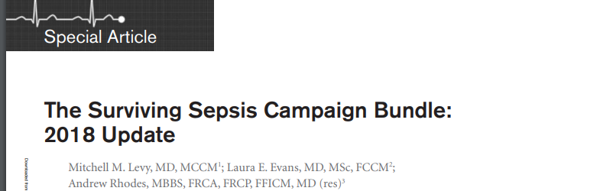
Current clinical practice guidelines:
recommend the use of hydrocortisone in patients with septic shock if adequate fluid resuscitation and treatment with vasopressors have not restored hemodynamic stability.
However, the guidelines classify the recommendation as weak, on the basis of the low quality of available evidence

Slide 4
ADRENAL TRIAL
Investigator-initiated, international, pragmatic, double-blind, parallel-group, randomized, controlled trial
From March 2013 through April 2017, 5501 eligible patients, of whom 3800 were enrolled in the trial at 69 medical–surgical ICUs.
The ICUs were in Australia (45 sites), the United Kingdom (12), New Zealand (8), Saudi Arabia (3), and Denmark (1)

Slide 5
P patients with septic shock who were undergoing mechanical ventilation
I an intravenous infusion of hydrocortisone (Pfizer) at a dose of 200 mg per day
C matching placebo (Radpharm Scientific)
O 90 day mortality
T March 2013 through April 2017, follow up – 90 days

Slide 6
Intervention and placebo :
plain glass vial, equivalent to 100mg of hydrocortisone. The powder is a white odourless, amorphous solid which is highly water soluble.
Trial treatment was prepared aseptically by reconstituting a trial treatment vial with 2mL of sterile water.
The reconstituted solution was added to an intravenous infusion bag of either 100mL 0.9% sodium chloride or 100mL 5% dextrose.
200 mg of drug which was administered by means of continuous intravenous infusion over a period of 24 hours for a maximum of 7 days or until ICU discharge or death, whichever occurred first.

Slide 7
Was the population well defined ?
Hydrocortisone infusion vs bolus ?benefit
Time to initiation fo steroid < 24 hours but exactly when ??
INCLUSION
1. Aged 18 years or older
2. Documented site of infection, or strong suspicion of infection
3. Two of the four clinical signs of SIRS
4. Being treated with mechanical ventilation at the time of randomization (including both via presence of an endotracheal tube or non-invasive ventilation with bi-level of continuous positive airway pressure)
5. Being treated with continuous vasopressors or inotropes to maintain a systolic blood pressure > 90mmHg, or mean arterial blood pressure (MAP) > 60mmHg, or a MAP target set by the treating clinician for maintaining perfusion
6. Administration of vasopressors or inotropes for ≥ 4 hours and present at time of randomization.

Slide 8
Exclusion .
Receiving systemic corticosteroids for indication other than septic shock
Received etomidate
Receiving amphotericin B for systemic fungal infection
Documented cerebral malaria
Documented strongyloides infection
Life expectancy ≤90 days from pre-existing disease
Treatment limitations in place (e.g., DNR)
Met all inclusion criteria for longer than 24 hours

Slide 9
Were patients randomised ?
There was 1:1 radomization to intervention and control arm
Randomization was stratified according to participating center and according to medical or surgical admission.

Slide 10
Was the randomisation concealed ?
Yes
Patients, caregivers, collectors of outcome data, adjudicators of
outcome, and data analysts were not aware of group allocation

Slide 11
Outcome measures
Septic Shock – vitals events within 1 week ?
?relevance of 90 day mortality
The primary outcome was death from any cause at 90 days after randomization.
Secondary outcomes included
death from any cause at 28 days after randomization
the time to the resolution of shock
22 the recurrence of shock
the length of ICU stay
the frequency and duration of mechanical ventilation
the frequency and duration of treatment with renal-replacement therapy
Number of blood transfusions

Slide 12
METHODOLODY AND STATISTICAL ANALYSIS
Population of 3800 patients would provide the trial with 90% power to detect an absolute difference of 5 percentage points in 90-day all-cause mortality from an estimated baseline mortality of 33%, at an alpha level of 0.05.
This calculation allowed for a rate of withdrawal and loss to follow-up of 1%.

Slide 13
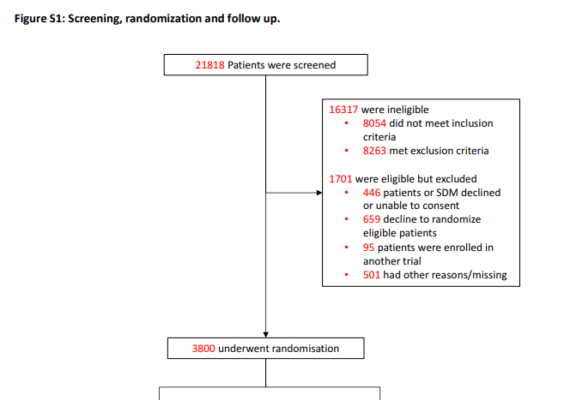

Slide 14
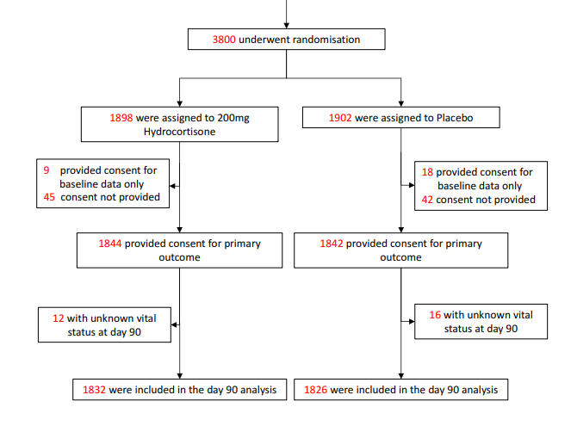

Slide 15
Was follow-up complete? - yes
Was the trial stopped early for benefit?- no
Were patients analyzed in the groups to which they were randomized? - yes

Slide 16
BASE LINE TRAITS

Slide 17
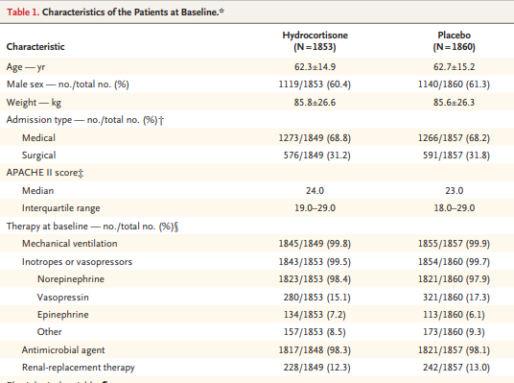

Slide 18

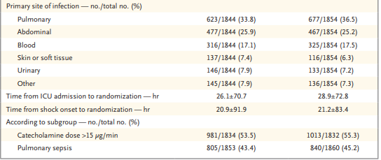

Slide 19
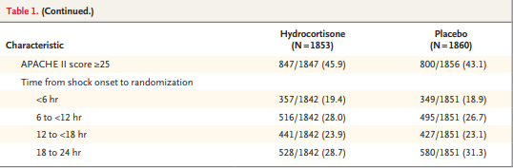

Slide 20
Were patients at baseline with respect to known prognostic factors?
Factors at base line which may have affected the prognosis
?appropriateness of antibiotic therapy – uniform antibiotics policy
?source control for focus of sepsis
?Dose of inotropes /severity of sepsis

Slide 21
RESULTS

Slide 22
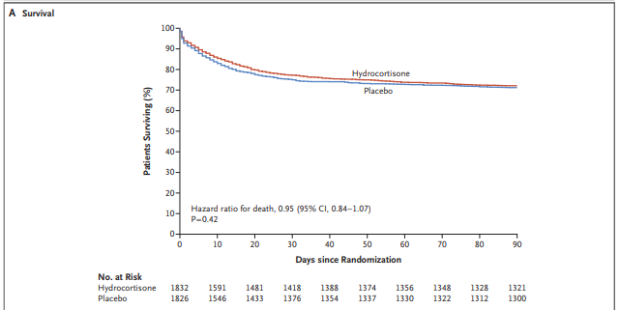
90 day mortality {n=511 (hydrocort) vs 526 (placebo), p =0.50}

Slide 23
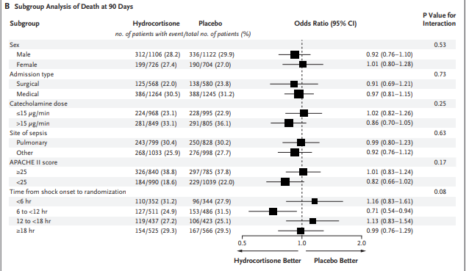

Slide 24
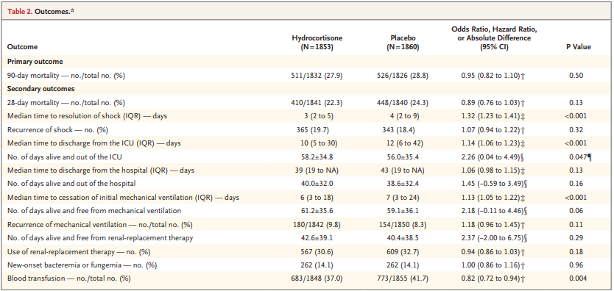

Slide 25
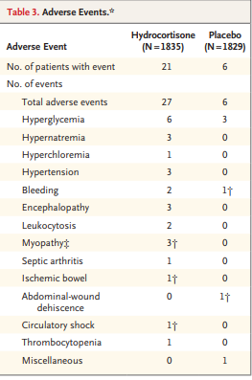
Adverse events
Adverse events were left to the clinicians
judgement , no central adjudication

Slide 26
Number of patients with adverse events – significantly greater in hydrocortisone group
  21 (1.1%) vs. 6 (0.3%), p=0.009
  Hyperglycaemia: 6 vs. 3
  Hypernatraemia: 3 vs. 0
  Encephalopathy: 3 vs. 0
Serious adverse events
  4 events in the hydrocortisone group
    2 myopathy, 1 ischaemic bowel, 1 circulatory shock
  2 events in the placebo group
    1 bleeding, 1 abdominal-wound dehiscence

Slide 27
Were the study patients similar to my patient?
Yes and No
Were all patient-important outcomes considered?
Mortality – ?2 weeks ideal cut off for ICU outcomes
Stratification of results based on severity of sepsis and inotrope requirement

Slide 28
Are the likely advantages of the novel treatment worth the potential harms and costs?
Time to resolution of shock , mechanical ventilation are important outcomes
No significant increase in bacteremia/fungemia /wound dehiscence
Hyperglycemia – manageable , acceptable if it provides mortality benefit

Slide 29
Conclusion of Authors :
Among patients with septic shock undergoing mechanical ventilation, a continuous infusion of hydrocortisone did not result in lower 90-day mortality than placebo

Slide 30
STRENGTHS
WEAKNESS
RCT , MULTICENTER , BLINDED
LARGE NUMBERS
NOT MUCH BASE LINE MISMATCH
?ACTH STIMULATION – capture relevant population
?bolus loading dose
?uniform antibiotic policy
? Delay in initiation of steroids

