Slide 1


Slide 2
Background
Anticholinergic drugs block the neurotransmitter acetylcholine in the central or peripheral nervous system, and have diverse actions depending on the site.

Slide 3
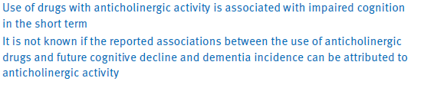
Background

Slide 4
Objective
To estimate the association between
The duration and level of exposure to different classes of anticholinergic drugs
AND
Subsequent incident dementia.

Slide 5
Study design
Nested case-control study
Data : Clinical Practice Research Datalink (CPRD), which includes records for more than 11.3 million patients from 674 primary care practices in the UK

Slide 6
PICOT
  Cases: Age: 65-99 with a recorded diagnosis of dementia
  Upto standard (UTS) data available for 6 years prior to enrollment
  Controls: Patients who have not been diagnosed to have dementia
  Exposure: Drugs with anticholinergic property
  Outcome: Odds ratios for incident dementia, adjusted for a range of demographic and health related covariates.

Slide 7
Definition of case
Dementia : presence in the patient’s record of any read codes for dementia as a diagnosis, symptom, or referral, or prescription for a cognitive enhancer (memantine, donepezil, rivastigmine, galantamine, or tacrine) if a code for a diagnosis of dementia was recorded within 12 months.

Slide 8
Exclusion criteria
motor neurone disease
HIV or AIDS
multiple sclerosis
Down’s syndrome
alcohol abuse before diagnosis of dementia.

Slide 9
Methodology
Diagnosis of dementia date :index date
Each case was matched to a maximum of seven controls
Matched on sex, year of birth, years of UTS data history, and area level deprivation measured by the index of multiple deprivation quintile of each practice based on its postcode.

Slide 10
Sampling method
Incidence density sampling to select controls

Slide 11
Drug exposure period
A DEP was defined for each case-control group, starting at least one year after the UTS date and ending four years before the index date.

Slide 12
Drug exposure
Anticholinergic Cognitive Burden (ACB) scale.
possibly anticholinergic: Drugs with serum anticholinergic activity or in vitro affinity to muscarinic receptors, but with no known clinically relevant negative cognitive effects are assigned a score of 1
definitely anticholinergic)Drugs with established and clinically relevant anticholinergic effects are assigned a score of 2 based on blood-brain penetration
definitely anticholinergic: Drugs with a score of 2 that also have reported associations with delirium are assigned a score of 3).
All other drugs are assigned a score of 0

Slide 13
. For the drugs available in the UK in the last 30 years without an ACB score
ACB score of 1 : thiazide diuretics, loop diuretics, and antihistamines;
ACB score of 3 :tricyclic antidepressants
ACB score of 0 :creams, eye drops, and ear drops have an

Slide 14
Defined daily doses (DDDs)
Defined as the assumed average maintenance daily dose for a drug based on its main indication in adults, using the DDD values assigned by the World Health Organisation’s (WHO) Collaborating Centre for Drug Statistics Methodology

Slide 15
. For prescriptions of different drugs with the same ACB score, DDDs were summed.
Categorisation of expsoure
  as 0,
  1-13,
  14-89,
  90-364,
  365-1459,
  >1460 DDDs.

Slide 16
Baseline characteristics
Median age of patients at index date was 83
63% were female.
The median drug exposure period (DEP) was 7.1 years.
Proportion of dementia cases diagnosed with depression at the start of the DEP was 12% (n=5071), rising to 20% (n=8030) during the DEP

Slide 17
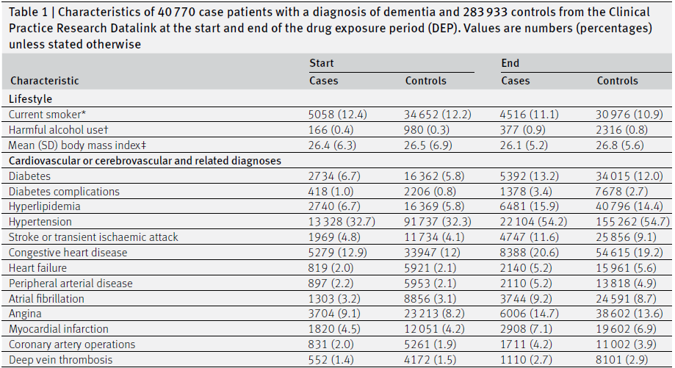

Slide 18
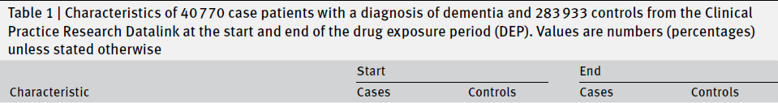
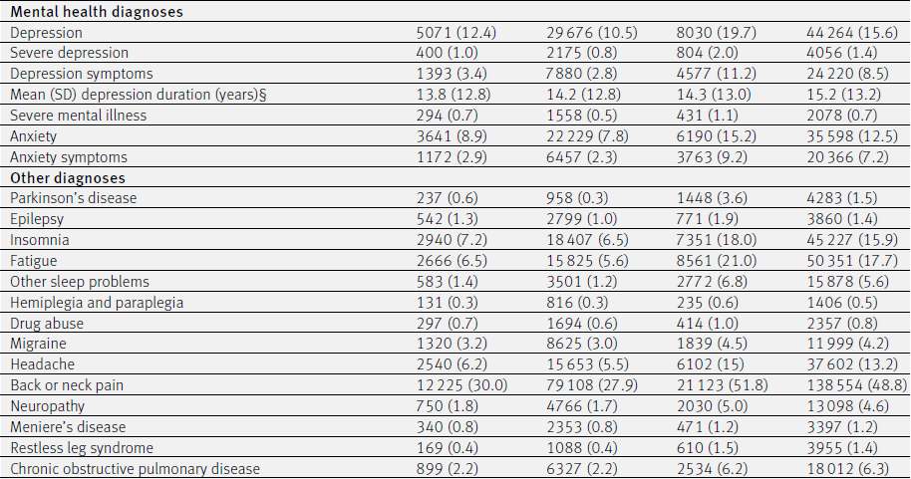

Slide 19
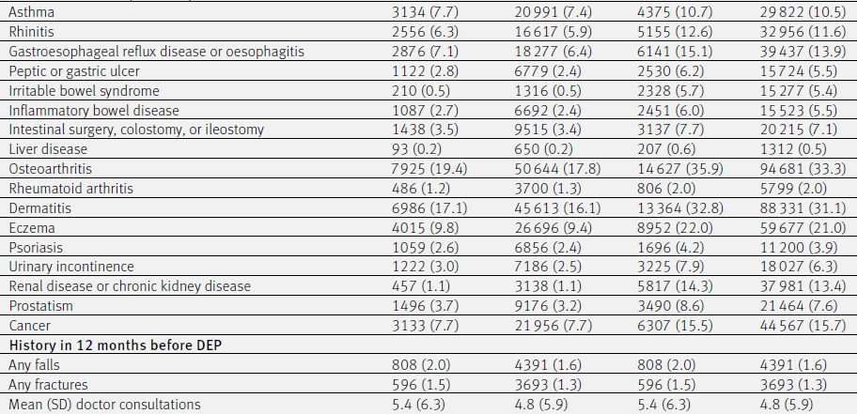

Slide 20
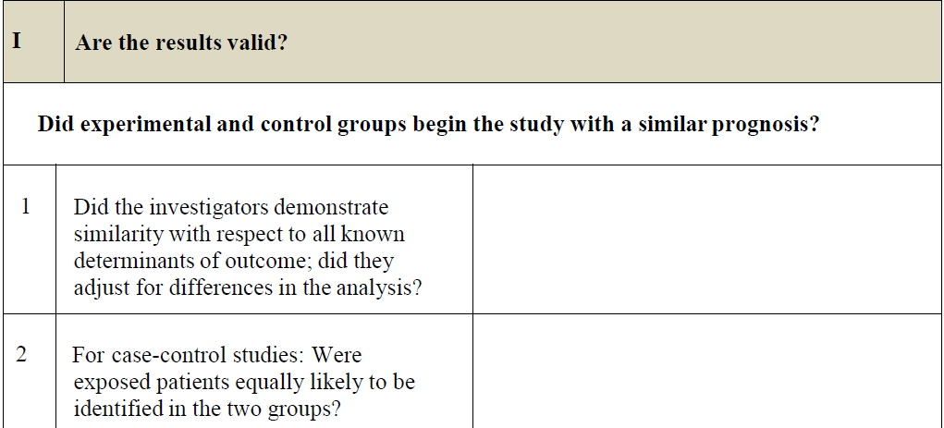
PD, Depression more in the cases
Yes

Slide 21
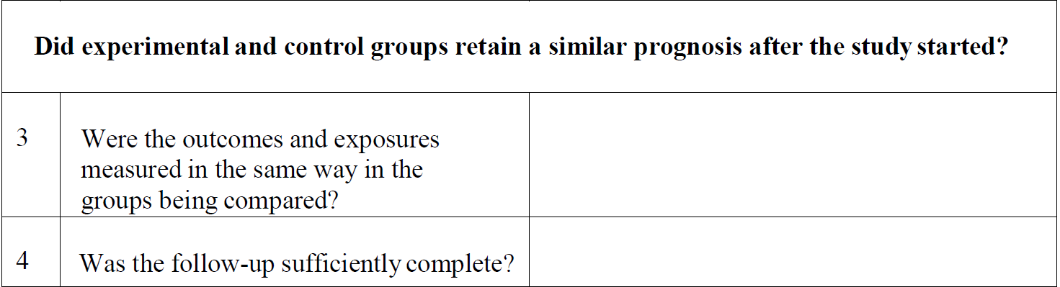
Yes
Yes

Slide 22
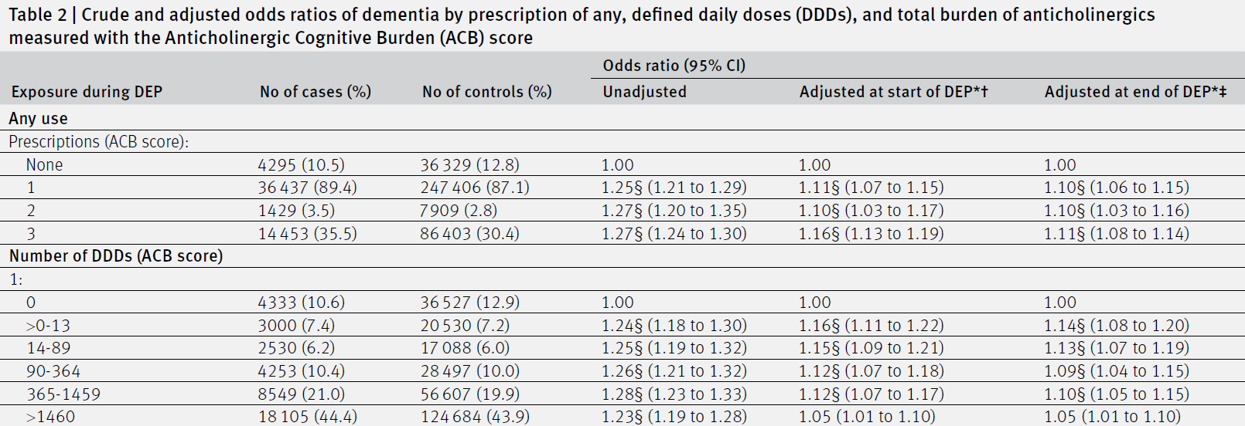

Slide 23
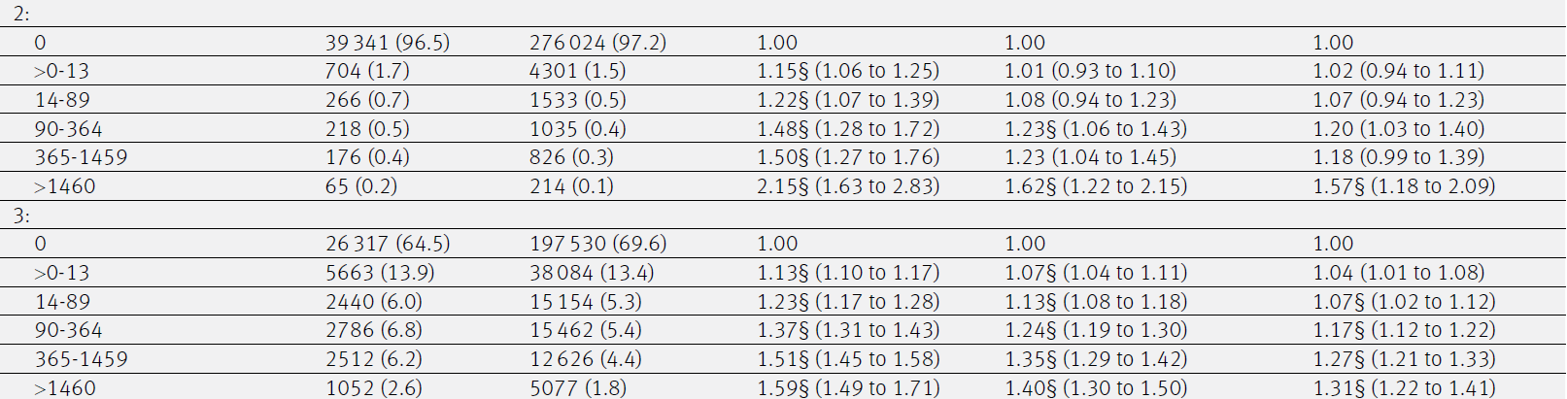

Slide 24
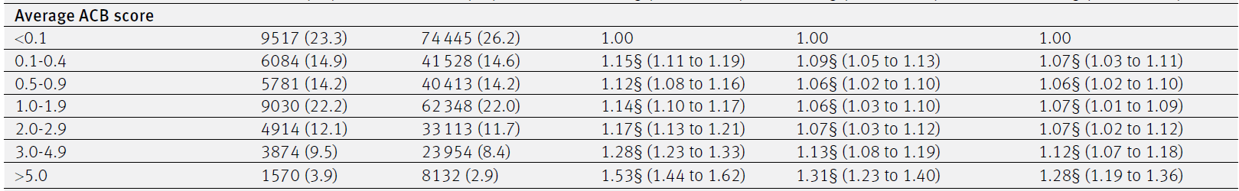

Slide 25
Inference
Positive and significant association between the prescription of any drug with an ACB score of 1, 2, or 3 and dementia with corresponding odds ratios
A dose-response effect was evident for prescribed doses of drugs with an ACB score of 2 or 3.

Slide 26
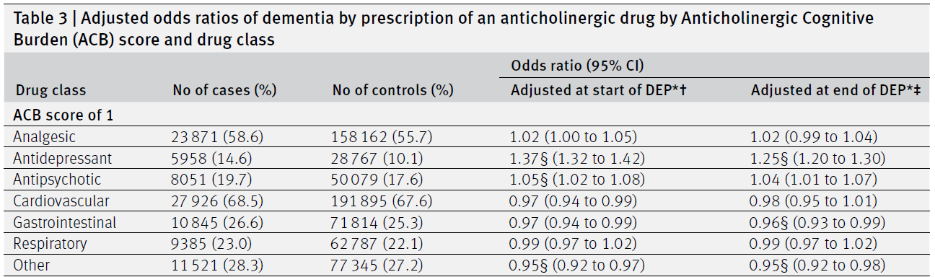

Slide 27
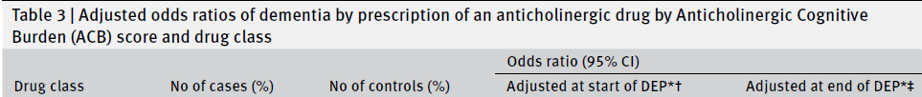
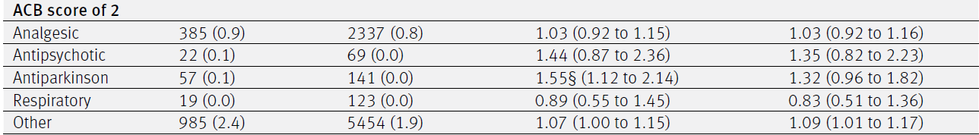

Slide 28
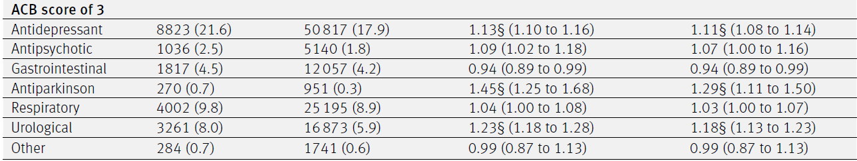

Slide 29
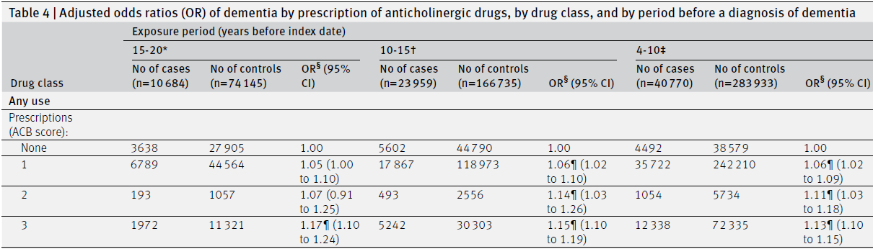

Slide 30
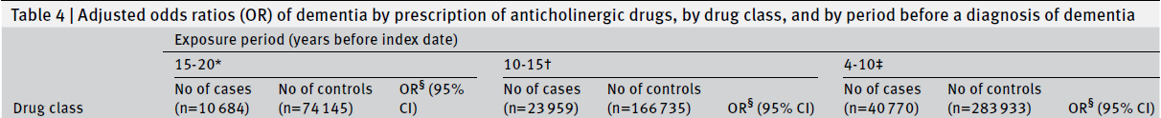
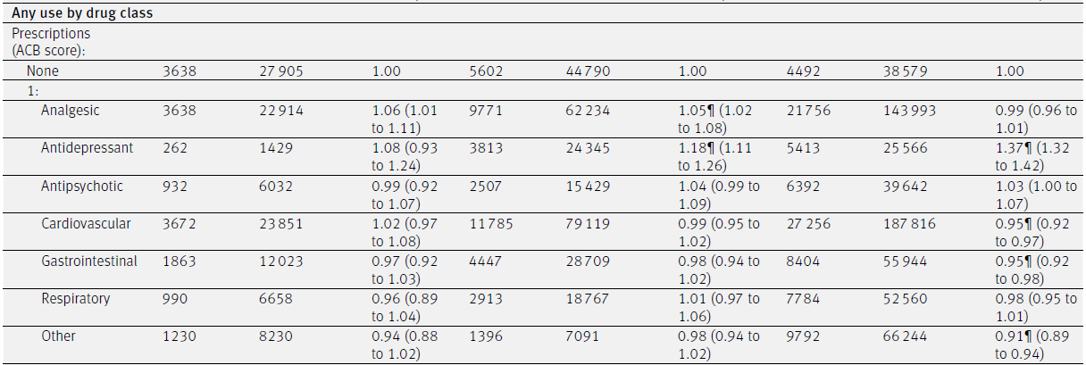

Slide 31
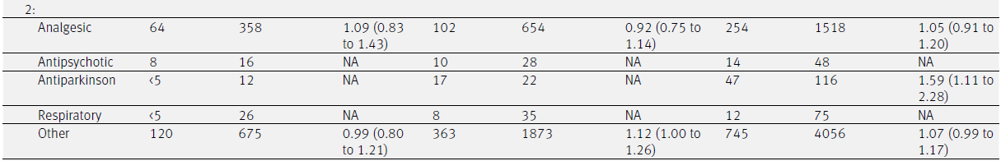

Slide 32
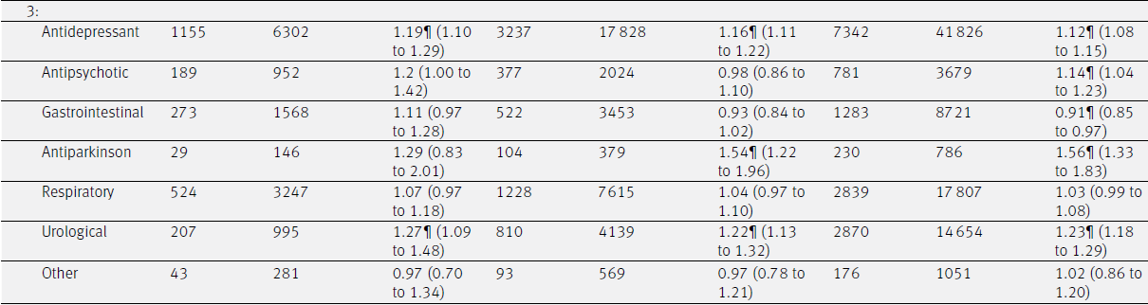

Slide 33
Inference
Significant association between dementia incidence and any prescription of antidepressant, antiparkinson, or urological drugs with an ACB score of 3,
No association with antispasmodic, antipsychotic, antihistamine, or other drugs with an ACB score of 3.
Positive associations for antidepressant drugs with an ACB score of 1

Slide 34
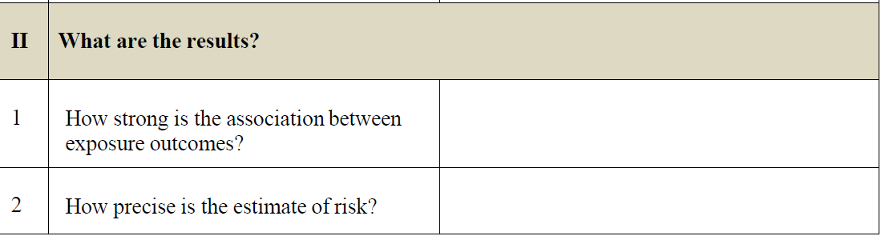
Odds ratio >1 for some parameters as mentioned
Precise

Slide 35
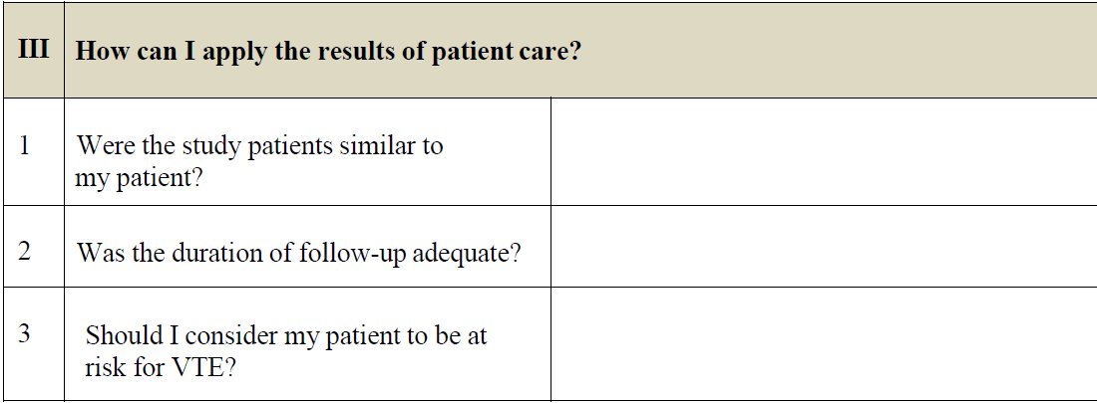
No
DM, smoking , ethanol use much less
No Asians included
Yes
Needs further studies
Dementia

Slide 36
Thank you

