Slide 1
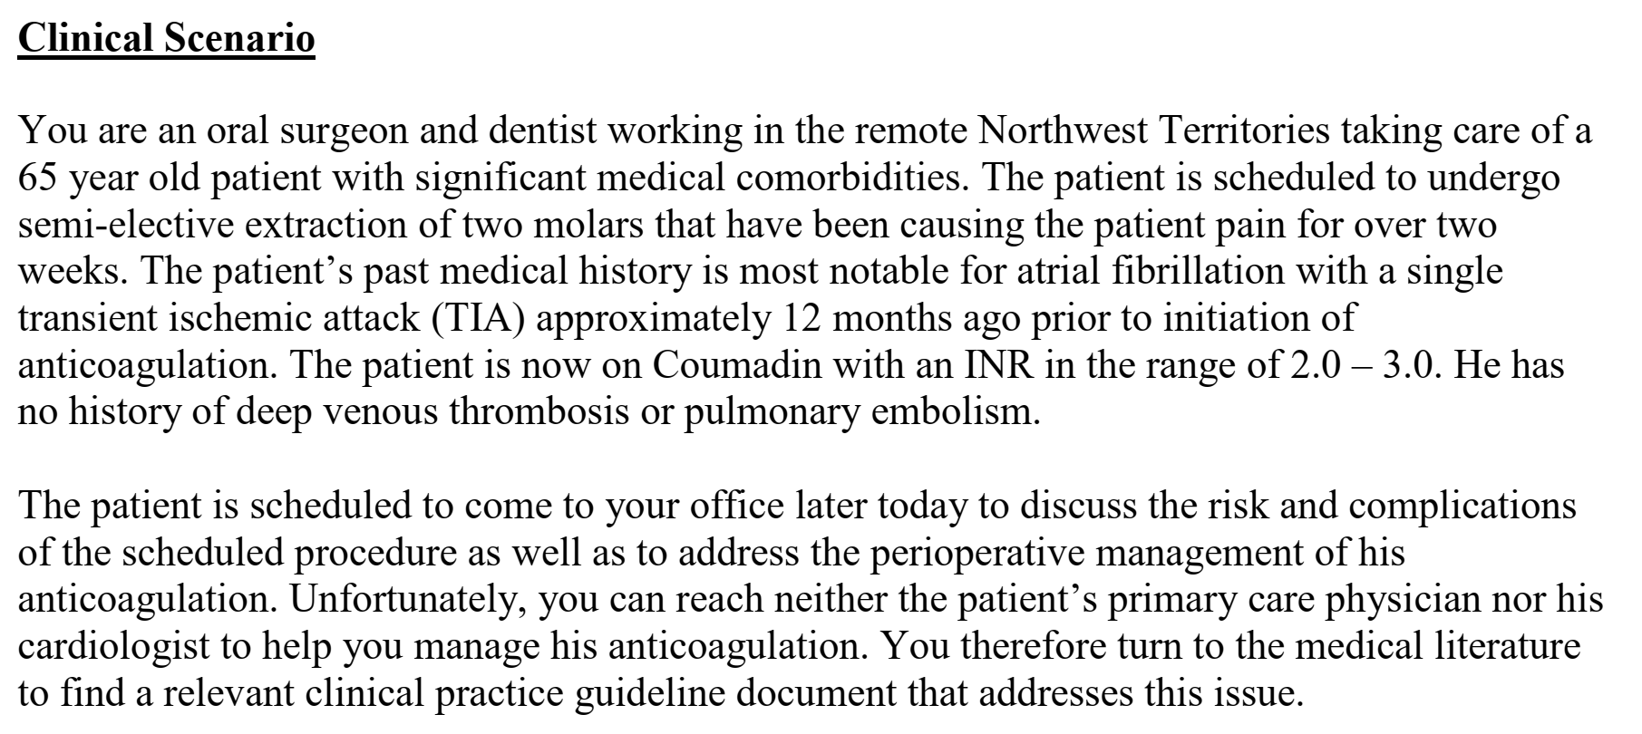

Slide 2
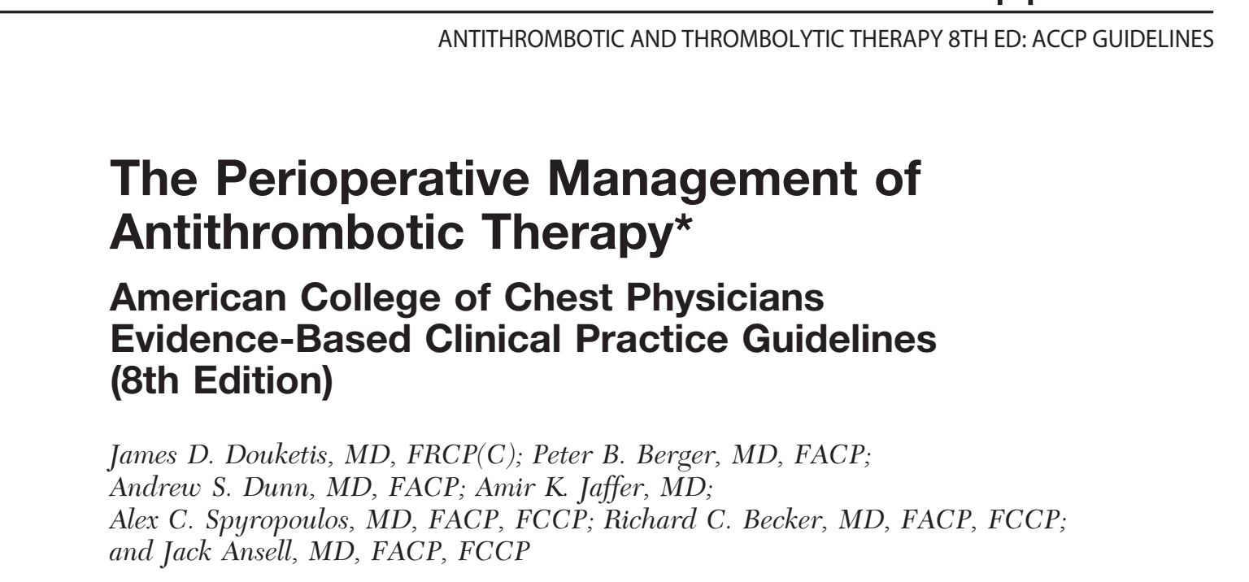

Slide 3
Background
Perioperative management of patients who require temporary interruption of vitamin K antagonists (VKAs) or antiplatelet drugs because of a surgical or other noninvasive procedure is a common
and challenging clinical problem
Risk of a thromboemblic event during interruption of VKA or antiplatelet therapy needs to be balanced against the risk for bleeding

Slide 4

The overall objective(s) of the guideline is (are) specifically described
To address the perioperative management of patients who are receiving vitamin K antagonists (VKAs) or antiplatelet drugs, such as aspirin and clopidogrel, and require an elective surgical or other invasive procedures
To address the perioperative use of bridging anticoagulation, typically with low-molecular-weight heparin (LMWH) or unfractionated heparin (UFH)
Secondary objective is to address the perioperative management of such patients who require urgent surgery.

Slide 5
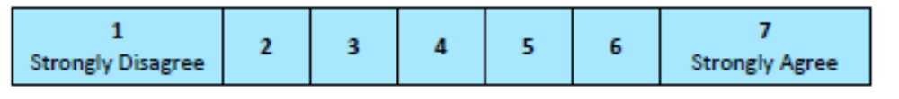
Minor procedures
Invasive procedures
Those receiving antiplatelets or VKAs
Bridging therapy
To prevent risk of increased bleeding and minimize risk of thromboembolism
7

Slide 6
The health question(s) covered by the guideline is (are) specifically described
  Target population – well defined
  Intervention(s) or exposure(s)
  Comparisons (if appropriate)
  Outcome(s)
  Health care setting or context

Slide 7
Perioperative Management of Patients Who Are Receiving VKAs
  Interruption of VKAs Before Surgery
  Resumption of VKAs After Surgery
  Laboratory Monitoring of VKA Therapy
  Patient Risk Stratification and Assessing Need for BridgingAnticoagulation – valve replacement, chronic AF, VTE

Slide 8
Perioperative Management of Patients Who Are Receiving Antiplatelet Therapy
  Risk Stratification
  Interruption of Antiplatelet Therapy Before Surgery
  Resumption of Antiplatelet Therapy After Surgery
  Laboratory Monitoring of Antiplatelet Therapy
  Surgery in Patients Receiving Antiplatelet Therapy
    Noncardiac Surgery
    CABG
    PCIs
  Surgery in Patients With Coronary Stents

Slide 9
Perioperative Management of Antithrombotic Therapy in Patients Who Require Dental, Dermatologic, or Ophthalmologic Procedures
  Patients Who Are Receiving VKAs
  Patients Who Are Receiving Antiplatelet Drugs
  Dermatologic Procedures
    Patients Who Are Receiving VKAs
    Patients Who Are Receiving Antiplatelet Drugs
  Ophthalmologic Procedures
    Patients Who Are Receiving VKAs
    Patients Who Are Receiving Antiplatelet Drugs

Slide 10
Perioperative Management of Antithrombotic Therapy Patients Who
Require Urgent Surgical or Other Invasive Procedures
  Patients Who Are Receiving VKAs
  Patients Who Are Receiving Antiplatelet Drugs

Slide 11
Perioperative Management of Patients Who Are Receiving Bridging
Anticoagulation
Perioperative Anticoagulation Treatment Regimens
  Therapeutic dose UFH/ LWH
  Low dose UFH/ LWH
Costs of Bridging Anticoagulation Treatment Regimens
Resumption of Bridging Anticoagulation After Surgery
  Proximity to Surgery That Anticoagulants Are Administered
  Dose of Anticoagulant Administered
  Type of Surgery and Associated Bleeding Risk
Laboratory Monitoring of Bridging Anticoagulation

Slide 12
Health questions well defined
7

Slide 13
The population (patients, public, etc.) to whom the guideline is meant to apply is specifically described.
Yes
? Age groups
5

Slide 14

The guideline development group includes individuals from all relevant professional groups
Consultants whose role was to focus on patient value and preference issue
experts in economic analysis
all participants submitted conflict-of-interest statements that were reviewed by the ACCP Health Science and Policy (HSP) Committee
established track record in the relevant clinical or research area, international and gender representation, prior involvement with the ACCP Conference on Antithrombotic and Thrombolytic Therapy, and absence of conflicts of interest that could not be resolved.
The senior editors suggested individual chapter chairs as well as chapter members.
James D. Douketis; Peter B. Berger, Andrew S. Dunn; Alex C. Spyropoulos; Richard C. Becker;
and Jack Ansell, MD

Slide 15
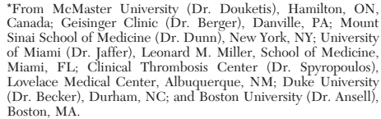
Name - yes
Discipline /content expertise - no
Institution – yes
Geographical location– yes
A description of the member’s role in the guideline development group – no
4

Slide 16
The views and preferences of the target population (patients, public, etc.) have been sought
Consultants whose role was to focus on patient value and preference issues
Costs of LMH, UHF
3

Slide 17
The target users of the guideline are clearly defined.
clear description of intended guideline audience (e.g. specialists, family physicians, patients, clinical or institutional leaders/administrators) - Not defined
Description of how the guideline may be used by its target audience (e.g., to inform clinical decisions, to inform policy, to inform standards of care) – not well defined
2

Slide 18

Systematic methods were used to search for evidence
A team of librarians and research associates at the McMaster University EPC conducted comprehensive literature searches
Cochrane Database of Systematic Reviews, MEDLINE, and Embase for published English-language literature and human studies between 2002 and May 2006
Systematic reviews, RCTs, Observational studies
Search terms not mentioned
Authors did not include data from abstracts of meetings for the development of recommendations
Abstracts that reported on groundbreaking data
4

Slide 19
The criteria for selecting the evidence are clearly described
  Description of the inclusion criteria, including
  Target population (patient, public, etc.) characteristics
  Study design
  Comparisons (if relevant)
  Outcomes
  Language (if relevant)
  Context (if relevant)
  Description of the exclusion criteria (if relevant; e.g., French only listed in the inclusion criteria statement could
Systematic reviews, RCTs, Observational studies
English literature
For each of the questions search was performed
  Not metioned clearly, tables summarizing evidence

Slide 20
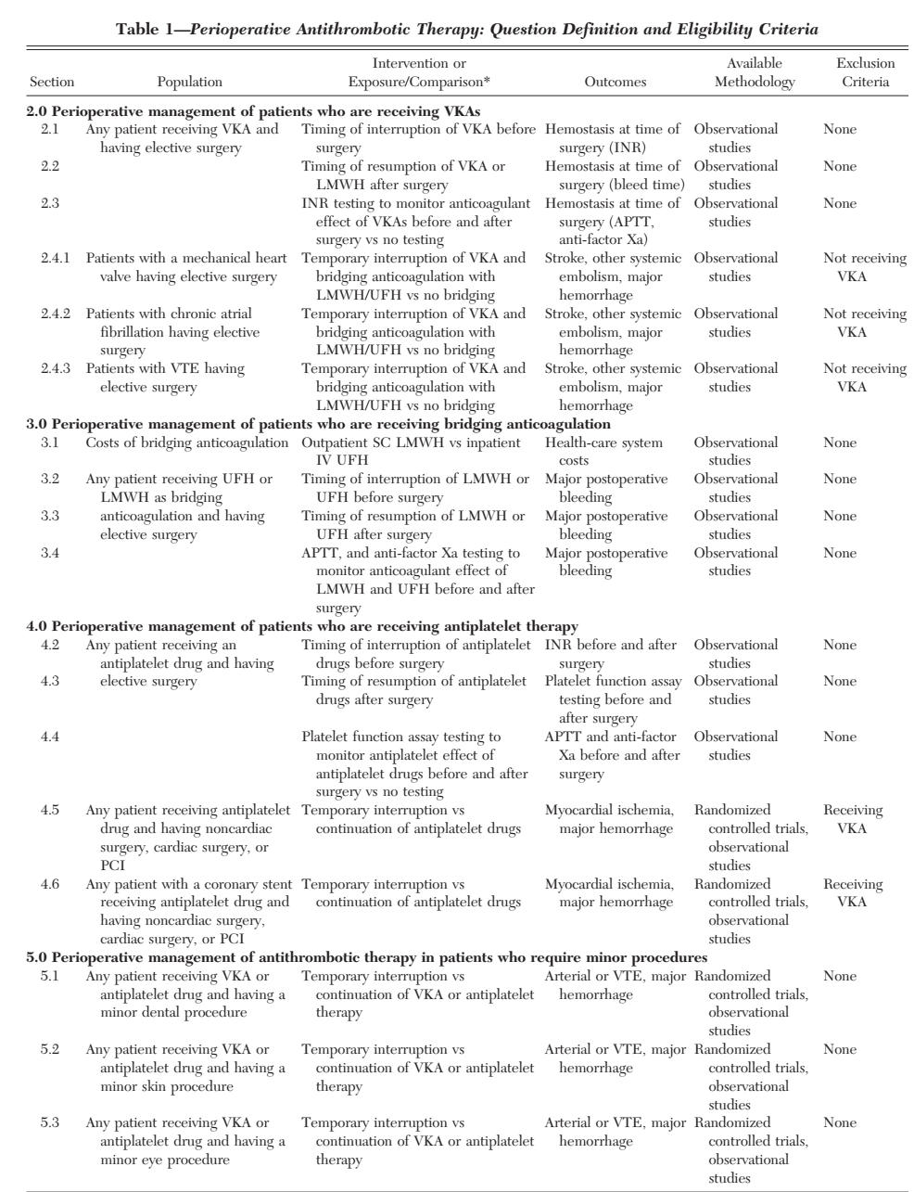
6

Slide 21
The strengths and limitations of the body of evidence are clearly described
Descriptions of how the body of evidence was evaluated for bias and how it was interpreted by members of the guideline development group
  Aspects upon which to frame descriptions include:
  Study design(s) included in body of evidence
  Study methodology limitations (sampling, blinding, allocation concealment, analytical methods)
  Appropriateness/relevance of primary and secondary outcomes considered
  Consistency of results across studies
  Direction of results across studies
  Magnitude of benefit versus magnitude of harm
  Applicability to practice context

Slide 22
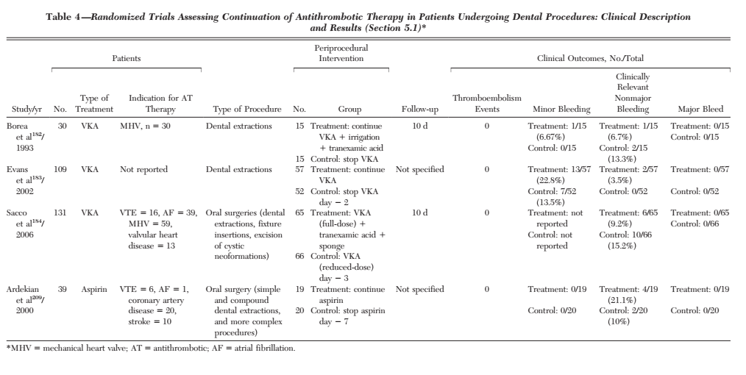
Grading of methodologic quality
Group specific recommendations
Grading Strength of Recommendation
5

Slide 23
The methods for formulating the recommendations are clearly described
Summary and recommendations from each chapter / sub question – peer review
Delphi method
External peer review
7

Slide 24
The health benefits, side effects, and risks have been considered in formulating the recommendations
  Supporting data and report of benefits
  Supporting data and report of harms/side effects/risks
  Reporting of the balance/trade-off between benefits and harms/side effects/risks
  Recommendations reflect considerations of both benefits and harms/side effects/risks

Slide 25
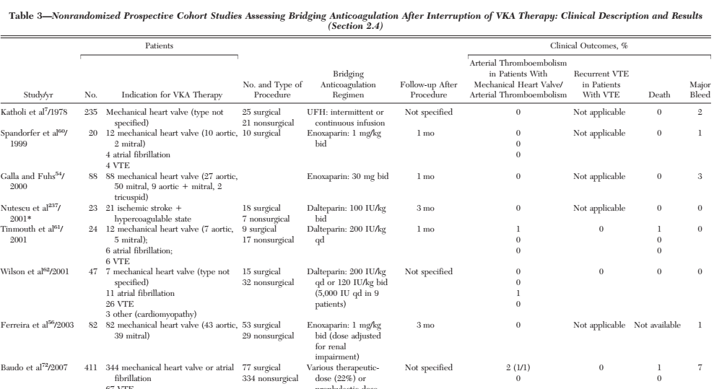
Yes
7

Slide 26
There is an explicit link between the recommendations and the supporting evidence
  the guideline describes how the guideline development group linked and used the evidence to inform recommendations
  Each recommendation is linked to a key evidence description/paragraph and/or reference list
  Recommendations linked to evidence summaries, evidence tables in the results section of the guideline
Yes
7

Slide 27
The guideline has been externally reviewed by experts prior to its publication
  Methods taken to undertake the external review – not mentioned
  Description of the external reviewers – not mentioned
  Outcomes/information gathered from the external review - – not mentioned
  Description of how the information gathered was used to inform the guideline development process and/or formation of the recommendations – not mentioned
Reviewers considered both content and methodology as well as whether there was balanced, not biased, reporting and adherence to HSP processes
External peer review before acceptance for publication
2

Slide 28
A procedure for updating the guideline is provided
  Statement that the guideline will be updated - yes
  Explicit time interval or explicit criteria to guide decisions about when an update will occur – no
  Methodology for the updating procedure is reported – yes
Extend the central assessment of methodologic quality of individual studies, overall judgments of evidence quality, and summaries of findings that we began in this iteration
5

Slide 29

The recommendations are specific and unambiguous
  Statement of the recommended action
  Identification of the intent or purpose of the recommended action
  Identification of the relevant population
  Caveats or qualifying statements, if relevant

Slide 30
3.0 Perioperative Management of Patients Who Are Receiving Bridging Anticoagulation
3.1. In patients who require temporary interruption of VKAs and are to receive bridging anticoagulation, from a cost-containment perspective we recommend the use of SC LMWH administered in an outpatient setting where feasible instead of inpatient administration of
IV UFH (Grade 1C)
7

Slide 31
The different options for management of the condition or health issue are clearly presented
  Description of options
  Description of population or clinical situation most appropriate to each option
Yes
7

Slide 32
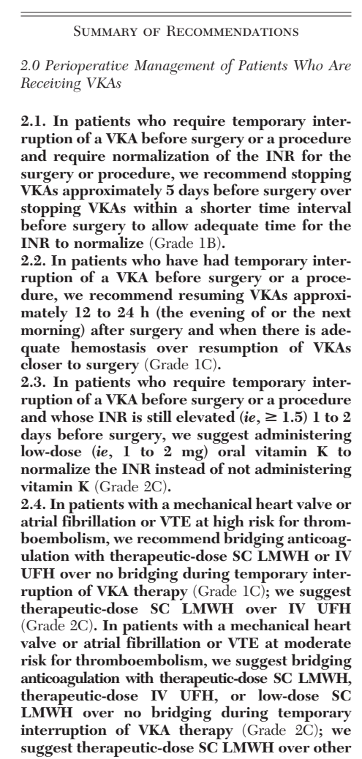
Key recommendations are easily identifiable
Yes
7

Slide 33

The guideline describes facilitators and barriers to its application
  Identification of the types of facilitators and barriers that were considered
  Methods by which information regarding the facilitators and barriers to implementing recommendations were sought
  Information/description of the types of facilitators and barriers that emerged from the inquiry
  Description of how the information influenced the guideline development process and/or formation of the recommendations
Not mentioned
  Platelet transfusions vs prohemostatic drugs
  FFP vs prothrombin concentrate
4
Notes:
(e.g., feedback from key stakeholders, pilot testing of guidelines before widespread implementation)
(e.g., practitioners have the skills to deliver the recommended care, sufficient equipment is not available to ensure all eligible members of the population receive mammography)

Slide 34
The guideline provides advice and/or tools on how the recommendations can be put into practice
  An implementation section in the guideline
  Tools and resources to facilitate application:
  Guideline summary documents
  Links to check lists, algorithms
  Links to how-to manuals
  Solutions linked to barrier analysis
  Tools to capitalize on guideline facilitators
  Outcome of pilot test and lessons learned
  Directions on how users can access tools and resources
Not mentioned
1

Slide 35
The potential resource implications of applying the recommendations have been considered
Two consultants with expertise in economic assessment to help with the
process of considering costs in those small numbers of recommendations that we considered very important to the decision
Bridging anticoagulant therapy
LWH vs UFH
Health care costs
6
Notes:
identification of the types of cost information that were considered (e.g., economic evaluations, drug acquisition costs)
• methods by which the cost information was sought (e.g., a health economist was part of the guideline development panel, use of health technology assessments for specific drugs, etc.)
• information/description of the cost information that emerged from the inquiry (e.g., specific drug acquisition costs per treatment course)
• description of how the information gathered was used to inform the guideline development process and/or formation of the recommendations

Slide 36
The guideline presents monitoring and/or auditing criteria
  Identification of criteria to assess guideline implementation or adherence to recommendations
  Criteria for assessing impact of implementing the recommendations
  Advice on the frequency and interval of measurement
  Descriptions or operational definitions of how the criteria should be measured
Yes
6

Slide 37

The views of the funding body have not influenced the content of the guideline.
  The name of the funding body or source of funding (or explicit statement of no funding)
  A statement that the funding body did not influence the content of the guideline
Not mentioned
Predominantly ACCP members
1

Slide 38
Competing interests of guideline development group members have been recorded and addressed
  Yes
Advisory committee for pharmaceuticals
7

Slide 39
Overall guideline assessment
Rate the overall quality of this guideline.
  5
I would recommend this guideline for use.
  Yes

