Slide 1
CRITICAL APPRAISAL OF A QUALITATIVE STUDY

Slide 2
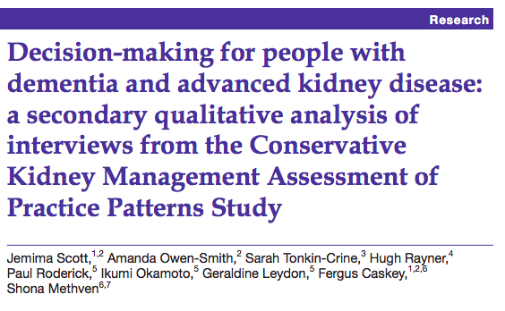


Slide 3
BACKGROUND
Chronic kidney disease (CKD) is an independent risk factor for cognitive impairment.4 Its prevalence in those with CKD is widely under-recognised.
A prospective cohort study found 61% of those with CKD4-5 had a Mini-Mental State Exam (MMSE) score ≤24 at baseline, indicative of significant impairment.
To explore dialysis decision-making for adults who lack capacity due to cognitive impairment, a common and under-recognised condition in those with advanced chronic kidney disease (CKD).

Slide 4
Study Design
Patients : CKD with cognitive impairement
Participants : Staff involved in CKM (conservative kideny management)
Tool: Semistructured Interview
Outcome : Factors taken into consideration during decision-making, and the process of decision-making itself.

Slide 5
Sampling
Purposive sampling was used to identify nine renal centres across the UK differing in the scale of their CKM programmes.
Within these centres, semistructured interviews were conducted with members of the renal multiprofessional team.
Clinical directors of renal centres identified staff involved in CKM.
Staff were asked to participate if they had experience of low clearance clinics or of caring for patients with advanced CKD.
A minimum of one consultant nephrologist and one staff nurse were recruited from each unit.

Slide 6
Was the choice of participants explicit and comprehensive?
No
Staff nurses and Nephrologists included.
Patient relatives, dialysis technicians etc were not included

Slide 7
Was data collection sufficiently comprehensive and detailed?
Yes
Semistructured interviews were conducted face to face or by telephone.
Interviewers were experienced qualitative researchers from the University of Southampton.
Staff were asked about how CKM was delivered, the role of primary and palliative care services.
Their views on CKM and experiences of involvement in CKM decision-making.
Interviews were audio-recorded digitally and transcribed verbatim

Slide 8
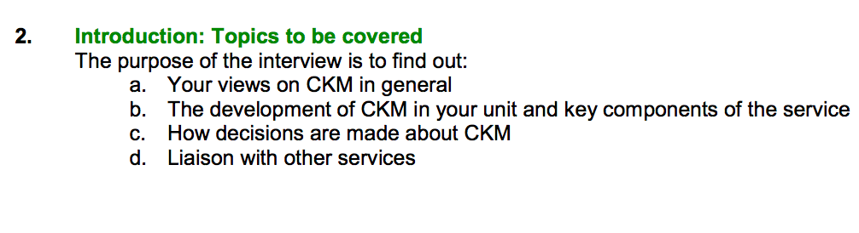

Slide 9
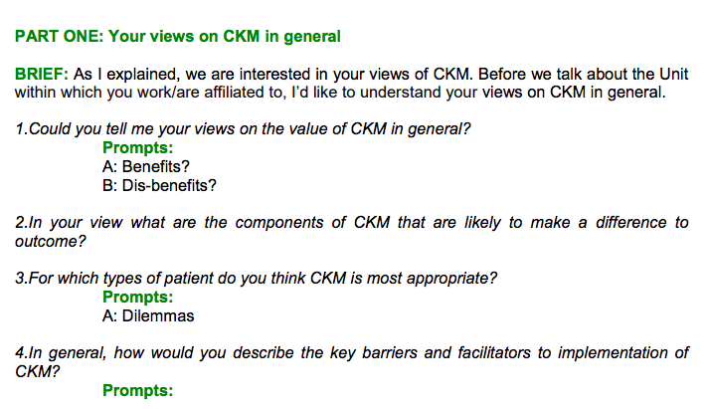

Slide 10
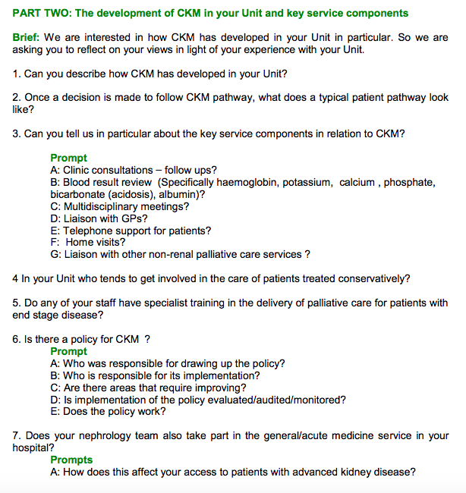

Slide 11
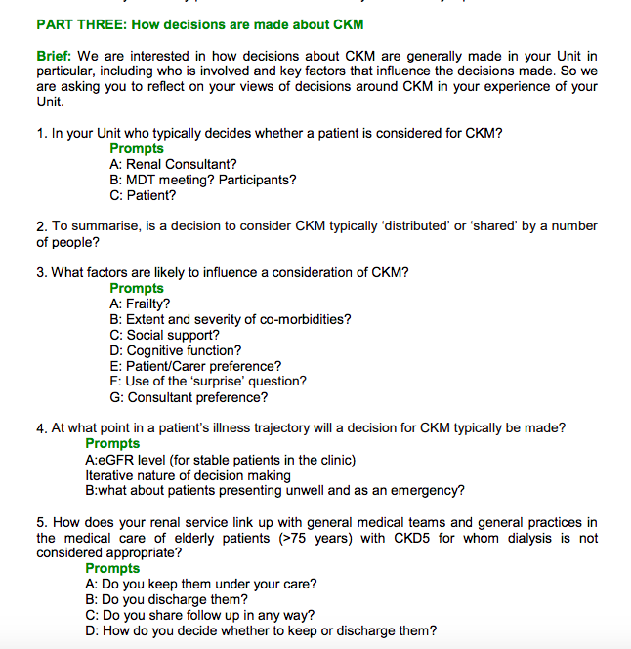

Slide 12
Were the data analyzed appropriately and the findings corroborated adequately?
Yes

Slide 13
Data Analysis
A secondary thematic analysis was conducted to identify themes within interviews with relevance to decision-making for adults who lack capacity as a result of cognitive impairment.
NVivo V.10 qualitative data analysis software (QSR International) was used to facilitate coding.
Each transcript was read by one of two clinical researchers, JS and SM, who were not involved in the original data collection process.
Codes attached to the text highlighted significance with regards to the study question.

Slide 14
Eight interviews were coded independently by both researchers to check consistency in the identification of relevant themes.
Differences were resolved by discussion.
Consensus was reached on an initial coding framework and applied to the remainder of the transcripts (divided between the two researchers).
Saturation of themes related to cognitive impairment was achieved within this secondary analysis; however, this was not an explicit objective of data collection.

Slide 15
The initial framework was further developed through an iterative process as data analysis continued.
Individual codes were built into a thematic framework, which was used to structure the analysis reported in this article.
Particular attention was paid where there were differences in views expressed between interviewees, which were used as a platform for further in-depth analysis.

Slide 16
What are the results of the study?
Sixty staff interviews were undertaken in the initial CKMAPPS study (six to nine per unit).
Participants included 22 nephrologists, 25 nurses, one palliative care consultant and 12 allied health professionals (six social workers, three dieticians, two counsellors, one pharmacist).
Forty-seven participants were women.
Median age was 49 years (range 28–67).

Slide 17
Two overarching themes were identified:
  factors taken into consideration during decision-making, and
  the process of decision-making itself.

Slide 18
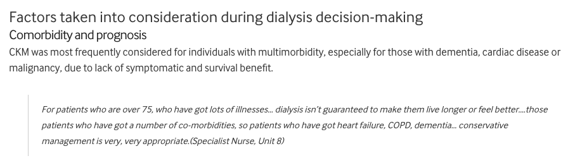

Slide 19
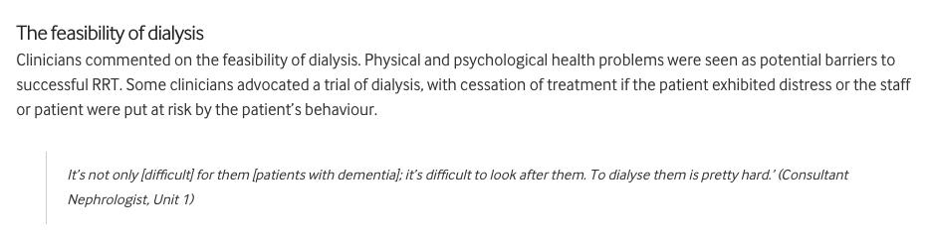

Slide 20
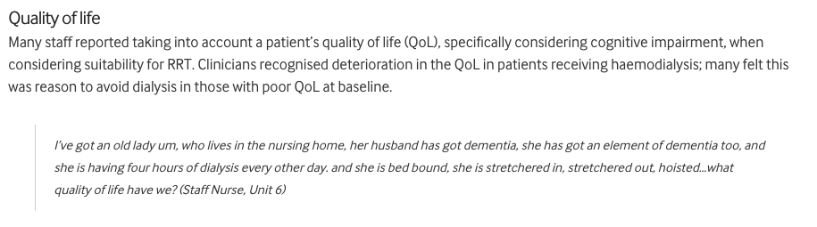

Slide 21
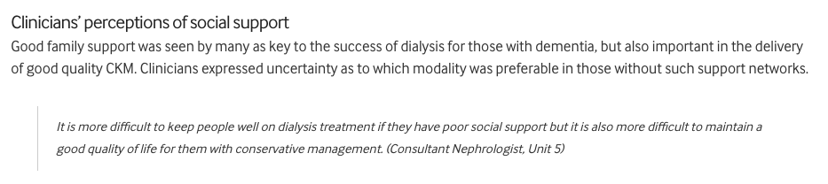

Slide 22
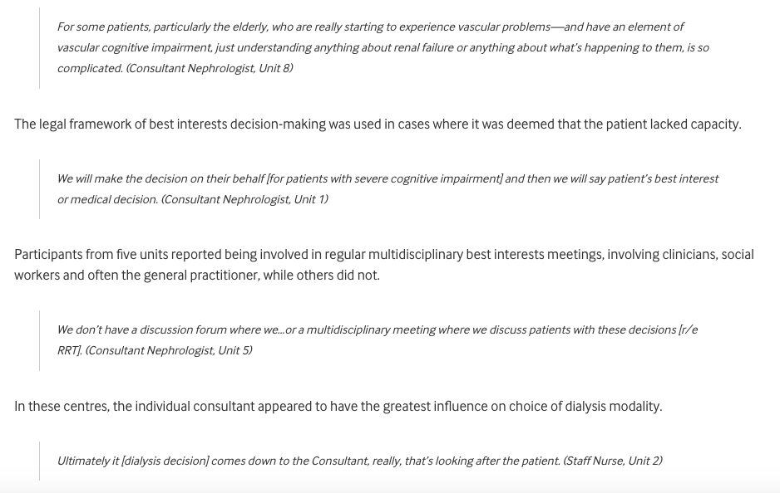

Slide 23
Comorbidity, social support, QoL and the feasibility of dialysis were reported as factors pertinent to clinicians’ decisions regarding suitability.
The majority of renal centres practised multidisciplinary team ‘best interests’ decision-making and were unwilling to act against the wishes of relatives.

Slide 24
Does the study offer helpful theoretical conclusions?
No

Slide 25
Does the study help me understand the context of my practice?
Yes
Best interest
Advanced directive

Slide 26
Is this study results applicable in my setting?
No
Study is done in a very different set up. In India, cost of HD has to be paid by the patient/family. Decision is usually left to next of kin

Slide 27
Does this study help me understand my relationships with patients and their families?
Yes

Slide 28
Thank You

