Slide 1
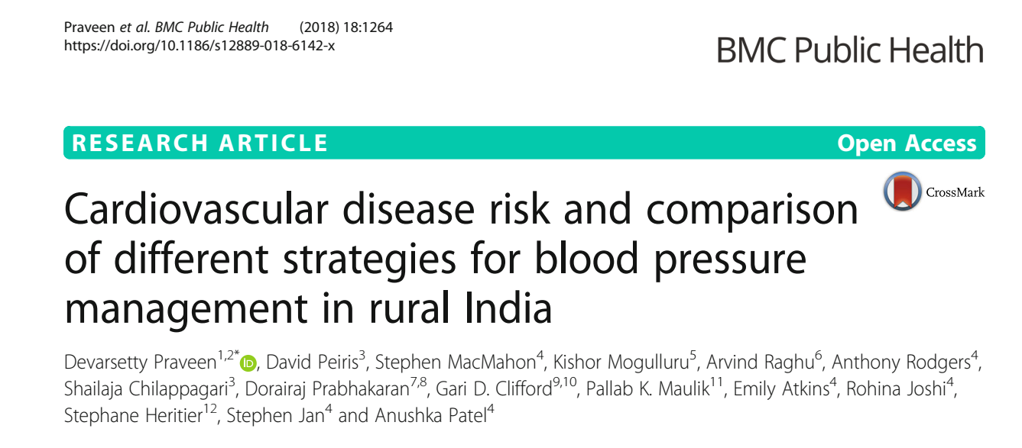

Slide 2
Background
Cardiovascular diseases are a major cause of premature morbidity and mortality globally, with ischemic heart disease and stroke responsible for 24·4% of all deaths in 2010
80% of these CVD deaths occur in low-and middle-income countries
In India, CVD already cause about 27% of deaths,

Slide 3
Currently single risk factor approach in India
National Program on prevention and control of Cancer, Diabetes, Cardiovascular diseases, and Stroke - 2010
Advocates the use of BP lowering drugs in patients with intermediate CVD risk and BP levels ≥140/90 mmHg and those with high CVD risk and BP levels ≥130/80 mmHg
Government of India-WHO. National Programme for Prevention and Control of Diabetes, Cardiovascular Disease and Stroke - A manual for medical officer. 2008. URL: http://www.searo.who.int/india/topics/cardiovascular_
diseases/NCD_Resources_COMBINED_MANUAL_for_medical_officer.pdf

Slide 4
PICO statement
P - Adults more than 40 years of age in district in South India
I – Absolute CVD risk approach
C – Single risk factor approach
O – Efficiency of BP lowering

Slide 5
Objectives
Describe current BP treatment patterns
To compare the efficiency of single risk factor and absolute CVD risk approaches to BP lowering in this setting

Slide 6
Methodology
Crossectional study
18 PHCs selected in the West Godavari district AP
  From 2 revenue districs (15+3)
3 villages selected from each PHC randomly
All eligible persons above 40 were identified and interviewed after consent was taken

Slide 7
Questionnaire with data on CVD risk factors, sociodemographic variables, current drug treatments
BP recorded (Automated sphygmomanometer, average of 2 readings)
Capillary blood glucose recorded

Slide 8
Ten year risk of fatal or non-fatal major CVD event (myocardial infarction or stroke) was estimated using algorithms based on the World Health Organization/ International Society for Hypertension (WHO/ISH) risk
charts
To estimate the population distribution of CVD risk, pre-treatment BP levels were imputed for all participants reporting use of BP lowering medications.
This was done by using the method described by Wald and Law for calculating the pre-treatment systolic and diastolic BP levels, as 80% of the high-risk patients on BP lowering treatment in the current study were on a single drug
regimen

Slide 9
The risk charts allocate individuals into the 5 risks groups: < 10%, 10–19%, 20–29%, 30–39%, and ≥ 40%.
Any patient with established coronary heart disease, cerebrovascular disease, peripheral vascular disease or with a BP > 160/100 mmHg are categorised as high risk without the need for formal risk assessment.
High risk - 10-year risk of ≥30% + established CVD and BP > 160/100 mmHg
Intermediate risk - 20–30% 10 year risk
Low risk - < 20% 10 year risk

Slide 10
BP lowering treatment paradigms
1) current practice
2) treating people with “hypertension” using the 140/90 mmHg threshold
3) treatment according to the new Indian NPCDCS guidelines (drug therapy
recommended in patients with CVD risk 20–30% and BP levels ≥140/90 mmHg or CVD risk of ≥30% and BP levels ≥130/80 mmHg
4) treating everyone in the intermediate and high risk categories (regardless of BP
5) treating only those in the high risk category (regardless of BP level)

Slide 11
Cost-effectiveness of each of the strategies relative to current practice in terms of cost per disability adjusted life years (DALYS) averted were estimated.
Costs of CV medication and potential savings associated with reduced hospitalisation from CVD events over 10 years
Medication cost was assumed to be 10 cents per day [6.4 Rs]
Cost of hospitalization was estimated to be 200 USD for each event [Rs 12,800]

Slide 12
Are the results valid?

Slide 13
Did the recommendations consider all relevant patient groups, management options and possible outcomes?
  Did the investigators adopt a sufficiently broad view point ?
    Yes, society at large
  Are the results reported separately for the relevant sub groups?
    No

Slide 14
Is there a systematic review and summary of evidence linking options to outcomes for each relevant question? - Yes
  Were the costs measured accurately?
    No [medications, hopsitalization; but hospitalisation costs underestimated]
  Did the investigators consider the timing of the costs and the consequences?
    Yes

Slide 15
The eligible study population (age ≥ 40 years) from 54 villages was 74,402. Data were collected from 62,254
  10,332 (13·9%) were not available for interview and 1816 (2·4%) refused participation.

Slide 16
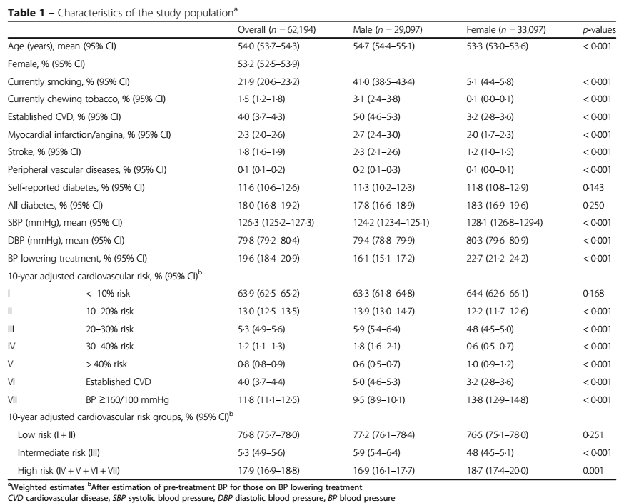

Slide 17
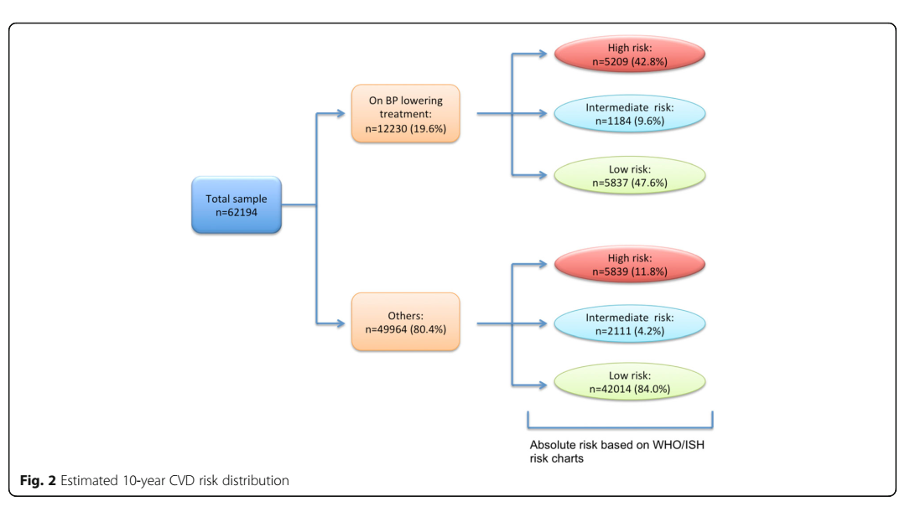

Slide 18
What are the results

Slide 19
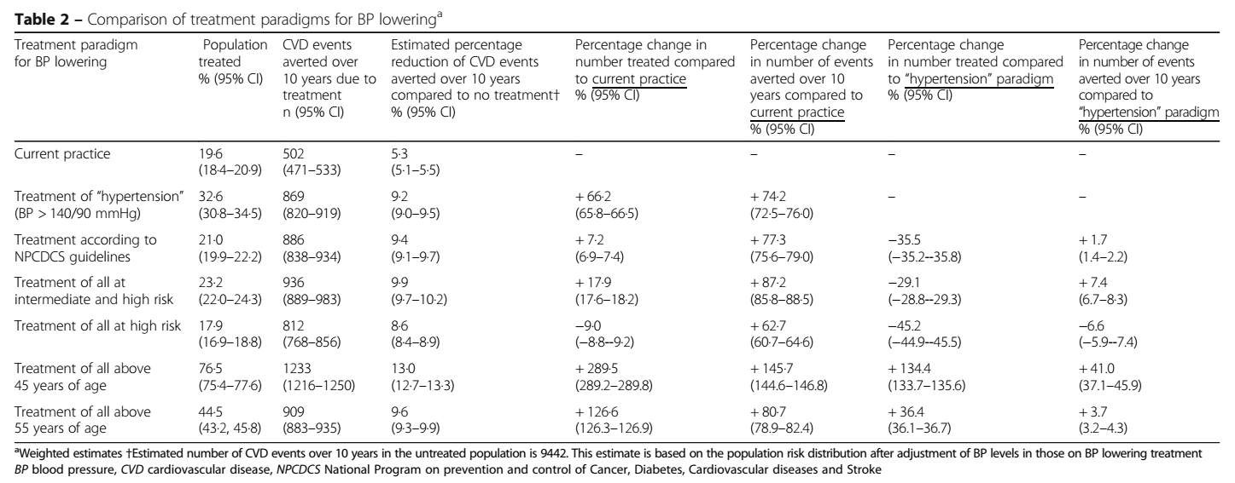

Slide 20
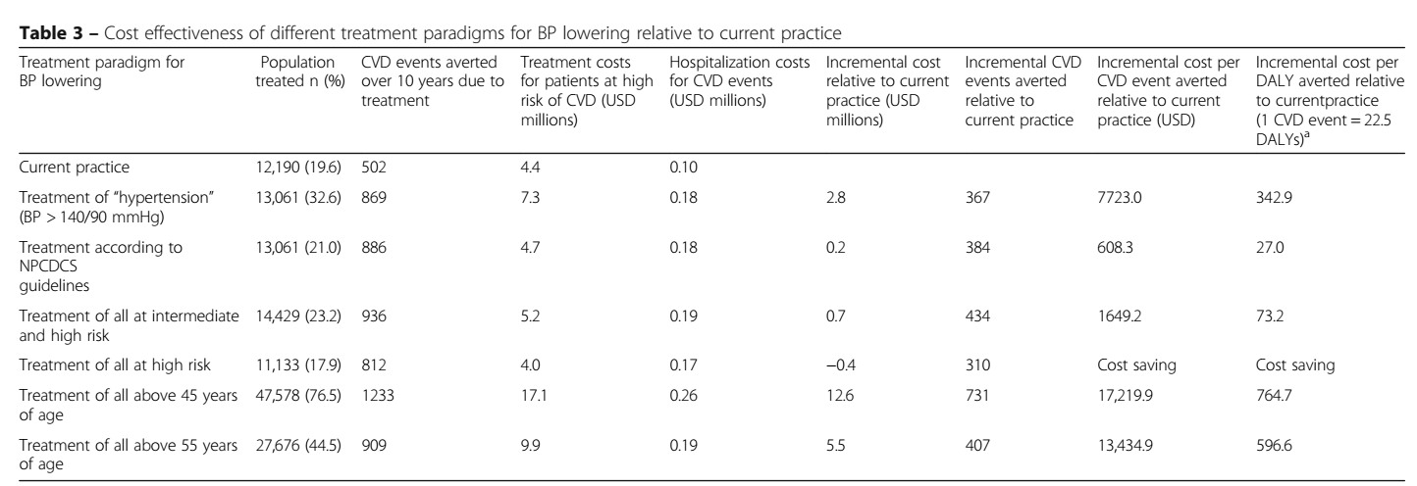
What were the incremental costs and effects of each strategy ?

Slide 21
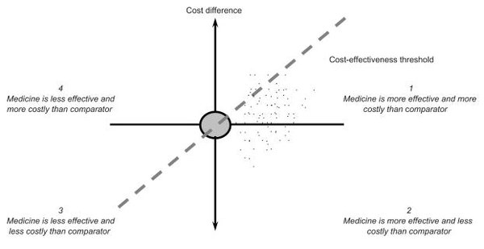

Slide 22
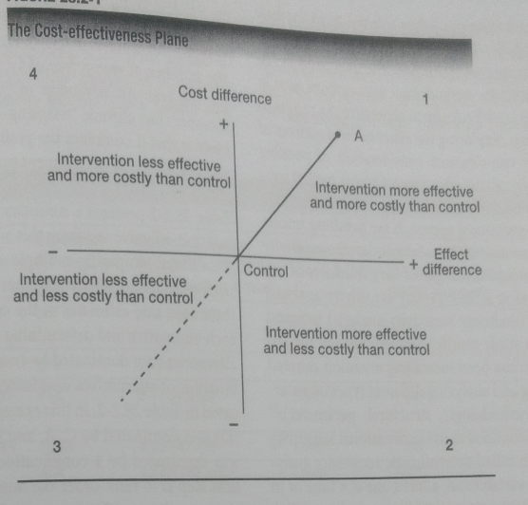
> 45
New
IR
140/90
HR

Slide 24
Do incremental costs and effects differ between subgroups?
  N/A
How much does allowance for uncertainty change the result?
  Sensitivity analyses were performed with the following differing assumptions to those made for the primary analyses:
  1) relative risk reduction of CVD events with BP lowering drug therapy (10% and 20%)
  2) estimated pre-treatment BP levels for those already on treatment (10 mmHg lower SBP and 5 mmHg lower DBP; and 5 mmHg lower SBP and 3 mmHg lower DBP); and
  3) average 10-year CVD risk for individuals with an estimated risk in the > 40% band using the WHO/ISH charts (40% and 60%)
Differences between treatment paradigms remained broadly similar

Slide 25
How can I apply the results to patient care?

Slide 26
Are the treatment benefits worth the risks and costs?
  Yes
Can I expect similar costs in my setting?
  Medications - similar costs
  Hospitalisations – higher costs

Slide 27
Conclusions
An absolute risk approach to BP lowering treatment is cost-effective
In those with high risk it is cost saving

