Slide 1
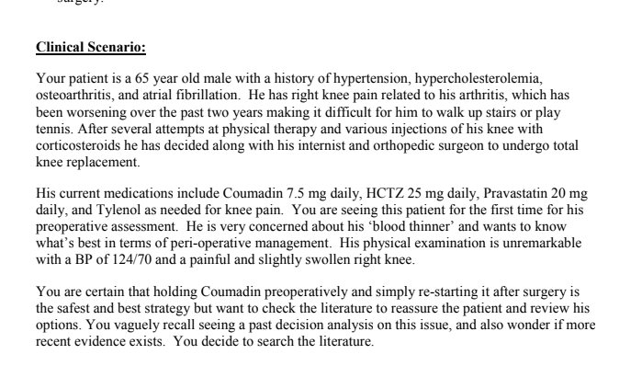

Slide 2
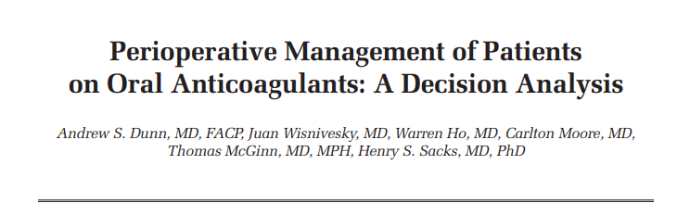

Slide 3
Oral anticoagulants are commonly prescribed for patients with conditions predisposing them to thromboembolism to decrease the risk of life-threatening events, such as stroke.

Slide 4
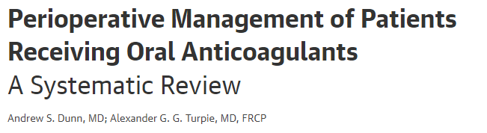

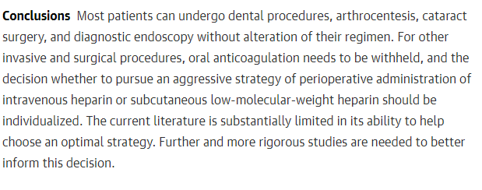

Slide 5
The lack of consensus was noted in a survey of physicians, which found that although most would administer perioperative full-dose intravenous heparin or LMWH for patients with mechanical aortic valves, approximately one third would do nothing other than withhold oral anticoagulation.

Slide 6
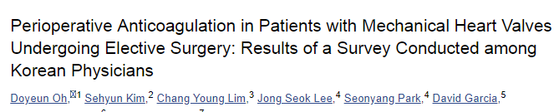


Slide 7
AIM :
perform a decision analysis comparing 2 distinct strategies:
1) a minimalist strategy consisting of simply withholding oral anticoagulants perioperatively and
2) an aggressive strategy consisting of withholding oral anticoagulants and administering LMWH or intravenous heparin perioperatively. These strategies were chosen, as they are commonly utilized and recommended.

Slide 8
Decision ananlytical method
A decision tree model was constructed to describe the possible outcomes of 2 strategies for the perioperative management of patients on oral anticoagulants.
. The perioperative period was defined as the 4 days prior to surgery (the preoperative period) and the day of and 4 days following surgery (the postoperative period). Patients are followed in the model until death.

Slide 9
The primary analysis (base case) was based on a 60- year-old individual with a history of hypertension and prosthetic aortic valve replacement undergoing elective major abdominal surgery.

Slide 10
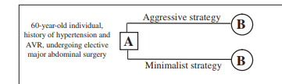
DECISION TREE

Slide 11
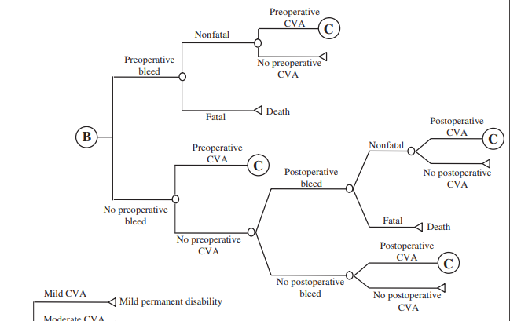
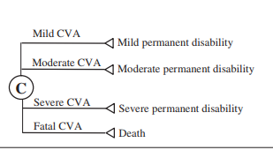

Slide 12
To vary the risk of thromboembolic stroke- assessed as secondary analyses the outcomes of 2 other hypothetical patients undergoing the same surgery
a 60-year-old individual with a history of hypertension and atrial fibrillation (low stroke risk) and a 60-year-old individual with a history of hypertension and prosthetic mitral valve replacement (high stroke risk).
To examine the impact of the potential bleeding risk of the procedure, the outcomes for the 3 hypothetical patients were also examined using dental extraction (low bleeding risk) as the elective procedure.

Slide 13
The probability of each event in the model was based on a review of the literature using the MEDLINE (1 January 1966 to 31 December 2003) and Cochrane Collaboration computerized databases.
The references of the retrieved articles were examined to further identify studies.
Information was extracted from the relevant studies for each input variable
Sensitivity analysis were performed around different plausible values based on the literature review.
Analyses were performed using TreeAge software.

Slide 14
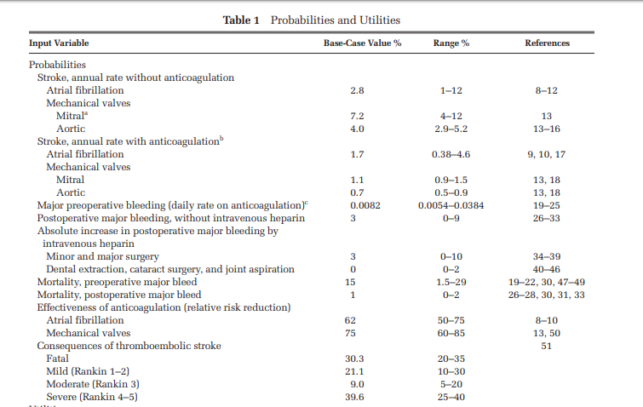

Slide 15
In decision theory, utility is a measure of the desirability of consequences of courses of action that applies to decision making under risk--that is, under uncertainty with known probabilities.
The fundamental assumption in utility theory is that the decision maker always chooses the alternative for which the expected value of the utility (EXPECTED utility) is maximum

Slide 16
If that assumption is accepted, utility theory can be used to predict or prescribe the choice that the decision maker will make, or should make, among the available alternatives.
For that purpose, a utility has to be assigned to each of the possible (and mutually exclusive) consequences of every alternative.
A utility function is the rule by which this assignment is done and depends on the preferences of the individual decision maker.

Slide 17
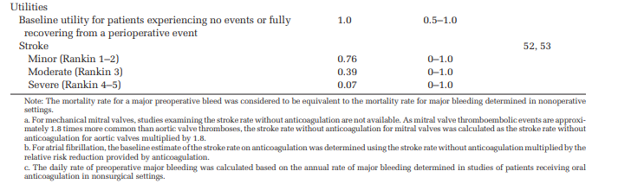

Slide 19
Did the recommendations consider all relevant patient groups, management options, and possible outcomes?
Are there systematic reviews of evidence that estimate the relative impact of management options on relevant outcomes?
Is there an appropriate specification of values and preferences associated with each of the outcomes?

Slide 21
Outcomes of the Analysis
Quality-adjusted life expectancy (QALE) was used as the measure of health outcomes.
The QALEs were obtained by multiplying the appropriate life-years in the different health states with the utility estimate for each health state.
Life expectancy was estimated using the declining exponential approximation of life expectancy (DEALE) method.

Slide 22
The mean mortality rates were estimated based on the US age-specific death rates as reported by the National Center for Health Statistics.
The excess annual mortality associated with aortic and mitral prosthetic valves; atrial fibrillation; and hypertension and minimal, moderate, or severe disability following a stroke was estimated based on a review of the literature.
Quality-adjusted life expectancy was discounted at an annual rate of 3% to account for time preferences.

Slide 23
Quality Adjustments
We adjusted life expectancy to reflect the quality of life for any given state of health by multiplying the life expectancy by the utility for that health state.
Death was defined as having a utility of zero, and patients experiencing no events or fully recovering from a perioperative event without permanent disability were defined as having a utility of 1.0.

Slide 24
conducted a probabilistic sensitivity analysis using a Monte Carlo simulation

Slide 25
What are the key recommendations?

Slide 26
For a 60-year-old individual with hypertension and a mechanical aortic valve undergoing elective major abdominal surgery in a probabilistic sensitivity analysis consisting of 10,000 Monte Carlo simulations:
the mean difference in QALE for the 2 strategies was 0.003 years favoring the minimalist strategy
(95% confidence interval,–0.005 years to 0.011 years).

Slide 27
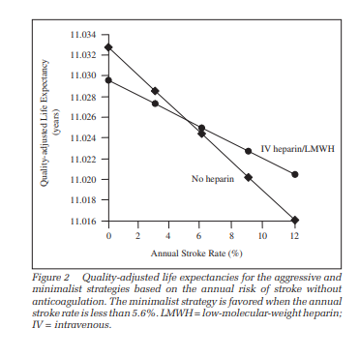

Slide 28
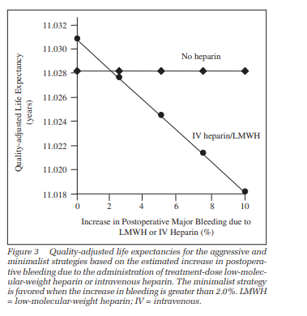

Slide 29
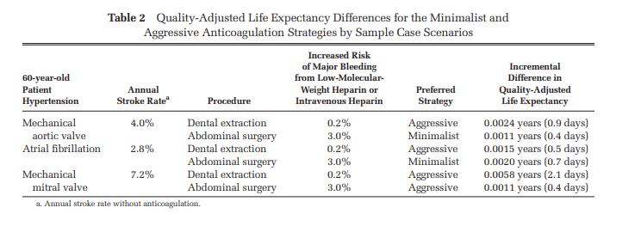

Slide 30
Do the recommendations make sense in your practice setting?
Do the authors indicate the strength of their recommendations?

