Slide 1
Critical appraisal of study on differential diagnosis
Vijay Alexander

Slide 2

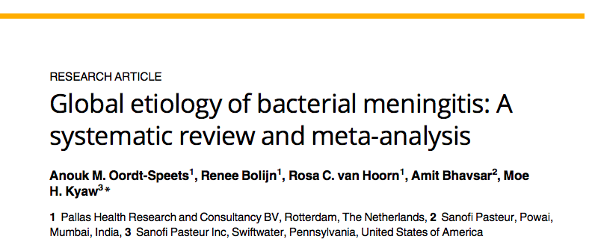

Slide 3
Background
Bacterial meningitis is a global public health concern, with several responsible etiologic agents that vary by age group and geographical area.
The etiologic agents responsible for bacterial meningitis vary by age group.
Among neonates, most cases of bacterial meningitis are due to group B Streptococcus agalactiae, Escherichia coli, and Listeria monocytogenes, while most cases in children and adults are caused by Streptococcus pneumoniae and Neisseria meningitidis.
Although Haemophilus influenzae is implicated in bacterial meningitis in all age groups, it is preponderant in children
The differences in etiology by age and region are yet to be systematically reviewed on a global scale.

Slide 4
PICOT
P : Patients with a diagnosis of bacterial meningitis
E : Evaluation for etiological agent
O : Final Diagnosis and Outcome for the patients
T: Variable, Articles published in the last 5 years were included

Slide 5
Study design – systematic review
Computer-based search of the PUBMED and EMBASE databases
Studies published in English
Studies selection process : 2 sets of authors , reviewed and choose. Third author in case of disagreement.
For each selected article, two researchers extracted the following data to an Excel spreadsheet: study characteristics (country, design, study period, and setting), study population (case definition, exclusion criteria, sample size, age, and sex), and etiological agents

Slide 6
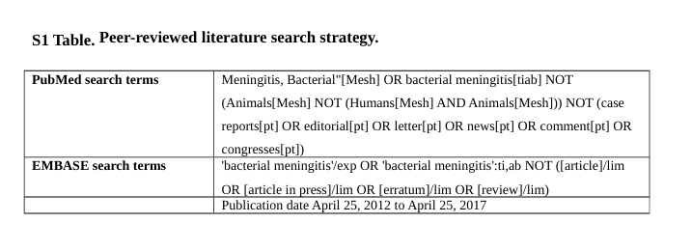

Slide 7
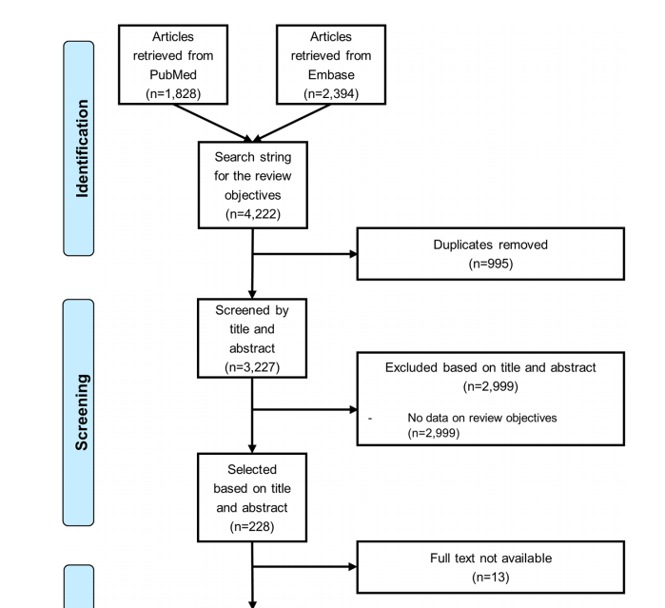
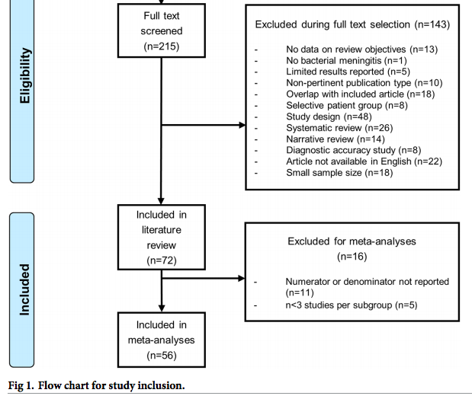

Slide 8
Did the study patients represent the full spectrum of those with this clinical problem?
Did the investigators define the clinical problem clearly ?
As it was a systematic review , broad definition included.
Were the study patients collected from all relevant clinical settings?
This was a global study. Data were stratified by six geographic regions in accordance with the World Health Organization (WHO) regional classification of Member States (African region, Region of the Americas, South-East Asian region, European region, Eastern Mediterranean region [including Israel], and Western Pacific region). The data also included patients from all age-groups.

Slide 9
Were study patients recruited consecutively from the clinical settings ?
Not mentioned
Did the study patients exhibit, the full clinical spectrum of this presenting complaints?
Details – not available

Slide 10
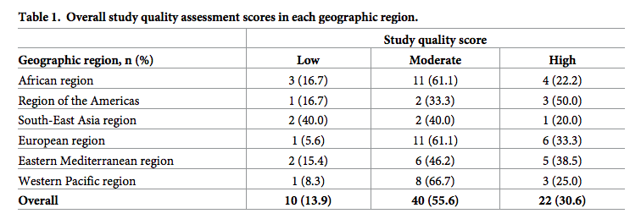

Slide 11
Was the diagnostic evaluation definitive?
Was the diagnostic evaluation sufficiently comprehensive?
Not mentioned

Slide 12
Was the diagnostic evaluation consistently applied to all patients?
Case definition for each study mentioned for each study in supplementary appendix – Most studies used clinical features + CSF culture / PCR / LAT

Slide 13
Were the diagnostic labels assigned reproducibly?
Yes
Final Diagnostic labels were created and data from studies were allotted to such labels.
Notes:
Physicians at the sites determine the final diagnoses and diagnostic codes, which are selected from a standardized list of 522 diagnostic entities, some of which are etiologic (such as Streptococcus pneumoniae) and others of which are syndromic (such as cough).

Slide 14
Were there few patients left undiagnosed?
No
Most studies included patients in whom a bacterial pathogen was identified based on culture/PCR/LAT.

Slide 15
For undiagnosed patients, was follow-up sufficiently long and complete?
No mention of undiagnosed patients made

Slide 16
What were the results?
What were the diagnoses and their probabilities?

Slide 17
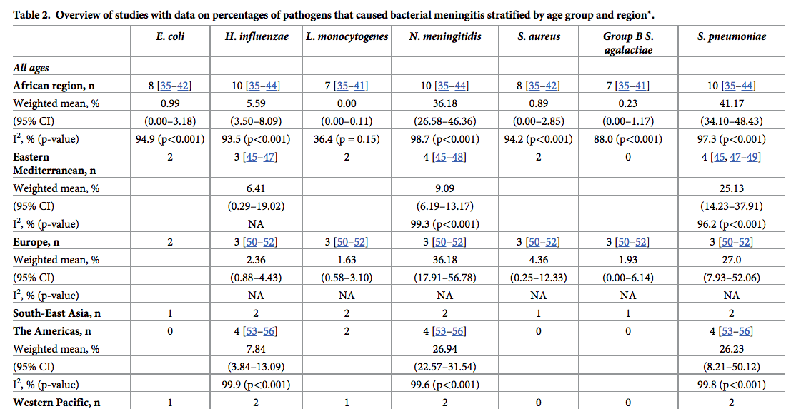

Slide 18
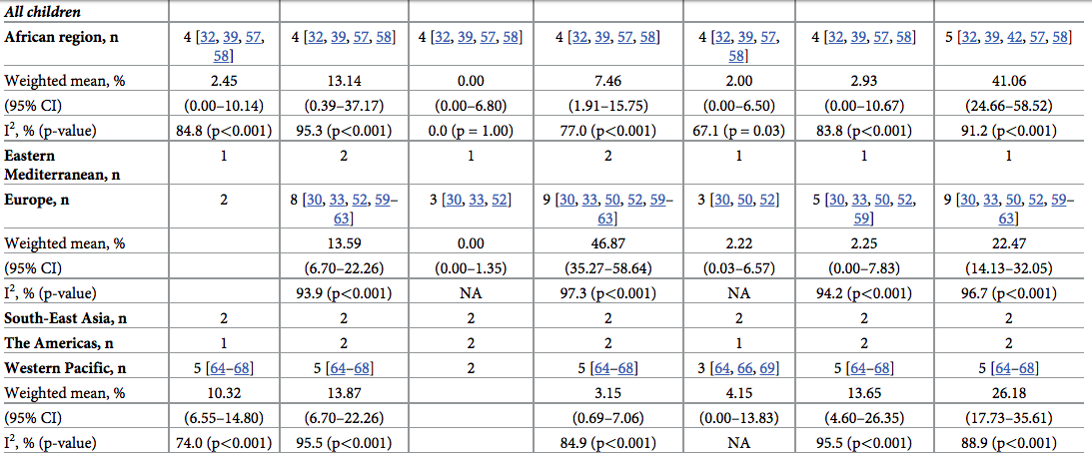

Slide 19
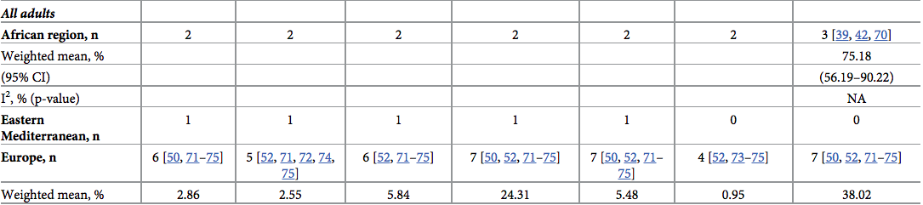
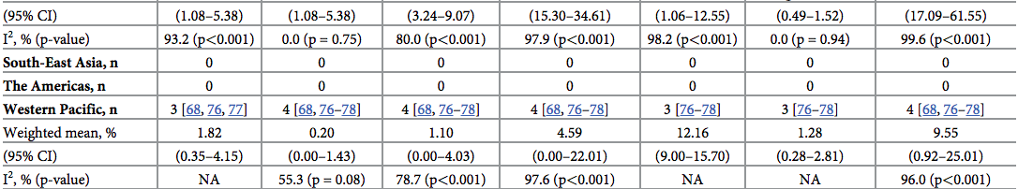

Slide 20
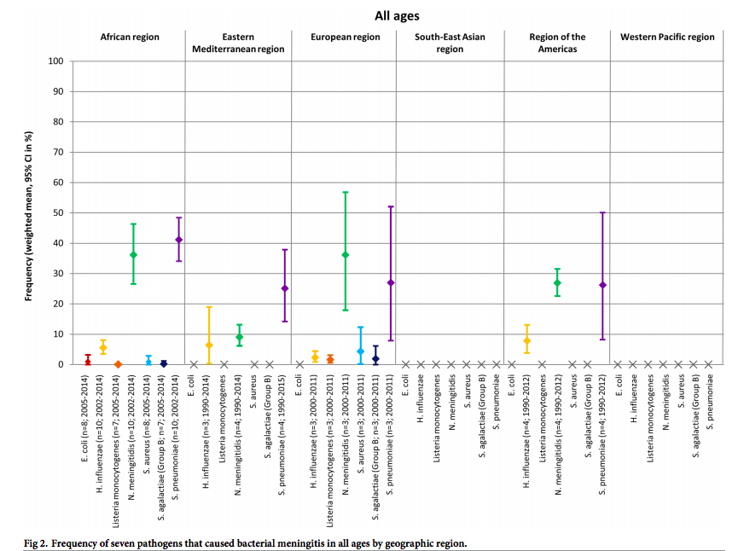

Slide 21
How precise are the estimates of disease probability?
Large heterogeneity was found between the included studies.
Strep pneumoniae was the most common etiological agent in all age groups
  Weighted mean : 41.17
  95 % CI ( 34.1 – 48.3)
  I² – 97.3
Hence the estimates have low precision.

Slide 22
Are the study patients and clinical setting similar to mine?
This was global study with care taken to include all major geographic locations.
The important pathogens identified is similar to the pathogens we encounter in our clinical practice as well.

Slide 23
Is it unlikely that the disease possibilities or probabilities have changed since this evidence was gathered?
No
This study has included data from 2012 – 2017 and was published in 2018.

Slide 24
Thank you

