Slide 1
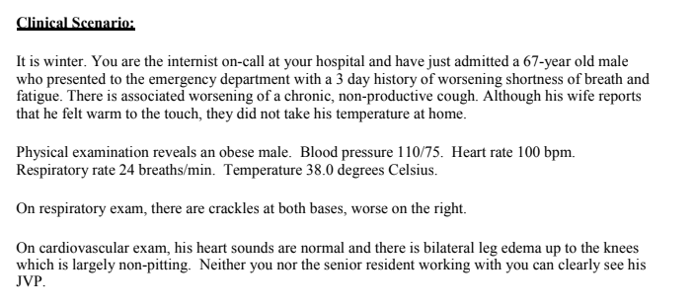

Slide 2
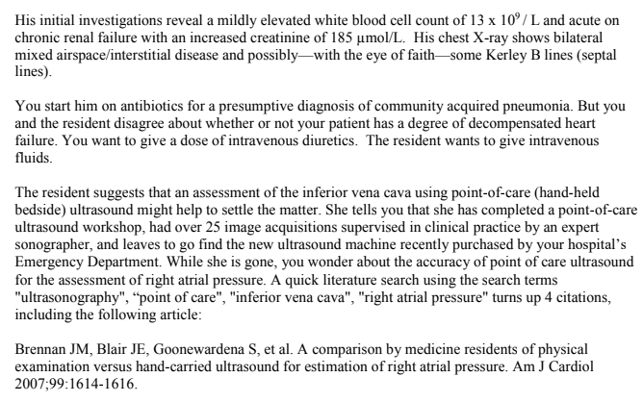

Slide 3
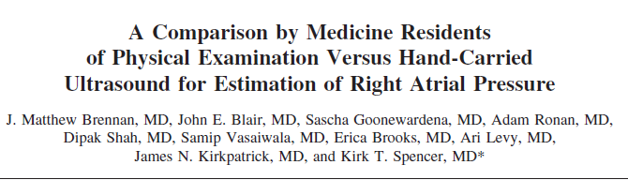
Anusha.S

Slide 4
AIM :
To compare the accuracies of physical examination and hand-carried ultrasound (HCU), performed by internal medicine residents with limited ultrasound training, for the estimation of right atrial (RA) pressure using right-sided cardiac catheterization as the gold standard for comparison.

Slide 5
Did participating patients constitute a
representative sample of those
presenting with a diagnostic dilemma?
PATIENTS : 84 consecutive patients referred for right-sided cardiac catheterization were enrolled.
Right-sided cardiac catheterization was performed using a flow-directed pulmonary artery catheter.

Slide 6
Did participating patients constitute a
representative sample of those
presenting with a diagnostic dilemma?
Obesity
Short neck
Neck lines ?
Intra thoracic lesions /growth /SVC syndrome

Slide 7
Were those interpreting the test and reference standard blind to the other results?
Yes
Did investigators compare the test to an appropriate, independent reference standard?
Yes
Did all patients receive the same reference standard irrespective of the results of the test results?
yes

Slide 8
COMPARATOR 1 :
44 patients underwent brief echocardiographic examinations using an HCU device .
This 6.6-pound device provides 2-dimensional images and has a limited number of controls for the adjustment of image depth and gain. Images can be frozen and scrolled for on-line review

Slide 9
Internal medicine residents with minimal echocardiographic exposure and no previous formal training in ultrasonography performed the HCU studies.
Each of the residents underwent 4 hours of formal didactic ultrasound training and performed 20 sonographer-supervised acquisitions and measurements of the inferior vena cava (IVC) from the subcostal approach.
The IVC was assessed with the patient reclined in the supine position 1 hour before or after catheterization by a resident blinded to the results of the catheterization.

Slide 10
IVC image quality was rated as poor, fair, or good on the basis of prespecified criterion. Poor quality images were omitted from the analysis
Images were then frozen and reviewed to find the maximum IVC diameter (IVCD max) during passive respiration within 2.0 cm of the junction of the IVC and the right atrium.

Slide 11
Images were then frozen and reviewed to find the maximum IVC diameter (IVCDmax) during passive respiration within 2.0 cm of the junction of the IVC and the right atrium.
Patients were then asked to perform a brief rapid inspiration or sniff, and additional loops were recorded. The minimum IVC diameter (IVCDmin) was then measured as the smallest IVC size recorded during the sniff.
The IVC collapsibility index (IVCCI) was calculated using theformula [(IVCDmax IVCDmin)/IVCDmax] 100. All values were the average of 3 measurements

Slide 12
COMPARATOR 2 :
40 patients who underwent right-sided cardiac catheterization were studied to assess the residents’ ability to evaluate RA pressure using the jugular venous pulse (JVP).
A resident blinded to the right-sided cardiac catheterization results examined the JVP 1 hour before catheterization.
The residents estimated mean RA pressure by examining the JVP using the technique they had learned during medical school and residency training. The physicians did not perform HCU examinations in these patients, because they could not have been blinded to their own JVP evaluations of RA pressure.

Slide 13
What were the results ?

Slide 14
Results
Adequate ultrasound images - 90% of patients (60% good quality, 30% fair quality); 4 patients- poor image quality, were excluded from analysis.

Slide 15
Age and body surface area did not differ among patients with good, fair, and poor images (p 0.05).
The mean RA pressure was 7.4 8.4 mm Hg.

Slide 16
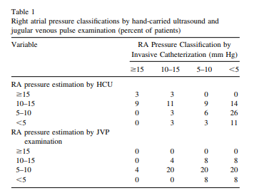

Slide 17
Right atrial pressure >10mmhg | SENSITIVITY | SPECIFICITY | PPV | NPV | ACCURACY
IVC D max >2cm | 70% | 80 % | 43% | 95% | 78%
IVCCI <50 % | 90% | 60% | 54% | 89% | 68%
JVP | 14% | 78% | 20% | 70% | 60 %

Slide 18
Will the reproducibility of the test results and its interpretation be satisfactory in my clinical setting?
Skill level of operator
Are the study results applicable to patients in my practice?
Yes
Will the test results change my management strategy?

