Slide 1
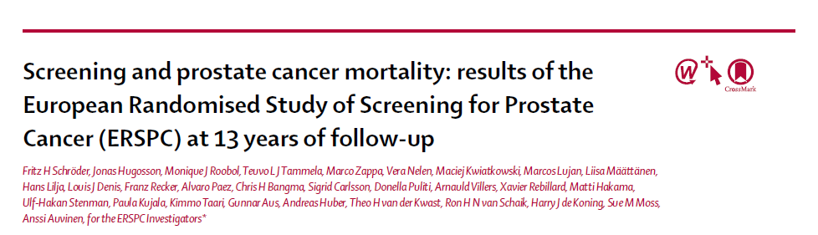
ANUSHA.S

Slide 2
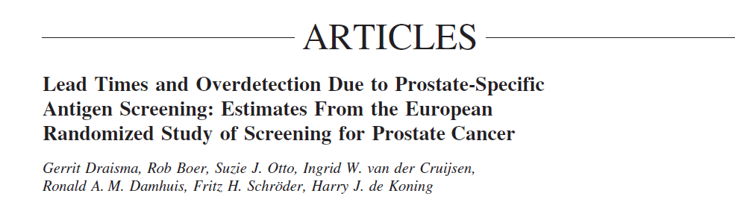
screening for prostate cancer is controversial because of adverse effects such as overdiagnosis.
Estimated to include 40–50% of screen-detected cases and often results in overtreatment with subsequent side effects.

Slide 3
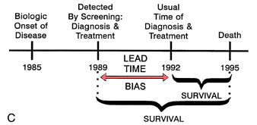

Slide 4
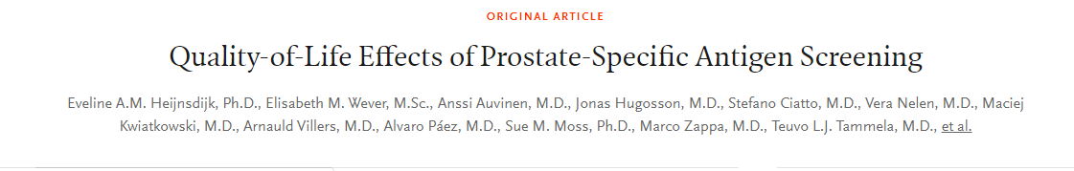
A modelling study, partly based on ERSPC data, showed that with a 4-year screening interval a gain of 52 life-years and a gain of 41 quality of-life-adjusted life-years (QALYs) was achieved per 1000 men, despite some reduction in quality of life due to overdiagnosis and long-term side-effects of treatment.

Slide 5
Aim :
to compare mortality from prostate cancer in an intervention group invited to screening with a control group with no intervention offered.

Slide 6
The ERSPC is a multicentre , randomised , screening trial.
The trial was initiated in 1993 in the Netherlands and in Belgium.
Five other centers (in Sweden, Finland, Italy, Spain, and Switzerland) joined the study between 1994 and 1998.
Two French centres started in 2000 and 2003.

Slide 7
P: Men aged 50–74 years at the time of randomization.
Screening test : prostate-specific antigen (PSA) in serum, with a cutoff of 3·0 ng/mL or more, was the main screening test and indication for biopsy
Screening interval :4 years (2 years in Sweden) was chosen on the basis of lead time estimated to be more than 8 years at the time of trial initiation.
Outcome :primary endpoint of the study was prostate cancer mortality.

Slide 8
Screening was discontinued after three screening rounds in Belgium, Finland, and Spain, and after two rounds in France, but continued up to five rounds in the Netherlands and ten in Sweden.

Slide 9
Were the data identified, selected, and combined in an unbiased fashion?
Eligible participants were identified from population registers and randomization was done individually based on computer-generated random numbers (with 1:1 allocation, except in Finland where an intervention to control ratio of roughly 1:1·5 was used).
Few centers had before randomization screening , few had after randomization screening .Investigators were always blinded.

Slide 10
Is there randomized control trial evidence addressing the impact of the intervention in asymptomatic people?

Slide 11
Deaths from prostate cancer were ascertained by local independent causes of death committees who assessed all deaths in men diagnosed with prostate cancer or those who had prostate cancer as a cause of death on the death certificate, masked to trial group, and following the same algorithm in all centers.
If consensus was not reached, the international causes of death committee was consulted. Of assessed deaths, those classified as definitely prostate cancer and probably prostate cancer and intervention related deaths were used as the outcome events in the analysis

Slide 12
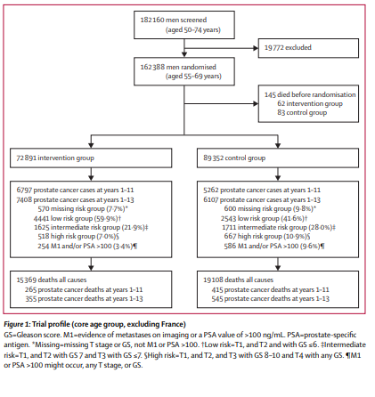

Slide 13
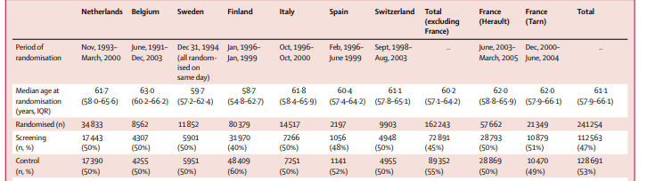

Slide 14
What are the benefits ?

Slide 15
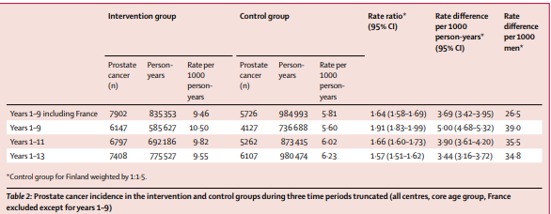

Slide 16
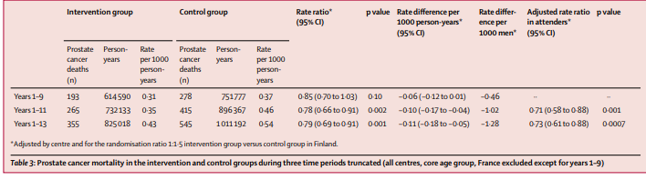

Slide 17
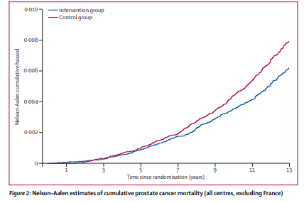

Slide 18
Number needed to invite (NNI) to avert one prostate cancer death was calculated as the inverse of the absolute risk reduction
The number needed to detect (NND) as the NNI multiplied by the excess incidence of prostate cancer in the intervention group

Slide 19
What are the benefits ?
The absolute risk reduction in prostate cancer mortality at 13 years of follow-up in the intervention group compared with the control group, after adjustment for the randomization ratio of 1:1·5 in Finland was 0·11 prostate cancer deaths per 1000 person-years or 1·28 prostate cancer deaths per 1000 men
which yielded an NNI of 781(95% CI 490–1929) and an NND of 27 (17–66).

Slide 20
What are the benefits?
A modelling study, partly based on ERSPC data, showed that with a 4-year screening interval a gain of 52 life-years and a gain of 41 quality of-life-adjusted life-years (QALYs) was achieved per 1000 men, despite some reduction in quality of life due to overdiagnosis and long-term side-effects of treatment.

Slide 21
What are the harms?
"Over diagnosis " ?? 50%
"Risks" of treatment – impotence /incontinence
Cost

Slide 22
How do benefits and harms compare in different people and with different screening strategies?
What is the effect of individuals’ values and preferences?
What is the effect of uncertainty associated with the evidence?
What is the cost-effectiveness?

