Slide 1
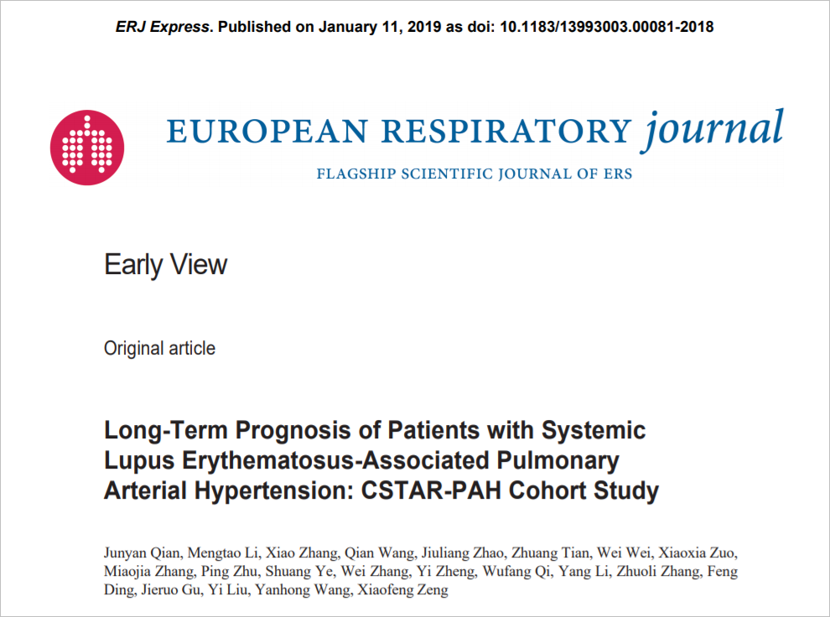
Asha Mathai

Slide 2
Background
Systemic lupus erythematosus (SLE)-associated PAH is most commonly reported in Asian countries
According to a meta-analysis , the 5-year pooled survival rate was 68% for patients with SLE-associated PAH compared with 92–94%in patients without PAH
Clinical outcome of SLE patients is dramatically worsened after developing PAH

Slide 3
Study design
Multicenter prospective cohort study
14 referral centers of CTD-associated PAH were qualified as patients enrollment centers
Patients who visited the referral centers from November 2006 to May 2016 and met the criteria were enrolled in the CSTAR-PAH cohort
The CSTAR registry is a nationwide registry involving 104 rheumatology centers covering 30 provinces in China .

Slide 4
P: Patients with SLE confirmed by the 2012 Systemic Lupus International Collaborating Clinics (SLICC) classification criteria and with PAH
T: November 2006 to May 2016

Slide 5
Aim
To identify the long-term clinical outcomes and prognostic factors of patients with SLE-associated PAH confirmed by right heart catheterization

Slide 6
Primary Outcome
  Death from any cause.
  Secondary outcome
  Achieving the integrated treatment goal recommended by the European Society of Cardiology (ESC) and the European Respiratory Society (ERS)
  Treatment goal was defined as achieved when all of the following four aspects were reached, including:
  1) clinical symptoms: no signs of right heart failure, syncope or progression
  2) WHO FC I or II, or 6MWD > 380–440 m
  3) serology: BNP < 50 ng/L or NT-proBNP < 300 ng/L
  4) cardiac imaging: normal right atrial area according to echocardiography.

Slide 7
Inclusion criteria:
  Patients with diagnosis of SLE confirmed by SLICC criteria and the diagnosis of PAH based on
  mean pulmonary arterial pressure (mPAP) ≥ 25 mmHg at rest
  pulmonary arterial wedge pressure (PAWP) ≤ 15 mmHg
  pulmonary vascular resistance (PVR) > 3 Wood unit
Exclusion criteria
Patients with other types of pulmonary hypertension
TLC < 60%
ventilation perfusion scintigraphy (V/Q) or computed tomographic pulmonary angiography (CTPA) showing pulmonary thromboembolism
overlapping CTD, such as SSc, or other CTDs

Slide 8
Statistical Analysis
Cumulative probabilities of survival and not achieving the treatment goal were calculated with the Kaplan-Meier estimator
Baseline factors were analyzed by univariate Cox regression
Variables with clinical relevance selected by univariate analysis were further subjected to multivariate analysis.
P values < 0.05 were considered significant

Slide 9
How serious was the risk of bias?
Was the sample of patients representative?
  Conducted in china
  Referred patients from 14 centres were included in nation wide registery

Slide 10
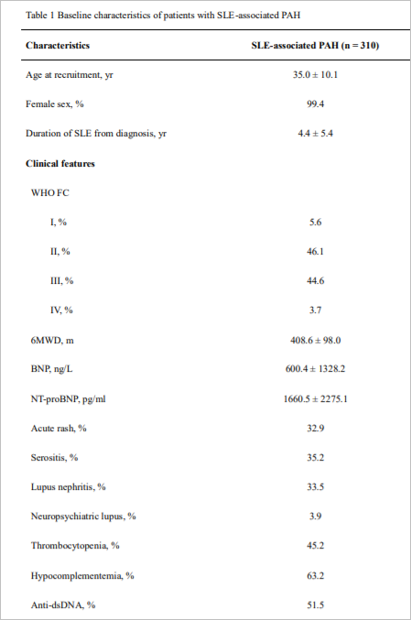
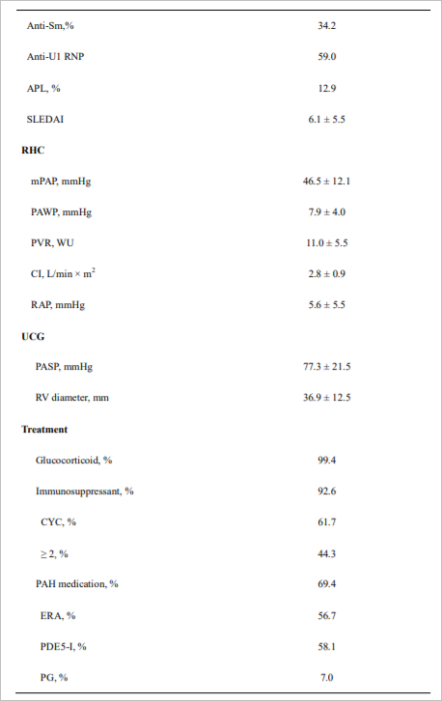
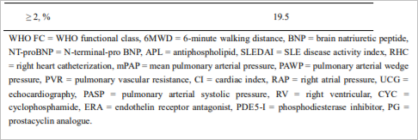
Were patients classified into prognostically similar group?

Slide 11
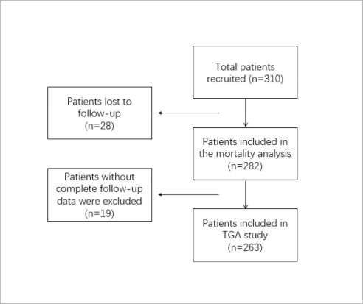
Was follow up sufficiently complete?

Slide 12
Were outcome criteria objective and unbiased?
yes

Slide 13
What are the results?
How likely are the results over time?
42 (14.9%) deaths
1-, 3- and 5-year survival rates for patients with SLE-associated PAH were 92.1%, 84.8% and 72.9%, respectively
The mean survival time was 7.0 years.

Slide 14
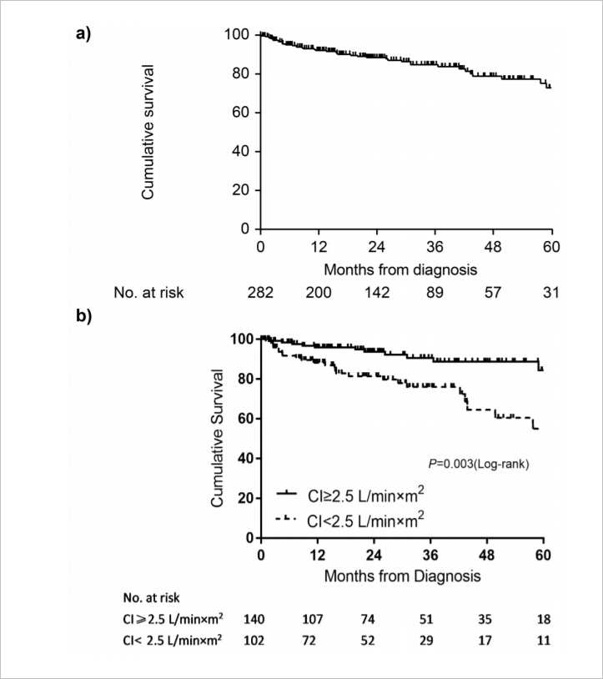

Slide 15
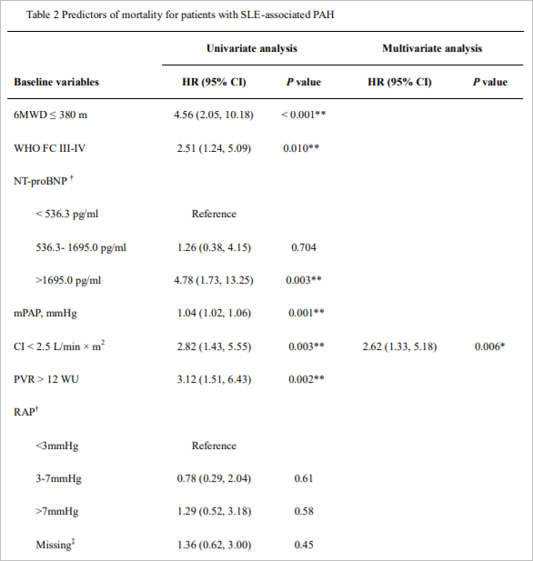
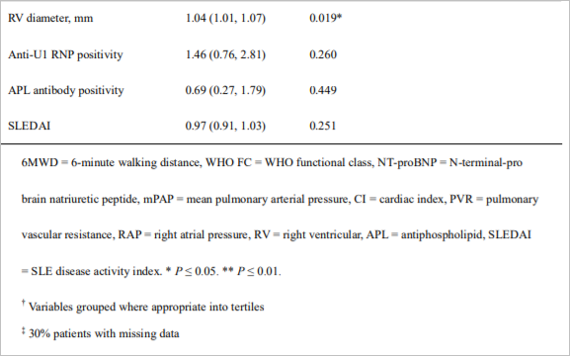

Slide 16
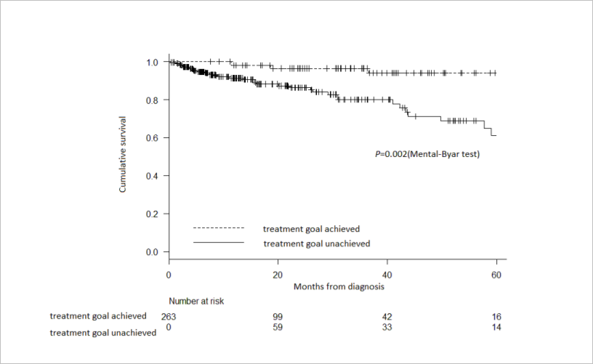
TGA was identified as a factor positively associated with survival in univariate time-dependent Cox regression
(HR = 0.18, 95% CI: 0.05 to 0.59, P = 0.005)

Slide 17
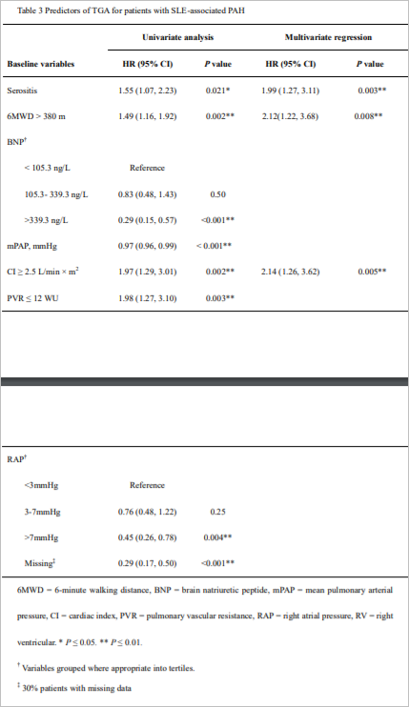
115 (43.7%) patients achieved the treatment goal
1-, 3- and 5-year TGA rates were 31.5%, 53.6% and 62.7%, respectively
The median time from baseline to TGA was 2.5 years

Slide 18
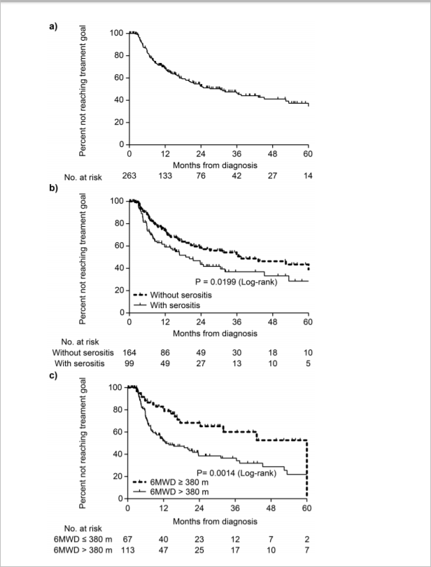

Slide 19
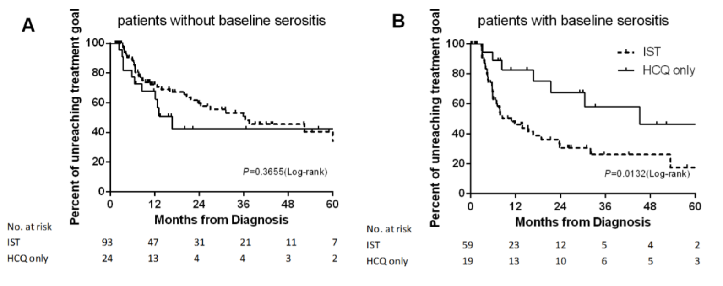
Patients with baseline serositis were more likely to reach TGA after IST compared to non-IST recipients
HR = 2.47, 95% CI: 1.21 to 4.17, P = 0.013

Slide 20
How precise are the estimates of likelihood?

Slide 21
How can I apply the results to patient care?
Were the study patients and their management similar to those in my practice?
Was follow up sufficiently long?
  Followed up for 5 years

Slide 22
Can I use the results in management of patients in management of patients in my practice?

