Slide 1
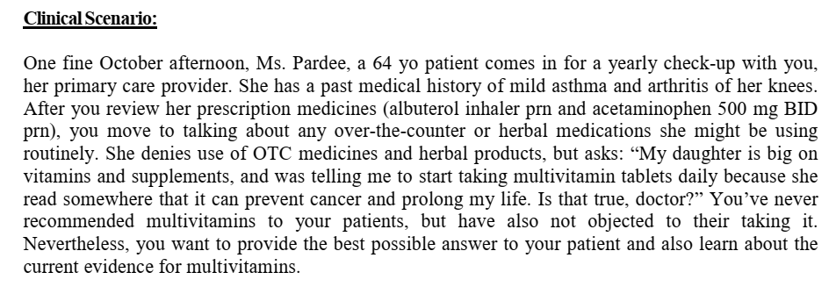

Slide 2
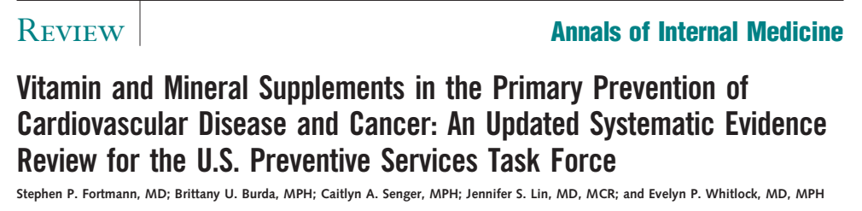

Slide 3
Background
Vitamins and minerals are commonly used as dietary supplements to promote health and prevent chronic diseases
Cancer and CVD have several shared risk factors, including inflammation, oxidative stress, and methionine metabolism.

Slide 4
Research question
Does vitamin and mineral supplements in community-dwelling, nutrient-sufficient adults effect primary prevention of cardiovascular disease (CVD) and cancer.

Slide 5
Participants : Nutritionally sufficient adults with no chronic diseases
Intervention : Vitamin and mineral supplements
Control : Placebo
Outcome :
Composite of CVD and cancer
Notes:
Moderate renal impairment defined as CrCl or eGFR between 15 and 60 mL/min (CKD stage G3 and G4). Non-valvular AF was diagnosed with electrocardiography. Patients were excluded if they had valvular AF, recent stroke, and conditions associated with an increased risk for bleeding.

Slide 6
Was the search for relevant studies exhaustive?
MEDLINE, Embase, Cochrane Central Register of Controlled Trials, Cochrane Database of Systematic Reviews, and Database of Abstracts of Reviews of Effects from January 2005
through 29 January 2013
Inclusion criteria – studies with
  Nutrient-sufficient adults who had no chronic disease and were performed in countries with a Human Development Index of ‘very high’
  Supplement doses to be lower than the upper tolerable limit set by the U.S. Food and Nutrition Board
  RCT – primary or secondary prevention
  Observational studies

Slide 7
One investigator abstracted study design information, baseline population characteristics, intervention details, disease incidence, mortality, and harms data from all included studies into a standardized evidence table
Two investigators independently assessed each study’s quality as “good,” “fair,” or “poor” by using predefined quality criteria based on USPSTF methods
Second investigator checked these data for accuracy.
All poor studies were excluded

Slide 8
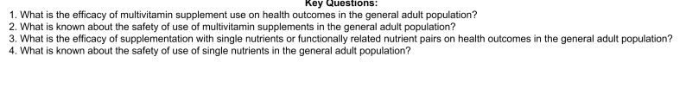
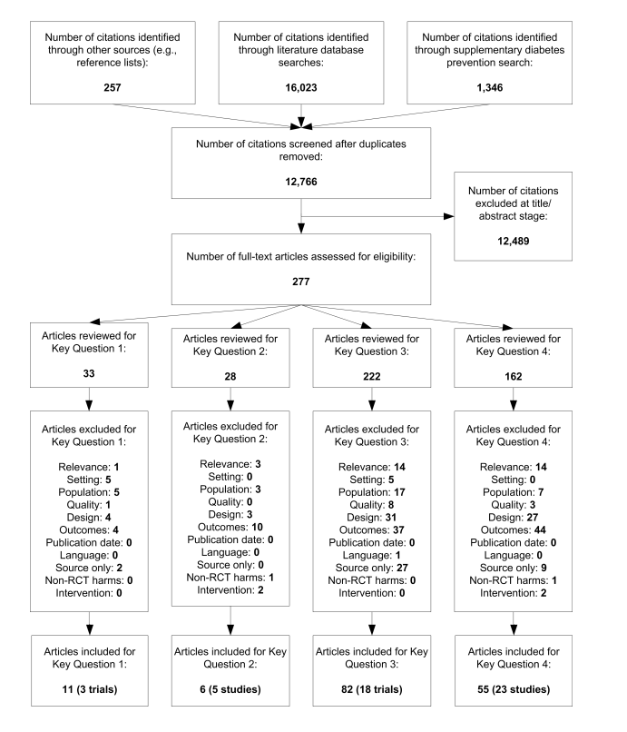

Slide 9
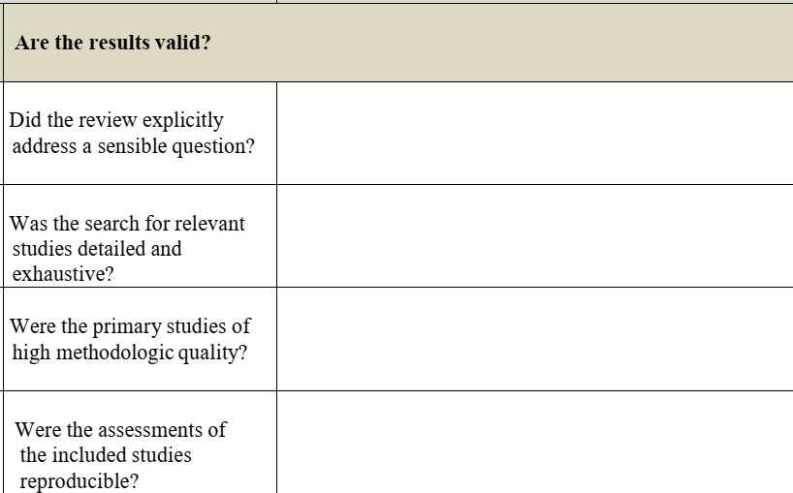
Yes
Yes, unpublished reports ?
Yes
Yes

Slide 10
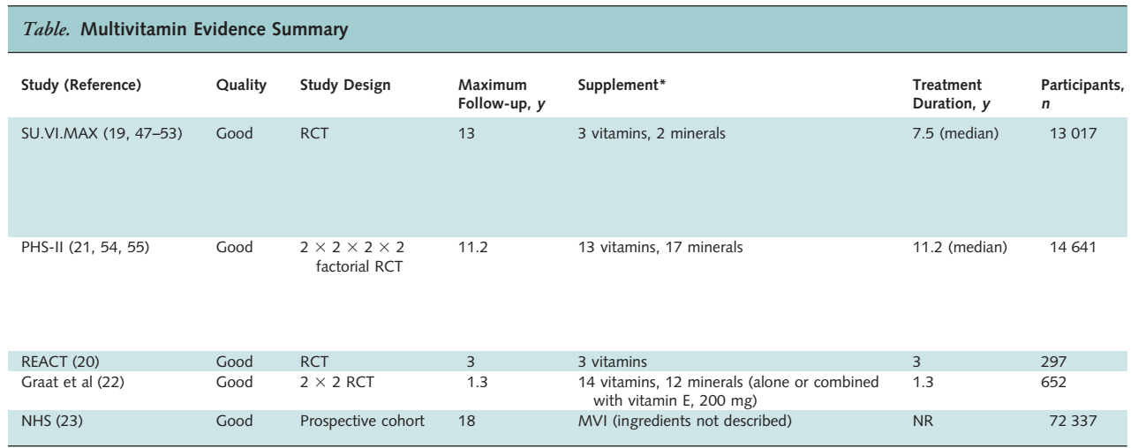

Slide 11
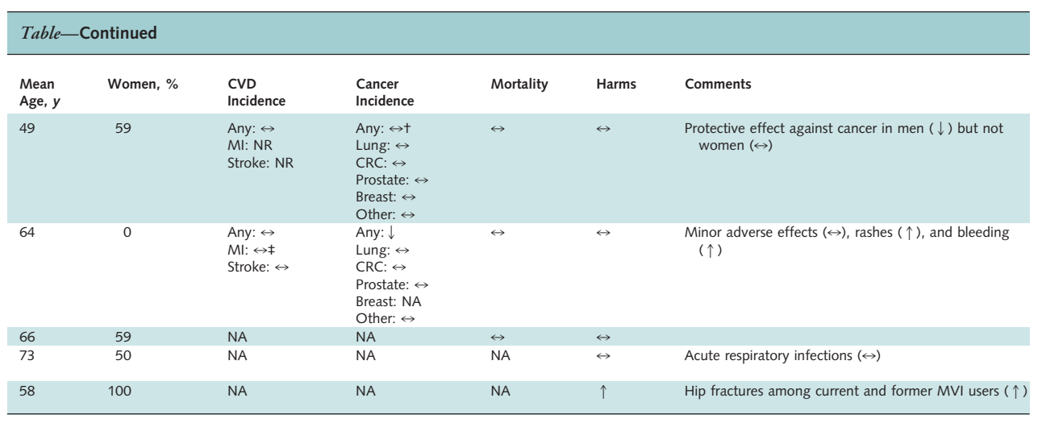

Slide 12
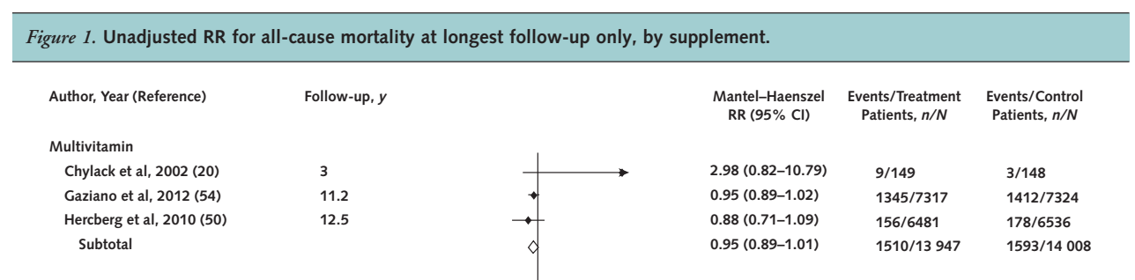

Slide 13
Results

Slide 14
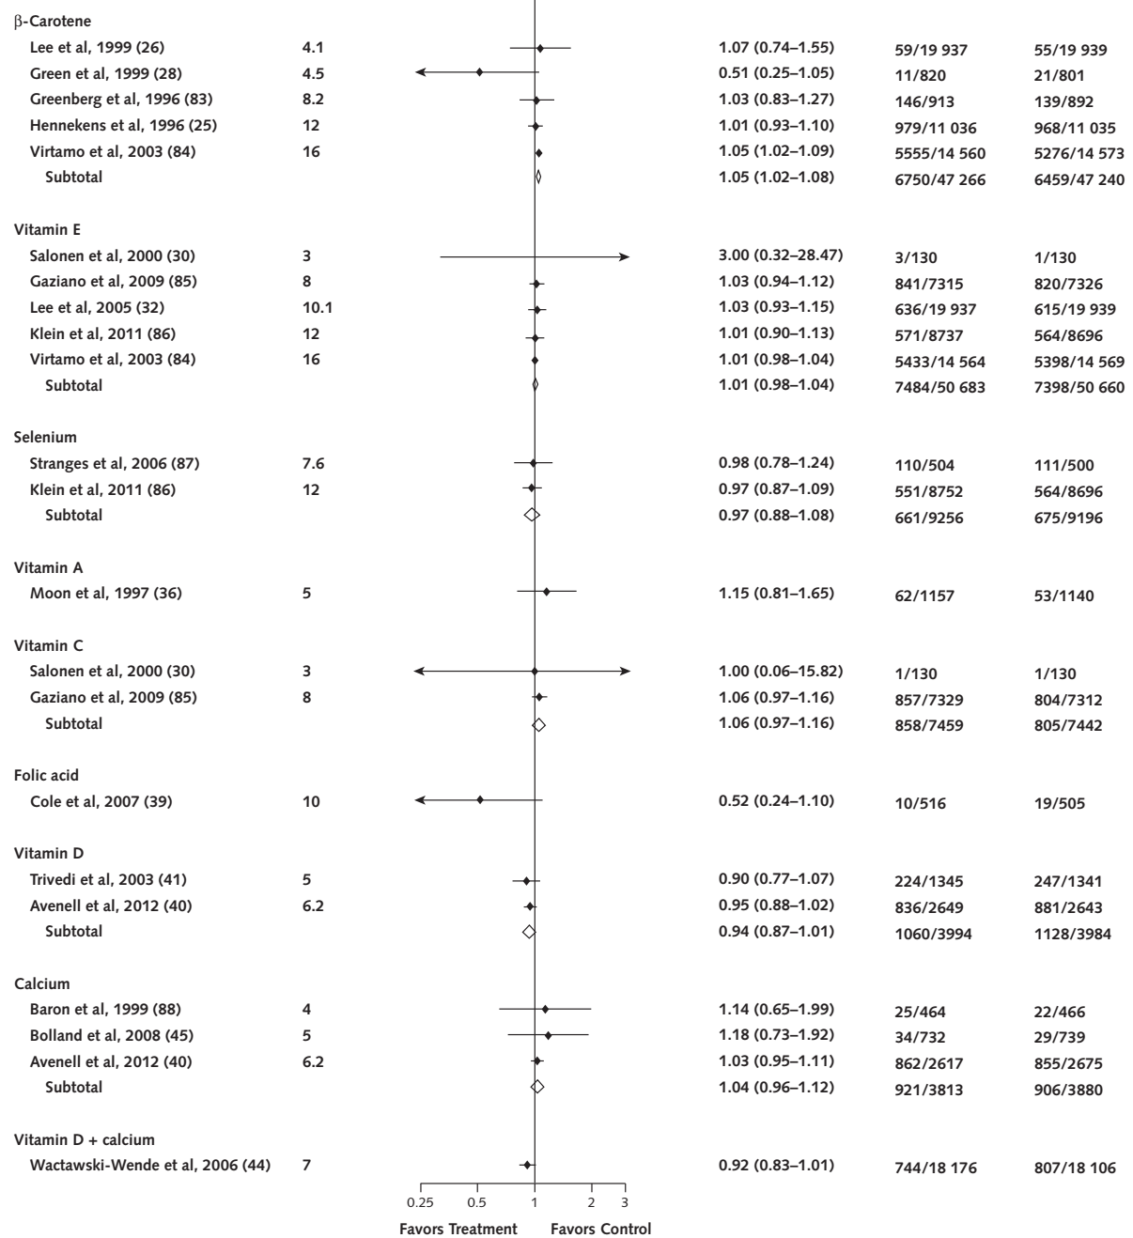
ER- CR = 0.006
NNH = 164

Slide 15
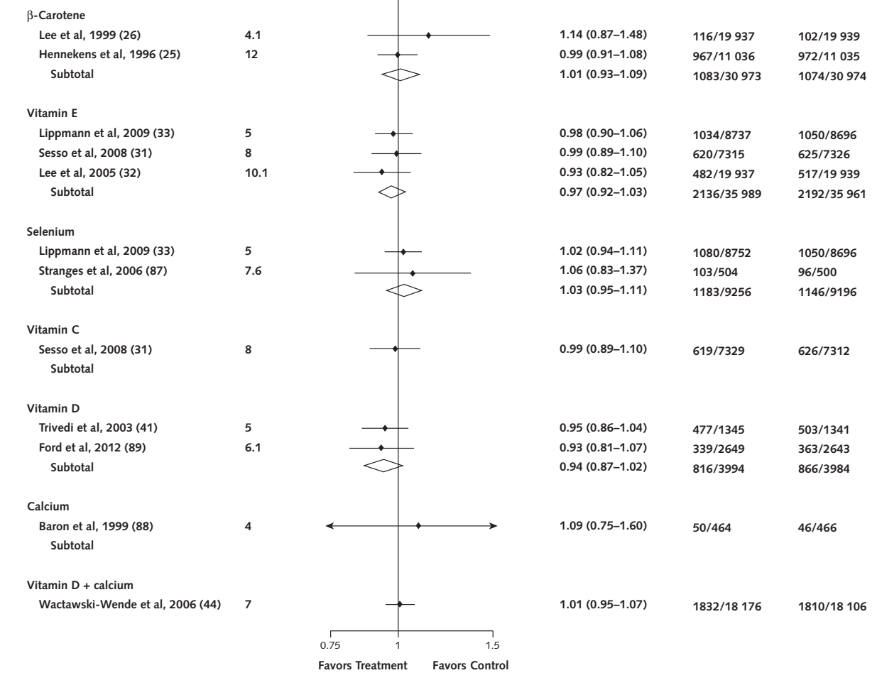

Slide 16
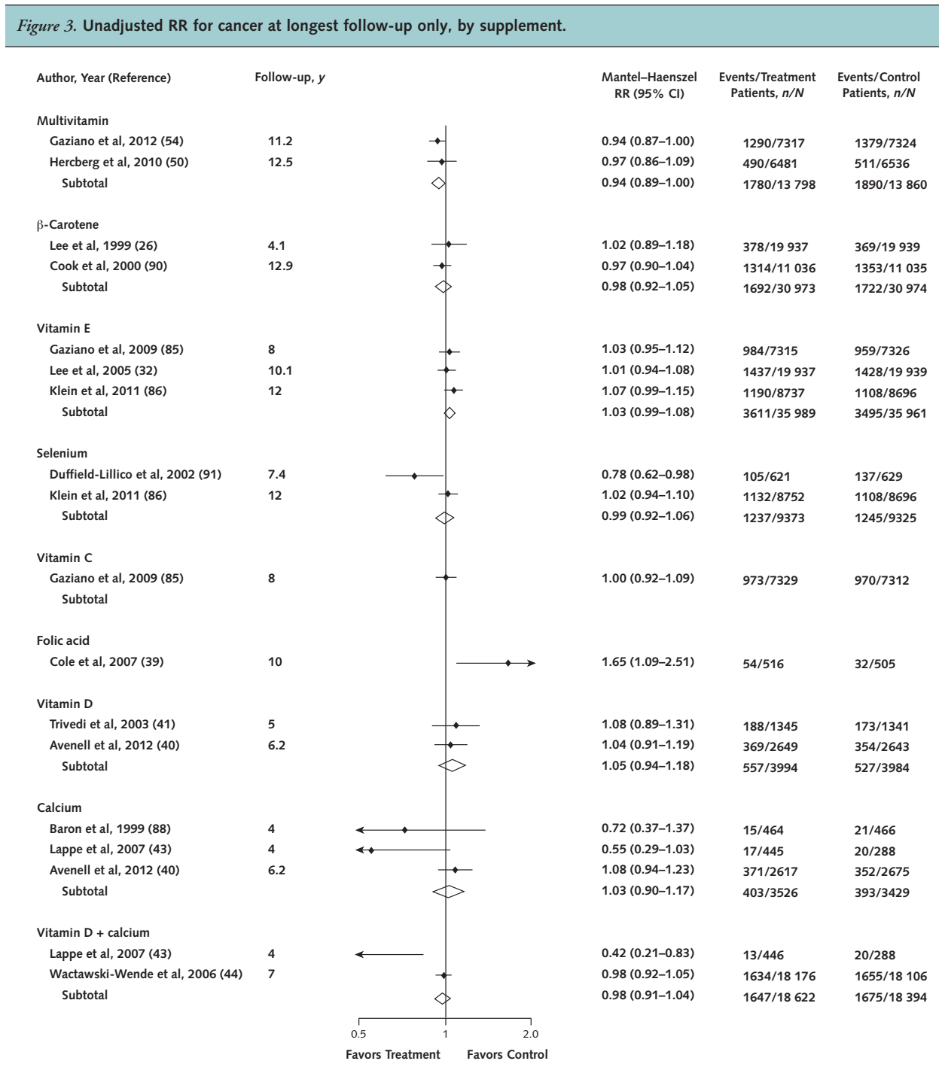

Slide 17
How precise are the results?
  Narrow confidence intervals

Slide 18
Were the results similar from study to study
  No I² , visually overlap of CIs present

Slide 19
How can I best interpret the results to apply them to care of my patients?
  Racial differences, Countries with Human development Index, baseline nutritional status may be lower
Were all patient important outcomes considered?
  Yes

Slide 20
Are the benefits worth the costs and potential risks
  No benefit demonstrated

Slide 21
Conclusion
In nutrient sufficient adults without co morbid illnesses, there is no benefit or harm with multivitamin supplements

