Slide 1
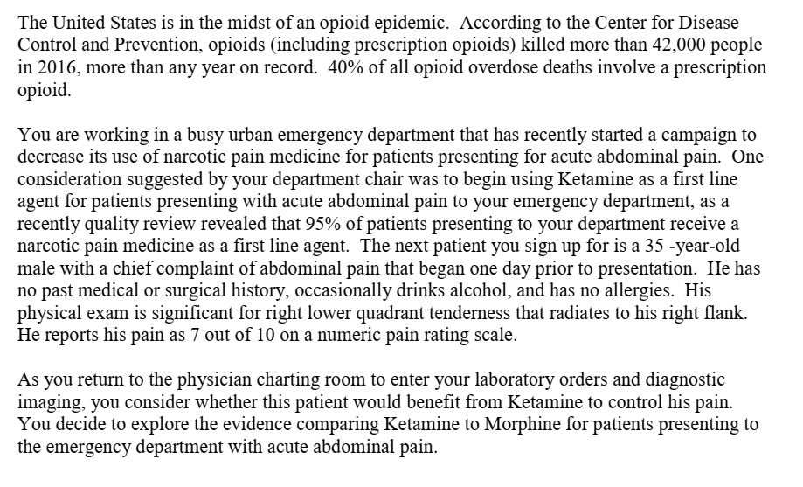

Slide 2
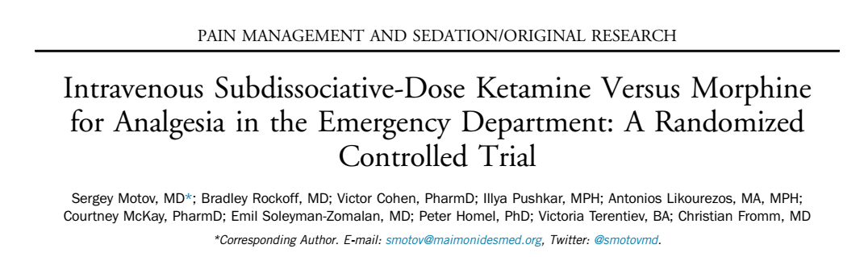

Slide 3
Background
Ketamine is a noncompetitive NMDA and glutamate receptor antagonist that decreases central sensitization
Subdissociative doses (0.1 to 0.6 mg/kg; most commonly 0.3 mg/kg) maintains potent analgesic and amnestic effects that are accompanied by preservation of protective airwayreflexes, spontaneous respiration, and cardiopulmonary stability
Opioid-sparing effects and to be effective in providing analgesia for pain that is poorly controlled by opioids in a variety of settings outside of the ED
Two retrospective studies demonstrated that subdissociative-dose ketamine in the dosing range of 0.1 to 0.6 mg/kg, when administered as an adjunct to opioid analgesics, significantly reduced pain
reported by patients in the ED
Notes:
Absence of prior M. tuberculosis infection or sensitization with environmental mycobacteria is associated with higher efficacy of BCG against pulmonary tuberculosis and possibly against miliary and meningeal tuberculosis. Evaluations of new tuberculosis vaccines should account for the possibility that prior infection may mask or block their effects.
Protection appeared greatest in children stringently tuberculin tested, to try to exclude prior infection with Mycobacterium tuberculosis or sensitization to environmental mycobacteria (rate ratio [RR], 0.26; 95% confidence interval [CI], .18-.37), or infants (RR, 0.41; 95% CI, .29-.58).
Protection against meningeal and miliary tuberculosis was also high in infants (RR, 0.1; 95% CI, .01-.77) and children stringently tuberculin tested (RR, 0.08; 95% CI, .03-.25).

Slide 4
Hypothesis
Ketamine administered as a single agent at 0.3 mg/kg will provide relief similar to that of a standard dose of morphine at 0.1 mg/kg for acute moderate to severe pain in the ED setting

Slide 5
Study design
Double blinded parallel randomized control trial

Slide 6
PICOT STATEMENT
P – Emergency Department patients with acute abdominal pain
I – IV Ketamine
C –IV Morphine
O –
  Comparative reduction of numeric rating scale pain scores between recipients of
  ketamine and morphine at 30 minutes
  Need for rescue analgesia at either 30 or 60 minutes

Slide 7
Was the study population clearly defined?
INCLUSION CRITERIA
Age - 18 to 55 years
Acute abdominal, flank, back, or musculoskeletal pain score of 5 or more on a standard 11- point (0 to 10) numeric rating scale
Requiring opioid analgesia, as determined by the treating attending
physician

Slide 8
Was the study population clearly defined?
EXCLUSION CRITERIA:
Pregnancy, breast-feeding,
Altered mental status
Allergy to morphine or ketamine
Weight less than 46 kg or greater than 115 kg
Unstable vital signs
Acute head or eye injury, seizure, intracranial hypertension
Chronic pain, renal or hepatic insufficiency,
Alcohol or drug abuse, psychiatric illness, or recent (4 hours before) opioid use

Slide 9
Were the outcome measures clearly defined?
YES
The primary outcome - comparative reduction of numeric rating scale pain scores between recipients of ketamine and morphine at 30 minutes
Secondary Outcomes
Need for rescue analgesia at either 30 or 60 minutes.
Vital sign changes and adverse events

Slide 10
Methodology
0.3 mg/kg of ketamine or o.1 mg/kg of morphine given to patients with pain scores more than 5
Pain scores, vital signs, and adverse effects recorded at 15, 30, 60, 90, and 120 minutes
fentanyl 1 ug/kg was administered as a rescue analgesic

Slide 11
Were adequate number of people included in the study?
To detect a difference of at least 1.3 change at 30 minutes
sample size of 90 (45 in each group)
83% power
α = 0.05
Notes:
Assuming an SD of 3.0
Repeated-measures ANOVA with a sample size of 90 (45 in each group)

Slide 12
Were the patients randomized?
Yes
Block randomization - every 10 participants upto 90
Allocation was concealed

Slide 13
To what extent was the study blinded
Double blinded

Slide 14
Did the intervention and control groups start with the same prognosis?

Slide 15
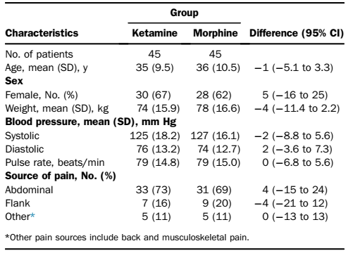


Slide 16
Mostly similar baseline characters
Randomisation achieved well matched characters

Slide 17
Were the groups prognostically balanced at the study completion?

Slide 18
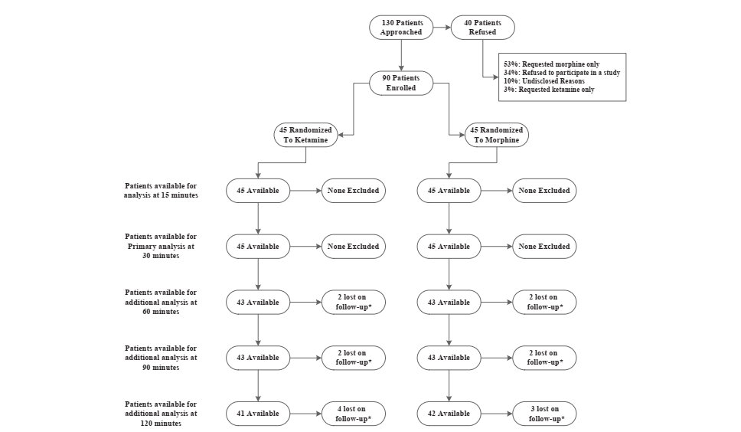

Slide 19
Was the follow up complete?
Yes the follow up was complete

Slide 20
Were the patients analyzed in the groups to which they were randomized?
Yes
Intention to treat analysis

Slide 21
Was the study stopped prematurely?
No

Slide 22
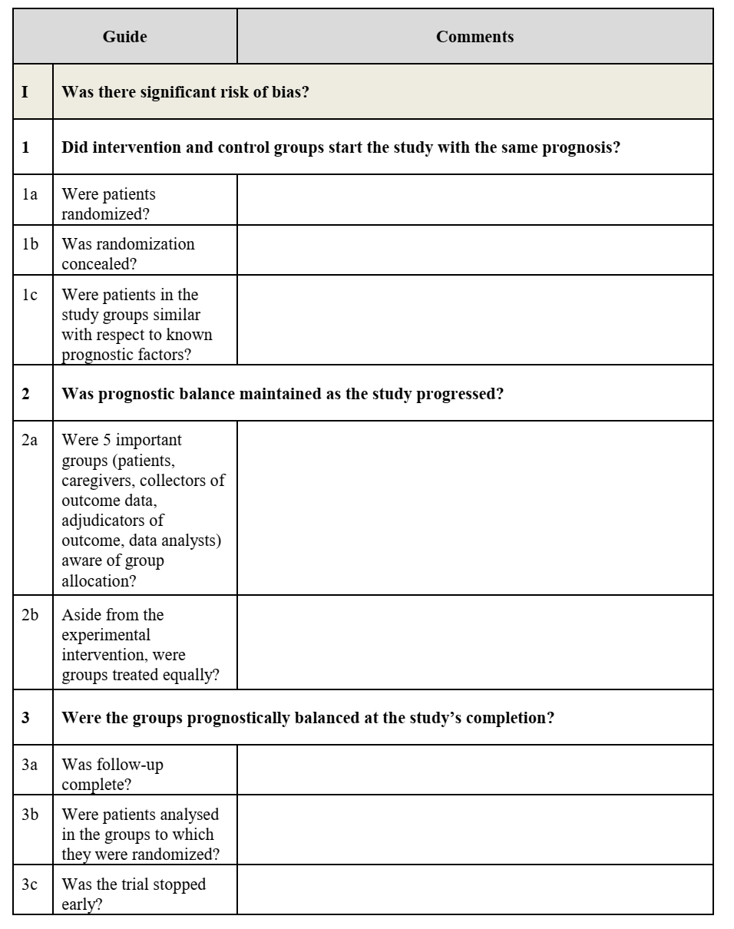
No
Yes
Yes
Yes
Only statistician, pharmacist and research manager were aware of group allocation
Yes
Yes
Yes
No

Slide 23
Validity of the study
Study population: well defined
Outcomes: clearly defined
Randomization: adequate
Blinding: Adequate
Sample size calculation: adequate
Intention treat analysis: done
Baseline characteristics: well matched

Slide 24
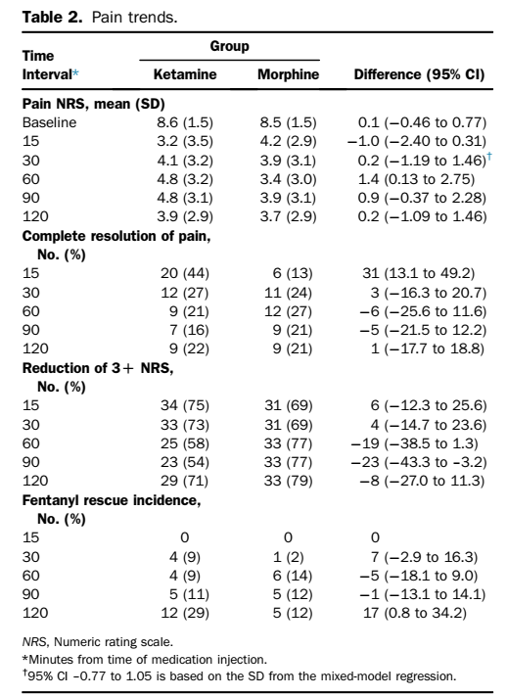
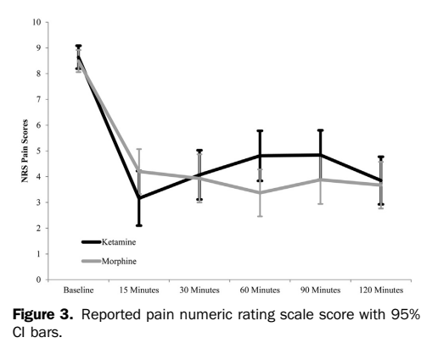
RESULTS

Slide 25
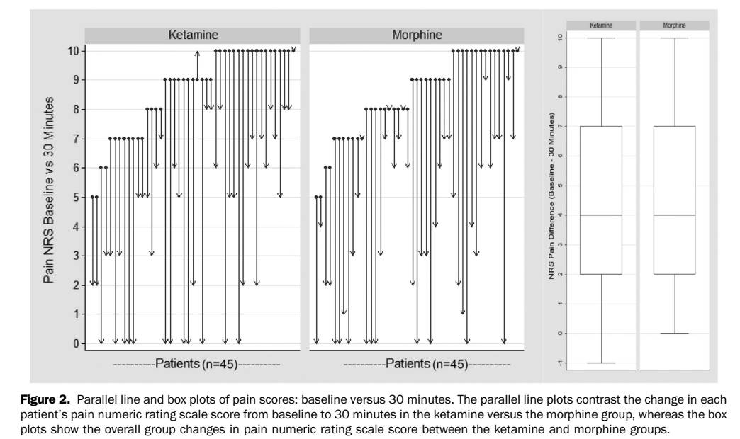

Slide 26
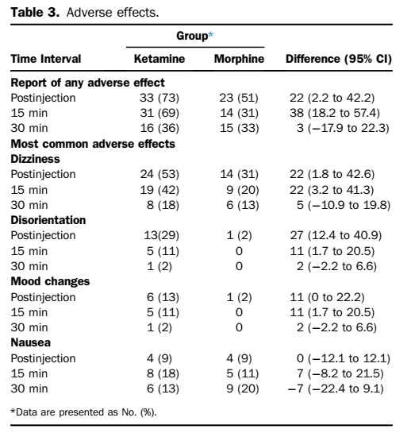
Adverse effects
Ketamine recipients experienced a statistically significant increase in adverse effects immediately postinjection and at the 15-minute interval
dizziness and disorientation

Slide 27
How can I apply the Result to patient care?
Ketamine given at sub dissocative doses has similar analgesic effects as compared with morphine and has no serious adverse effects.

Slide 28
Were the Study Patients similar to my patients in practice?
Predominantly similar – but lesser musculoskeletal pain /trauma

Slide 29
CONCLUSIONS
Ketamine given at sub dissocative doses has similar analgesic effects as compared with morphine and has no serious adverse effects.

Slide 30
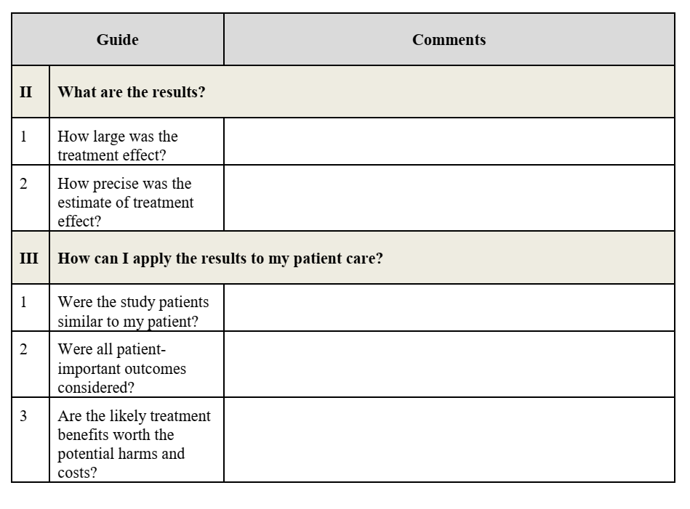
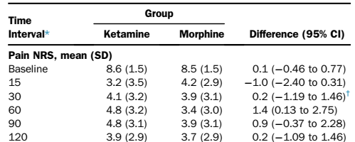
Difference in mean pain score at 30 min - (4.1 – 3.9).
Not statistically significant
No
More trauma/ MSK pain
Yes
Yes

