Slide 1
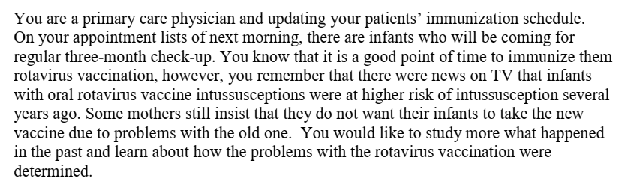

Slide 2
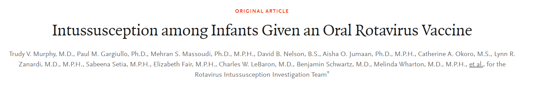
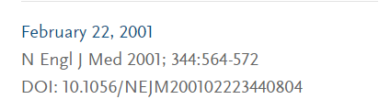

Slide 3
Background
Rotavirus causes severe gastroenteritis and affects most infants
In October 1998, distribution of RRV-TV began.
Between this time and May 27, 1999, the Vaccine Adverse Event Reporting System received nine reports of intussusception among infants given RRV-TV, as compared with only four reports overall
Temporary suspension of vaccination against rotavirus and the initiation of a case–control investigation

Slide 4
Research question
Are infants receiving oral tetravalent rhesus–human reassortant rotavirus vaccine at an increased risk of developing intussusception

Slide 5
Methodology
Case control study
Population - infants atleast 1 but less than 12 months old
Cases - those with a discharge diagnosis of intussusception
Controls Infants born in the same hospital in which the
infants with intussusception had been born, with whom they were
matched according to age
  1:4 ratio

Slide 6
Cases
  Inclusion criteria
  Age - 1-12 months
  Intussusception confirmed by radiologic procedure, at surgery, or at autopsy
  Exclusion criteria
  if the family did not reside in the United States
Controls
  Controls were infants born in the same hospital in which the infants with intussusception had been born
  matching according to birth hospital and age
  Exclusion criteria
  Adopted infants,
  Hopitalisation since birth,
  Second-born of a pair of twins
  Parents or guardians did not live in the United States.

Slide 7
Medical history , hospital records were analysed for vaccination dates
parents or guardians interviewed for demographic data, dietary practices
Medical providers interviewed about conditions associated with intussusception and on symptoms of illness at visits within two weeks before the reference date
Matched odds ratios for intussusception during predefined risk periods within the first 21 days after vaccination (0 to 2, 3 to 14, 3 to 7, 8 to 14, and 15 to 21 days after vaccination

Slide 8
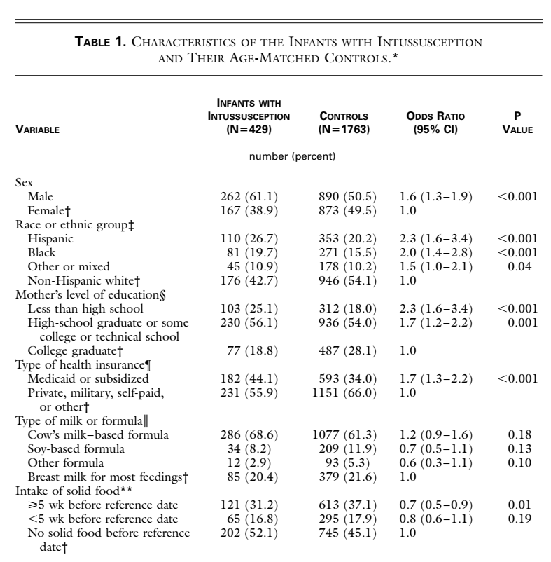

Slide 9
Did the investigators demonstrate similarity with respect to all known determinants of outcome No Did they adjust for differences in the analysis? Yes

Slide 10
Were exposed patients equally likely to be identified in the two groups? Yes

Slide 11
Were the outcomes and exposures measured in the same way in the groups being compared Yes
Was the follow-up sufficiently complete? Yes

Slide 12
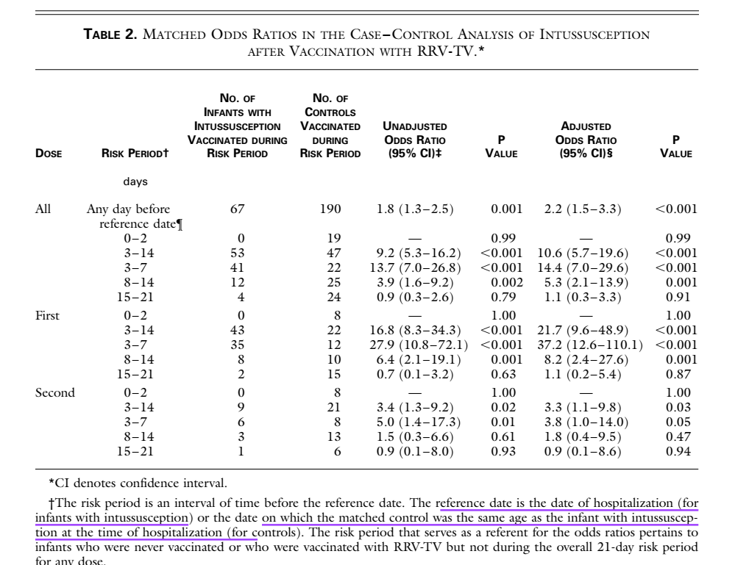

Slide 13
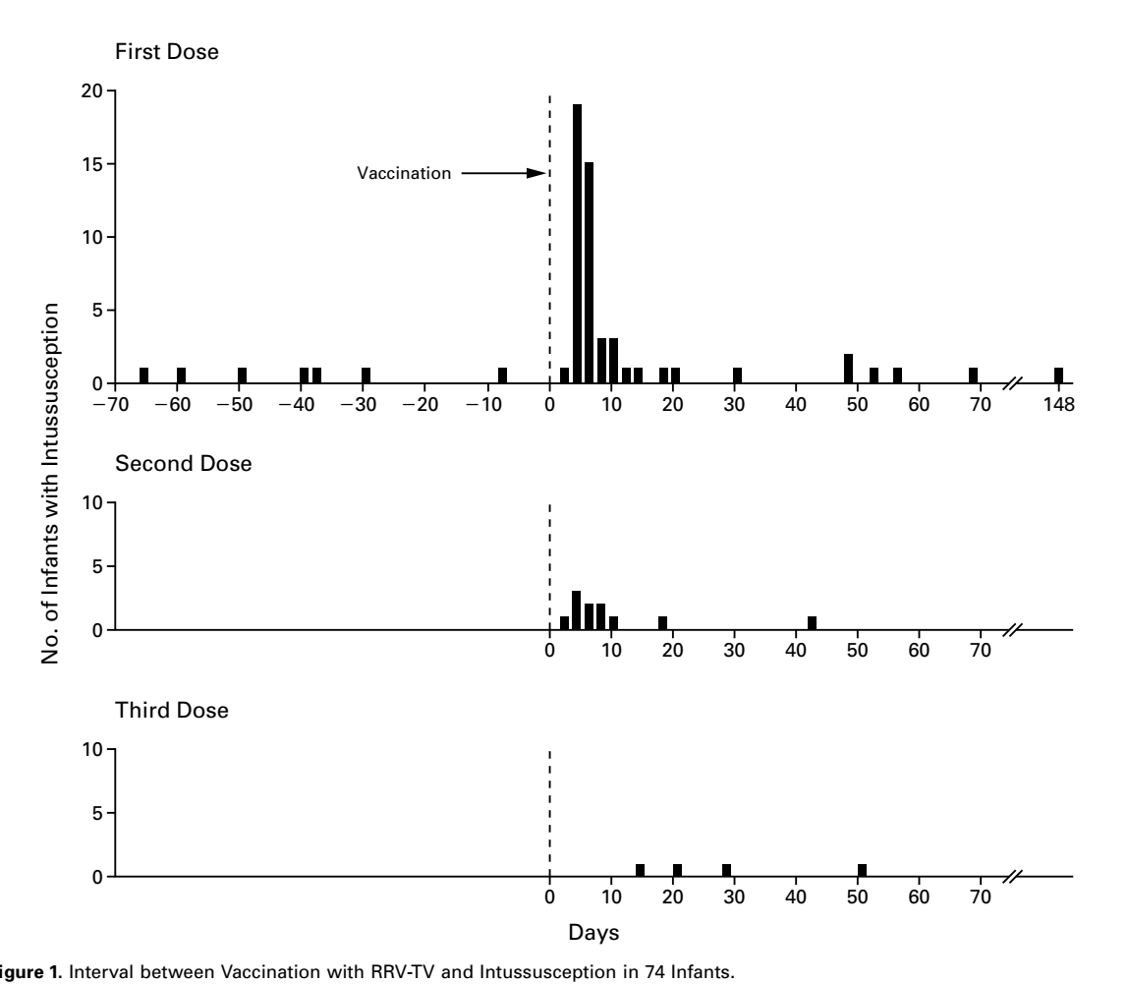

Slide 14
How strong is the association between exposure outcomes?
How precise is the estimate of risk?

Slide 16
Conclusion
Oral tetravalent rhesus–human reassortant rotavirus vaccine was associated with an increased risk of developing intussusception

Slide 17
How can I apply the results to patient care?
Were the study patients similar to my patient?
  Higher and more severe rotaviral infections in developing countries
  Benefits may outweigh the risks
Was the duration of follow up complete?
  Yes

Slide 18
1291 background cases of intussusception would occur annually in the absence of RRV-TV vaccination.
According to the results of our adjusted case–control analysis, if a national program of vaccination with RRV-TV were fully implemented,
361 cases of intussusception attributable to RRV-TV would occur in addition to the 1291 background cases, for an increase of 28.0 percent.
According to the results of our case-series analysis, 732 additional cases
attributable to intussusception would occur, for an increase of 56.7 percent.

