Slide 1
Clinical Scenario
Ms. Ling is a 69-year-old patient with COPD and hypertension who was admitted to the intensive care unit (ICU) following very severe bronchospasm intra-operatively when she was undergoing a laparascopic cholecystectomy.
Her bronchospasm improved only marginally with beta-agonist treatment so she remained intubated and mechanically ventilated.
While diagnosing the root cause of this intraoperative event, and while waiting for signs and symptoms to resolve, life support was anticipated for 2 or 3 further days in the ICU. On day 1 post operatively, the residents on morning rounds wondered what type of heparin she should receive for thromboprophylaxis.

Slide 2
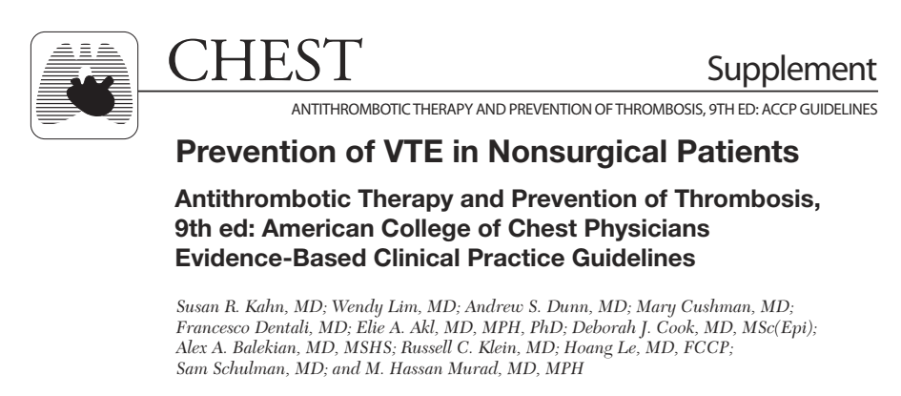
Rachana Shenoy
20/12/2018

Slide 3
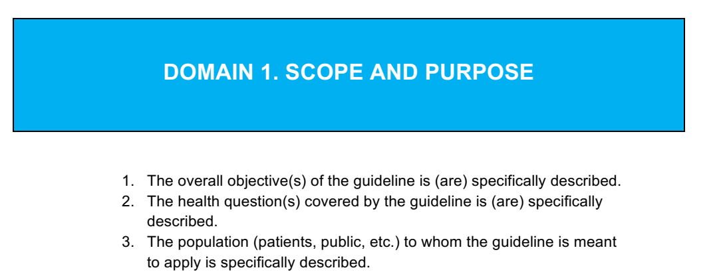

Slide 4
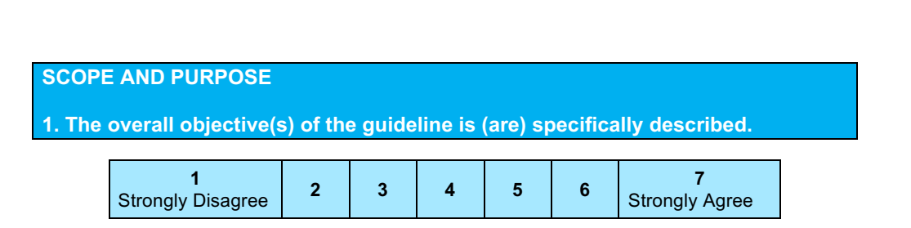
Prevention of VTE in nonsurgical patients- use of antithrombotic therapy and prevention of thrombosis
Score- 7

Slide 5
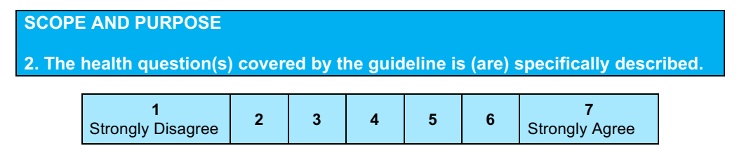
Target population was defined reasonably well.
The drug to be used was mentioned- name, frequency.
Context explained
Score- 5

Slide 6
Population
(1) hospitalized acutely ill medical patients
(2) critically ill patients
(3) patients with cancer receiving cancer treatment in the outpatient setting
(4) patients with cancer with indwelling
central venous catheters (CVCs)
(5) Chronically immobilized patients
(6) long-distance travelers
(7) asymptomatic persons with thrombophilia.

Slide 7
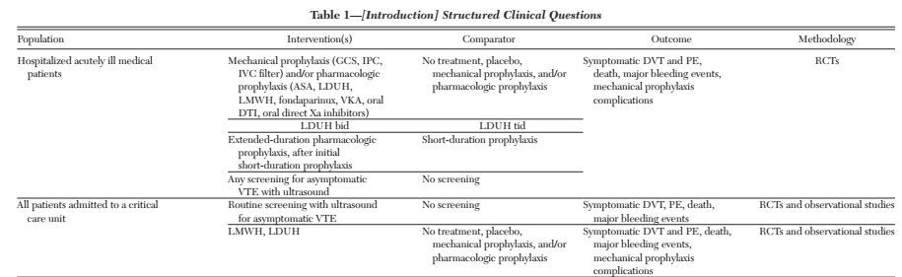

Slide 8
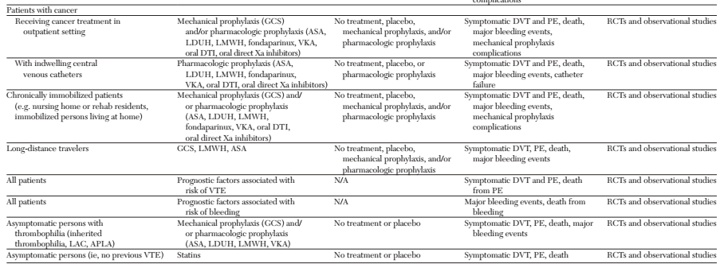

Slide 9
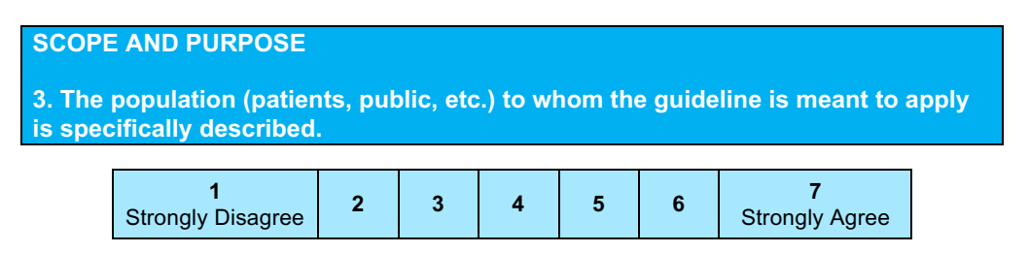
Score- 5
In patients with cancer- ? stage, duration of CVC
How was asymptomatic thrombophilia diagnosed in the first place?
Comorbidities not mentioned.

Slide 10
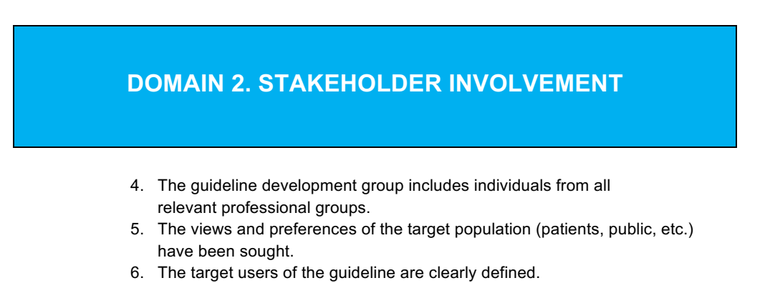

Slide 11
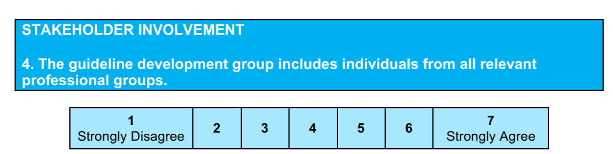
Acknowledgements are listed at the end of the article.
However, their role in the guideline development is not mentioned.
Score- 6

Slide 12
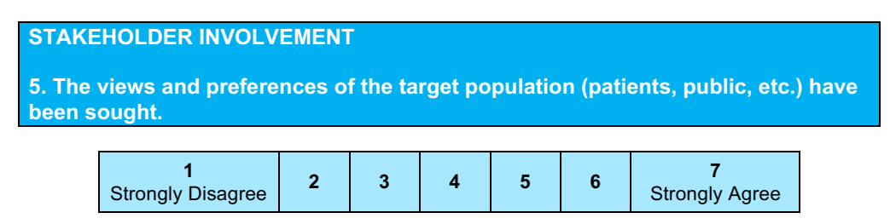

They used a values-rating exercise: Feeling thermometer from 0 (death) to 100 (full health) for the year in which the event occurred.
Median ratings - outcomes of symptomatic DVT, PE, catheter thrombosis, severe GI bleeding (80, 75, 80, 75), for intracranial bleeding was 40.
1:1 ratio of symptomatic VTE to major extracranial bleeding and 2.5:1 ratio of symptomatic VTE to intracranial bleeding for tradeoffs.
Score- 4

Slide 13
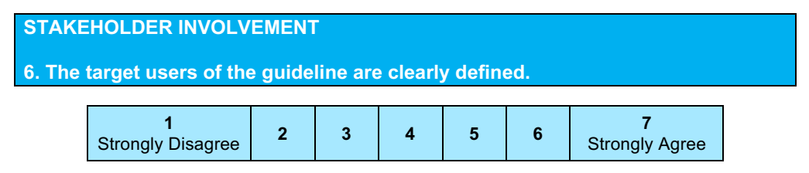
No, there is a disclaimer that says it is only to guide clinical decisions.
Score- 3

Slide 14
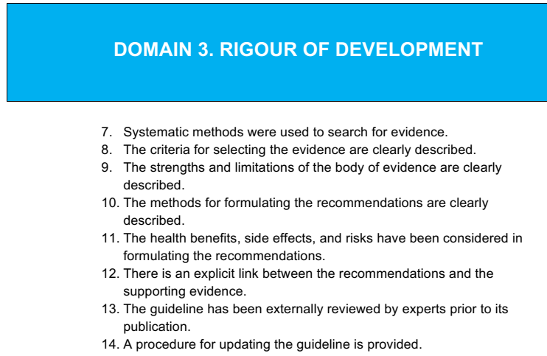

Slide 15
Methods
Literature searches were conducted
Quality of evidence was tested using GRADE
The panel considered the balance of benefi ts and harm, patients’ values and preferences, and patients’ context and resources to develop weak or strong recommendations.

Slide 16
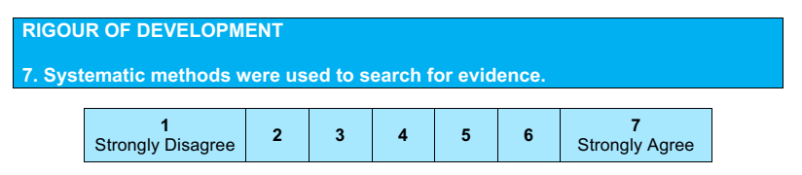
The name of the database, time period of search, etc is not mentioned.
However, in the appendix, all the different types of studies with their PICOT are mentioned.
Score- 5

Slide 17
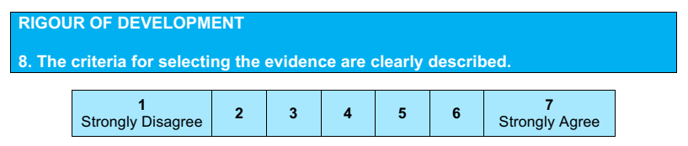
Inclusion criteria have been mentioned.
Score- 6

Slide 18
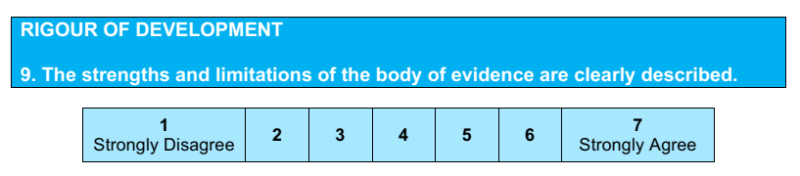
The panelists of the four articles dealing with VTE prevention faced challenges in finding data on absolute treatment effect and developed several possible approaches for estimating the effect of prophylaxis on the incidence of symptomatic VTE events.
However, they have used the GRADE strategy to assess and describe the risk of bias.
Score- 6

Slide 19
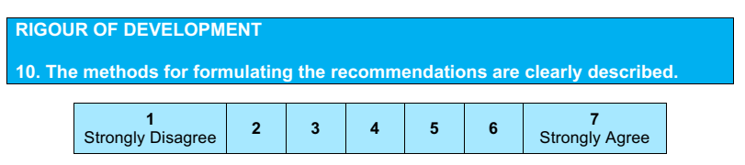
The guideline development steps and method of voting system was not mentioned.
Score- 4

Slide 20
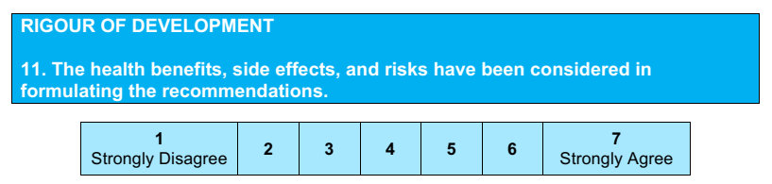
Estimation of risk is mentioned under methodology.
Data on benefit vs harm is mentioned in the supplementary material against each study.
Outcomes, balancing trade-offs have been looked at.
Recommendations reflecting both beneficial and adverse considerations have been made.
Score- 7

Slide 21
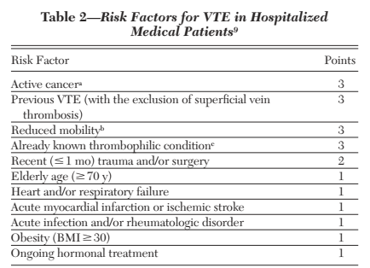
Risk estimation
Baseline Risk in Hospitalized Medical Patients
Stratified into low and high risk
RAM used – however, lack of prospective validation, applicability only to high-risk subgroups, inadequate follow-up time, and excessive complexity are the setbacks of most RAM.

Slide 22
Baseline Risk in Critically Ill Patients:
Indirectly done using data from previous trials to report events, assess relative risk, etc.

Slide 23
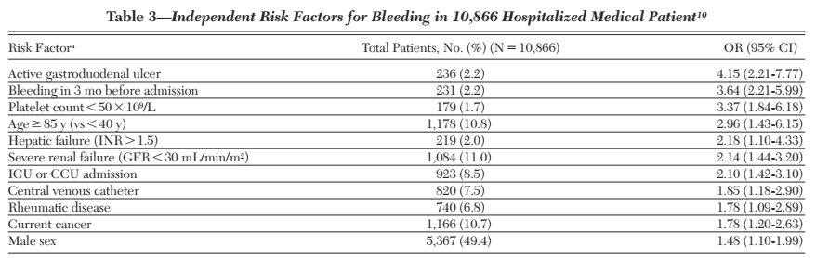
Risk Factors for Bleeding in Hospitalized Medical Patients

Slide 24
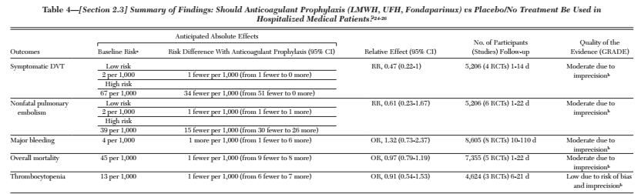

Slide 25
Outcomes of interest
Symptomatic DVT, PE, death from PE, major bleeding, heparin-induced thrombocytopenia (HIT), and mechanical thromboprophylaxis complications.
For patients with CVCs, catheter failure as an outcome was included.
Also, data on fatal bleeding (IC, GI)

Slide 26
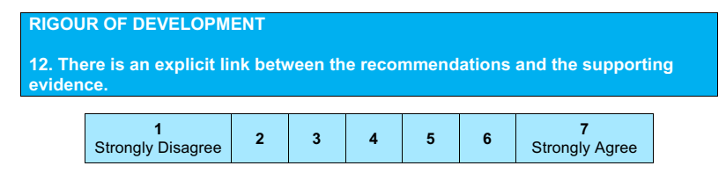
Evidence summaries are shown in the description below the recommendations.
Score- 7

Slide 27
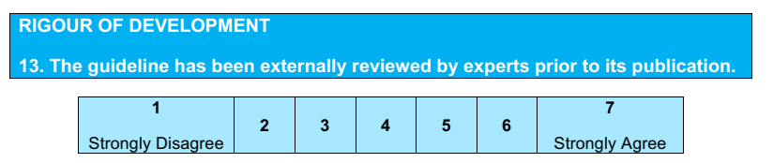
Score- 2

Slide 28
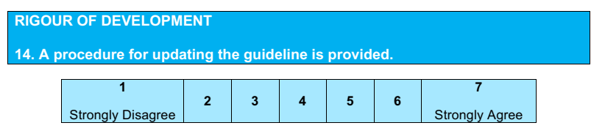
Score- 1

Slide 29
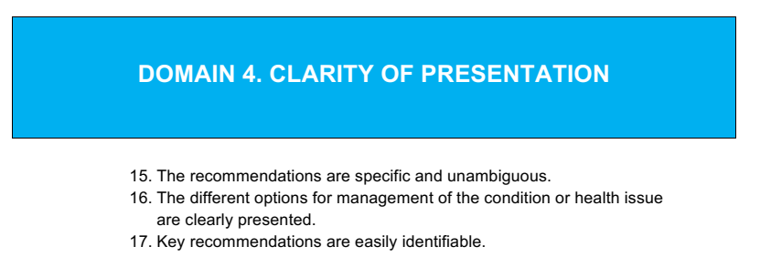

Slide 30
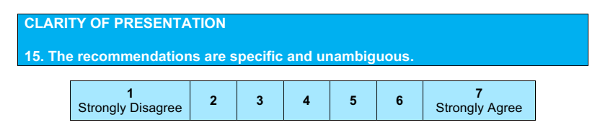
Score- 6
The dosage is not clearly mentioned.
? the nature of illness needing hospitalisation/ stratifying duration of travel not mentioned.

Slide 31
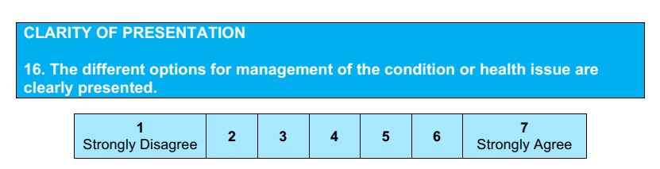
Score- 7
Different options and the scenario appropriate for these have been mentioned.

Slide 32
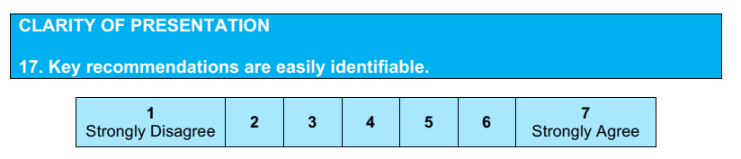
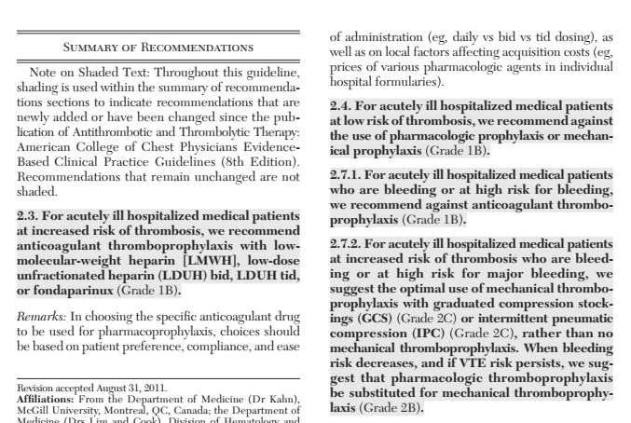
Score- 7

Slide 33
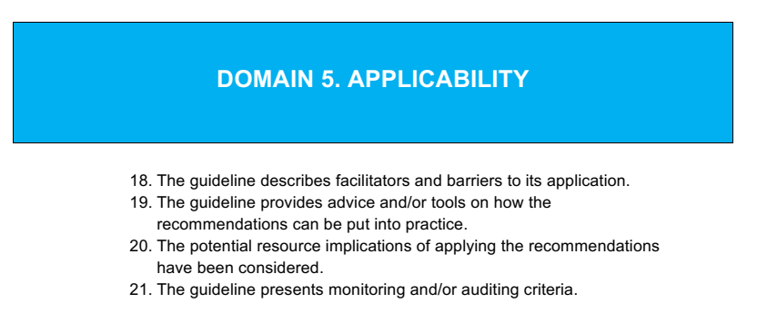

Slide 34
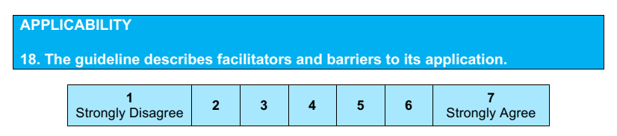
Barrier analysis has not been mentioned clearly.
Score- 3

Slide 35
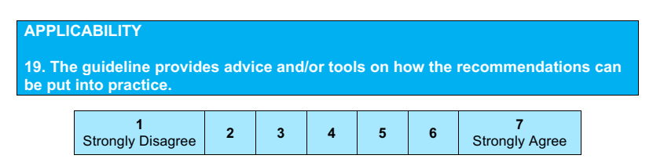
Score- 5
Lessons learned, how to apply this recommendation is not stated clearly.

Slide 36
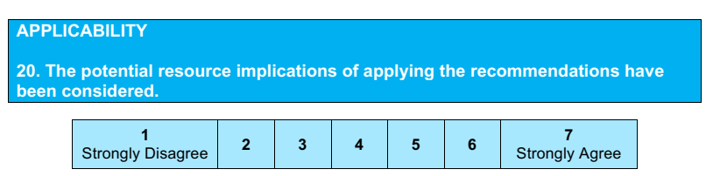
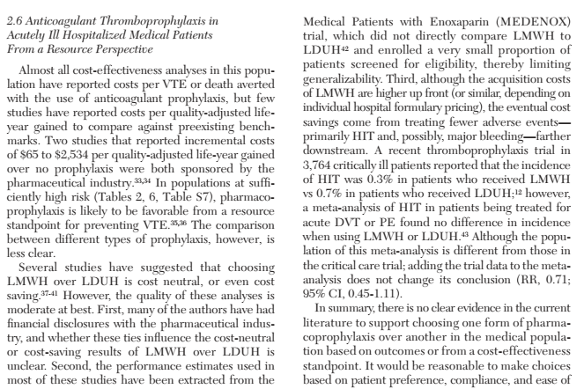
Score- 5
Cost effectiveness and resource perspectives are mentioned.

Slide 37
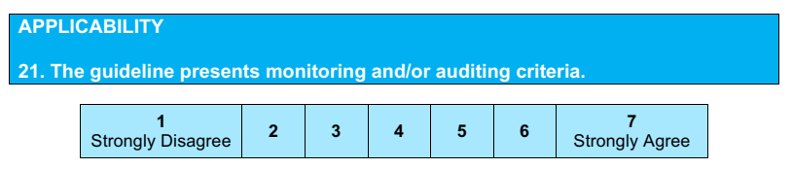
Score- 4

Slide 38
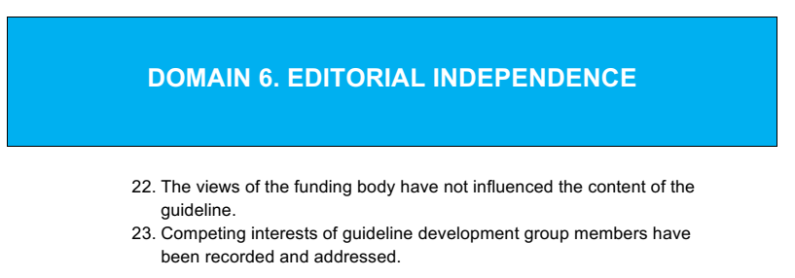

Slide 39
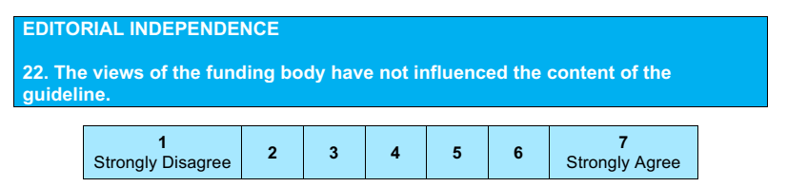

Score- 7

Slide 40
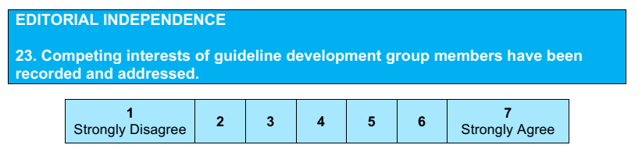
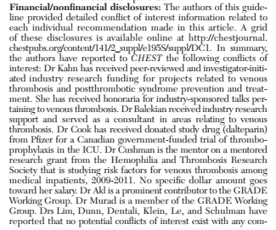
Score- 7

Slide 41


Slide 42
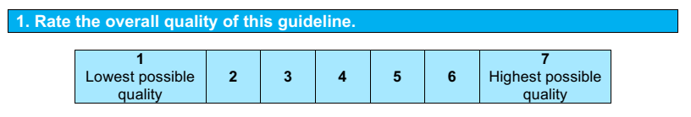
Score- 5

Slide 43
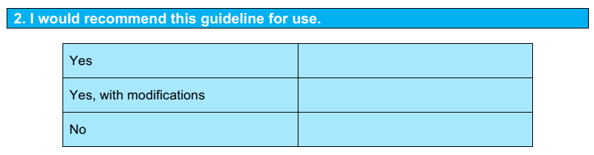
Yes, with modifications.

