Slide 1
CRITICAL APPRAISAL OF A QUALITATIVE STUDY

Slide 2
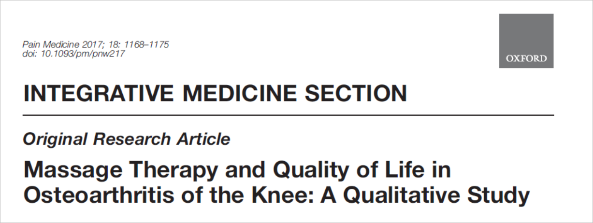
Asha Mathai

Slide 3
Background
About 10% of the adult population in the United States suffers from osteoarthritis (OA) with concomitant effects on quality of life
Standard treatment for knee OA includes pharmacotherapy, joint injections, physical therapy and assistive devices, exercise, weight management, and joint replacement surgery for end-stage disease
Massage is an intervention with a high safety and low adverse event profile when administered by trained massage therapists
Previous studies of massage as a therapeutic intervention for osteoarthritis of the knee have demonstrated the feasibility, safety, and preliminary efficacy, with increased functionality and decreased pain persisting eight weeks following treatment cessation

Slide 4
Hypothesis
Participants receiving massage would experience benefits such as stress reduction and enhanced quality of life

Slide 5
METHOD
One-on-one, semistructured interviews
Purposive sampling was used to recruit individuals who participated in the Exploring Massage Benefits for Arthritis of the Knee (EMBARK) study, a randomized clinical trial

Slide 6
P- Patients with osteoarthritis
I – Massage therapy for 8 weeks
O- Benefits such as stress reduction and enhanced quality of life
T- November 2009 and October 2010.

Slide 7
Funding source: National Center for Complementary and Integrative Health (NCCIH) at the National Institutes of Health.
The sponsors had no role in study design, data collection and analysis, decision to publish, or preparation of the manuscript.

Slide 8
INCLUSION CRITERIA
Patients with osteoarthritis
Relatively independent, ambulatory
Adherent to the intervention and study procedures
Who were open to sharing their thoughts and feelings about their experiences in a brief interview.
Individuals who participated in the Exploring Massage Benefits for Arthritis of the Knee (EMBARK) study

Slide 9
Validity Criteria

Slide 10
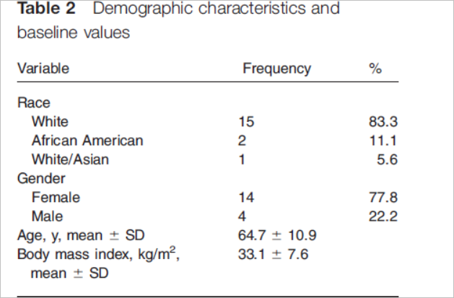
Was the choice of participants explicit and comprehensive?
2 community hospitals affiliated with academic health centers in Connecticut and New Jersey.
Patients - Eighteen adults who previously participated in a dose-finding clinical trial of massage therapy for osteoarthritis of the knee.
Only those who volunteered to take part were included

Slide 11
Was data collection sufficiently comprehensive and detailed?
Data collection was done from November 2009 and October 2010
Obtained from the previous randomised trial
An interview guide was created based on prior studies of Hsu et al.
Participants were queried on
  Pre- and post intervention experiences and perceptions of massage and osteoarthritis
  any lifestyle changes made as a result of receiving the massage intervention in the dose-finding study

Slide 12
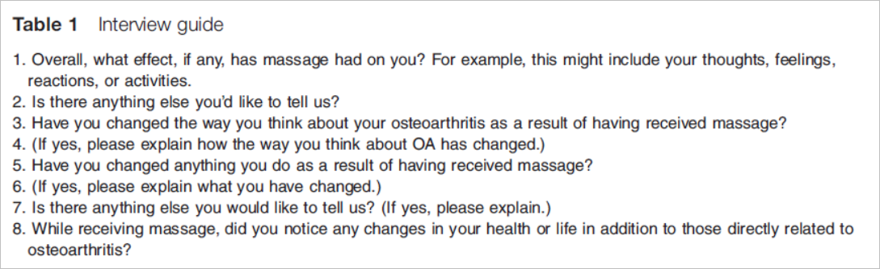
One-on-one, semistructured interviews were conducted by three investigators either in person or over the telephone
Interviews occurred at a single session, and detailed notes were taken by the investigators

Slide 13
Were the data analyzed appropriately and the findings corroborated adequately?
Transcripts were analyzed using standard methods of content analysis
After completing the interviews, transcripts were read by two investigators
Findings were categorized as potential themes
Quantitative data was analyzed using SAS software (Version 9.1, SAS Institute, Cary, NC, USA).

Slide 14
Linear mixed model regression determine between-group changes in all outcome measures and changes in domain-specific (i.e., pain, stiffness, and functionality) quantitative measures
Two-tailed alpha of less than 0.05 was considered statistically significant.
Multiple comparison test was used to determine whether means differ significantly across treatment groups.
Between-method triangulation of quantitative outcomes from the clinical trial and Participants’ statements of their attitudes, feelings, and experiences was chosen to establish external validity of qualitative data

Slide 15
Study Results

Slide 16
What are the results of the study?
Three salient themes emerged from analysis.
1) relaxation effects
2) improved quality of life associated with receiving massage therapy,
3) the accessibility of massage therapy in treating osteoarthritis

Slide 17
Theme 1: Relaxation Effects Associated with Massage Therapy
(44%) study participants stated that they felt the massage intervention was relaxing.
Theme 2: Improved Quality of Life with Massage
(44%) participants noted improved mood, mental and emotional status, outlook on life, and overall well-being.
Theme 3: The Accessibility of Massage as a Treatment for Osteoarthritis
A number of participants explained that they found benefit from massage therapy, but expressed regret that insurance coverage for massage is currently unavailable
Of the 10 participants who were asked if massage would be utilized if covered by their insurance plans, all replied in the affirmative

Slide 18
Applicability to Patient Care

Slide 19
Does the study offer helpful theoretical conclusions?
Participant responses noted an improved ability to perform activities of daily living after massage therapy

Slide 20
Does the study help me understand the context of my practice?
To some extent

Slide 21
Does this study help me understand my relationships with patients and their families?

Slide 22
Is this study results applicable in my setting?
Small sample size
No randomisation or blinding
Selection bias
Qualy
Cost analysis
Different race

