Slide 1
You are the medical director of interventional cardiology at a large Academic Medical Center and one of the interventional cardiologist has asked for an appointment with you to discuss post-interventional care of patients with acute coronary syndromes in the hospital. The cardiologist, a well-respected individual who is loved by her patients, is concerned about the cost of treating patients with expensive antiplatelet therapy, Aspirin and Clopidogrel. However, she acknowledges that there is benefit from using Aspirin plus Clopidogrel over Aspirin alone in most patients who have had a recent acute coronary event. After a brief phone conversation with her you agree that this is an important issue that needs to be further investigated and you consider developing a policy for the cardiovascular institute.
You perform a search of the literature and find a cost-utility analysis that was recently published in a highly rated journal. You send the paper to the cardiologist and arrange for a meeting with her to review the issue and appraise the paper. Using your skills you acquired during last year’s Evidence Based Clinical Practice Workshop you believe that you could make this a good learning experience for the cardiologist and together the two of you could develop a meaningful and important policy.

Slide 2
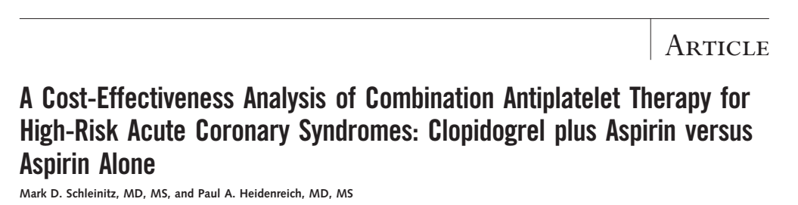
Rachana Shenoy
21/12/2018

Slide 3
Background
The Clopidogrel in Unstable Angina to Prevent Recurrent Events (CURE) trial- evidence for DAPT following an ACS.
But is giving both Clopidogrel and Aspirin cost-effective? Does the absolute risk reduction of this combination outweigh its cost?

Slide 4
Why study this?
3 variables:
Ongoing risk of the treated
population,
Durable efficacy of clopidogrel added to
aspirin, and
Bleeding risk conferred by adding clopidogrel.

Slide 5
Exclusion criteria
Prolonged ST-segment elevation, who had
undergone revascularization in the previous 3 months, who were at risk for severe bleeding or heart failure, oral anticoagulants or glycoprotein IIb/IIIa inhibitors in the preceding 3 days.

Slide 6
P- unstable angina and ECG changes or non–Q-wave myocardial infarction
I- Combination therapy with clopidogrel, 75 mg/d, plus aspirin, 325 mg/d, for 1 year, followed by aspirin monotherapy, was compared with lifelong aspirin therapy, 325mg/d.
O-Lifetime costs, life expectancy in quality adjusted life-years (QALYs), and the incremental cost-effectiveness ratio
T- Lifetime

Slide 7
Methods
Cost effective analysis was done using Markov model.
Myocardial infarction, stroke, vascular death and revascularization, intracerebral and gastrointestinal hemorrhagic events, and clopidogrel-associated TTP
Age-related mortality
Age-adjusted annual health care costs
Events classified as those that changed quality of life, annual costs or probability of future events and those that caused temporary decrements in quality of life.

Slide 8
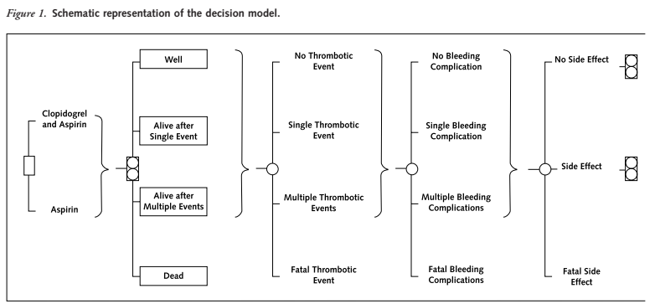

Slide 9
Costs
Costs for each event and for chronic care of
disabled patients were derived from literature.
For cost of drugs, average wholesale price in the US was used.
Care costs were classified as acute and chronic.
If there was a stroke, they added 20% of the additional cost.
All other expenses- age adjusted annual health expenditures.

Slide 10
Did the recommendations consider all relevant patient groups, management options and possible outcomes?
Yes, although they excluded those with HF, those that had recent revasculsarisation.
All possible outcomes in the form of cardiovascular events, risk of CNS/GI bleeding were considered.

Slide 11
Did the investigators adopt a sufficiently broad viewpoint?
No
Data extracted from a single RCT- CURE
Costs of health-related expenditure – based on the US economy.

Slide 12
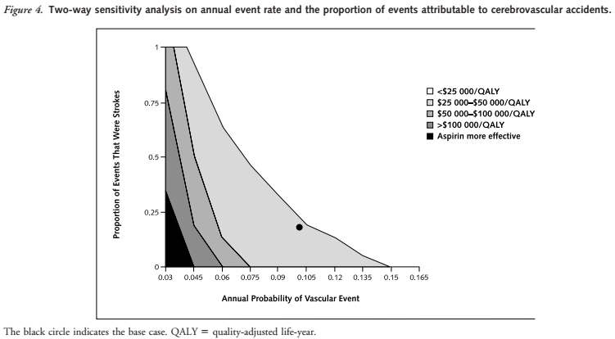
Are results reported separately for relevant patient subgroups?
Results for those with strokes has been mentioned.
However, there are separate results for those with GI bleeding/ recurrent cardiovascular events.

Slide 13
Is there a systematic review and summary of evidence linking options to outcomes for each relevant question?
No

Slide 14
Were costs measured accurately?
Yes

Slide 15
Did investigators consider the timing of costs and outcome?
Yes

Slide 16
What are the results?
Patients treated with aspirin lived an average of 9.51 QALYs after their initial event, incurring costs of $127 700. Those treated with clopidogrel plus aspirin lived an average of 9.61 QALYs with a lifetime cost of $129 300, or $1600 more.
The incremental cost-effectiveness ratio for clopidogrel plus aspirin relative to aspirin alone was $15 400 per QALY.

Slide 17
What were the incremental costs and effects of each strategy?
At 10% risk reduction estimate, the incremental cost-effectiveness ratio was $45900 per QALY.
At a relative risk reduction of 28%, the cost-effectiveness ratio decreased to $9800 per QALY compared with aspirin alone.
The average discounted lifetime cost for combination therapy increased by $1100 when clopidogrel cost $7.10 per day, resulting in an incremental cost-effectiveness ratio of $26 000 per QALY. At a daily cost of $1.80, this decreased to $8900 per QALY.
When the relative risk for hemorrhage was 67% greater with clopidogrel plus aspirin than with aspirin alone, the addition of clopidogrel to aspirin cost $18 800 for each QALY gained.

Slide 18
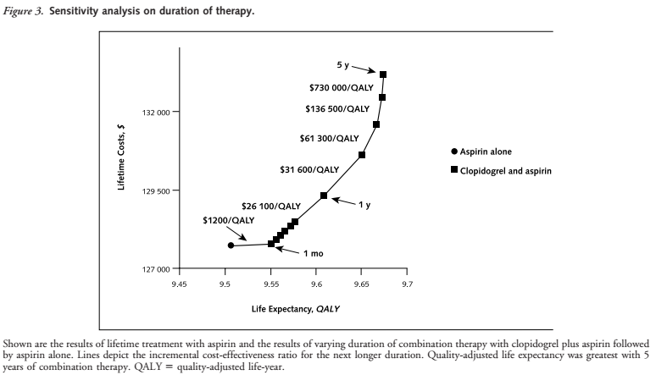
Notes:
For persons who have an annual risk for a vascular
event of less than 4% and a low risk for stroke, aspirin
alone is more effective than combined clopidogrel and aspirin
For such patients, the benefit of fewer
vascular events is outweighed by the increased risk for
bleeding.

Slide 19
How much does allowance for uncertainty change the results?
Not very different
A probabilitic sensitivity analysis was also done

Slide 20
Conclusion
For patients with high-risk acute coronary syndromes, adding clopidogrel to aspirin for 1 month increased life expectancy by 0.04 QALY, more than 2 weeks of perfect health.
One year of combination therapy added more than 1 month to quality-adjusted life expectancy and cost $15 400 for each QALY gained relative to aspirin, or $26 100 per QALY relative to 1 month of combination treatment.

Slide 21
Limitations
Assumption that all excess bleeding events
were gastrointestinal and were potentially more costly than procedural hemorrhage.
Only based on one RCT.
Event rate calculation was based on the Framingham Heart study- potential for underestimation of future events.
This data cannot be extrapolated to all patients with coronary disease.

Slide 22
How can I apply the results to patient care?
Are the treatment benefits worth the harms and costs?

Slide 23
Can I expect similar costs in my setting?
Cost of Clopidogrel =
Cost of Aspirin =
Cost of DAPT for 1 month =
Cost of DAPT for 1 year =

