Slide 1
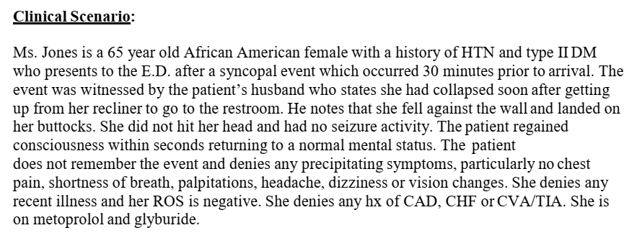
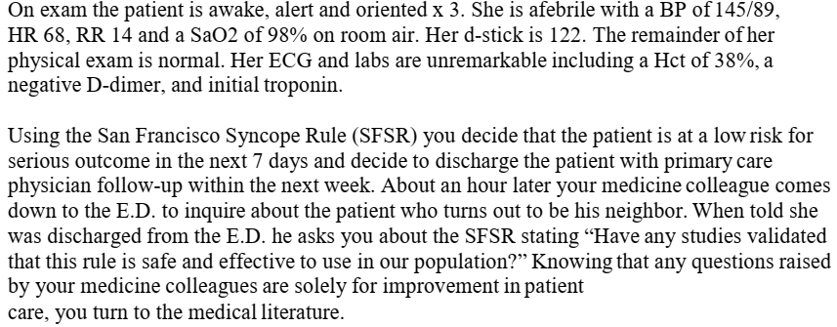

Slide 2
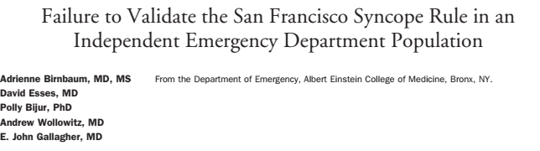

Slide 3
PICO
Population: ED Syncope patients
Intervention: Use of risk stratification tools to identify high-risk syncope patients - San Francisco Syncope Rule
Comparison: Unaided clinical intuition
Outcome: Serious adverse outcome within 7 days (death, MI, PE, arrhythmia, CVA, significant hemorrhage, or any condition causing a return ED visit with hospitalization for a related event.

Slide 4
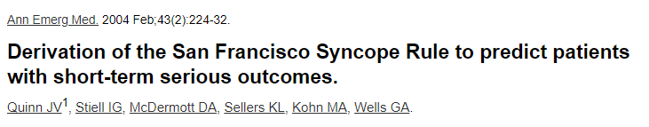
Is this a newly derived instrument?

Slide 5
Were all important predictors included in the derivation process?
Decision rule that would predict patients at risk for short-term serious outcomes and help guide admission decisions
Prospective cohort study
Emergency department setting
Patients with syncope or near syncope
Outcomes - Death, myocardial infarction, arrhythmia, pulmonary embolism, stroke, subarachnoid hemorrhage, significant hemorrhage, or any condition causing a return ED visit and hospitalization for a related event
Follow up – 7 days

Slide 6
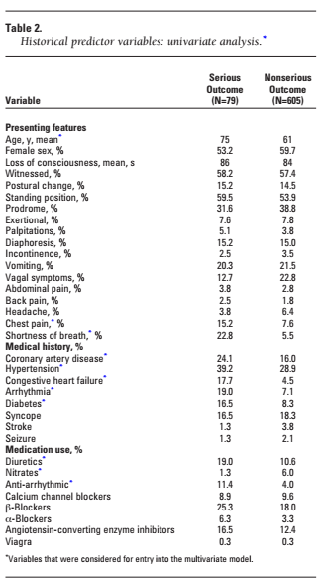
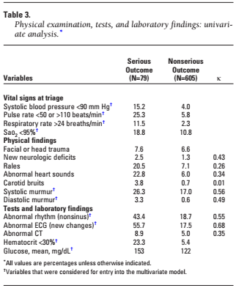

Slide 7
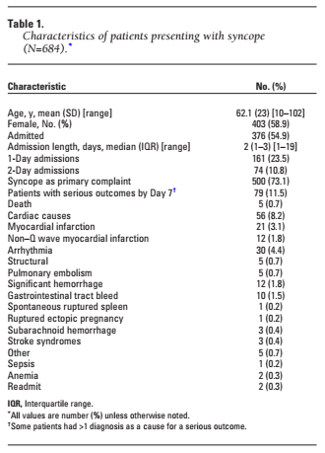

Slide 8
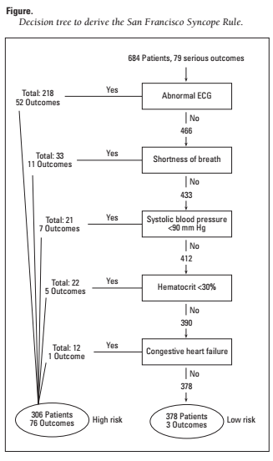

Slide 9
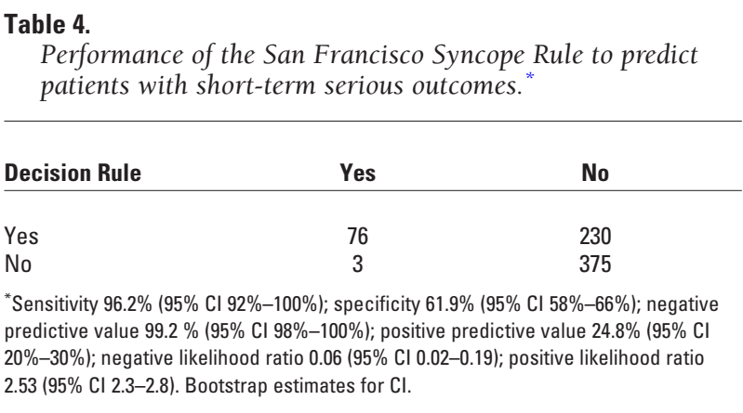

Slide 10
684 visits for syncope, and 79 of these visits resulted in patients' experiencing serious outcomes.
50 predictor variables considered, 26 were associated with a serious outcome on univariate analysis.
Predictors -
  Complaint of shortness of breath,
  Hematocrit level less than 30%,
  Triage systolic blood pressure less than 90 mm Hg
  History of congestive heart failure.
  Abnormal ECG
96% (95% confidence interval [CI] 92% to 100%) sensitivity and 62% (95% CI 58% to 66%) specificity. If applied to this cohort, the rule has the potential to decrease the admission rate by 10%.

Slide 11
Were all important predictors present in a significant proportion of the study population?
Yes

Slide 12
Does the rule make clinical sense?
Yes

Slide 13
How well did the validation study meet the following criteria?
Did the patients represent a wide spectrum of severity of disease?
Inclusion -
All adults patients > 21 years presenting to the ED with acute syncope or near syncope
Exclusion
Altered mental status, alcohol or illicit drug-related loss of consciousness, definite seizure, and transient loss of consciousness caused by head trauma were excluded.

Slide 14
How were the predictors applied?
Emergenc phyisicans completed a structured datd collection questionnaire
They looked at
  Complaint of shortness of breath,
  hematocrit level less than30%,
  Triage systolic blood pressure less than 90 mm Hg, or
  history of congestive heart failure
2 senior physicians - ECG changes
  Not sinus rhythm
  New changes

Slide 15
Was there an explicit and accurate interpretation of the predictor variables and the actual rule without knowledge of the outcome?
Yes
The decision to admit or discharge enrolled patients from the ED was determined solely by the emergency physician independent of the decision rule.
Follow-up through day 7 after the index ED visit was performed by trained research associates through structured interview with the admitting inpatient attending physician.
Follow-up of patients discharged from the ED or not hospitalized through day 7 was also performed by telephone contact with the patients

Slide 16
For how long were the patients followed?
7 days
Were outcomes objective?
Yes

Slide 17
How powerful is the rule?

Slide 18
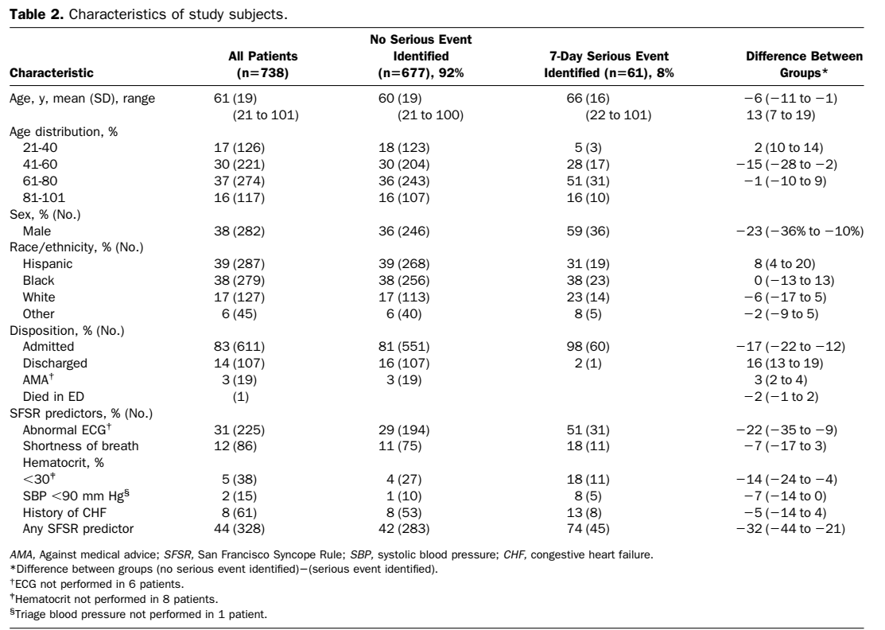

Slide 19
What were the actual outcome rates in the low risk groups in the two studies?

Slide 20
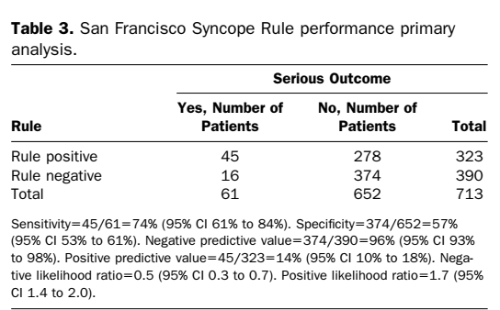

Slide 22
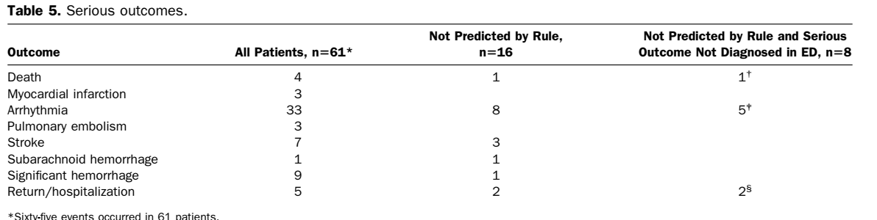

Slide 23
Conclusion
The independent validation of the San Francisco Syncope Rule to
identify 7-day serious outcomes in ED patients with syncope is less predictive than previously reported

