Slide 1
Critical appraisal of study on differential diagnosis
Asha Mathai

Slide 2
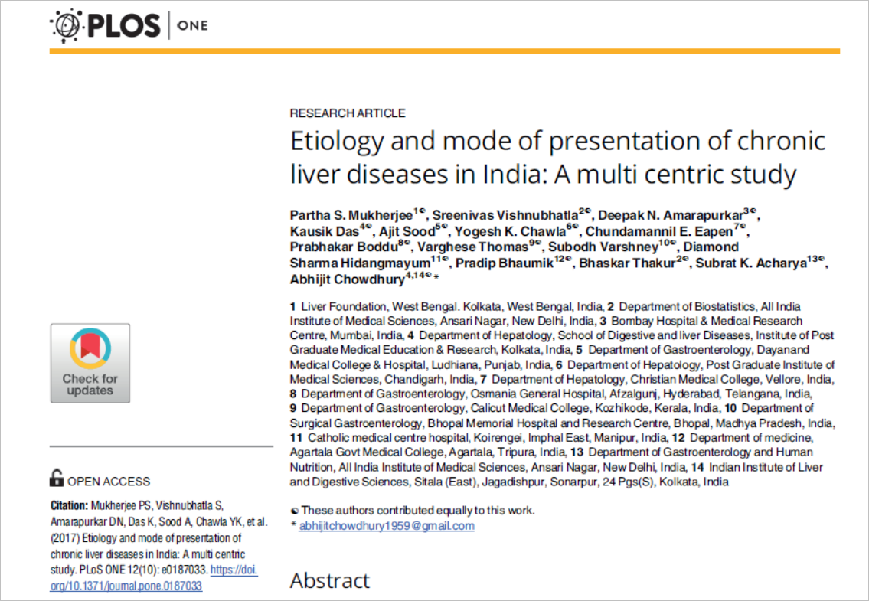

Slide 3
Background
Chronic liver diseases (CLD) cause significant morbidity and mortality worldwide.
Multiple etiological factors lead to a similar clinico-pathological syndrome in CLDs
There had been a 46% increase in CLD mortality in the world between 1980 to 2013
Increase in CLD mortality has been reported from the low and low-middle income countries of Asia and Africa.

Slide 4
PICOT
P- Patients with newly diagnosed liver disease
E : Evaluation for etiology of CLD
O: Sociodemographic parameters and etiological distribution
T: Observational study from 2010- 2013

Slide 5
Study design
Data were collected over a defined period (April 2010 to March 2013) according to a uniform protocol in 11 centers spread across India
The single monitoring and coordinating center was at Delhi.
This data was later uploaded to a web-based system which could be accessed only from a single central port (SV) which was responsible for coordination and monitoring.

Slide 6
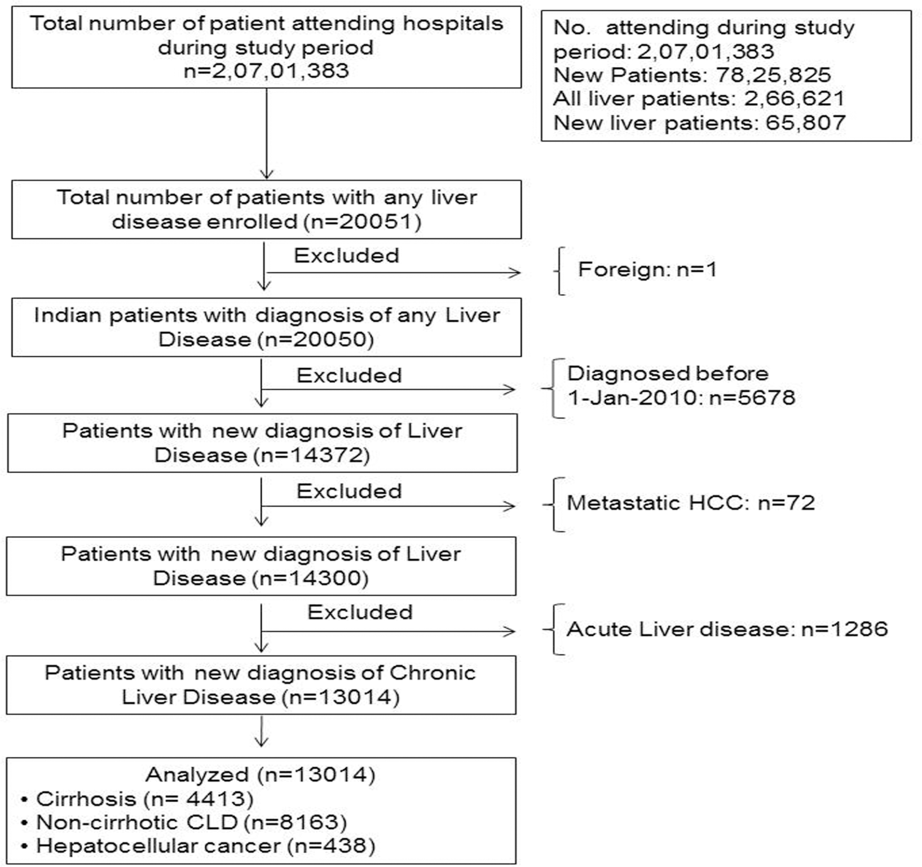

Slide 7
Did the study patients represent the full spectrum of those with this clinical problem?
Did the investigators define the clinical problem clearly ?
Uniform diagnostic definitions were used
Were the study patients collected from all relevant clinical settings?
To achieve a representative data centers were selected from five geographically different regions of the country
But Only Tertiary care centres were included

Slide 8
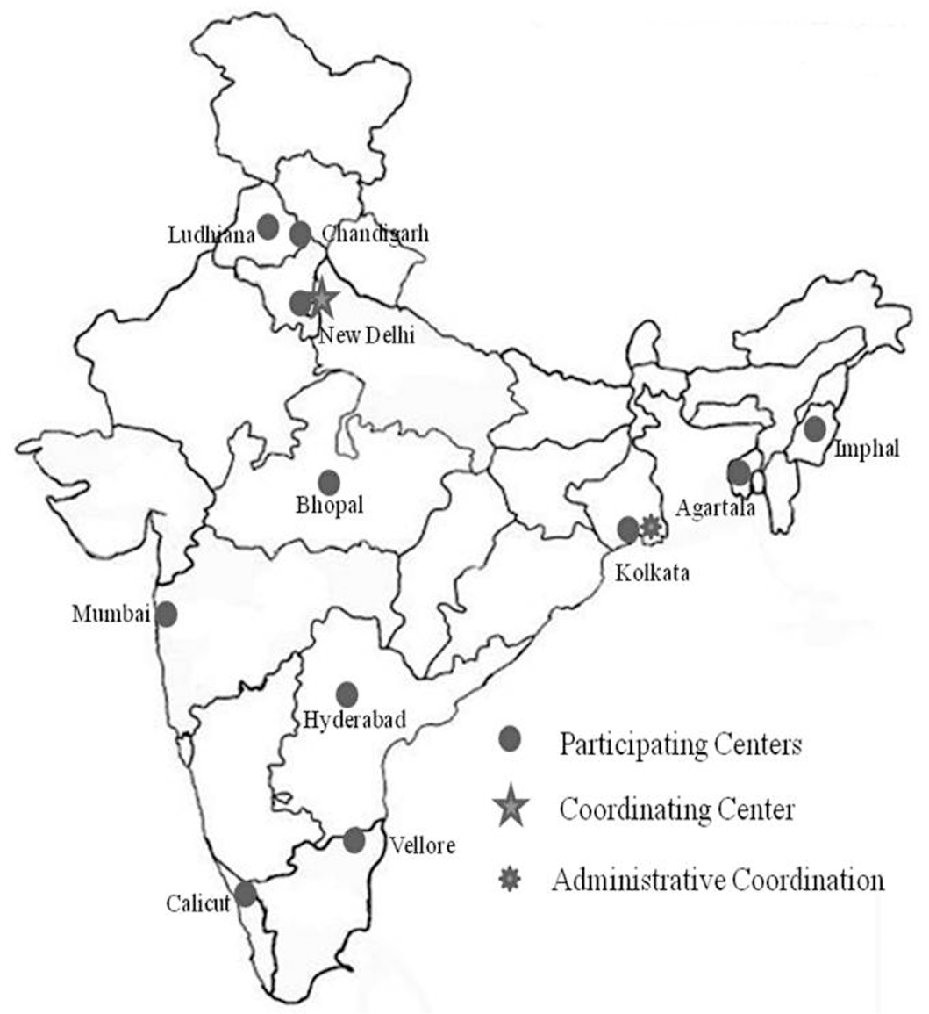

Slide 9
Were study patients recruited consecutively from the clinical settings ?
No
Study included (13014) 19. 77% of all newly diagnosed liver disease patients (65807)
Not mentioned the selection process
Did the study patients exhibit, the full clinical spectrum of this presenting complaints?
Not mentioned

Slide 10
Was the diagnostic evaluation definitive?
Was the diagnostic evaluation sufficiently comprehensive?
No data regarding it available
But common diagnostic evaluation criteria was applied

Slide 11
Was the diagnostic evaluation consistently applied to all patients?
Not mentioned

Slide 12
Were the diagnostic labels assigned reproducibly?
Yes
Final Diagnostic labels were created
Were there few patients left undiagnosed?
Probably No

Slide 13
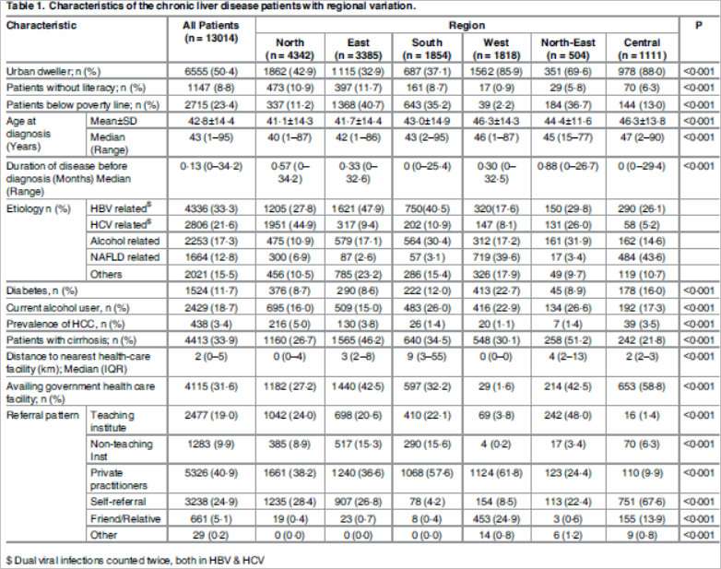
What were the results?
What were the diagnoses and their probabilities?

Slide 14
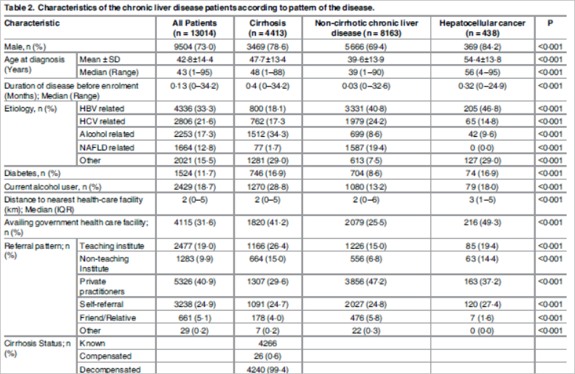

Slide 15
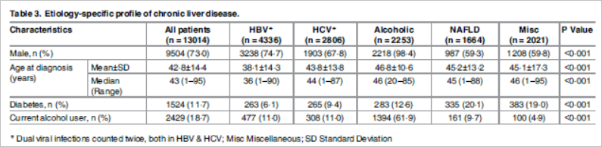
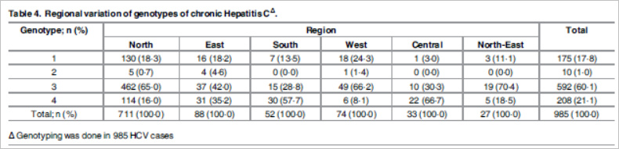

Slide 16
How precise are the estimates of disease probability?
 | All patients | cirrhosis | Non cirrhotic | Hepatocellular
HBV | 33.3% 32.51- 34.13 | 18.1% 17.02- 19.29 | 40.8% 39.74- 41.88 | 46.8% 42.18- 51.48
HCV | 21.6% 20.86- 22.28 | 17.3% 16.18- 18.41 | 24.2% 23.33-25.19 | 14.8% 11.82- 18.47
Alcohol | 17.3% 16.67- 17.97 | 34.3% 32.88- 35.68 | 8.6% 7.98- 9.19 | 9.6% 7.17- 12.71
NAFLD | 12.8% 12.22-13.37 | 1.7% 1.4- 2.18 | 19.4% 18.6- 20.31 | 0% 0- 0.87
Others | 15.5% 14.89- 16.13 | 29% 27.71- 30.38 | 7.5% 6.96- 8.1 | 29% 24.94- 33.41

Slide 17
Are the study patients and clinical
setting similar to mine?
Conducted in multiple tertiary care centres in India including CMC Vellore

Slide 18
Is it unlikely that the disease possibilities or probabilities have changed since this evidence was gathered?
Unlikely for any change

Slide 19
Thankyou

