Slide 1
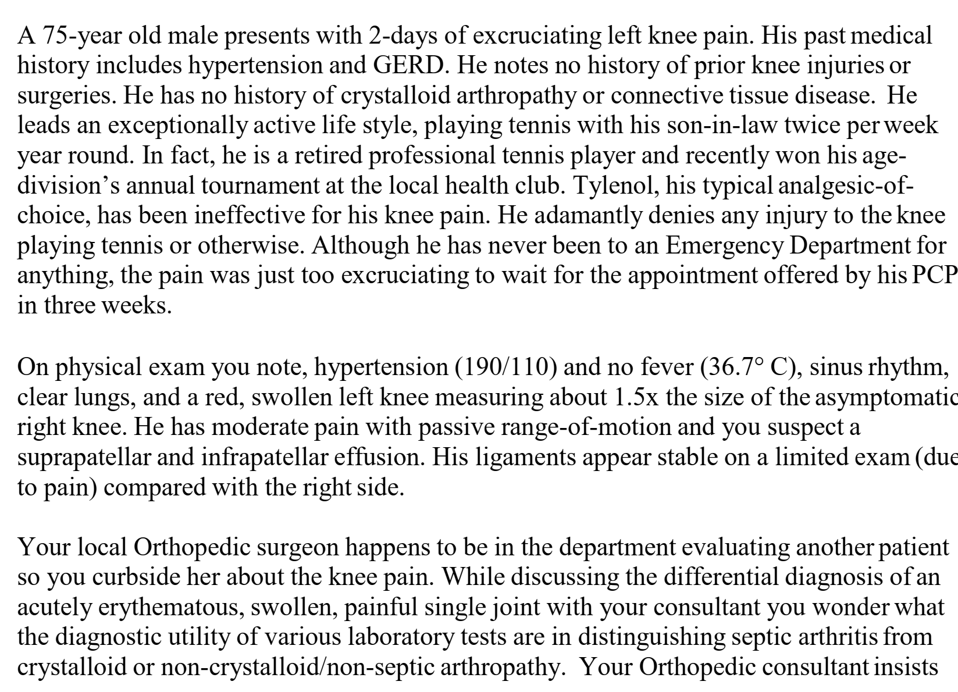


Slide 2
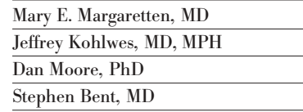

Slide 3
Introduction
Nongonococcal bacterial arthritis is possibly the most dangerous and destructive type of acute arthritis
The mortality rate for in-hospital septic arthritis ranges from 7% to 15%, despite antibiotic use.

Slide 4
P – patients who present with an acutely painful and swollen joint
Objective - To review the accuracy and precision of the clinical evaluation for the diagnosis of nongonococcal bacterial arthritis
Diagnostic value of the history, physical examination, blood, or synovial fluid laboratory test results for distinguishing septic arthritis from other conditions.
Outcome - Likelihood ratios for all symptoms and signs used to differetniate septic arthritis from other causes of an acutely painful or swollen joint

Slide 5
Are the results valid

Slide 6
Did the review explicitly address a sensible question
Yes
To review the accuracy and precision of the clinical evaluation for the diagnosis of nongonococcal bacterial arthritis

Slide 7
Was the search for relevant studies detailed and exhaustive
Yes
1966 to January 2007 - EMBASE, PubMed, Appropriate MeSH terms
Articles that reported the diagnostic value of the history, physical examination, blood, or synovial fluid laboratory test results for distinguishing septic arthritis from other conditions
Arthritis, infectious, physical examination, medical history taking, diagnostic tests, and sensitivity and specificity, combined with the MeSH terms: arthritis, infectious or arthritis, gouty and synovial fluid, and arthritis, infectious AND (risk* [title/abstract] OR risk* [MeSH:noexp] OR risk* [MeSH:noexp] OR cohort studies [MeSH terms] OR group

Slide 8
Inclusion criteria
patients who presented with an acutely painful or swollen joint and
contained original data on accuracy and precision of the history and/or physical examination and/or laboratory data in diagnosing septic arthritis.
Gold standard - synovial fluid culture - imperfect gold standard with reported sensitivities of only 75% to 95%
gold standard tests of positive Gram stain, positive blood cultures, no organism isolated but macroscopic pus aspirated from joint, or response to antibiotics.
Exclusion criteria
No gold standard

Slide 9
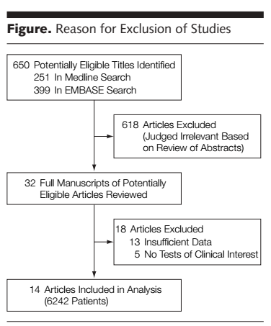
3 studies included gonococcal arthritis

Slide 10
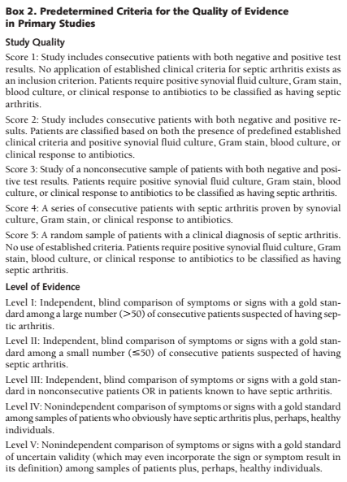
Were the primary studies of high methodologic quality

Slide 11
Symptoms based on individual article definitions
Fever - 37.5°C to 38.0°C and whether fever occurred at either presentation or during hospital course.
Elevated WBC count - > 10,000
Elevated ESR - > 30
Elevated CRP - > 100 mg / L
Reduction in synovial fluid glucose - serum/synovial fluid glucose ratio of less
than 0.5 or 0.75

Slide 12
Adults and included patients in rheumatology clinics, those patients presenting to the emergency department, or hospitalized patients.
only 3 studies attaining a level 1 score
Most studies used an adequate gold standard.

Slide 13
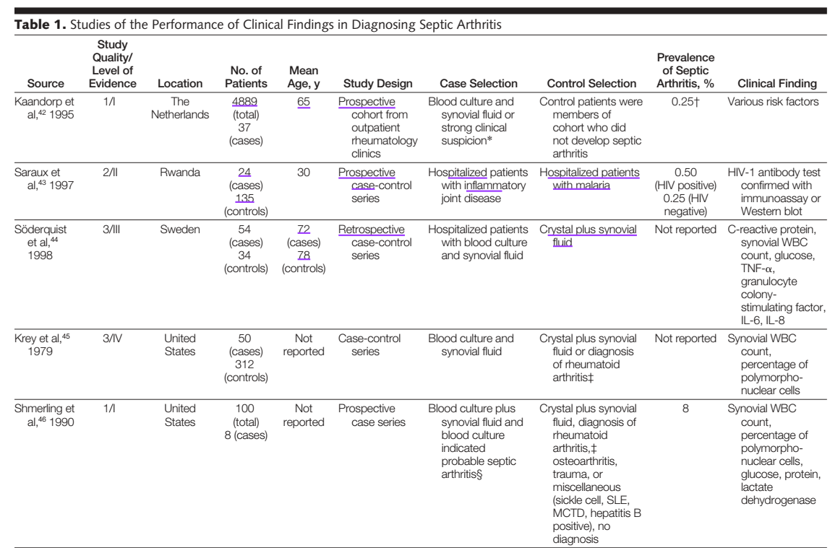

Slide 14
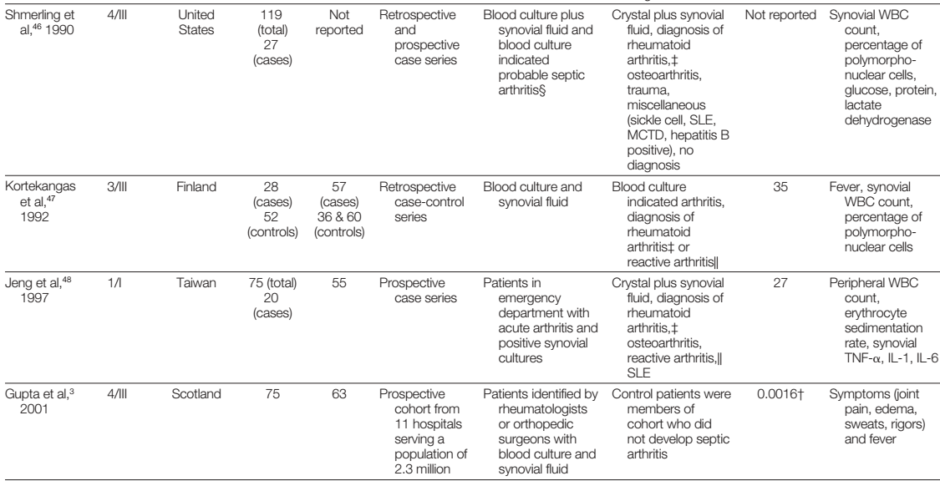

Slide 15
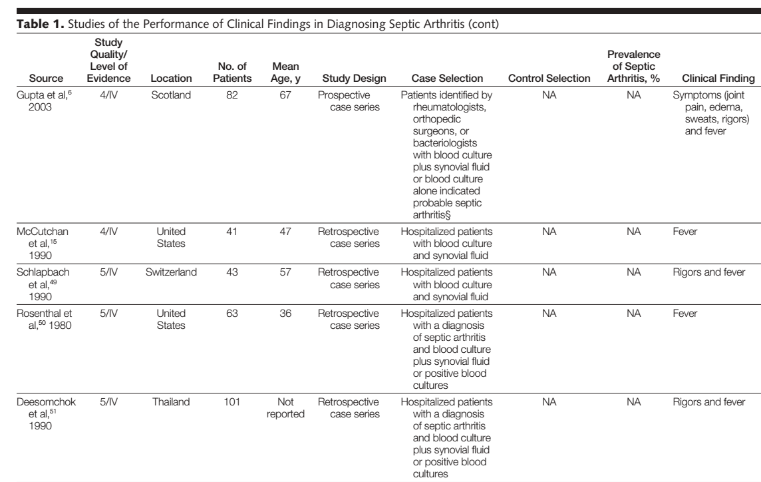

Slide 16
Were the assessments of the included studies reproducible
Yes
Objective assessments
3 reviewers reviewed the studies independently

Slide 17
What are the results

Slide 18
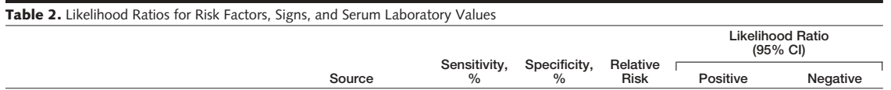
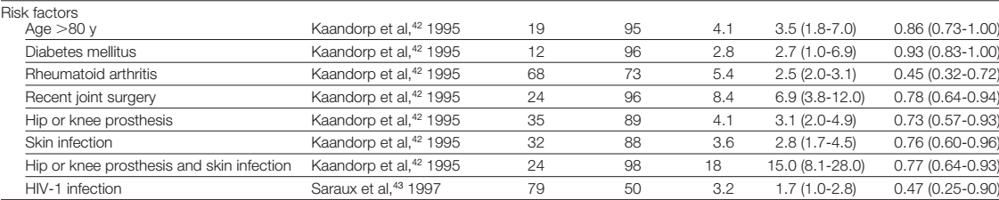
Risk factors

Slide 19
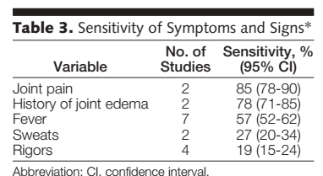
Signs and symptoms
only 6 studies tested sensitivity of symptoms for diagnosing septic arthritis

Slide 20
Lab values
Abnormal peripheral WBC count, ESR, and CRP were found to have limited diagnostic power for changing the pretest probability of septic arthritis, mostly due to their low specificity

Slide 21
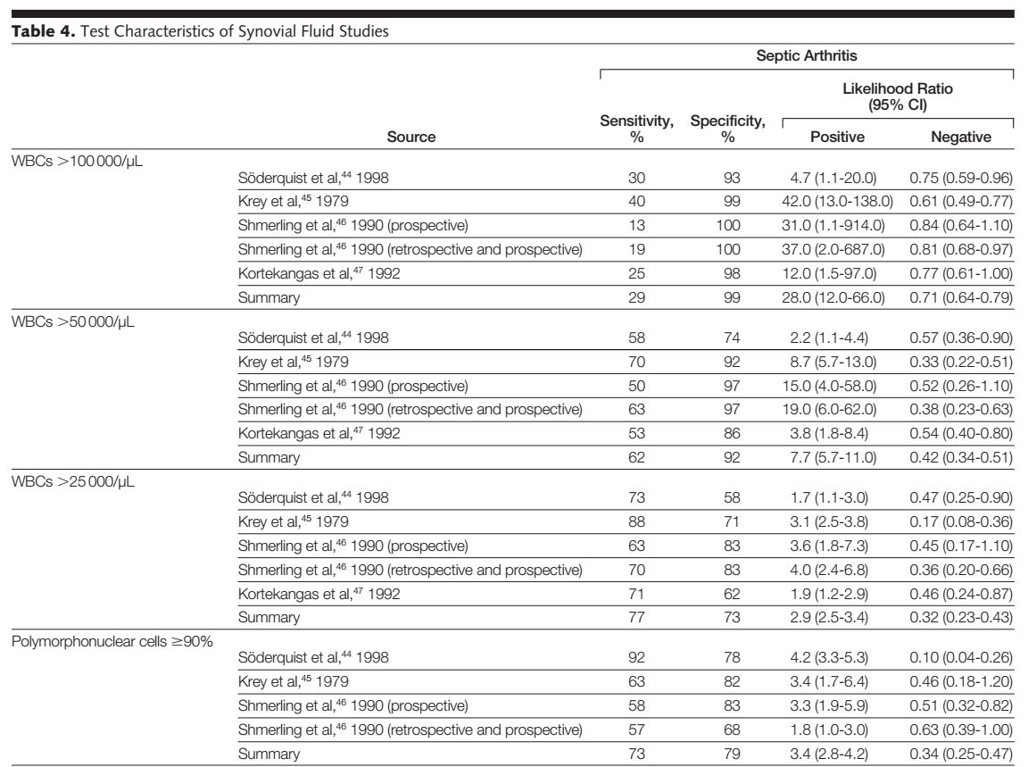
Progressively higher synovial WBC counts increase the likelihood of septic arthritis

Slide 22
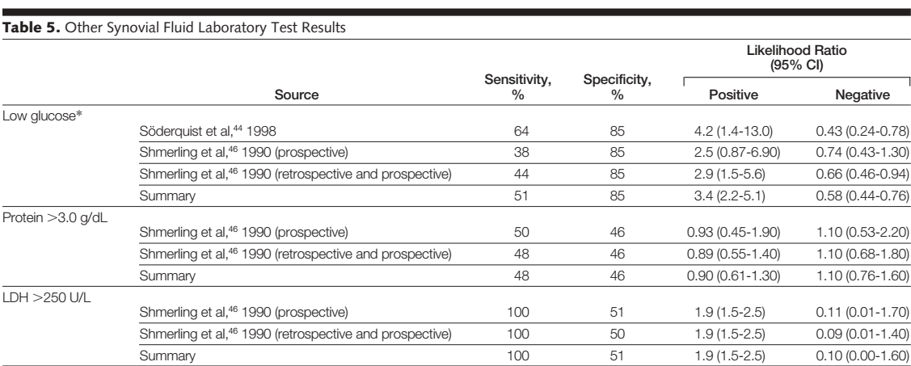

Slide 23
History and physical examination are not able to substantially change
the pretest probability of septic arthritis in patients with an acutely painful, swollen joint
Arthrocentesis with synovial fluid analysis for WBC count and percentage of polymorphonuclear cells is the best diagnostic tool available for detecting bacterial arthritis while waiting for synovial culture test results.
Synovial fluid glucose, protein, and lactate dehydrogenase are not informative.

Slide 24
What are the overall results of the study
Risk factors - age older than 80 years, diabetes mellitus, rheumatoid arthritis, recent joint surgery, hip or knee prosthesis and/or skin infection, and HIV-1 infection
Most of these risk factors were only useful when present and did not substantially lower the likelihood of bacterial infection when they were absent
Symptoms
Joint pain and a history of joint swelling are reasonably sensitive [no specificity]
Fever - poor sensitivity and specificity

Slide 25
How precise are the results

Slide 26
Were the results similar from study to study
Not for all parameters

Slide 27
Will the results help me in caring for my patients
Yes

Slide 28
How can I best interpret the results to apply them to the care of my patients
Stratify according to risk
Arthrocentesis
Gold standard –
  Gram stain and culture as a gold standard
  Gram stain – sensitivity is only 29% to 50%
  the sensitivity of culture may only be 82%.
  Misclassification of patients with overestimation or underestimation of reported LRs
  Combination of Gram stain, culture, and clinical follow-up to detect patients missed by Gram stain and culture alone

Slide 29
Were all patient important outcomes considered
Yes

Slide 30
Are the benefits worth the costs and potential risks
Yes

