Slide 1
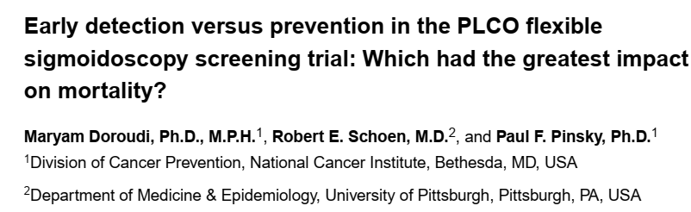

Slide 2
Background
Even though its incidence is on the decline colorectal cancer is still a cause for significant morbidity and mortality in the US
Studies have not assessed whether the observed mortality reduction is primarily due to primary prevention via removal of adenomatous polyps or due to the effects of early detection

Slide 3
PICO
P – Adults aged 55-74
I – flexible sigmoidoscopy
C- usual care - stool occult blood, digital rectal examination
O – To establish if mortality reduction was primarily due to prevention of incident CRC via removal of adenomatous polyps or to early detection of cancer

Slide 4
Method
Randomized Prostate, Lung, Colorectal and Ovarian (PLCO) Cancer Screening Trial evaluated screening versus usual care
154,900 men and women
No current trial cancer not on any current treatment for cancer
Sigmoidoscopy vs usual care - DRE, SOB
  Baseline, 3 y, 5y
Demontrated 21% reduction in the incidence of Colorecal cancer in the intervention group and 26% reduction in mortality.
Median follow up pf 11.9 years , max - 13 years

Slide 5
PLCO abstractors recorded on standardized forms the clinical assessment that led to the diagnosis of CRC for all participants
Categories ‘screen detected’, ‘symptomatic’, and ‘other’
Other - not detected by PLCO screening
Surveillance / screen detected
CRC-specific survival rates using Kaplan-Meier plots
The log-rank test was used to compare survival for different categories of cases, including trial arm, mode of detection and anatomic location

Slide 6
Outcomes
To estimate the fraction of avoided CRC deaths in the intervention arm that were due to either early detection or prevention via removal of adenomatous polyps
To evaluate the expected number of CRC deaths if the observed cases in the usual care arm had the survival of the intervention arm and similarly, the expected number of CRC deaths if the observed cases in the intervention arm had the survival of the usual care arm

Slide 7
154,900 individuals enrolled in PLCO, 77,445 and 77,455 were randomized to the intervention and usual care arms
1,008 CRC cases in the intervention arm and 1291 in the usual care arm.
The 13-year survival rates in the intervention and usual care arms were 68% and 65%, respectively, and not significantly different (p=0·16, log-rank test).

Slide 8
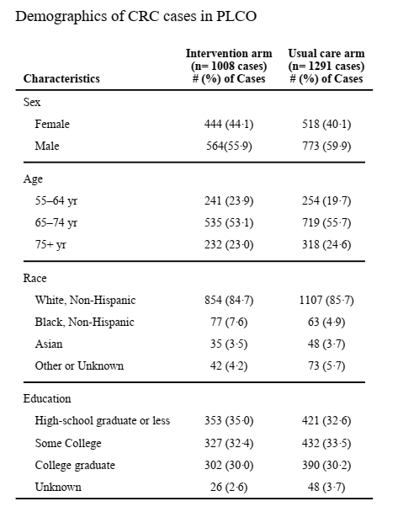

Slide 9
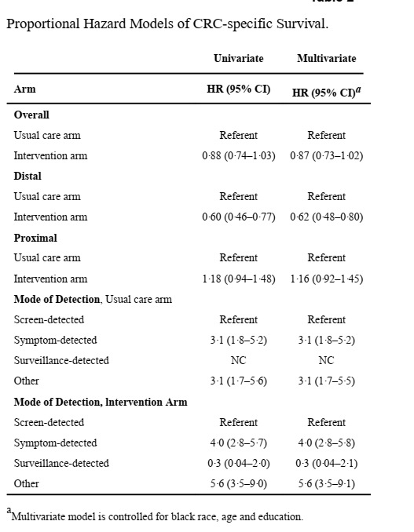

Slide 10
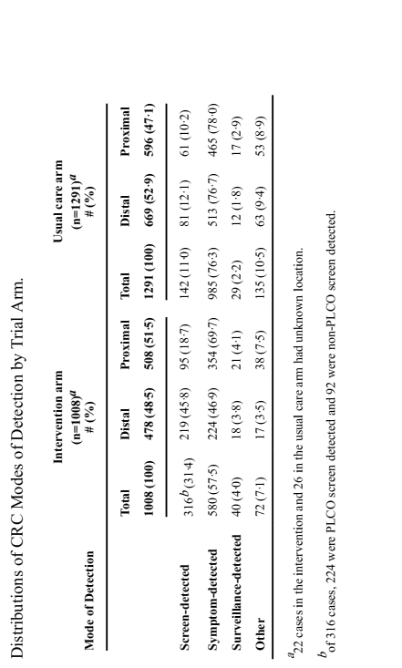
. The intervention arm had a higher percentage of screen-detected cases (31·4% vs 11·0%, p<0·0001, Chi-square test) and a lower percentage of symptom-detected cases (57·5 % vs 76·3%, p<0·0001, Chisquare test) compared to the usual care arm.

Slide 11
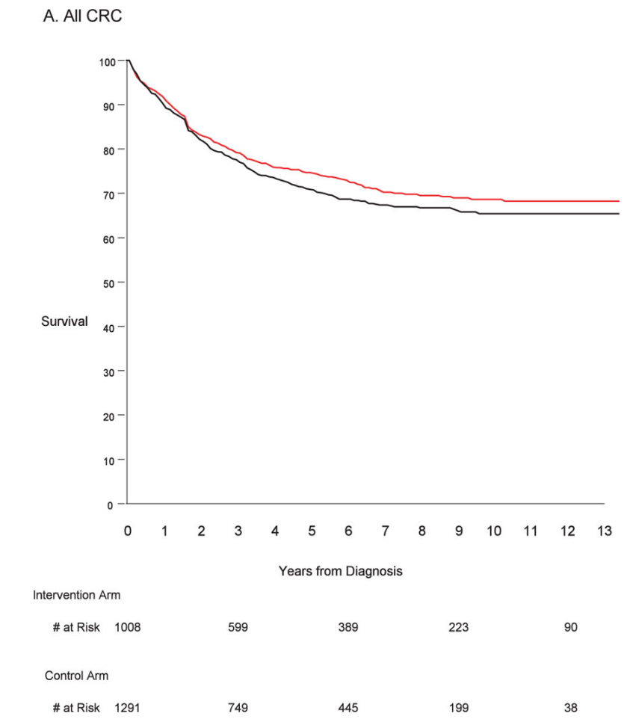
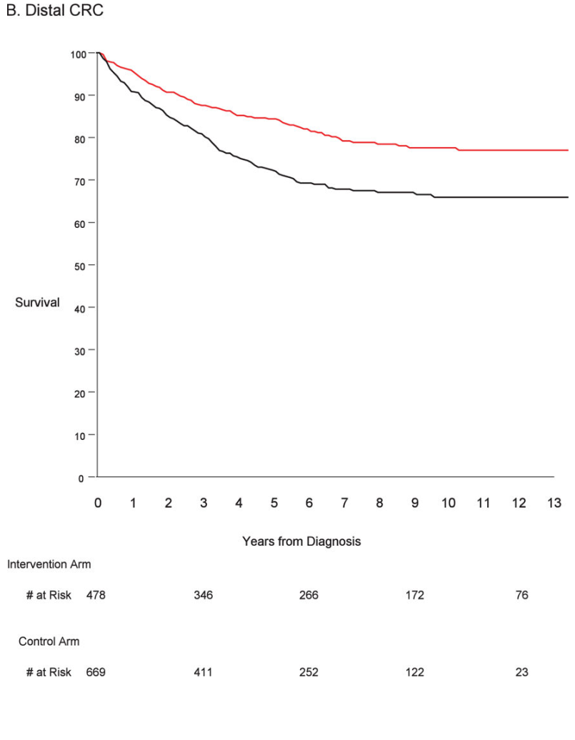
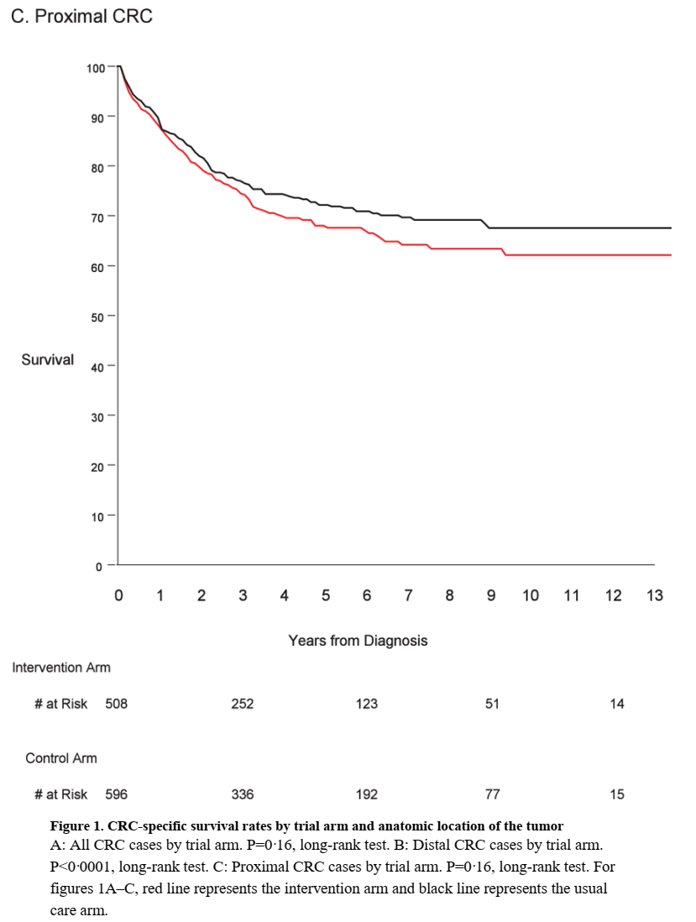

Slide 12
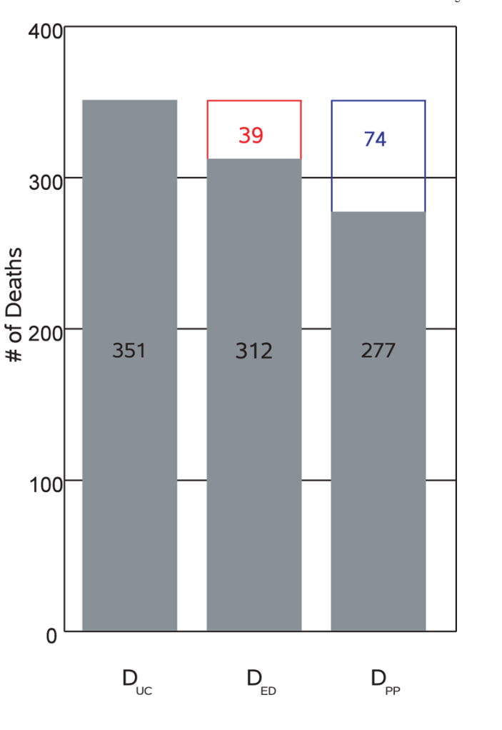
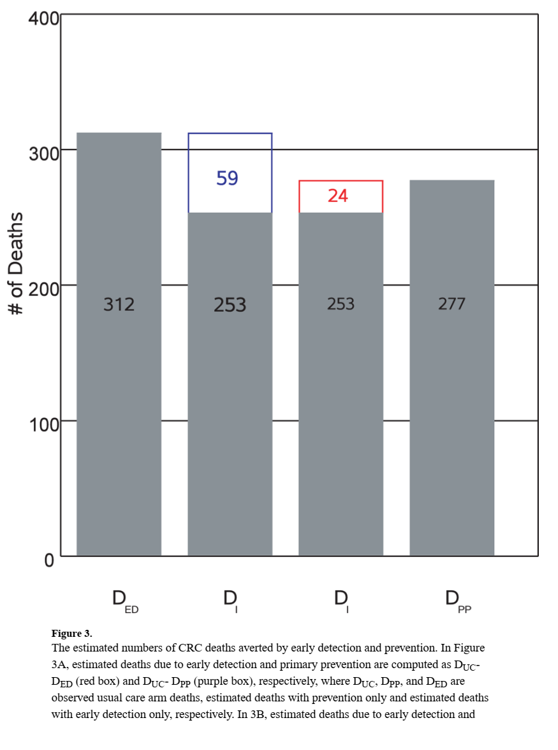


Slide 13
The model estimated that DED (deaths from early detection alone) was 312 and DPP (deaths from prevention alone) was 277
Subtracting DED and DPP from the observed usual care arm deaths
(DUC=351) gives 39 deaths averted due to early detection and 74 averted due to prevention
Alternatively, subtracting the observed intervention arm deaths (DI=253) from DED and DPP, respectively, gives an estimated 59 deaths averted due to prevention and 24 averted due to early detection

Slide 14
The estimated proportions of deaths averted due to prevention are 65% (39/(39+74)) by the first method and 71% (59/(59+24)) by the second method, with the remainder, 35% and 29%, estimated due to early detection.
The total combined estimated deaths prevented, 113 and 84 by the two methods, are reasonably close to the observed number of intervention arm CRC deaths prevented of 98
(i.e., 351–253).

Slide 15
In the intervention arm, the 5 and 13 year CRC-specific survival rates were 75% and 68%, respectively, compared to the corresponding usual care arm rates of 71% (5-year) and 66% (13-year).
Our estimates indicate that about 65–70% of prevented CRC deaths were due to primary prevention, and only 30–35% due to early detection.

Slide 16
Summary of recommendations
CRC-specific survival was similar across arms in PLCO, suggesting a limited role of early detection in preventing CRC deaths. Modeling suggests two-thirds of avoided deaths were due to prevention.

