Slide 1
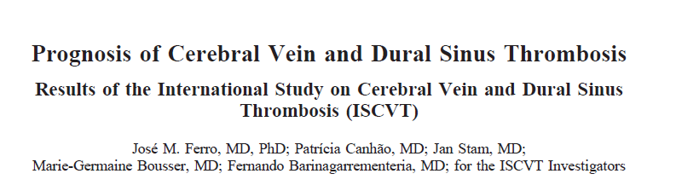
ANUSHA.S

Slide 2

The incidence of CVT is estimated to be approximately between 2 and 5 per million per year.

Slide 3
Multicenter multinational (21 countries 89 centres) prospective observational study
From May 1998 to May 2001
All participating centers committed themselves to provide data on
consecutive cases diagnosed at their institutions and to perform at
least a 6-month follow-up observation

Slide 4
P:
Patients aged >/= 15 years with symptomatic CVT.
The diagnosis of CVT had to be confirmed by conventional
angiography, CT venography, MRI combined with MR venography,
surgery, or autopsy.
624 adult cases were included in the study from 89 centers in 21 countries

Slide 5
Was the sample of patients representative?
Self-reported
Most of participating departments were neurology ?miss out on cases admitted under other departments

Slide 6
Follow up
Follow-up visits were performed at 6 months, at 12 months, and
yearly thereafter, preferably by direct interview and observation by
the local investigators.
If that was not possible, alternative methods included telephone
interview of the patient or interview of a relative or general
Practitioner.
For patients who were lost to follow-up, the condition on
the day of hospital discharge was regarded as the final follow-up.

Slide 7
Were patients classified into prognostically homogeneous groups?
Presenting syndromes were dichotomized
isolated intracranial hypertension (any combination of headache, vomiting, and papilledema with/without visual loss or sixth nerve paresis, without other neurological symptoms or signs) and
other presenting syndromes
?not classified according to treatment received

Slide 8
Statistical analysis
Demographic, clinical, and imaging variables and risk
factors as possible explanatory variables of the outcomes
Bivariate analysis was performed for each outcome with the
chi sq test (with Yates correction when necessary) or Fisher exact test for
categorical data and with the Student t test or ANOVA for continuous
Data
For the outcome “death or dependence at the end of follow-up,”
we performed survival analysis using Kaplan-Meier and Cox regression
Statistics and Calculated the hazard ratios (HRs) and 95% CIs
for the retained variable.

Slide 9
The diagnosis of CVT was established by
MRI/MR venography in 443 patients (71%)
intra-arterial angiography in 74 (12%)
CT venography in 13 (2%)
by multiple imaging methods in 89 (14%)
surgery or autopsy in 5 (1%).

Slide 10
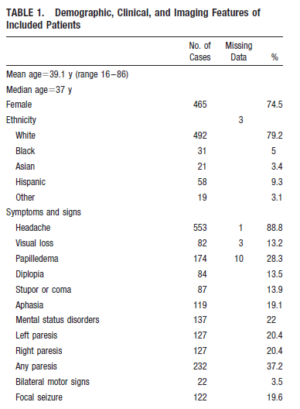
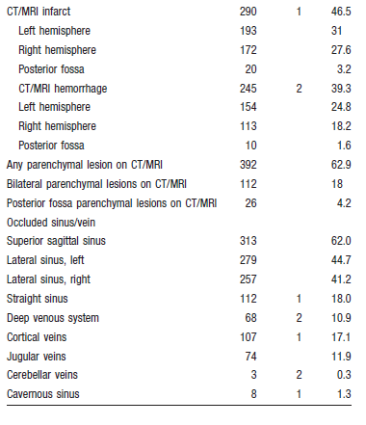

Slide 11
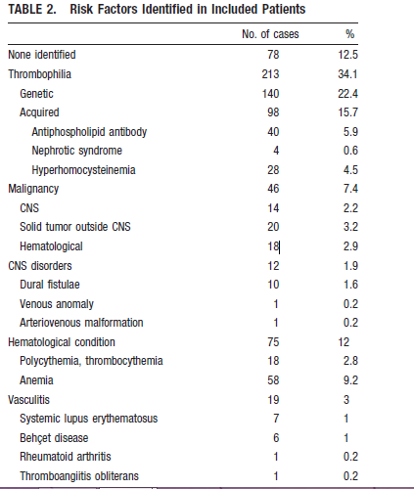
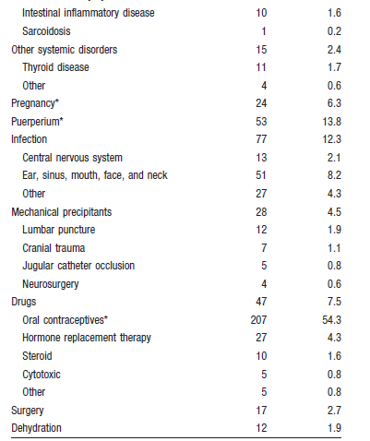

Slide 12
Anticoagulation -520
subcutaneous LMWH 218 (34.9%)/but 98 receive only DVT px dose
Iv heparin -401 cases [64%]
Antiplatelet drugs -37 patients [5.9%]
local endovascular thrombolysis- 13 (2.1%)
Shunts were performed in 10 patients(1.6%)
9 (1.4%) had decompressive craniotomy or hematoma evacuation

Slide 13
outcome
Primary outcome was death or dependence (mRS 2) at the end of the follow-up period.
Secondary outcomes were death and death or dependence at 6 months.

Slide 14
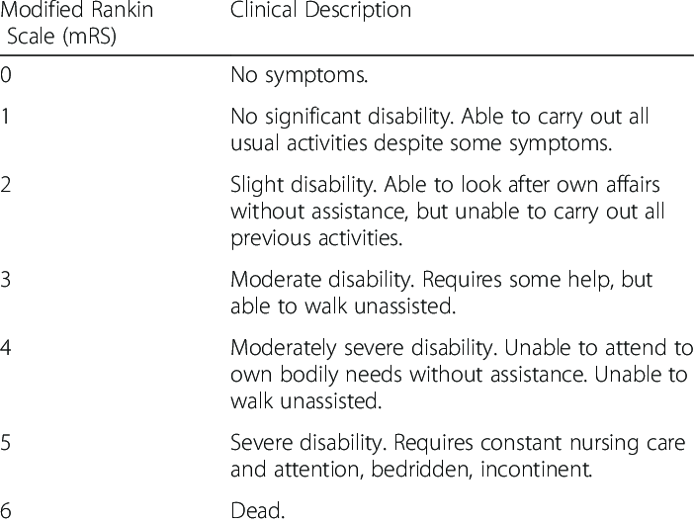

Slide 15
At the end of the study -follow-up information for 98.7%
Reported that 8 patients (1.3%) were lost to follow-up after discharge, however primary outcome is not reported for 39 patients .
Median length of follow-up was 16 months (mean18.6, SD11.1).

Slide 16
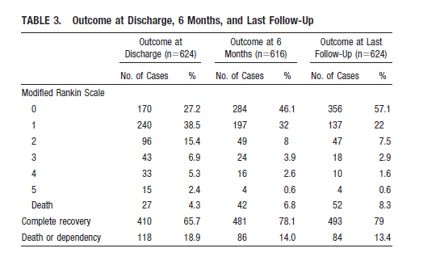

Slide 17
DEATH OR DEPENDENCY
In isolated raised ICP presentation : 7%
In other presentation :14 %
HR: 0.45; 95% CI- 0.23 to 0.87

Slide 18
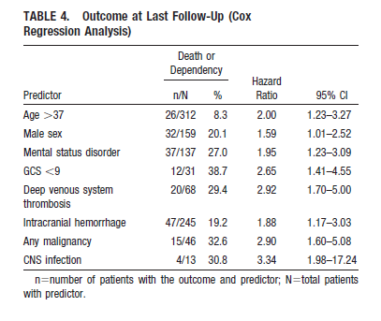

Slide 19
Were outcome criteria objective and unbiased?
Yes
Was the follow-up sufficiently long?
Yes , long term ?
How likely are the outcomes over time?
Acceptable
How precise are the estimates of likelihood?
Wide confidence intervals

Slide 20
Were the study patients and their management similar to those in my
Practice?
Yes , significant numbers have not received anticoagulation
Can I use the results in the management
patients in my practice?.....

