Slide 1
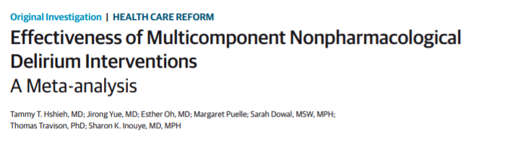
Rachana Shenoy
18/12/2018

Slide 2
Background
High incidence of delirium in the elderly.
Do we have effective interventions to prevent delirium incidence and falls in the elderly?

Slide 3
Aims
To perform a systematic review of all studies related to multicomponent nonpharmacological delirium interventions
To conduct a quantitative meta-analysis evaluating the effect of
these interventions on important clinical outcomes.

Slide 4
Methods
Inclusion criteria
First level- original articles, the median or mean age of participants was 65 years or older, they discussed relevant topics given the search terms, they were published in English, and they included human participants
Second level- if they studied multicomponent nonpharmacological delirium interventions, if they assessed delirium incidence and not prevalence and if they used a validated delirium instrument for ascertainment

Slide 5
Outcomes
Primary outcomes- Delirium incidence and falls
New onset delirium during hospitalization- incidence, measured using validated tools (Confusion Assessment Method and Delirium Observation Screening Scale)
Falls were defined as total number per 1000 patient days.
Secondary outcomes- length of stay, rate of discharge to a long-term care institution(institutionalization), and change in functional or cognitive status

Slide 6
Did the review explicitly address a sensible clinical question?
Yes
To evaluate available evidence on multicomponent nonpharmacological delirium interventions in reducing incident delirium and preventing poor outcomes associated with delirium.

Slide 7
Was the search for relevant studies exhaustive?
No
Databases searched included PubMed, Google Scholar, ScienceDirect, and the Cochrane Database of Systematic Reviews
January 1, 1999 to December 31, 2013
All relevant trials regardless of language or publication status (published, unpublished, in press, and ongoing) not used.
Age above 65 years
When essential data were not reported, corresponding authors were contacted up to 3 times.

Slide 8
Were selection and assessments of studies reproducible?
Yes
A standardized data extraction protocol was prepared by a multidisciplinary team.
When essential data were not reported, corresponding authors were contacted up to 3 times.

Slide 9
Did the review address possible explanations of between-study differences in results?
Yes
I² values of less than 25% were regarded as low heterogeneity, and fixed-effects models for the meta-analysis were used.
I² values of 25% to 75% represented moderate heterogeneity, and a random-effects model was applied.
I² values exceeding 75% represented high heterogeneity, and a meta-analysis was not considered appropriate for the interpretation

Slide 10
Did the review present results that are ready for clinical application?
Yes
Delirium incidence
Falls
Institutionalization
Length of stay
Change in functional status
Change in cognitive status
However, no mention on mortality

Slide 11
Was the Risk of Bias of the Primary Studies Assessed?
Yes
Two review authors independently assessed the risk of bias using a standardized assessment form.
Two additional reviewers conducted spot checks to confirm the accuracy of
extracted data and to resolve any discrepancies.
6 domains were tested- random or balanced allocation method, allocation concealment, completeness of outcome data, lack of selective outcome reporting, and absence of other sources of bias, as well as blinding of participants, personnel, and outcome assessors.

Slide 12
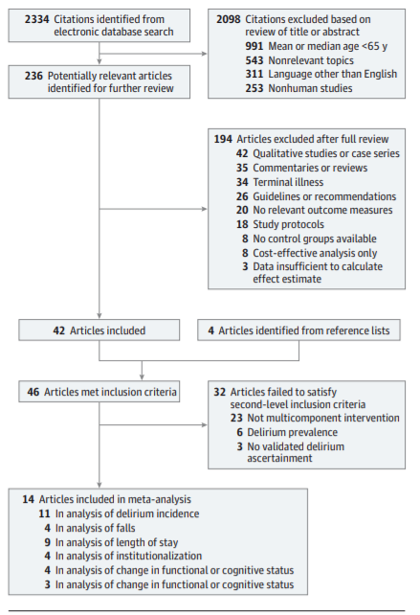
PRISMA diagram

Slide 13
Statistical analysis
Study quality and effectiveness of interventions -linear regression analysis to determine at the study level whether there was an association between the continuous Cochrane Collaboration’s risk of bias score (range, 0-6) and the multiplicative increase in odds (ie, OR) of incident delirium with intervention vs control.
Studies were divided into low quality (<3) and high quality (4-6) depending on their score and independent meta-analysis was done for each of them.

Slide 14
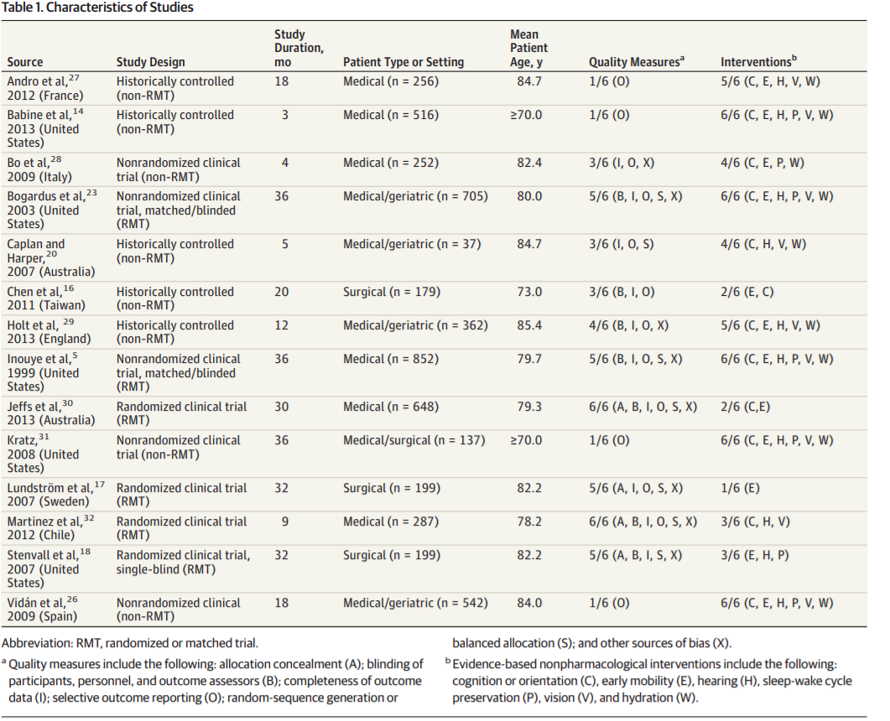
What is the risk of bias across all the studies?

Slide 15
Results
Approximately 4267 patients at 12 sites, mean age 79.7 years
Delirium incidence- 11 studies, odds of delirium were 53% lower in the intervention group compared with controls (OR, 0.47; 95% CI, 0.38-0.58). NNT 14
Meta-analysis of 4 studies examining fall incidence involving 1038 patients showed that the odds of falling were 62% lower among
intervention patients(OR, 0.38; 95% CI, 0.25-0.60).

Slide 16
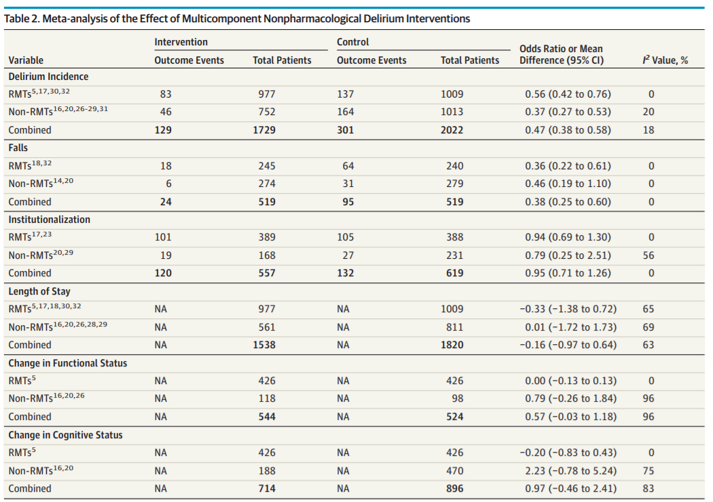

Slide 17
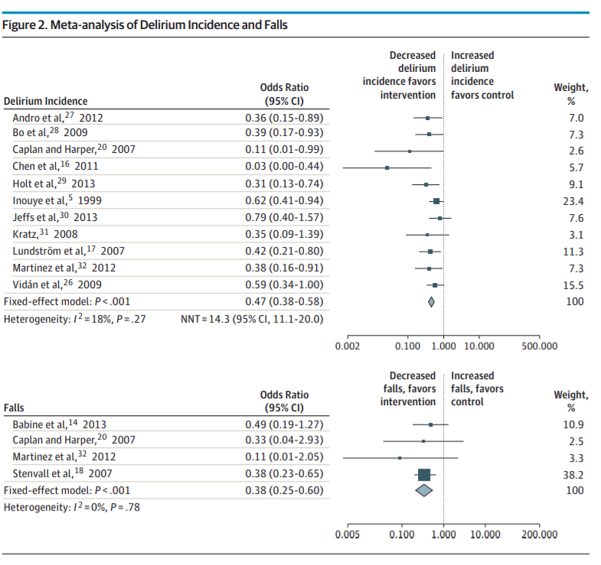

Slide 18
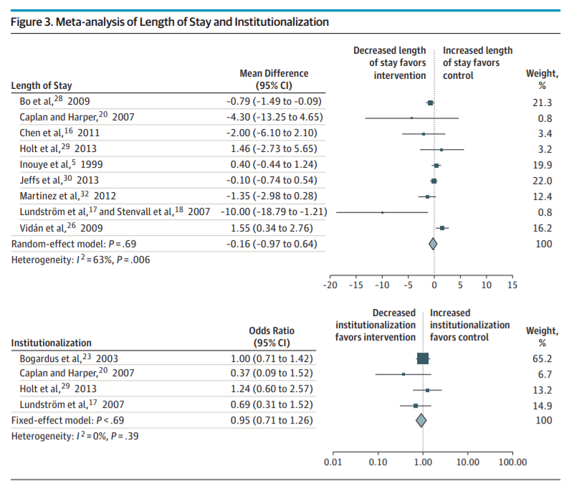

Slide 19
Credibility of the Systematic Review Process
Did the review explicitly address a sensible clinical question? Yes
Was the search for relevant studies exhaustive? No
Was the risk of bias of the primary studies assessed? Yes
Did the review address possible explanations of between-study differences in results? ?
Did the review present results that are ready for clinical application? Yes
Were selection and assessments of studies reproducible? Yes
Funding source: : Study was supported in part by grant from the National Institute on Aging.

Slide 20
Do the systematic review population, intervention, comparison, and outcomes fit the patient at hand (i.e., indirectness)?
Yes

Slide 21
Would your decisions differ if either boundary of the confidence interval represented the truth (i.e., imprecision which occurs with a small number of events and wide confidence intervals)?
Yes

Slide 22
Are the Results inconsistent Across Studies?
No

Slide 23
Is there a high likelihood of publication bias?
No funnel plot, hence cannot be commented upon

Slide 24
Do you consider the magnitude of treatment effect large (e.g. RR> 2.0 or <0.5)?
Yes

Slide 25
Do the Results Directly Apply to My Patient?
Yes

