Slide 1
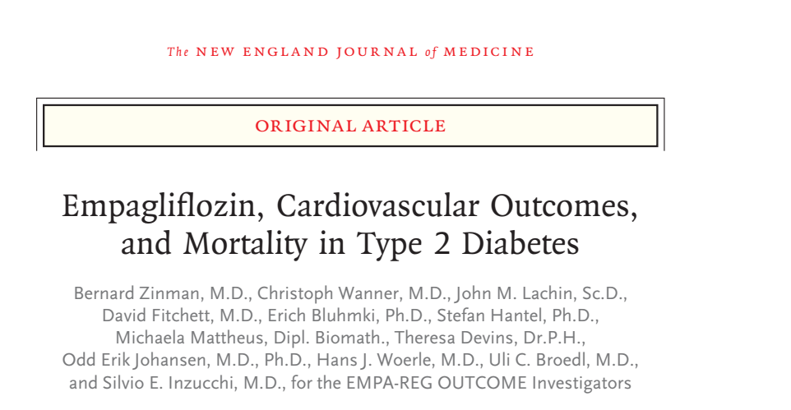
Rachana Shenoy
17/12/2018

Slide 2
Background
The protective effect of glycemic control on microvascular complications has been well established.
However, no class of drugs has effectively shown reduction in cardiovascular morbidity.
Empagliflozin is a renal SGLT2 inhibitor with the additional benefits of lowering BP, weight loss and low risk of hypoglycemia.

Slide 3
Multi center, randomized, double-blind, placebo-controlled trial.
P- Adult patients with Type 2 DM with a BMI ≤ 45 and eGFR of ≥ 30, 590 sites in 42 countries
I- Tab Empagliflozin 10mg or 25mg once daily
C- Standard care
O- Composite of death from cardiovascular causes, non fatal MI or stroke
T- September 2010 through April 2013

Slide 4
Inclusion criteria
Cardiovascular disease, defined by ≥1 of the following:
  MI >2 months prior
  Multivessel CAD
  Single vessel CAD with positive stress test or UA hospitalization in prior year
  UA >2 months prior and evidence of CAD
  Stroke >2 months prior
  Occlusive peripheral artery disease
Either of:
  No glucose-lowering agents in prior 12 weeks and A1c 7-9%
  Stable glucose-lowering therapy in prior 12 weeks and A1c 7-10%

Slide 5
Exclusion criteria
Uncontrolled hyperglycemia with fasting glucose >240 mg/dL
Liver disease with ALT, AST or ALP x3 ULN
Planned cardiovascular surgery or angioplasty in 3 months
GFR <30 mL/min/1.73 m² by MDRD
Prior surgery with chronic malabsorption in prior 2 years
RBC disorders
Cancer
Anti-obesity drug treatment in prior 3 months
Systemic steroids
Change in thyroid hormone dosage in prior 6 weeks
Nursing, pregnant, or child-bearing age women not using acceptable method of birth control or refusing pregnancy testing
Alcohol or drug abuse

Slide 6
Primary outcome - composite outcome of death from cardiovascular causes, nonfatal myocardial infarction, or nonfatal
stroke (3-point MACE)
Secondary outcome- 3-point MACE + risk of hospitalization for unstable angina

Slide 7
Statistical analysis
Noninferiority for the primary outcome with Empagliflozin (pooled doses of 10 mg and 25 mg) versus placebo with a margin of 1.3 for the hazard ratio.
Four-step hierarchical-testing strategy

Slide 8
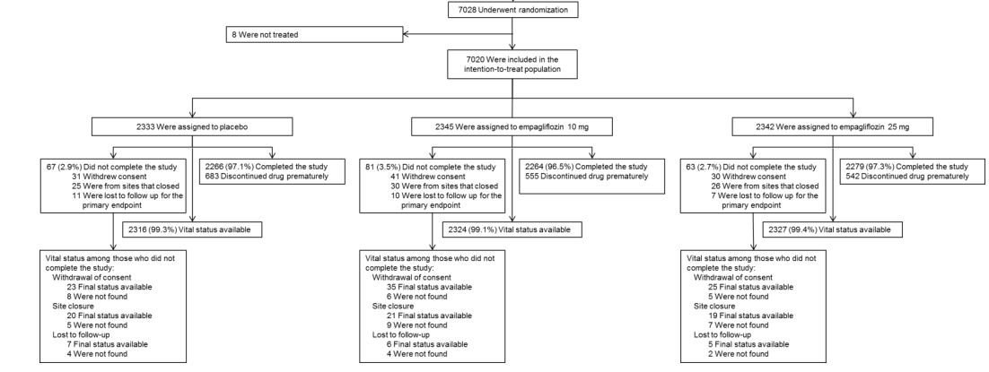

Slide 9
Were the groups prognostically balanced?

Slide 10
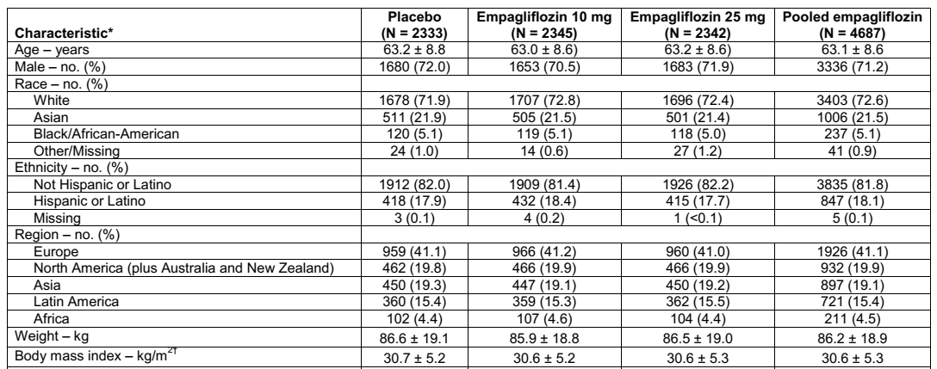
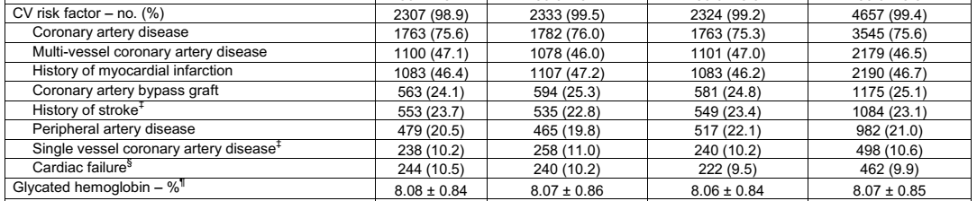

Slide 11
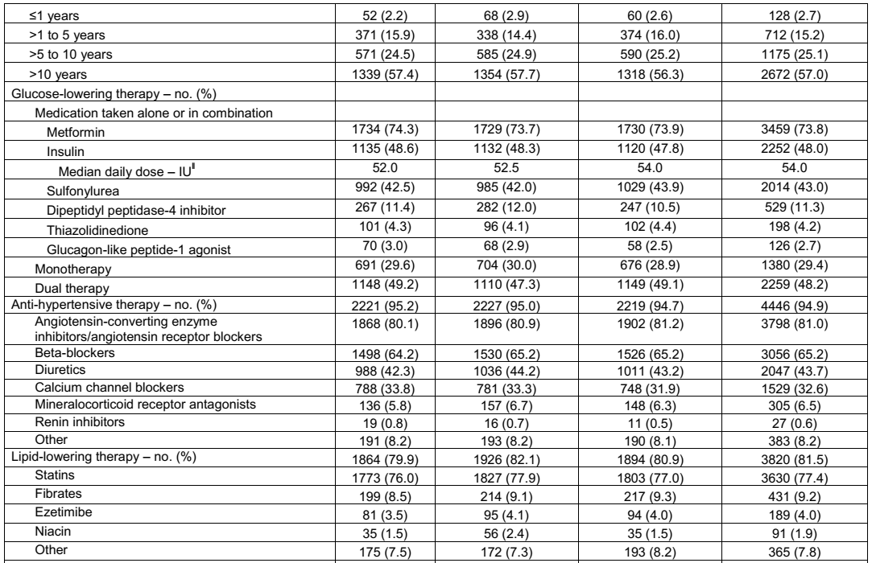

Slide 12
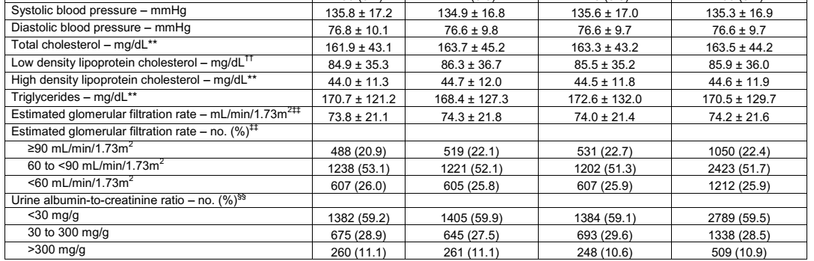

Slide 13
Were patients randomized?
Randomization was performed with the use
of a computer-generated random-sequence and interactive voice- and Web-response system.
1:1:1 – drug vs placebo
They were stratified according to HbA1c, BMI, eGFR and geographic location.

Slide 14
Was randomization concealed?
Yes

Slide 15
Were patients, caregivers, collectors of outcome data, adjudicators of outcome and data analysts aware of group allocation?
- Double blind

Slide 16
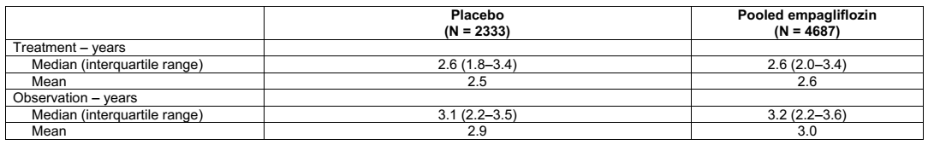
Was follow up complete?
Yes

Slide 17
Was the trial stopped early for benefit?
No

Slide 18
Were patients analysed in the groups to which they were randomized?
Yes

Slide 19
Did the investigators analyze patients according to the treatment they received and the groups to which they were assigned?
Yes

Slide 20
How large was the treatment effect?
The primary outcome occurred in a significantly lower percentage of patients in the Empagliflozin group (490 of 4687 [10.5%]) than in the placebo group (282 of 2333 [12.1%]) (hazard ratio 0.86; 95.02% [CI], 0.74 to 0.99; P<0.001 for noninferiority and P=0.04 for superiority).

Slide 21
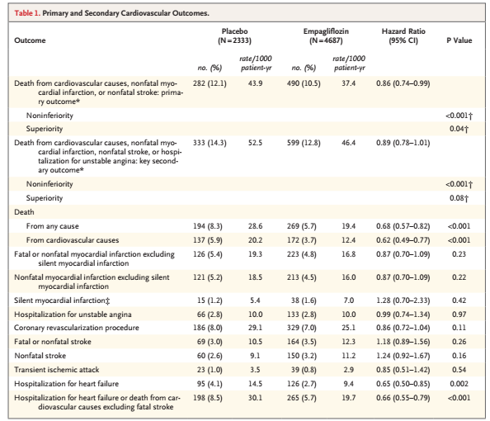
Results
Notes:
Given that only 10% of participants (706/7020) in EMPA-REG OUTCOME had known heart failure on enrollment, the 35% reduction in hospitalization for heart failure may represent prevention of new-onset heart failure or prevention of an exacerbation of existing, potentially undiagnosed heart failure in this population.
95% of patients received antihypertensive therapy (angiotensin-converting enzyme inhibitors/angiotensin receptor blockers, 81%; β-blockers, 65%; and diuretics, 43%), 77% of patients received statins, and 83% of patients received aspirin. This speaks to the ability of empagliflozin to tackle some of the residual cardiovascular risk not achieved by traditional means.

Slide 22
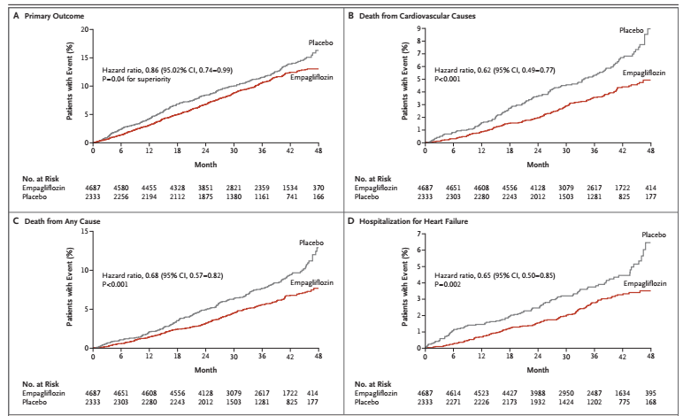
Notes:
Early separation- within 3-6 months

Slide 23
How precise was the estimate of the treatment effect?
The use of Empagliflozin was associated with a reduction in CV mortality, nonfatal MI, or nonfatal stroke (10.5% vs. 12.1%; HR=0.86 (95% CI 0.74-0.99), P=0.04; NNT 62).
Reduction in all-cause mortality (5.7% vs. 8.3%; HR=0.68 (95% CI 0.57-0.82), P<0.001; NNT 38) and cardiovascular mortality (3.7% vs. 5.9%; HR=0.62 (95% CI 0.49-0.77), P<0.001; NNT 45).
Reduction in hospitalization for HF (2.7% vs. 4.1% (HR 0.65; 95% CI 0.50-0.85; P=0.002; NNT 71)

Slide 24
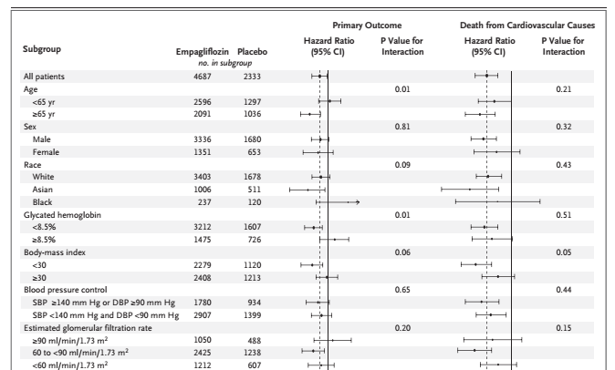
Did the intervention and control groups begin the study with a similar prognosis?

Slide 25
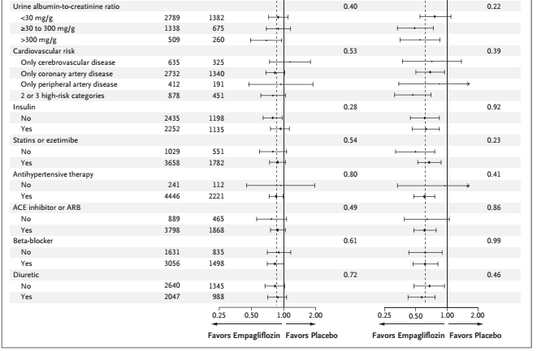

Slide 26
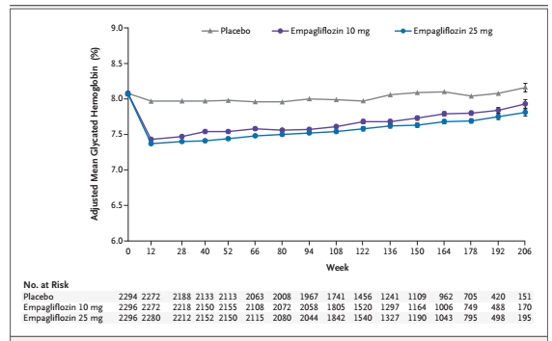
Glycemic control

Slide 27
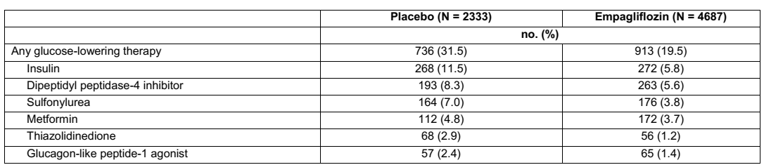
Effect on glycemic control- those requiring additional therapy

Slide 28
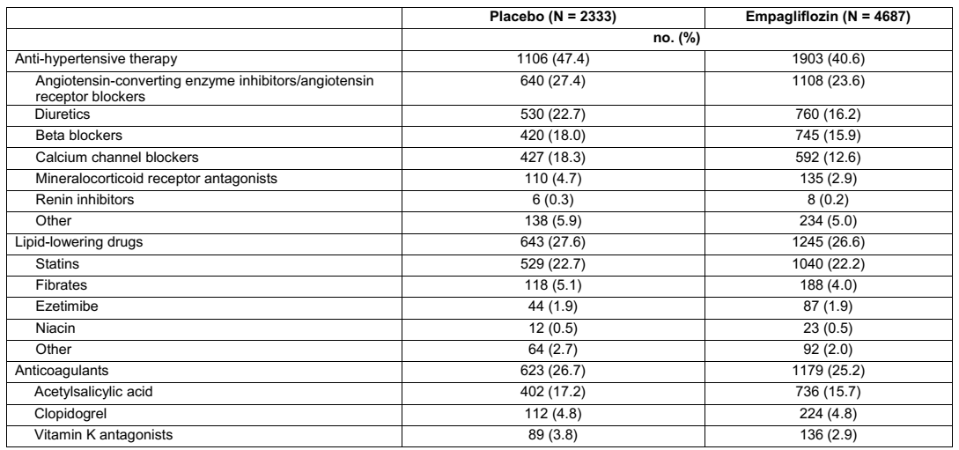
Addition of other drugs and effect on cardiovascular risk factors

Slide 29
Adverse effects
There were no differences in UTI or urosepsis between the groups though there was a greater incidence of genital infections with the medication (6.4% vs. 1.8%; P<0.001; NNH 22).

Slide 30
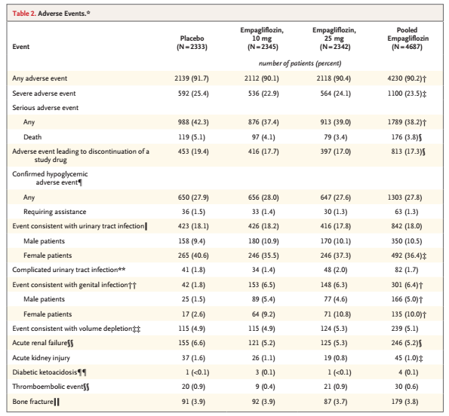
Adverse effects
Safety was assessed on the basis of adverse
events that occurred during treatment or within 7 days after the last dose of a study drug.
Notes:
Adverse events of special interest included confirmed hypoglycemic adverse events (plasma glucose level, ≤70 mg per deciliter or an event requiring assistance), and adverse events reflecting urinary tract infection, genital infection, volume depletion, acute renal failure, bone fracture, diabetic ketoacidosis, and thromboembolic events.

Slide 31
Limitations
Only 30% female population
Predominantly European White subjects
Entirely designed, funded and analysed by the pharma company.

Slide 32
How can I apply the results to my patient care?
Addition of this drug to standard care therapy for a patient with T2DM and high risk for cardiovascular morbidity – reduction in MACE/mortality.
Class effect or drug effect?
How to decide on which dose to give?

Slide 33
Were the study patients similar to my patients?
Yes

Slide 34
Were all patient-important outcomes considered?
Yes
They looked at cardiovascular outcomes (most important entity in long term morbidity and mortality in patients with T2DM).
They also looked at glycemic control.

Slide 35
Are the likely advantages of the novel treatment worth the potential harms and costs?
Cost of treatment with Empagliflozin for one month- approx Rs. 30,000.
A personalised approach- use of this drug.

