Slide 1
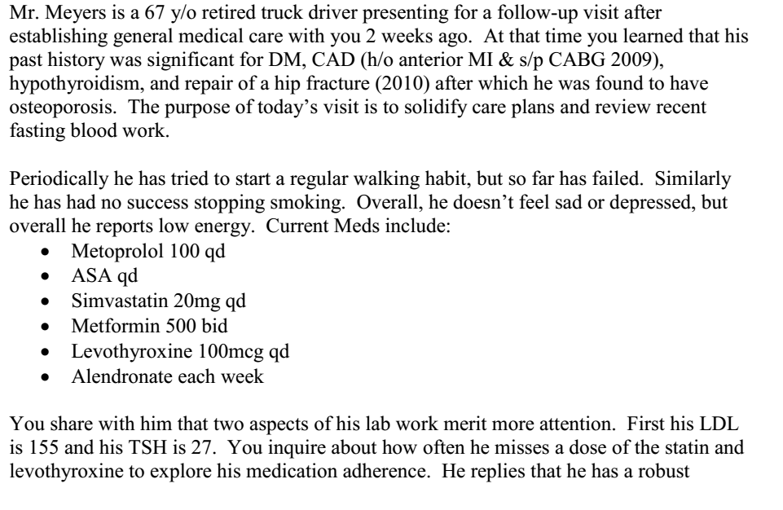

Slide 2
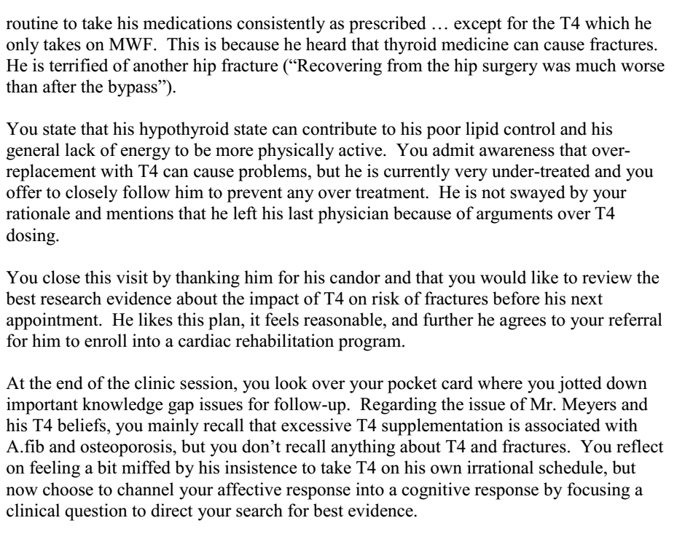

Slide 3
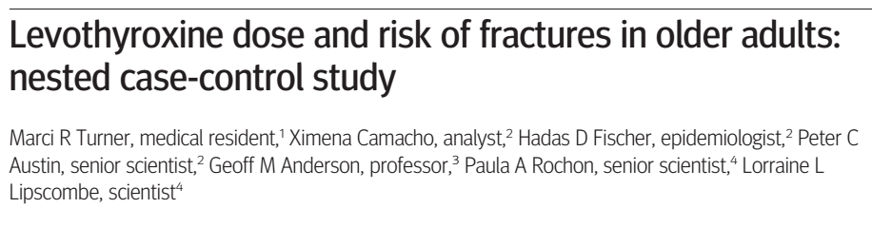
26/12/2018

Slide 4
Background
With normal ageing, thyroid hormone production, secretion and degradation decreases – older people with hypothyroidism have lower requirement s for replacement.
Over 20% of older adults are over treated leading to iatrogenic hyperthyroidism.
Subclinical hyperthyroidism is associated with lower bone density and bone quality , an excess of thyroid hormone effects the NM function and muscle strength – arrhythmias/falls/ fracture.

Slide 5
Methods
Population based, retrospective cohort with nested case control design
P: people above age of 70 years from the Ontario health database
Cases: prescription for levothyroxine
Controls: No levothyroxine prescription
O: fractures
Time: 1st April 2002 to 31st march 2007

Slide 6
Study Cohort
Inclusion:
  70-105 years
  At least one prescription for levothyroxine
Exclusion:
  Received dialysis or palliative care in 6 months before entry into cohort
  Thyroid cancer or previous hyperthyroidism

Slide 7
Outcomes
Primary outcome:
  Any fracture – wrist/forearm/shoulder/arm/thoracic spine/lumbar spine/pelvis/hip or femur/ leg or ankle.
Secondary :
  Hip or femur fracture alone
  Followed up until the first event of outcome, death, initiation of dialysis or palliative care, diagnosis of thyroid cancer or the end of the study.

Slide 8
Levothyroxine Use
Current: duration of prescription encompassed the index date
Recent: 15-180 days before the index date
Remote: more than 180 days from index date
Cumulative dose:
  Milligrams dispensed in the previous 15 months
  Minimum of 0.018mg to maximum of 158.5mg
  Low dose: daily dose in lowest 25th centile
  Medium: 25th to 75th centile
  High: >75th centile

Slide 9
Statistical Analysis
Conditional logistic regression to estimate associations between levothyroxine use and fracture outcomes.
Confounders:
  Charlson Comorbidity Index
  History of health service use
  Previous fractures
  Risk factors for fractures
  Use of prescription drugs

Slide 10
Are the results valid?
Did the cases and the control group have the same risk (chance) for being exposed in the past?
  Were the cases and the control similar with respect to the indication or circumstances that would lead to the exposure?

Slide 11
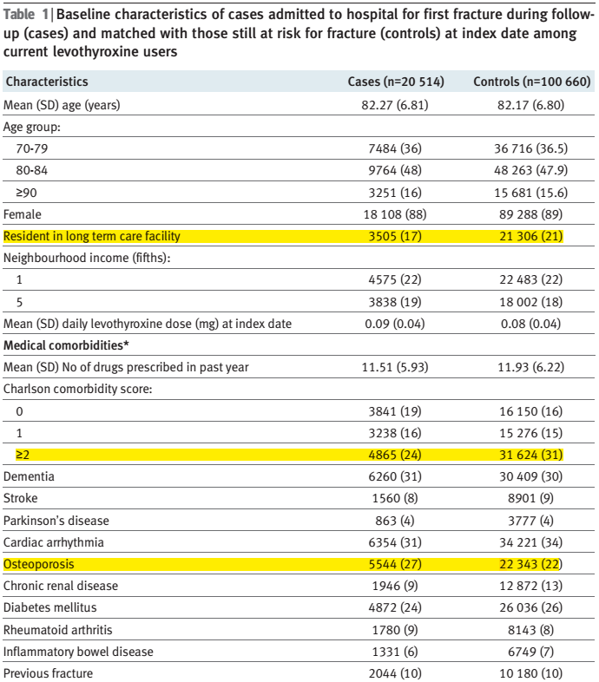

Slide 12
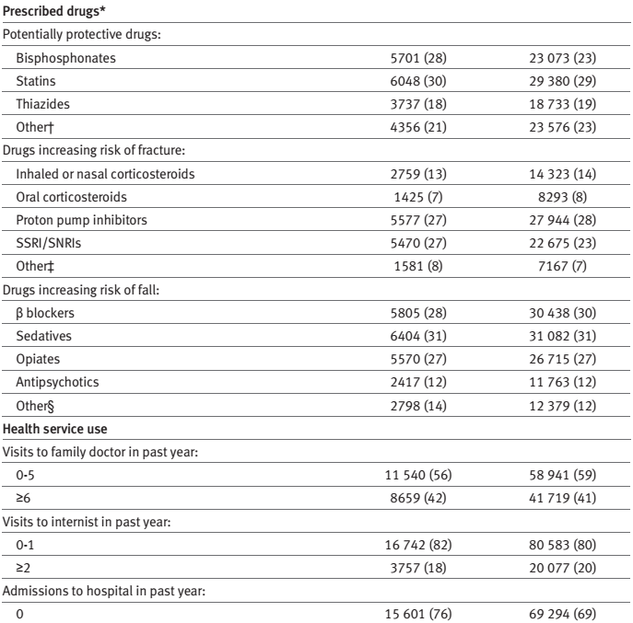
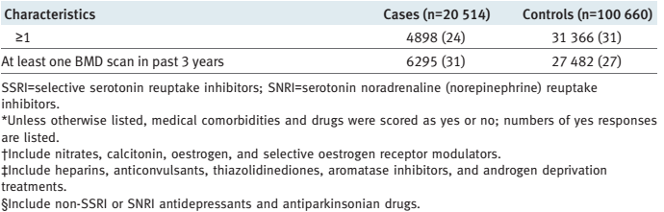

Slide 13
Were the circumstances and the methods for determining exposure similar for cases and controls?
  Yes

Slide 14
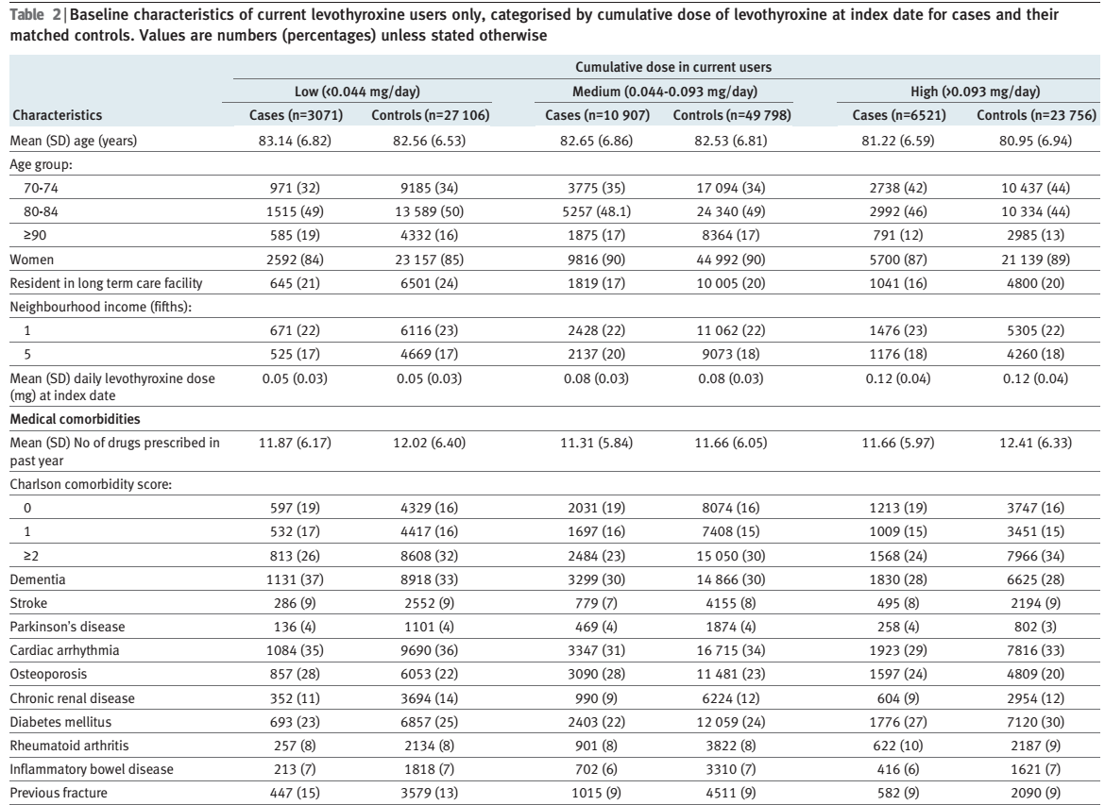

Slide 15
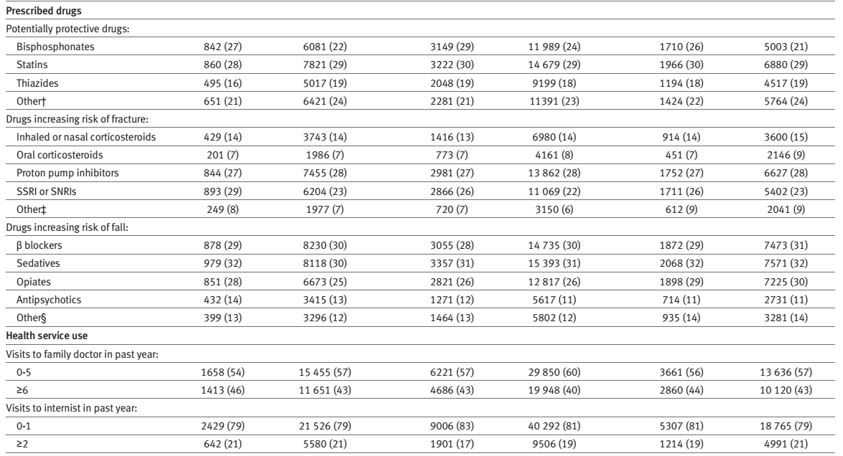
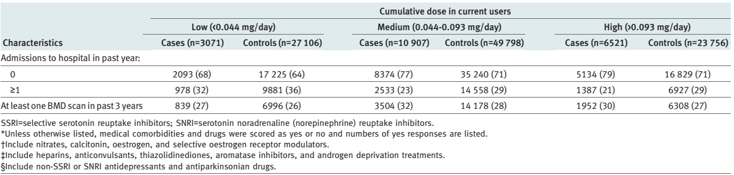

Slide 16
What are the results?
How strong is the association between exposure and outcome?
  213511 adults using levothyroxine
  Mean age 82
  3.83 years of follow up
  10.4% people (88% women) sustained at least 1 fracture
  92.3% of cases were current users of levothyroxine
  15% of which were low users mean daily does of 0.046mg
  53.2% were medium dose 0.076mg
  31.8% were high dose 0.122mg

Slide 17
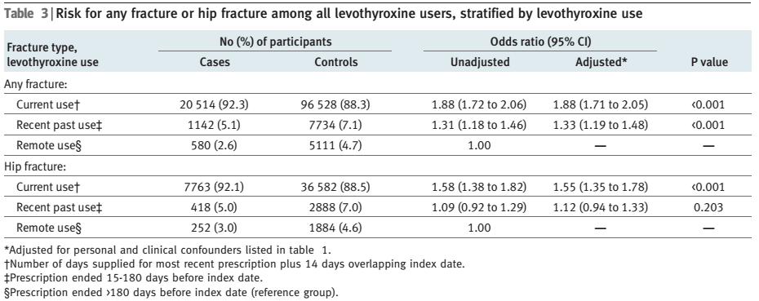

Slide 18
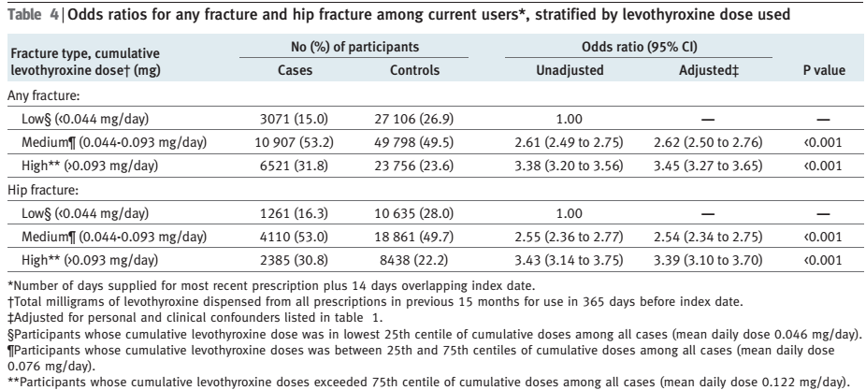

Slide 19
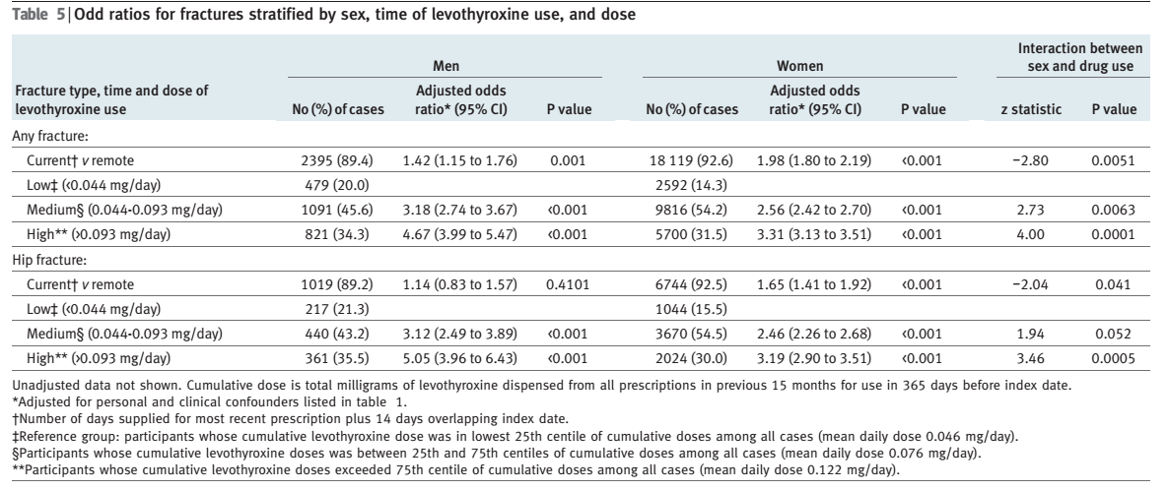

Slide 20
Limitations
Laboratory and radiological data were not available
Could not verify the indication for initiation of levothyroxine
Actual use of the drug could not be verified
Other risk factors like could not be measured

Slide 21
How precise is the estimate of risk?
  Increased risk of fracture of 1.88 ( 95% CI 1.71 to 2.05) for current levothyroxine users
  1.33 (95% CI 1.19 to 1.48) for recent levothyroxine users

Slide 22
How can I apply the results to my patient care?
Were the study patients similar to patients in my practice?
  Canadian population based study, no ethnicities provided.
Was the duration of follow up adequate?
  yes

Slide 23
Is the exposure similar to what might occur in my patient?
  possibly
What is the magnitude of the risk?
  1.88 increased risk of fractures
Are there benefits that offset the risks of the exposure?

