Slide 1
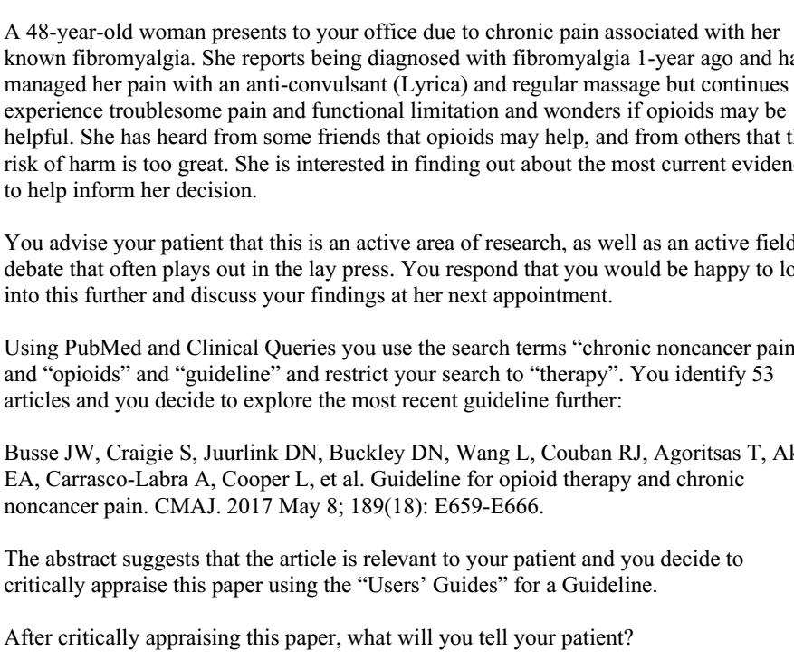

Slide 2
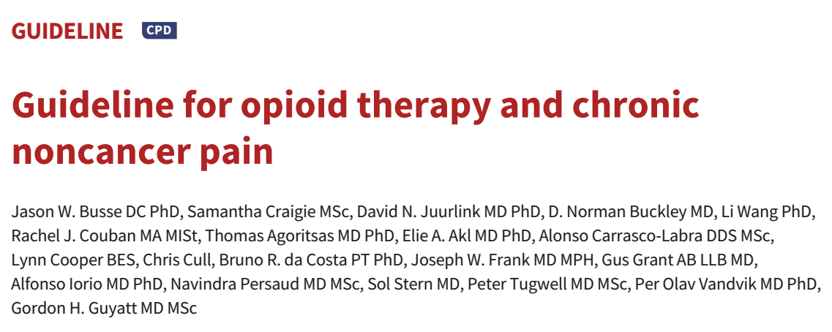
20/12/2018

Slide 3
Background
Chronic non cancer pain includes any painful condition that persists for at least 3 months and is not associated with malignant disease.
15-19% of Canadian adults live with chronic non cancer pain, which affects their activities of daily living, physical function and has an impact on quality of life.
Canada has the second highest rate per capita of opioid prescribing.
Substantial risk accompany the use of opioids in non cancer pain.
  Admissions to publicly funded treatment programs for opioid related problems doubled from 42004 – 2013
  1 in every 550 patients started on chronic opioid therapy died of opioid related causes at a median of 2.6 years from the first prescription

Slide 4
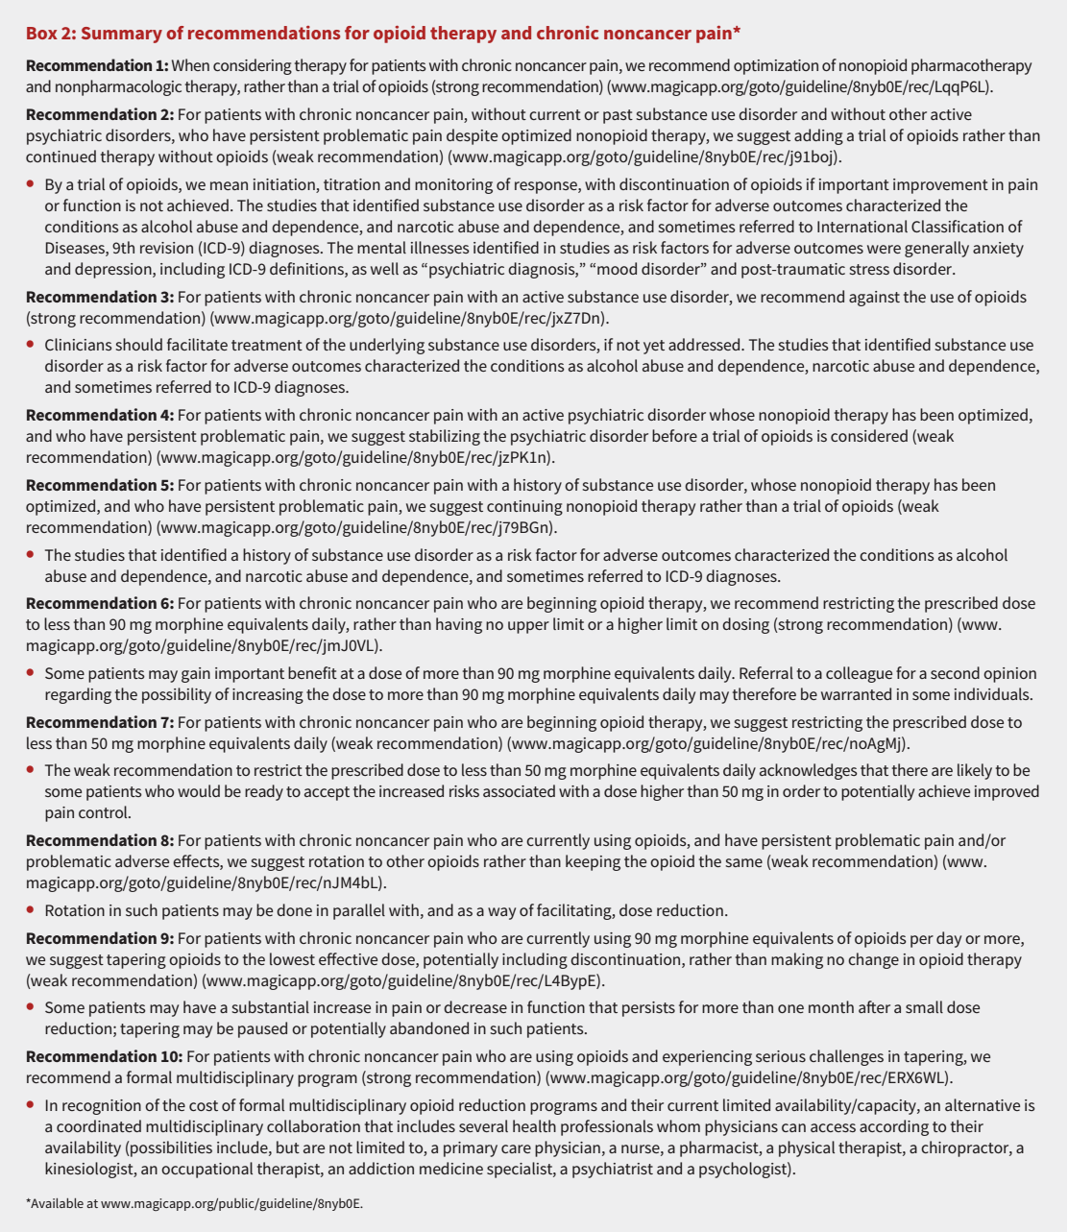

Slide 5

Overall objective of the guideline is specifically described?
  Yes
  Is to inform the prescribing of opioids for adults with chronic non cancer pain.
  Target audience includes : people who prescribe opioids or create policy regarding this issue.
  Score: 5

Slide 6
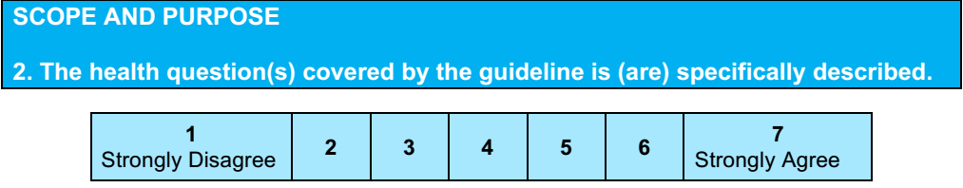
Use of opioids in the management of non cancer chronic pain for adults more than 18 years of age
Score: 6

Slide 7
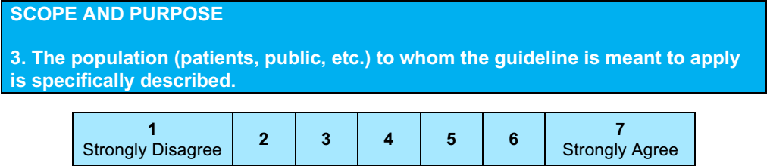
Yes
Score: 7
Patients with chronic pain

Slide 8
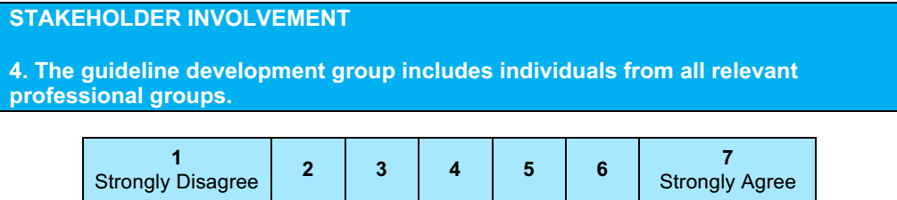
Steering committee: oversaw all aspects of guideline development.
Guideline panel: 13 clinicians and 2 patient representatives
Clinical expert committee: 13 experienced clinicians
Patient advisory committee: 16 member patient advisory committee.
Yes
Score 7

Slide 9
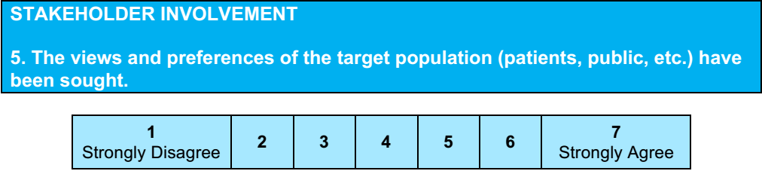
Yes
Score : 7
Stakeholders meeting in July 2015 to discuss the previous guidelines.
Second meeting in January 2017 to discuss the new guidelines
Attendees included:
  Representatives from law enforcement, pharmacy, medical regulation, patient advocacy groups, family medicine, pain medicine, addiction medicine, coroners, nursing , worker’s compensation boards, Canadian Centre on Substance abuse and CADTH.

Slide 10
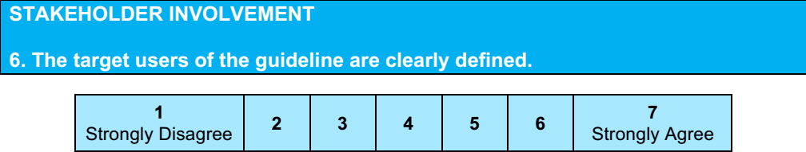
Yes
Score :7
Target audience: primary care physicians; specialists who manage patients with chronic non cancer pain; nurse practitioners; regulatory agencies
Secondary audience: patients living with chronic pain; pharmacist; other health care professionals who manage patients with non cancer pain.

Slide 11
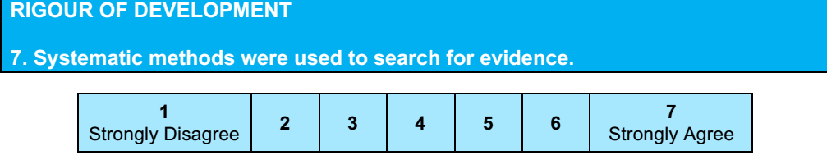
Evidence synthesis team: conducted systematic reviews.
  AMED
  CINAHL
  Cochrane Library
  Embase
  MEDLINE
  PsycINFO
  Pubmed till from July 2015 till October 2016
  Including RCT and observational studies.
  Evidence summaries were created using GRADE system
  Yes: score : 6

Slide 12
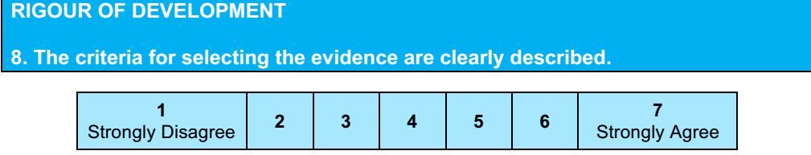
Not specifically mentioned, how many articles were assessed , and what the inclusion / exclusion criteria were.
Score: 2

Slide 13
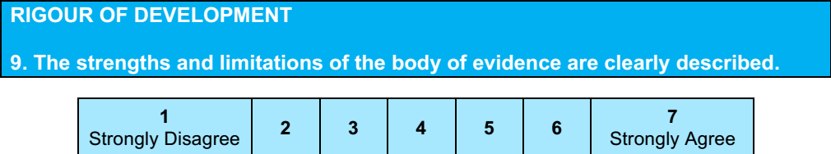
Reviewers assessed the risk of bias for RCT using modified Cochrane risk of bias instrument and for observational studies used the criteria from User’s guide to Medical literature.
Evidence summaries were created using GRADE system.
Score: 6

Slide 14
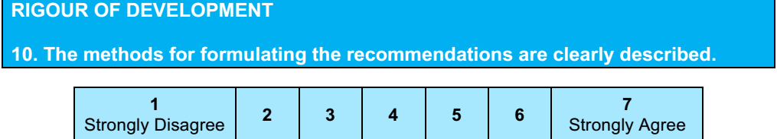
Yes
Score: 7
Three categories of guidance: recommendations, good practice statements and expert guidance.
GRADE system applied to move from evidence to recommendation.
1st in person meeting in July 2015
2nd in person meeting in January 2017
Online voting to select their recommendation

Slide 15
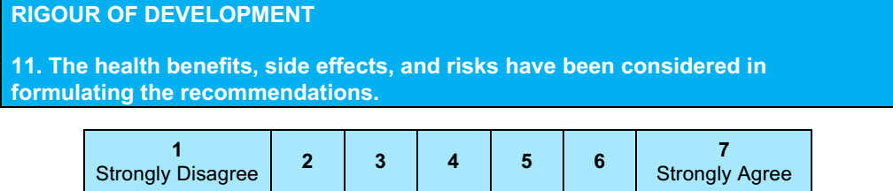
Yes
Score: 7

Slide 16
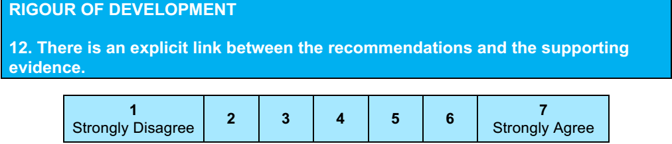
Yes
Score: 7

Slide 17
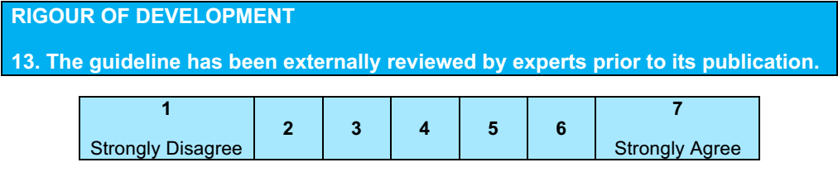
Yes
Score: 7
Draft of the guideline recommendations on the National Pain centre website for public consultation Jan 30 to Feb 28 2017
Then reviewed by external review committee for the adherence to the Clinical Practice Guideline we can trust

Slide 18
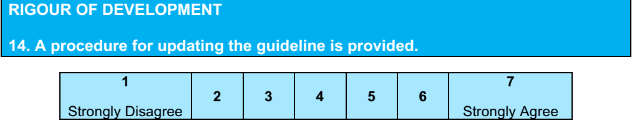
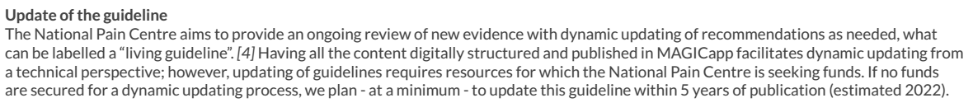
No
Score 1

Slide 19
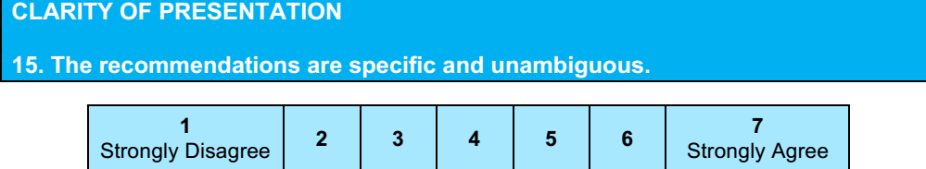
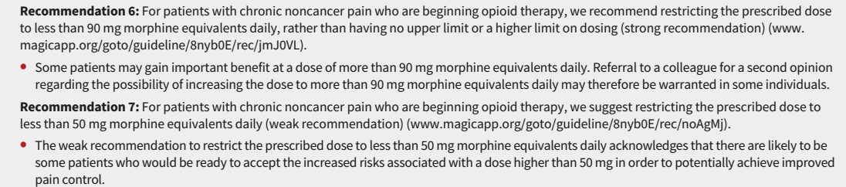
Score: 4
Two sub sections in the recommendations pertaining to dosage seem to be overlapping in nature

Slide 20
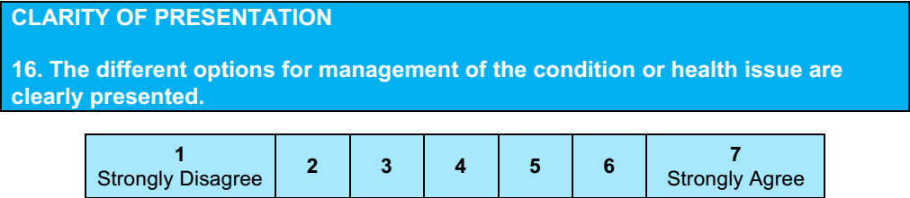
No
Score: 5

Slide 21
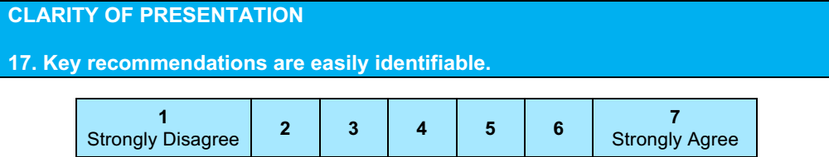
Yes
Score: 7

Slide 22
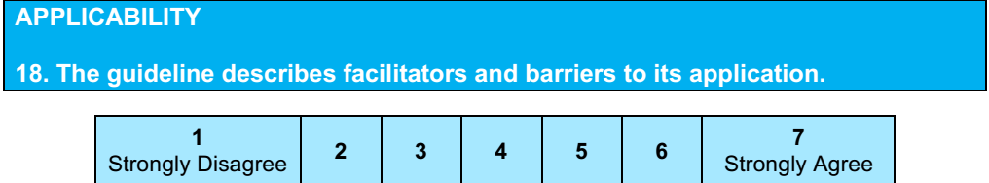
Yes
Score : 6
Recommendation are subject to resource availability.

Slide 23
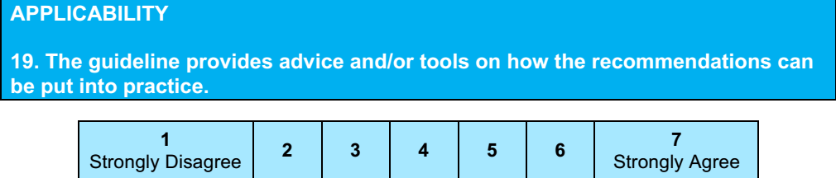
Yes
Score: 6

Slide 24
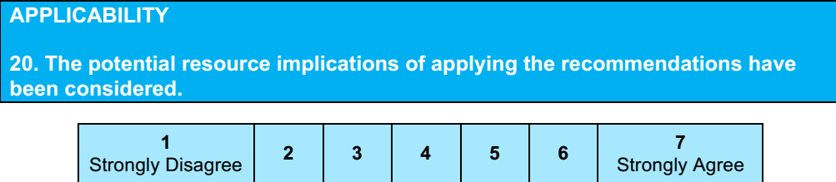
Yes
Score: 6

Slide 25
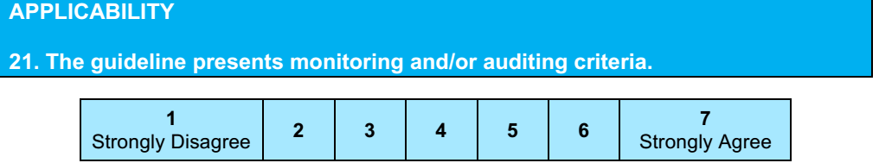
No
Score: 1

Slide 26
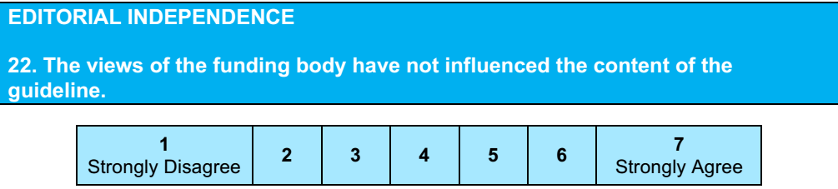
Score: 7
Investigator initiated
Grants from the Canadian Institutes of Health Research and Health
Canada
No role in design and conduct of the study

Slide 27
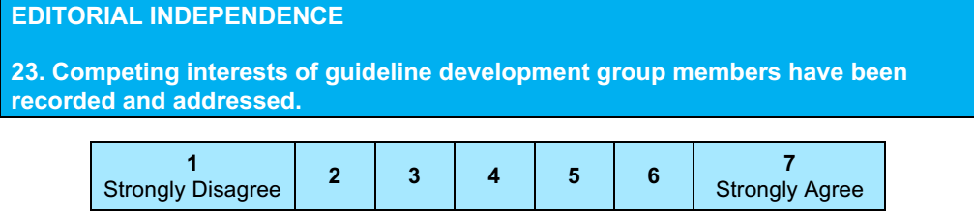

Yes
Score “: 6

Slide 28
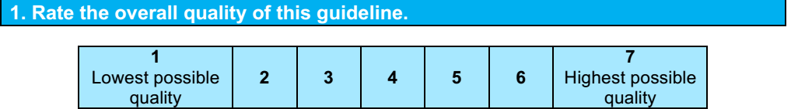
6

Slide 29
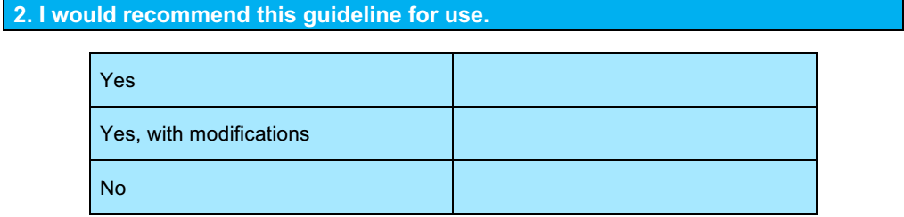
Yes , with modifications : dosing regimen to be clearly defined.

Slide 30
My patient would benefit from optimisation of non opioids analgesia, prior to the initiation of OPIODS.

