Slide 1
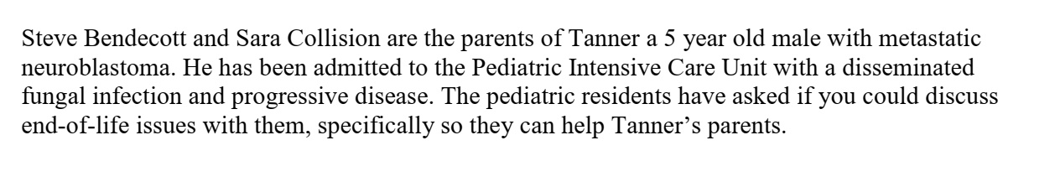
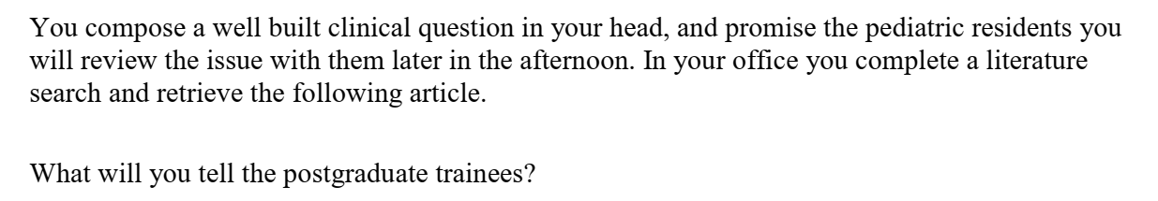

Slide 2
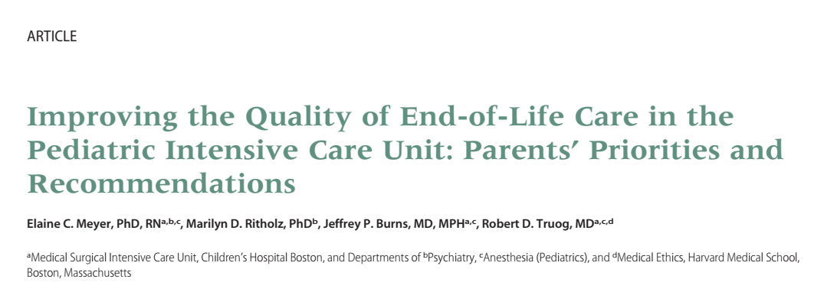


Slide 3
PICO
P - Parents whose children had died in PICU after withdrawal of life supports
I – open ended, self administered questionarres
O - To identify and describe the priorities and recommendations for end of-life care and communication from the parents’ perspective

Slide 4
Validity criteria

Slide 5
Was the choice of participants explicit and comprehensive?
Single hospital in Boston
Parents whose children had died after the foregoing of life-sustaining treatment were eligible to participate.
Age - newborn to 18 years
Full range of medical and surgical diagnoses
12 and 45 months had elapsed after the children’s deaths
Yes

Slide 6
Was data collection sufficiently comprehensive and detailed?
To elicit parent-derived rather than expert-hypothesized priorities
4 open-ended questions
Two questionnaires were mailed to each address to provide 1 for each of 2 parents in 2-parent households
Complete the questionnaire independently

Slide 7
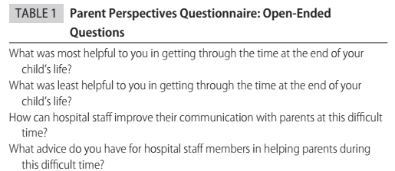
Yes

Slide 8
Were the data analysed appropriately and the findings corroborated adequately?
Yes
Data were read and coded independently by the first 2 authors
Parental priorities were established if they appeared in 20% of the parental responses.
Ethics committee clearance, consented

Slide 9
Results
96 eligible households
56 completed questionnaires (58%) from 56 different parents
36 mothers (64%) and 20 fathers (36%)
mean age of parent respondents was 42.3 years (±8.4)
75% were married
Ninety-one percent (91%) were white
Regarding religious identification, 50% were Catholic, 34% Protestant, 5% Jewish, 2% Muslim, and 9% indicated no religious affiliation

Slide 10
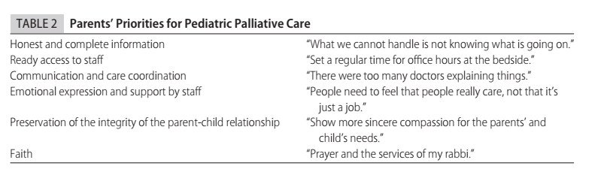

Slide 11
Applicability to patient care
Yes
Different social, cultural and educational back grounds

Slide 12
Does the study offer helpful theoretical conclusions?
Yes

Slide 13
Does the study help me understand the context of my practice
Yes

Slide 14
Does this study help me understand my relationships with patients and their families?
Yes

