Slide 1
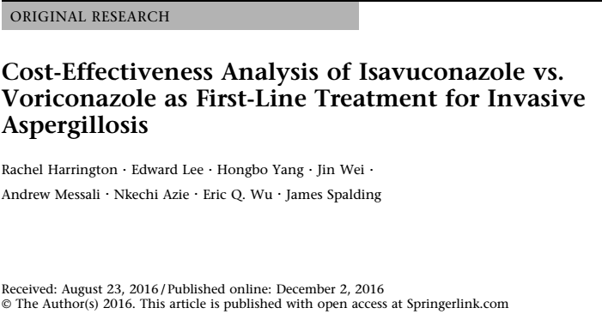

Slide 2
Background
Invasive aspergillosis is a fungal infection that primarily affects immunocompromised individuals.
Overall survival rates at 84 days after diagnosis has been reported to be 21%.
Median length of hospitalisation 18-26 days, with median costs between $32,465 and $68,008 with antifungal medications accounting for 6-10.2% of costs.
Voriconazole is the preferred agent for the first line treatment for IA for both clinical and economic perspective.

Slide 3
Literature review of 10 pharmaco-economic analyses in 6 different countries comparing voriconazole and other options for IA: voriconazole was the most cost effective.
In 2015 isavuconazole was approved for use for IA based on SECURE trial , showed that it had comparable efficacy to voriconazole.

Slide 4
Methods
Cost effectiveness decision tree model was constructed.
P: patients with proven, probable , possible IA (SECURE trial population)
I: treatment with isavuconazole
C: treatment with voriconazole
O: Total cost per IA patient
  Total cost defined as sum of drug + AE + hospital stay costs ( 30 days from first admission)
  Incremental cost per death avoided
  Incremental cost per additional responder
  US hospital perspective

Slide 5
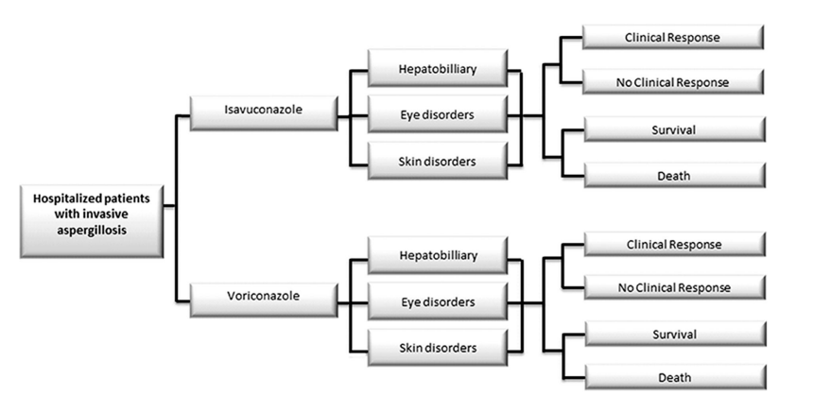
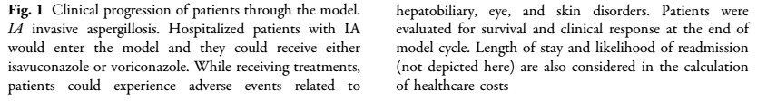

Slide 6
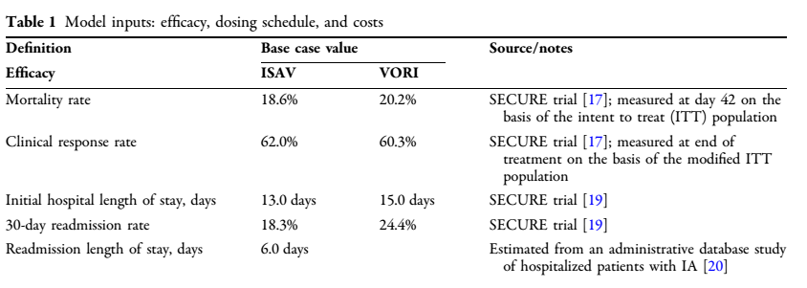
Efficacy and safety inputs
Extracted fro SECURE TRIAL

Slide 7
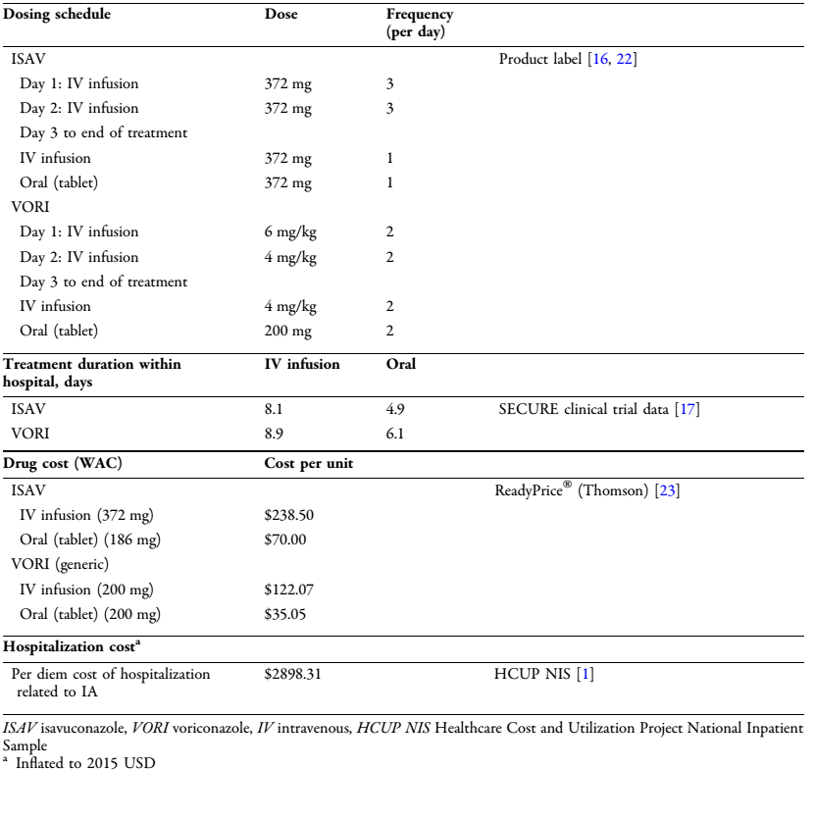

Slide 8
Are the results valid?
Did the recommendations include all patient relevant groups, management options and possible outcomes?
  Did they adopt a sufficiently broad point of view?
    No.
    US hospital based estimation
    Data from the SECURE trial alone was used.
    However, the comparison of voriconazole which is first line management for IA to other pre-existing treatment options has already been done.

Slide 9
Are the results reported separately for different patient groups?
  Yes, specific different patient group was estimated.

Slide 10
Is there a systematic review and summary of evidence linking options to outcomes for each relevant question?
Were costs measured accurately?
  yes

Slide 11
Did the investigators consider timing of costs and outcomes?
Up to 30 days from first admission was the time frame considered .

Slide 12
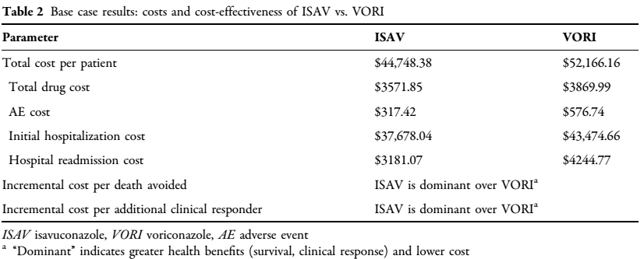
What are the results?
What are the incremental costs and effects of each strategy?

Slide 13
Do incremental costs and effects differ between sub groups?
  YES
  DSA for incremental cost per death avoided and incremental cost per clinical responder showed isavuconazole was dominant against voriconazole except when:
    Length of hospital stay was increased by 25% for isavuconazole and voriconazole remained unchanged
    42 day mortality rate or clinical response rate changed unfavourably for isavuconazole and remained unchanged for voriconazole.

Slide 14
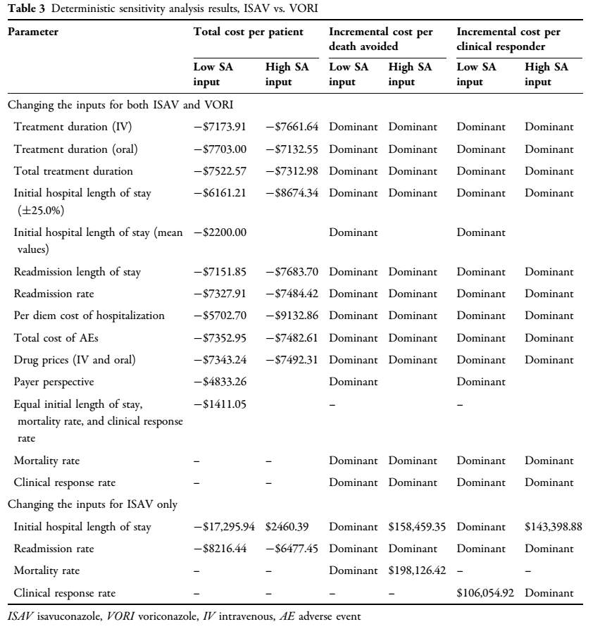
Deterministic and Probabilisitic Sensitivity Analysis

Slide 15
How much does allowance for uncertainty change the results?
No mention of underlying comorbid conditions have been considered.
Does not allow for uncertainty

Slide 16
Limitations
Did not consider cost of treating underlying conditions
No subsequent therapy was considered
US hospital based analysis
Funded by the Astellas Pharma Development Group

Slide 17
How can I apply the results to my patient care?
Are the treatment benefits worth the harm and costs?
  yes
Can I expect similar costs in my setting?
One vial of isavuconazole 372mg is Rs. 18,000/, thrice daily dosing
for 8 days : Rs. 4,32,000
Voriconazole 1 vial 200mg is Rs,1,990/- thrice daily dosing for 8 days
  Rs.47,760/-

