Slide 1
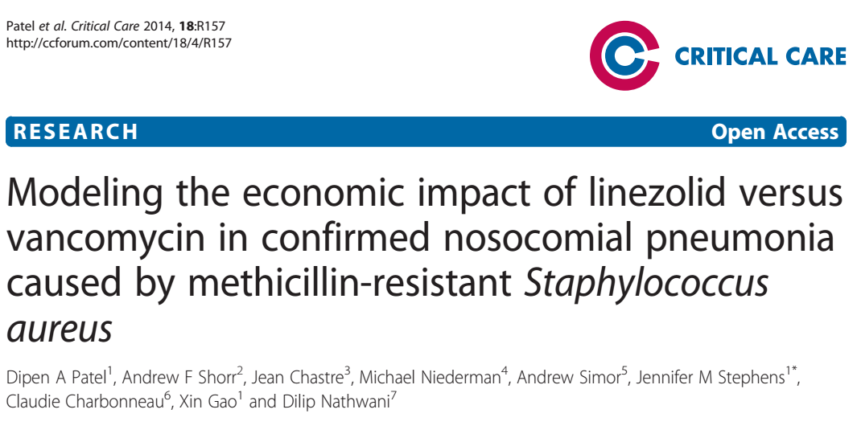
24/12/2018

Slide 2
Background
Nosocomial Pneumonia is the second most frequent hospital acquired infection in the US.
MRSA is responsible for a large number of case of health care associated and ventilator associated pneumonia.
MRSA associated NP results in considerable patient morbidity and mortality and use of health care resources with significant length of hospital stay.

Slide 3
Vancomycin and Linezolid are commonly recommended agents in clinical guidelines for the treatment of MRSA.
2 large prospective RCT’s that linezolid (600mg every 12 hours) was statistically non inferior to fixed dose vancomycin (1gm twice daily)
In retrospective sub group analysis of this of these trials revealed significantly higher survival and clinical cure rates in the linezolid treatment group.
Investigate the economic impact of improved clinical outcomes with linezolid compared with vancomycin in the treatment of MRSA confirmed NO

Slide 4
Methods
Model Design
  Cost effectiveness analysis for IV linezolid Vs IV vancomycin
  Decision tree modelling approach : to capture first line and second line therapy
  Time horizon was 4 weeks
  Total payer perspective was considered the base case analysis
  Based on a recent phase IV prospective, double blind , controlled , multi centre international clinical trial
    Mean age 62
    69% white
    66% male
    75% mechanically ventilated
    85% at least 1 day ICU admission
    63% were from the US

Slide 5
P: Patients with Nosocomial pneumonia due to MRSA
I: IV linezolid
C: IV vancomycin
O: treatment success
  Failure
  Drug discontinuation
  Failure due to death
T: 4 weeks follow up

Slide 6
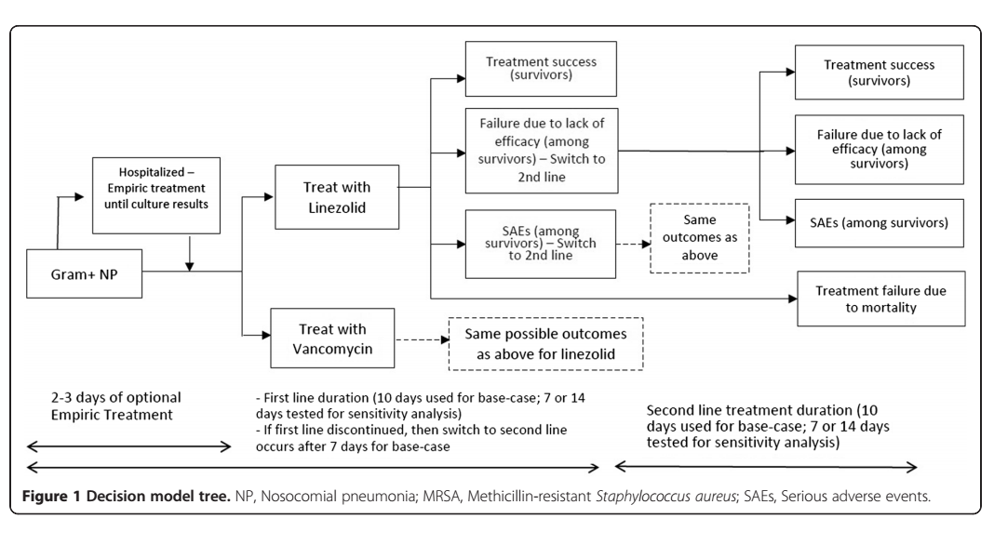

Slide 7
Are the recommendations valid?
Did they consider all relevant patient groups, management options and possible outcomes?
  Direct medical costs were evaluated as both in patient and out patient.
  No indirect medical costs or non medical costs were estimated

Slide 8
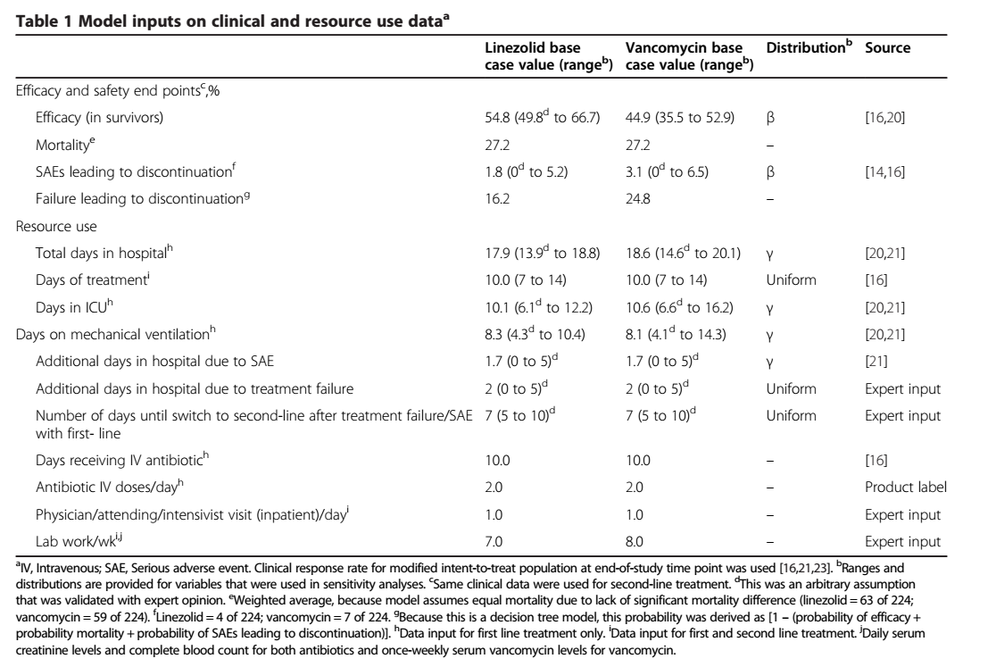

Slide 9
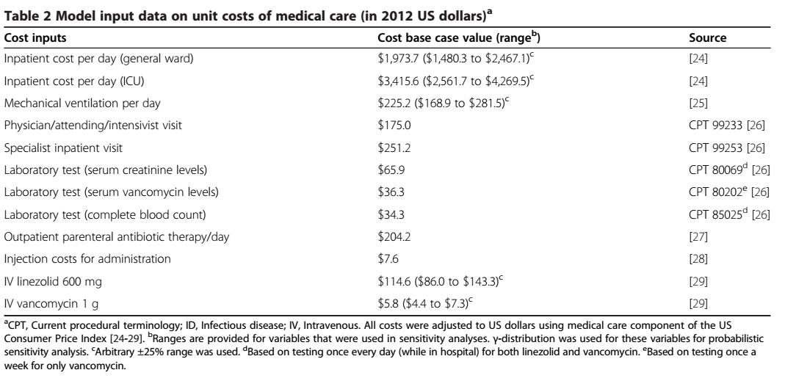

Slide 10
Sensitivity analysis
One way sensitivity analysis was used to assess impact of model uncertainties and the robustness of the analysis.
A published source was used for ranges wherever possible.
In its absence an arbitrary range was used (+/- 4 days for length of stay or +/-25% of cost.)
Probabilistic sensitivity analysis was performed.

Slide 11
Are there systematic reviews of the evidence that estimate the relative impact of management options on relevant outcomes?
  No, they have mentioned published data, but no specifications provided.
Is there an appropriate specification of values and preferences associated with each of the outcomes?
  Based on previously published data or in the absence of the same, arbitrary measures were used.
Do the authors indicate the strength of their recommendations?
  no

Slide 12
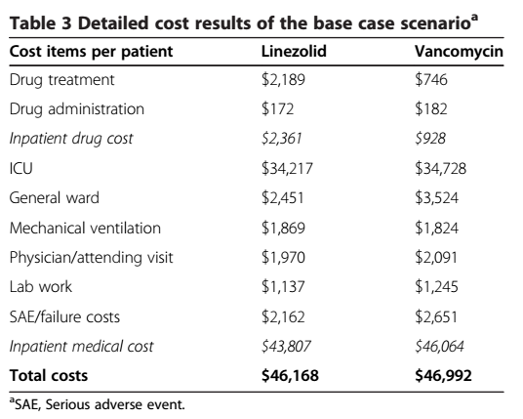
What are the results?
Proportions of successfully treated patients were 62.9% with linezolid and 60.2% with vancomycin.
Factoring in success rates, cost of treating a patient with Linezolid was $73,420 and $78,073 for vancomycin.

Slide 13
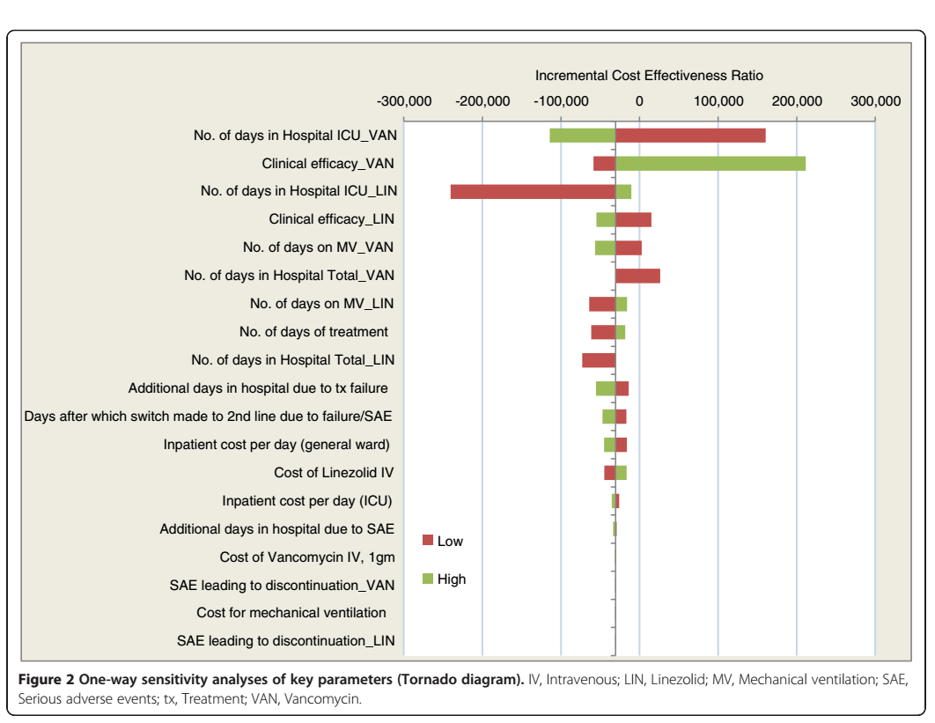

Slide 14
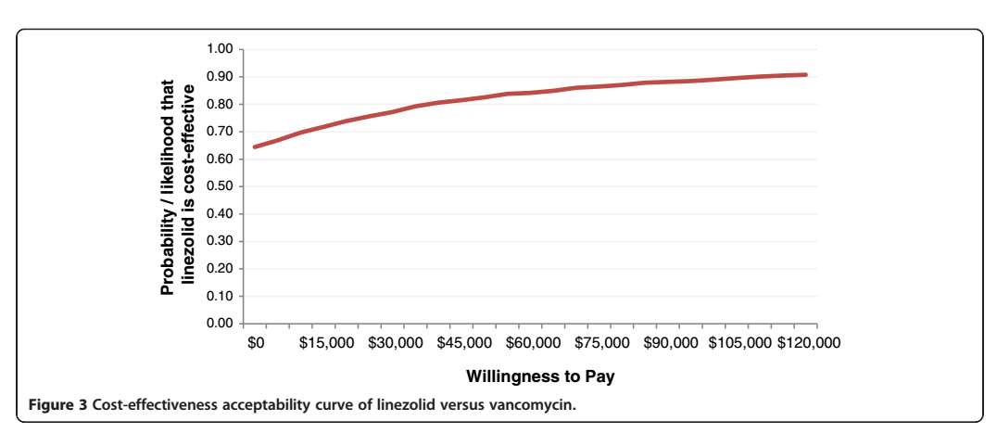

Slide 15
What are the key recommendations?
Linezolid is cost effective alternative to vancomycin for treatment of MRSA NP

Slide 16
Will the recommendations help you in caring for your patients?
Do the recommendations make sense n your practice setting?
Vancomycin 1gm Rs. 650
Linezolid 600mg Rs.300

