Slide 1
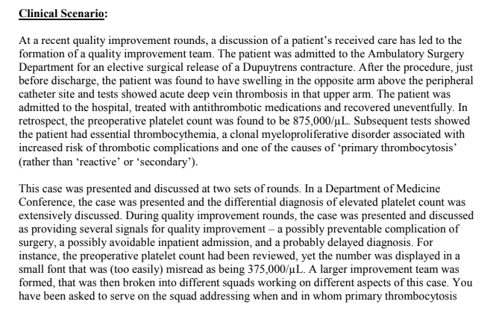

Slide 2
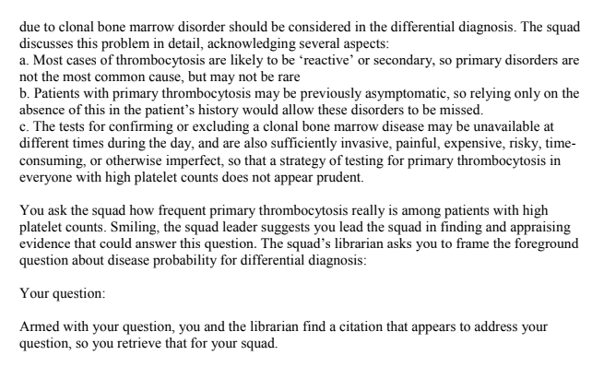

Slide 3
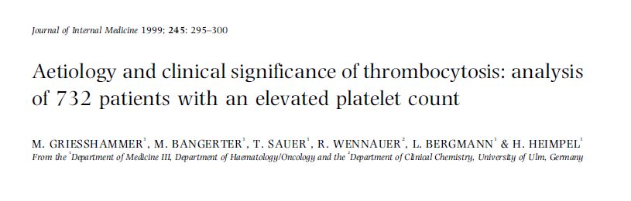
ANUSHA.S

Slide 4
Primary thrombocytosis refers to a persistent elevation of platelet count due to clonal thrombopoiesis as it occurs in chronic myeloproliferative or in some myelodysplastic disorders .
Secondary thrombocytosis is due to a variety of underlying conditions. Short-lived secondary thrombocytosis is observed in conditions such as acute bleeding, trauma, major surgical procedures or after severe physical exertion .
In contrast, secondary thrombocytosis associated with malignancy, chronic infection, iron deﬁciency or chronic inﬂammatory diseases may persist for a longer time.

Slide 5
Objective
To determine the etiology and clinical signiﬁcance of an elevated platelet count (thrombocytosis) in a large cohort of patients
Design
A retrospective review of the medical records was performed on all patients, who had at least one platelet count 500 * 109 /L encountered during a 3.5-year period.
Setting
Departments of Medicine and Surgery, University of Ulm, Germany.

Slide 6
Retrospectively reviewed the medical records of all 732 patients to determine
(i) the etiology of elevated platelet counts:
(ii) additional laboratory parameters, i.e. full blood count, serum potassium, creatinine. lactic dehydrogenase (LDH). Erythrocyte sedimentation rate (ESR) and plasma ﬁbrinogen
(iii)the presence of thromboembolic complications; and
(iv) follow-up information.

Slide 7
Did the study patients represent the full spectrum of those with this clinical problem?
Yes
Was the diagnostic evaluation definitive?
All platelet counts were performed on Coulter counter STKS (Coulter Electronics, Krefeld, Germany) using EDTA anticoagulated fresh blood. The normal range of platelet counts for this machine is 150-450*109 /L. High counts were conﬁrmed by repeat examinations and/or peripheral smear examination.

Slide 8
What were the diagnoses and their probabilities?
How precise are the estimates of disease probability?

Slide 9
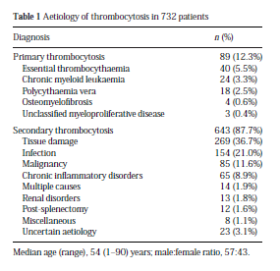

Slide 10
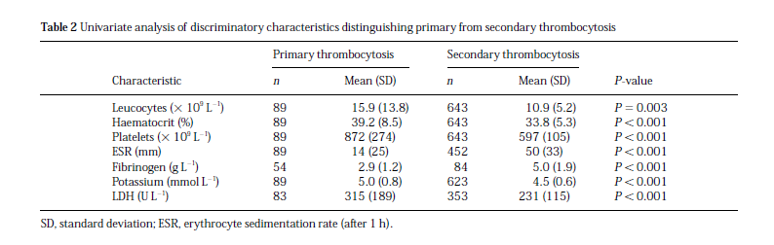

Slide 11
Significantly higher incidence of both arterial and venous thromboembolic complications in patients with primary thrombocytosis (12.4%) as compared to patients with secondary thrombocytosis (1.6%).
All patients with secondary thrombocytosis developing thrombotic complications had additional risk factors such as preceding surgery or a coexisting malignancy.

Slide 12
Are the study patients and clinical setting similar to mine?
Is it unlikely that the disease possibilities or probabilities have changed since this evidence was gathered?

