Slide 1


Slide 2
BACKGROUND
Clinically difficult to distinguish between a swollen joint due to crystal arthritis or septic arthritis.
Distinction is critical because septic arthritis is associated with a much higher rate of morbidity.
Joint fluid WBC count is often used to help distinguish inflammation from infection.
Crystal arthritis, such as gout and pseudogout, can also elevate the synovial WBC count.
It is not clear whether the presence of crystals (one definite diagnosis) nullifies the value of the WBC count in excluding the possibility of septic arthritis.

Slide 3
CLINICAL QUESTION
Does elevated synovial WBC count in patients with crystal arthritis useful in diagnosis of concomitant septic arthritis?

Slide 4
METHODOLOGY
PATIENT: All adult patients >/= 18 years of age with crystals in the joint aspirate sent to the laboratory during the study period of Jan 1996 to December2002.
STUDY DESIGN- Retrospective study conducted at an urban university tertiary care referral center.

Slide 5
METHODOLOGY
Hospital medical database was queried for all joint fluid samples containing crystals during the 7-year study period.
Using a structured, standardized form, the following data were explicitly extracted from the patients’ medical records:
  Age, gender, joint aspirated, synovial fluid culture.
  Gram’s stain, synovial WBC count, type of crystals, and the discharge diagnosis.
Septic arthritis was defined as a positive synovial fluid culture.
Fluid samples that were found to originate from a bursa were excluded.

Slide 6
RESULTS
365 fluid samples containing crystals.
100 patients were excluded
  80 patients had a repeat arthrocentesis of the same joint.
  20 patients were found to have fluid sent from a bursa rather than a joint
265 fluid samples
  183 (69.0%; 95% confidence interval [CI] 63.5–74.6%) contained monosodium urate crystals (gout)
  81 (30.6%; 95% CI 25.0 –36.1%) contained calcium pyrophosphate crystals (pseudogout)
  1 (0.4%) contained both.

Slide 7
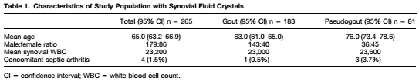
BASELINE CHARACTERISTICS

Slide 8
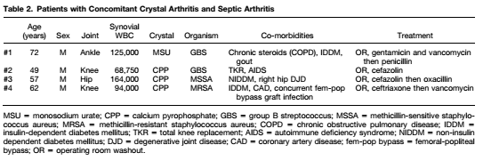
4 of the crystal containing samples had positive cultures.
  2 beta-hemolytic streptococcus and 2 staphylococcus aureus.
Mean synovial WBC count of the 4 samples with concomitant crystals and septic arthritis was
  113,000 (95% CI 72,700 – 153,200), which was significantly higher than the entire population at 23,200 (p > 0.01).
4 patients with concomitant disease had significant co-morbidities and synovial WBC counts > 50,000

Slide 9
Are the results of the study valid?
Did the clinicians face diagnostic uncertainity?
  Yes.
  Difficulty in differentiating septic arthritis from crystal arthritis.
Was the blind comparison with an independent gold standard?
  Gold standard was synovial fluid culture.
Did the results of the test being evaluated influence the decision to perform the gold standard?
  No. All participants had synovial fluid culture done.

Slide 10
WHAT ARE THE RESULTS?
What likelihood ratios are associated with the range of possible test results?

Slide 11
Wbc count > 50,000 but less than 1 lakh
 | DISEASE + | DISEASE - | Total
> 50,000 | 4 (TP) | 31 (FP) | 35
< 50,000 | 0 (FN) | 230 (TN) | 230
Total | 4 | 261 | 265
Sensitivity= TP/ (TP + FN)
  = 4/4= 1
Specificity= TN/ (TN +FP)
  = 230/230= 1
LR+ = Sensitivity/ (1- specificity)= 1/0
LR- = (1- sensitivity)/ Specificity= 0
NOT FEASIBLE

Slide 12
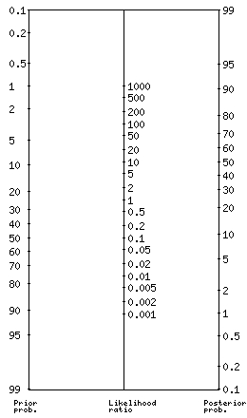
WBC COUNT > 1LAKH VERSUS < 1 LAKH
 | DISEASE + | DISEASE - | TOTAL
> 1 LAKH | 2 (TP) | 16 (FP) | 18
< 1 LAKH | 2 (FN) | 245 (TN) | 247
TOTAL | 4 | 261 | 265
Incidence of 22 % if WBC is made to more than 1,00,000
  4/x= 0.22
  X= 4/0.22= 18.
Sensitivity= 2/2= 0.5
Specificity= 245/261= 0.939
LR+ = 0.5/0.061= 8.19
LR- = 0.5/ 0.939= 0.53

Slide 13
HOW CAN I APPLY THE RESULTS TO PATIENT CARE?
Will the reproducibility of the test result and its interpretation be satisfactory in my setting?
  Requires further studies.
  Low synovial fluid culture positivity
    Did not include patients with positive blood culture or clinically found to have purulent synovial fluid.
Are the results applicable to my patient?
  Racial differences. Minimal baseline characteristics only available.
Will the results change my management?
  Yes
Will patients be better off as a result of the test?
  Yes. Possibility of septic arthritis needs to be considered even in patients with crystal arthritis.

