Slide 1
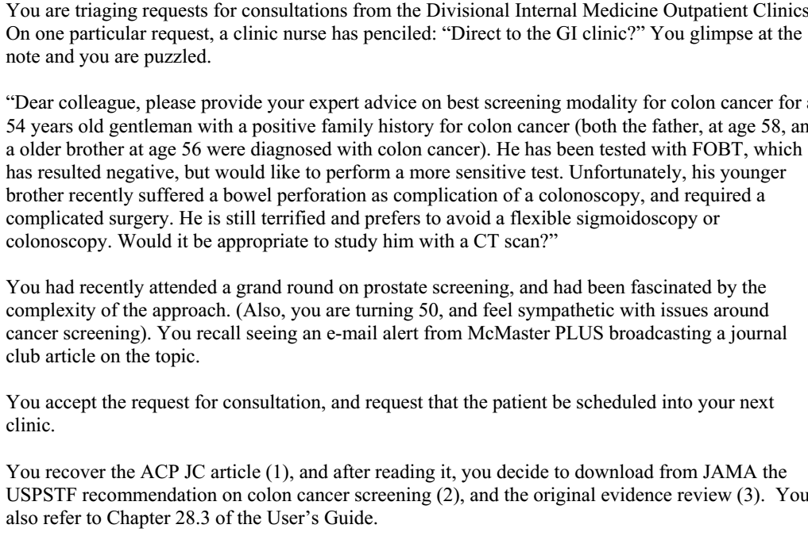

Slide 2
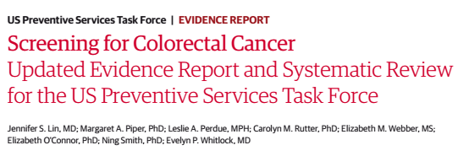
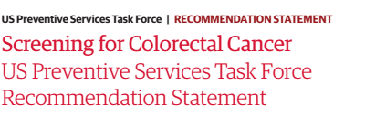
27/12/2018

Slide 3
Background
Even though its incidence is on the decline colorectal cancer is still a cause for significant morbidity and mortality in the US
A variety of tests are available for screening.
USPSTF recommend that CRC screening be done every 10 years with colonoscopy, an annual high sensitivity gFOBT or FIT and SIG every 5 years.
Current systematic review has been carried out to update relevant evidence since 2008.

Slide 4
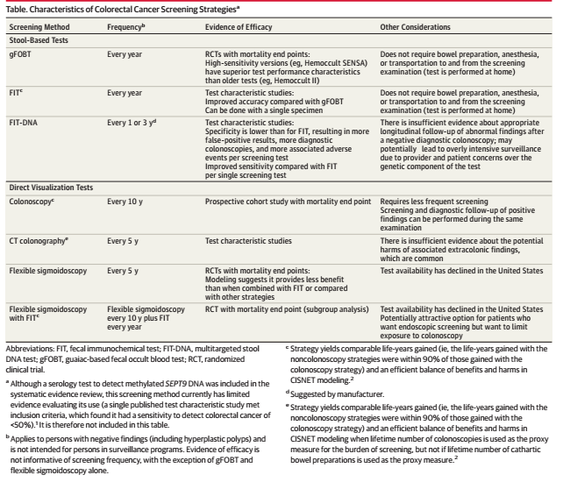

Slide 5
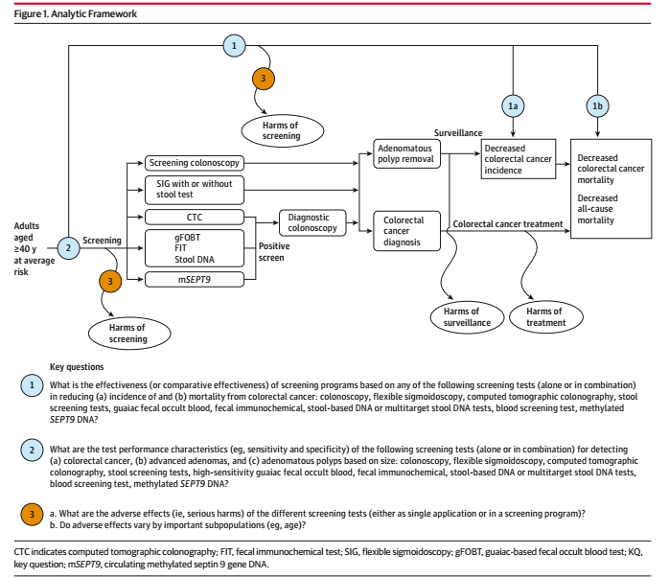
Method

Slide 6
High-sensitivity gFOBT (Hemoccult SENSA; Beckman Coulter)
has a sensitivity of 62% to 79% and a specificity of 87% to 96% for
detecting colorectal cancer.
Faecal immunochemical tests can be grouped according to whether they are qualitative (fixed cut off) or quantitative (adjustable cut off) assays
  Sensitivity and specificity of the OC-Light test using a cut off of 10 μg haemoglobin
  (Hb)/g faeces to detect colorectal cancer range from 79% to 88%
  and 91% to 93%,

Slide 7
FIT-DNA test available in the United States (Cologuard; Exact Sciences), its sensitivity and specificity to detect colorectal cancer was 92% (95% CI,
84%-97%) and 84% (95% CI, 84%-85%).
  sensitivity to detect advanced precancerous lesions (advanced adenomas
  and sessile serrated polyps measuring 1 cm) was 42% (95% CI,
  39%-46%), and its specificity to detect “all non advanced findings”
  (including non-neoplastic findings and negative colonoscopy findings) was 87% (95% CI, 86%-87%).
Colonoscopy is generally considered the criterion standard for
test characteristic studies.

Slide 8
CT colonography test performance with bowel preparation found that the per-person sensitivity to detect adenomas measuring 10 mm or larger ranged from 67% to 94%; specificity ranged from 86% to 98%.
Only 2 studies evaluated the performance of CT colonography without bowel preparation; sensitivity and specificity to detect adenomas measuring 10mm or larger ranging from 67% to 90% and 85% to 97%.

Slide 9
How serious is the risk of bias?
Is there randomized control trial evidence addressing the impact of the intervention in asymptomatic people?
  yes

Slide 10
What are the recommendations and will they help you in caring for patients?
Were the data identified, selected and combined in an unbiased fashion?

Slide 11
Data Sources and Searches
MEDLINE
PubMed
Cochrane Central Register of controlled trials
  January 1st 2008 to December 31st 2014
  Supplemented by expert suggestions, reviewing reference lists
  Gray literature , ClinicalTrials.gov and WHO International Clinical Trial Registry platform
English language articles only

Slide 12
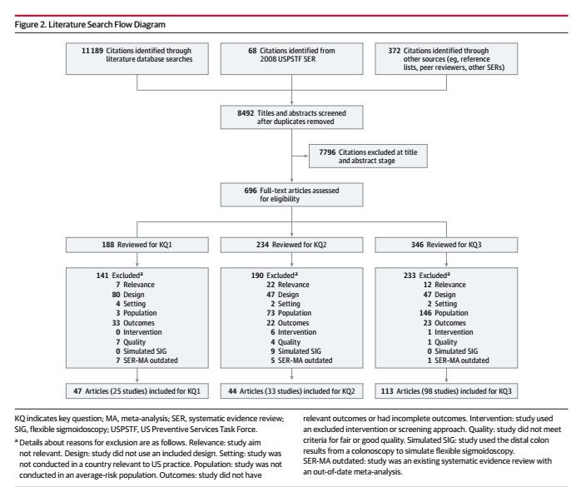

Slide 13
Study selection
Two investigators independently reviewed 8492 titles ad abstracts and 696 articles.
Discrepancies were resolved through consensus and consultation with third investigator
KQ1: RCT’s and well conducted prospective cohort or population based nested case control studies were examined
KQ2: diagnostic accuracy using colonoscopy as reference standard
KQ3: all trials and observational studies that reported serious adverse events
Notes:
KQ2: not used colonoscopy on random subset verification bias excluded, no full representation of patients spectrum bias excluded

Slide 14
Data extraction and Quality Assessment
2 reviewers critically appraised all articles., using USPSTF design specific quality criteria
AMSTAR score and Newcastle Ottawa Scales were used

Slide 15
Data Synthesis and Analysis
For each KQ, the number and design of included studies, overall results, consistency or precision of results, reporting bias, study quality, limitations of the body of evidence, and applicability of findings were summarized.
The results were synthesized by KQ, type of screening test, and study design.
The analyses for test performance focused primarily on per-person test sensitivity and specificity to detect adenomas (by size, where reported, <6 mm, >6 mm, >10 mm), advanced adenomas(as defined by the study), and CRC.
Because of the limited number of studies and the clinical heterogeneity of studies, the analyses were largely descriptive.

Slide 16
What are the benefits?
Screening for colorectal cancer in adults aged 50 to 75 years reduces colorectal cancer mortality.
The benefit of early detection of and intervention for colorectal cancer declines after age 75 years.
The time between detection and treatment of colorectal cancer and realization of a subsequent mortality benefit can be substantial.

Slide 17
The Hemoccult II test was the first colorectal cancer screening test to demonstrate reduction in disease specific mortality in an RCT.
  Six trials showed that after 11 to 30 years of follow-up, screening with low-sensitivity gFOBT reduced the risk of colorectal cancer death by about 9%to 22% when performed biennially.
Flexible sigmoidoscopy has also been assessed in multiple RCTs.
  Pooled meta-analysis of 4 trials demonstrated that time screening with flexible sigmoidoscopy reduced the risk of dying of colorectal cancer by 27% after about 11 to 12 years (incidence rate ratio, 0.73 [95% CI, 0.66-0.82])
  9 to 14 fewer colorectal cancer deaths per 100 000 person-years.

Slide 18
CISNET models estimated that screening with flexible sigmoidoscopy from the ages of 50 to 75 years, repeated every 5 years, would result in about 181 to 227 life-years gained per 1000 persons screened over a lifetime.
A combined approach of flexible sigmoidoscopy repeated every 10 years with annual FIT screening resulted in about 246 to 270 life-years gained per 1000 persons screened.

Slide 19
With an age to begin screening of 50 years and an age to end
screening of 75 years
Assuming 100% adherence to screening over a lifetime
4 screening strategies were estimated to provide an efficient balance of benefits and harms while also providing roughly comparable life-years gained:
colonoscopy every 10 years,
annual FIT
flexible sigmoidoscopy every 10 years combined with annual FIT
CT colonography every 5 years.

Slide 20
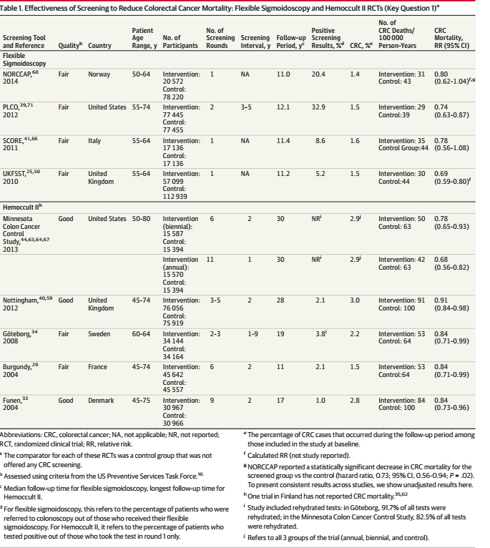

Slide 21
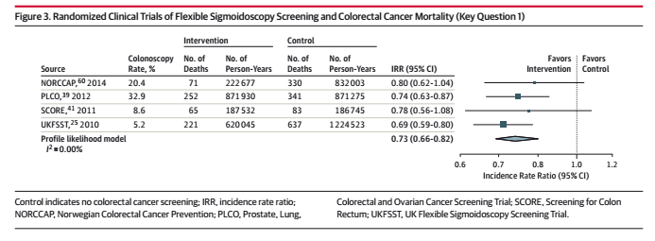

Slide 22
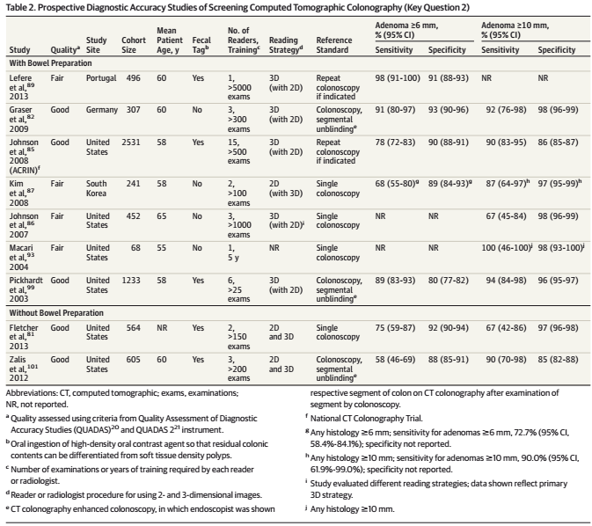

Slide 23
What are the harms?
The majority of harms result from the use of colonoscopy.
The rate of serious adverse events from colorectal cancer screening increases with age.

Slide 24
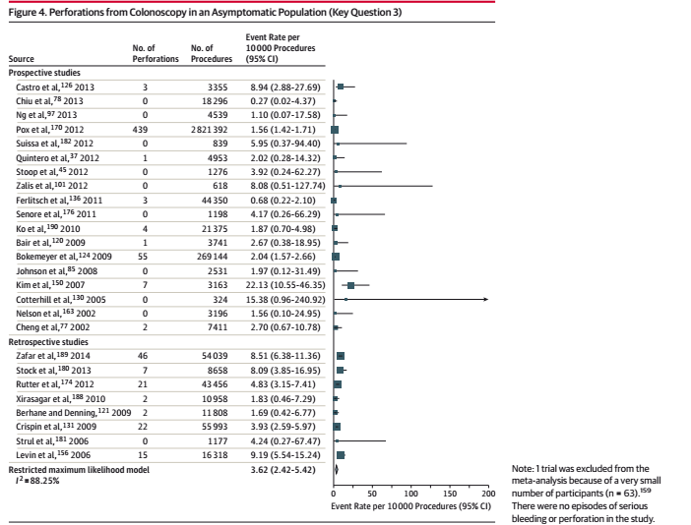

Slide 25
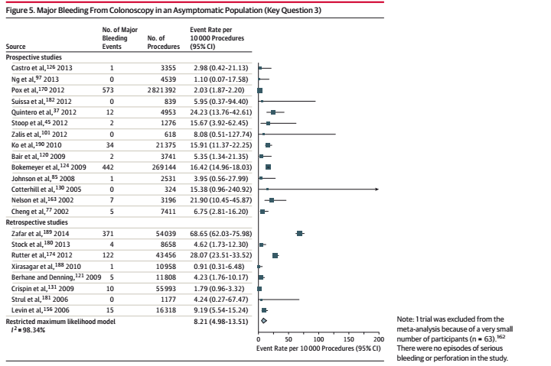

Slide 26
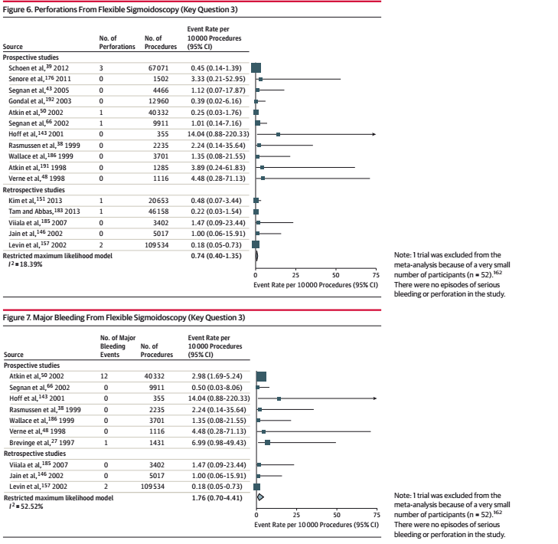

Slide 27
How do the benefits and harms compare in different people and with different screening strategies?

Slide 28
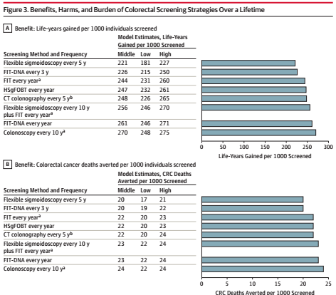
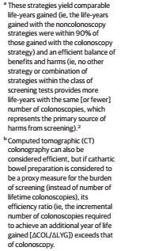

Slide 29
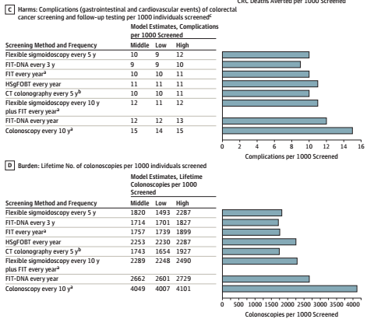
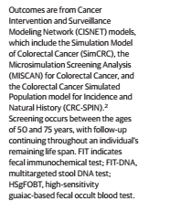
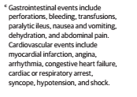

Slide 30
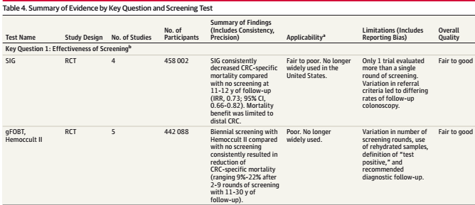

Slide 31
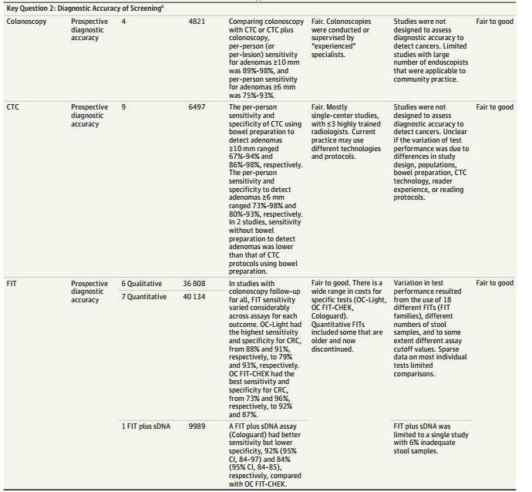

Slide 32
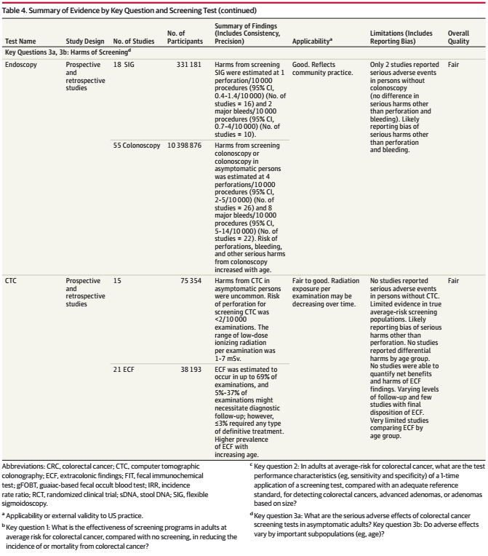

Slide 33
What is the effect of individuals values and preferences?
  Between the age of 50 to 75 years, there is a definite benefit in screening in asymptomatic people.
  However in patients above the age of 75years, decision should be based on individual cases
  In patients with significant family history , screening should commence earlier and be more frequent

Slide 34
What is the effect of uncertainty?
What is the cost effectiveness?
  Not assessed in this study

Slide 35
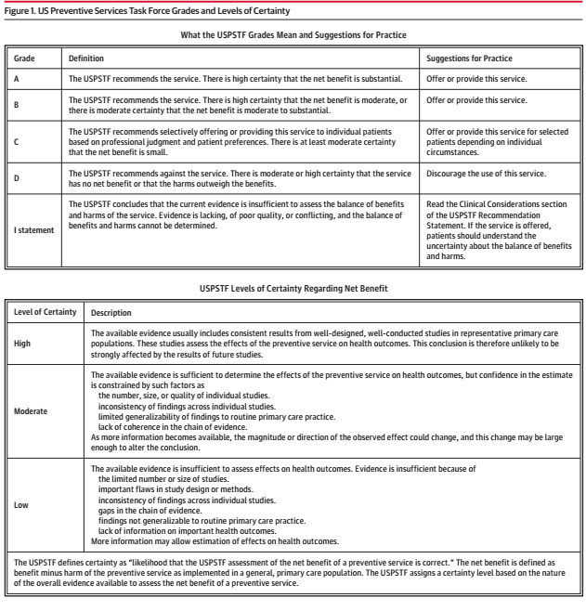

Slide 36
Summary of recommendations
The USPSTF recommends screening for colorectal cancer starting
at age 50 years and continuing until age 75 years (A recommendation)
The risks and benefits of different screening methods vary.
The decision to screen for colorectal cancer in adults aged 76 to
85years should be an individual one, taking into account the patient’s
overall health and prior screening history(C recommendation).
Screening would be most appropriate among adults who :
  Are healthy enough to undergo treatment if colorectal cancer is detected
  do not have comorbid conditions that would significantly limit their life expectancy.

