Slide 1
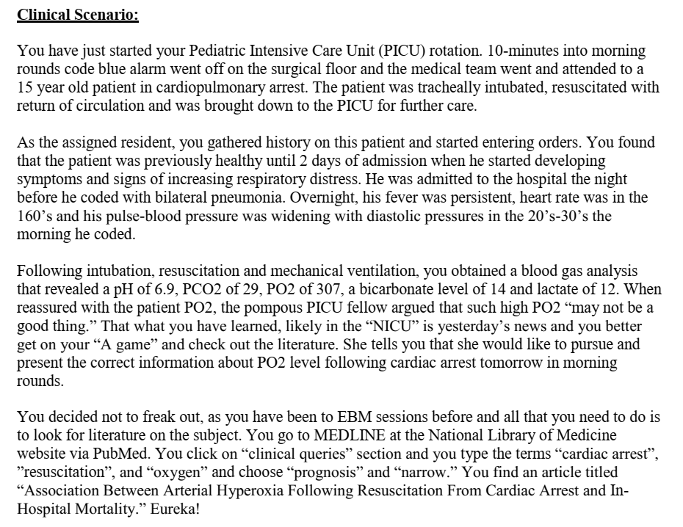

Slide 2
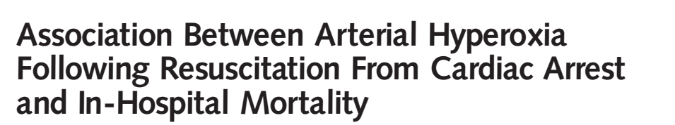
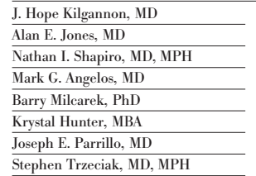

Slide 3
Background
Post cardiac arrest approximately 60% of patients will not survive to hospital discharge
Postcardiac arrest syndrome – global ischemia reperfusion injury, myocardial stunning, and anoxic brain injury
Role of supplemental oxygen –controversial
Too little oxygen may potentiate anoxic injury.
Too much oxygen may increase oxygen free radical production, possibly triggering cellular injury and apoptosis

Slide 4
Did the study address a relevant clinical question?
Yes
Whether exposure to hyperoxia after ROSC from cardiac arrest was associated with poor clinical outcome

Slide 5
PICO statment
  P: Patients who survived cardiac arrest in an ICU setting
  Exposure: hyperoxia after ROSC
    3 arms -
    Hyperoxia - PO2 - > 300
    Hypoxia – Po2 - <60
    Normoxia
  O: In hospital mortality

Slide 6
methodology
Prospective cohort study
Inclusion criteria
  Age >17 years
  Nontraumatic cardiac arrest
  Cardiopulmonary resuscitation within 24 hours prior to ICU arrival
  Arterial blood gas analysis performed within 24 hours following ICU arrival
  3 arms -
    Hyperoxia - PO2 - > 300
    Hypoxia – Po2 - <60
    Normoxia

Slide 7
Propensity matching was done
Assuming a ratio of approximately 3 patients in the hypoxia group for every 1 patient in the normoxia and hyperoxia groups
The sample size that was analyzed allowed greater than 80% power to detect a significant difference in proportions between the groups
α level of .017

Slide 8
Baseline characteristics

Slide 9
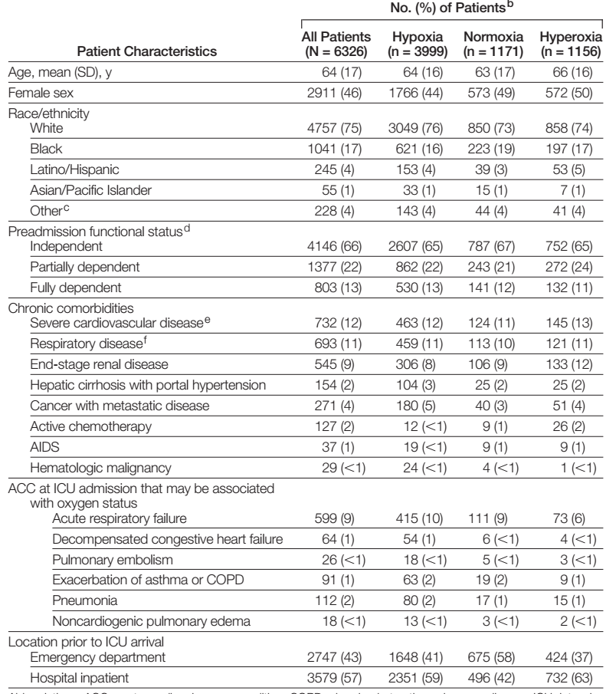

Slide 10
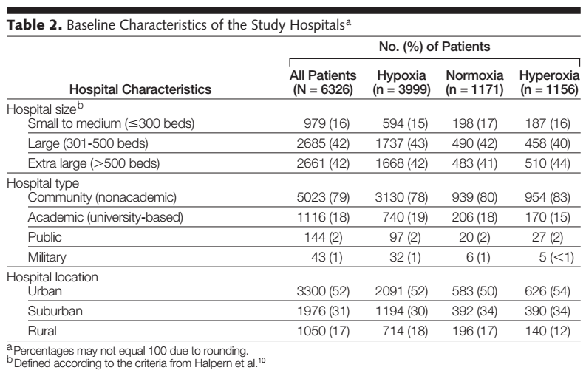

Slide 11
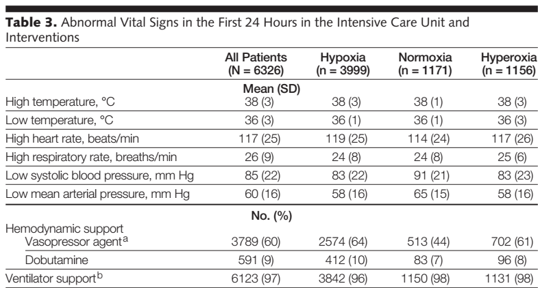

Slide 12
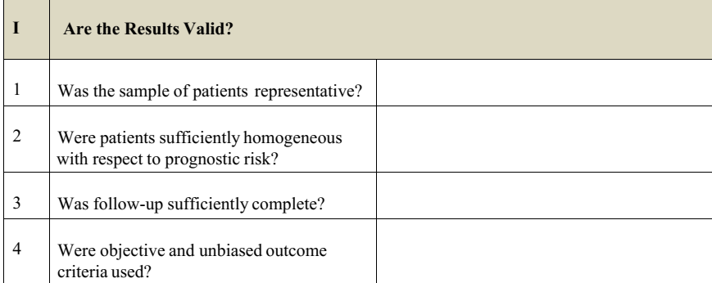
Yes
Duration of hypoxia/ hyperoxia
When was ABG performed
?crossover
Duration of stay
Yes
Yes

Slide 13
results

Slide 14
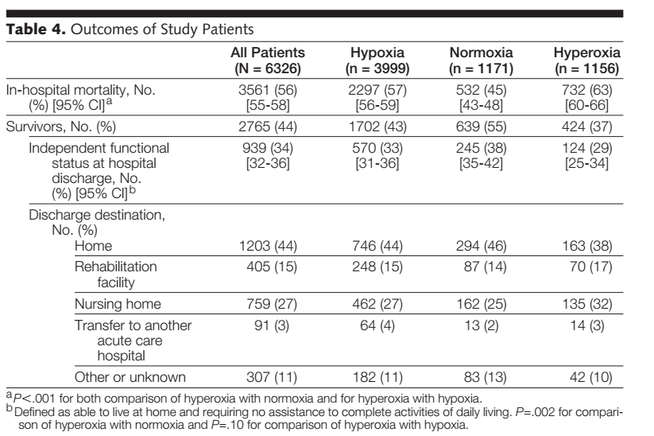

Slide 15
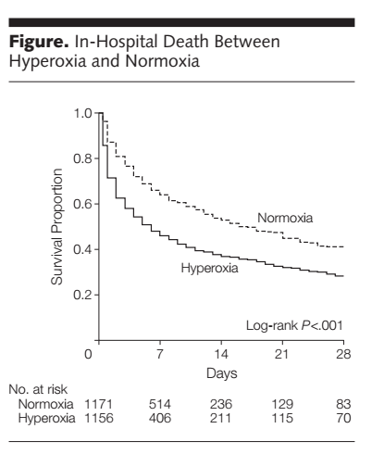

Slide 16
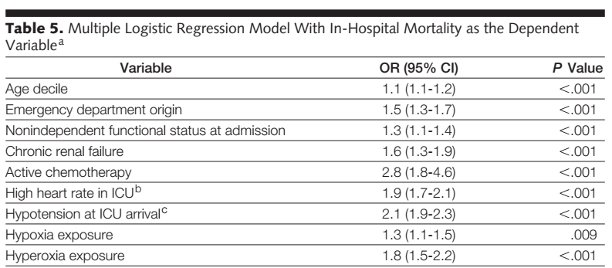
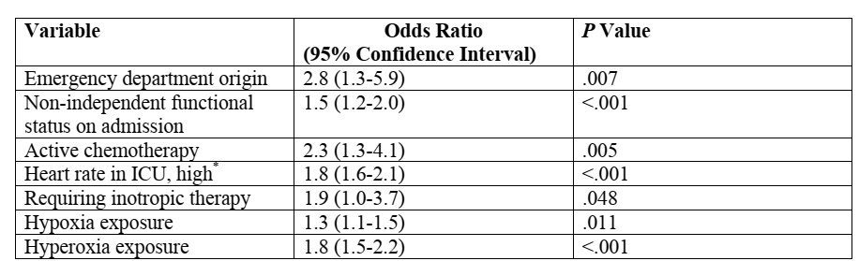

Slide 17
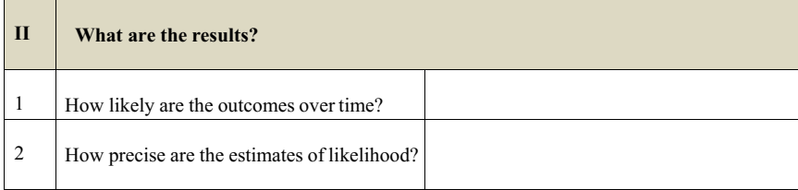
N/A
Precise, narrow CI

Slide 18
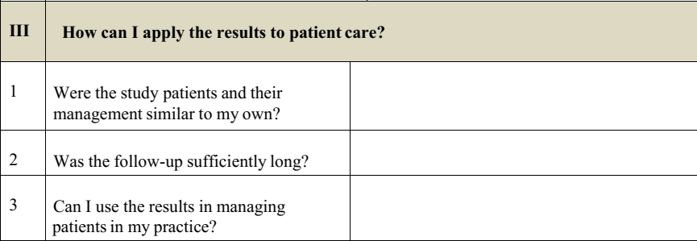
Yes
Yes
Association between hyperoxia and increased mortality demonstrated

