Slide 1
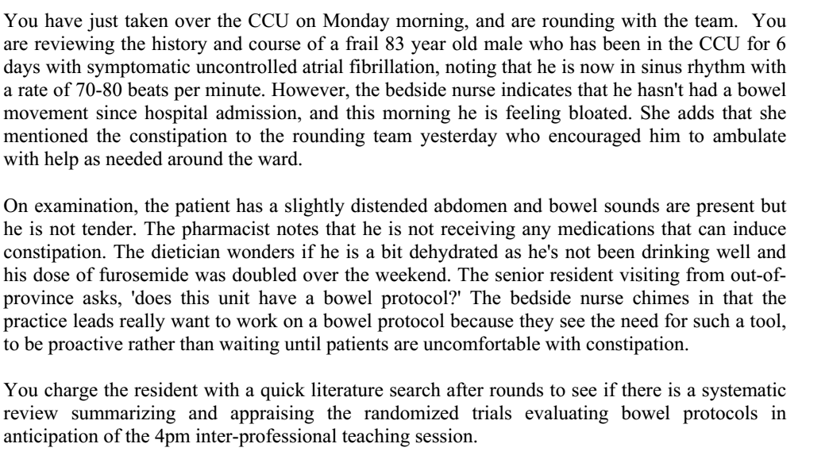

Slide 2
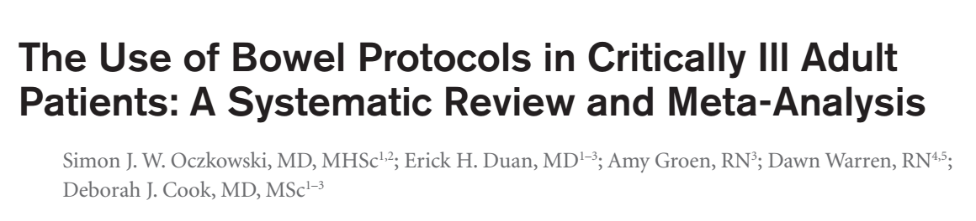
18/12/2018

Slide 3
Background
Altered gut motility is common among critically ill patients , and can manifest as feeding intolerance, diarrhoea or constipation.
Risk factors include: use of opioids, anticholinergics, immobility and high disease severity.
Constipation has been associated with adverse outcomes: feeding intolerance, delirium, increased duration of mechanical ventilation and hospital stay.
Constipation has been defined as: failure to pass stool within 72 hours of ICU admission.

Slide 4
Did the review explicitly address a sensible clinical question?
Yes
Does the use of bowel protocols in critically ill patients reduce the incidence of constipation, feeding intolerance and reduced duration of mechanical ventilation?

Slide 5
P: RCT’s with patients who were admitted to ICU’S with complaints of constipation
I: bowel protocol ( lactulose based of PEG based)
C: placebo, standard care, no protocol
O: constipation, feed intolerance, duration of mechanical ventilation
T: 2009-2016

Slide 6
Inclusion:
  Adult patients >18 years
  Admitted to medical/surgical/mixed ICU
  >50% receiving mechanical ventilation
Exclusion
  Primary gastrointestinal disorders

Slide 7
Primary outcome:
  Constipation
  Feeding intolerance
  Duration of mechanical ventilation
Secondary outcomes:
  Adverse effects(diarrhoea)
  Constipation related effects
  Long term patient care

Slide 8
Was the search for relevant studies exhaustive?
Peer reviewed electronic search :
  MEDLINE
  Embase
  CINAHL
  CENTRAL
Hand searched conference abstracts for the ATS, Society of critical care medicine and clinical trials databases (ISRCTN)

Slide 9
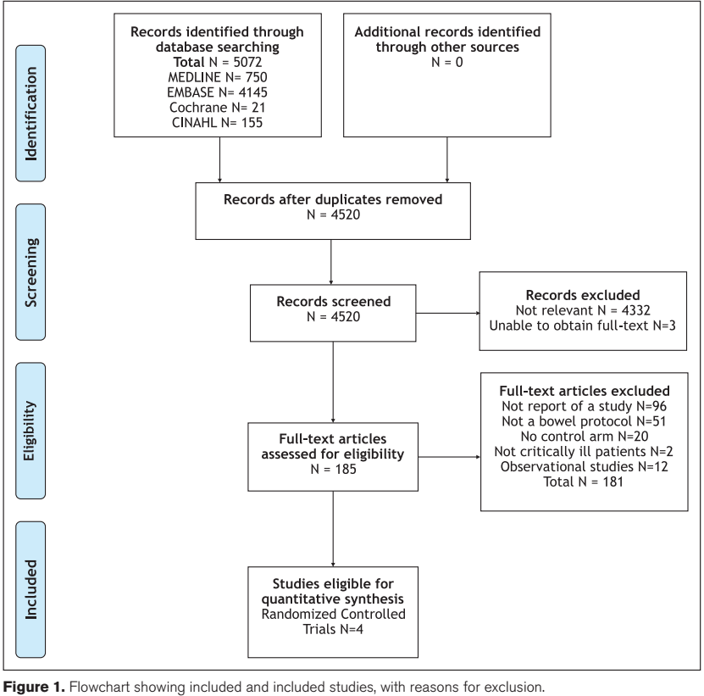

Slide 10
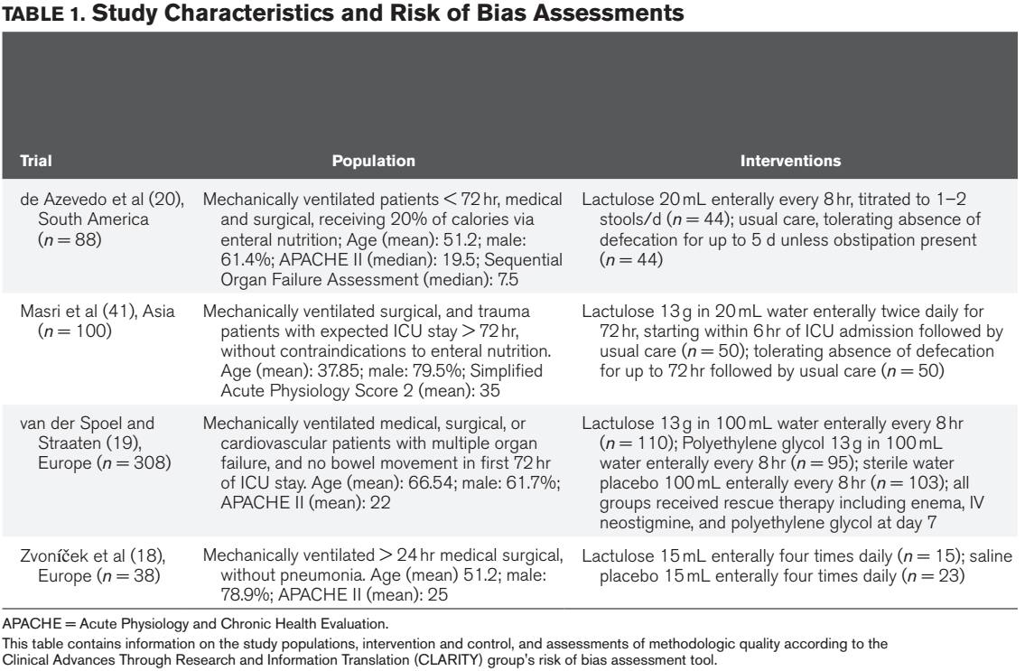

Slide 11
Were selection and assessment of the studies reproducible?
Search results were exported to DistillerSR for eligibility assessment, risk of bias and data extraction
Two reviewers independently and in duplicate screened titles and abstracts and assessed full articles, full length texts for eligibility
Weighted kappa was used to asses interrater reliability
Third party reviewer if primary reviewer disagreements arose

Slide 12
Was the risk of bias of the primary studies assessed?
Clinical Advance Through Research and Information Translation (CLARITY) Group’s Modified Cochrane Database of Systematic Review tool.
Random sequence generation, blinding, incomplete outcome data and selective reporting
Assessed if the investigators took sufficient measures to reduce the risk of bias

Slide 13
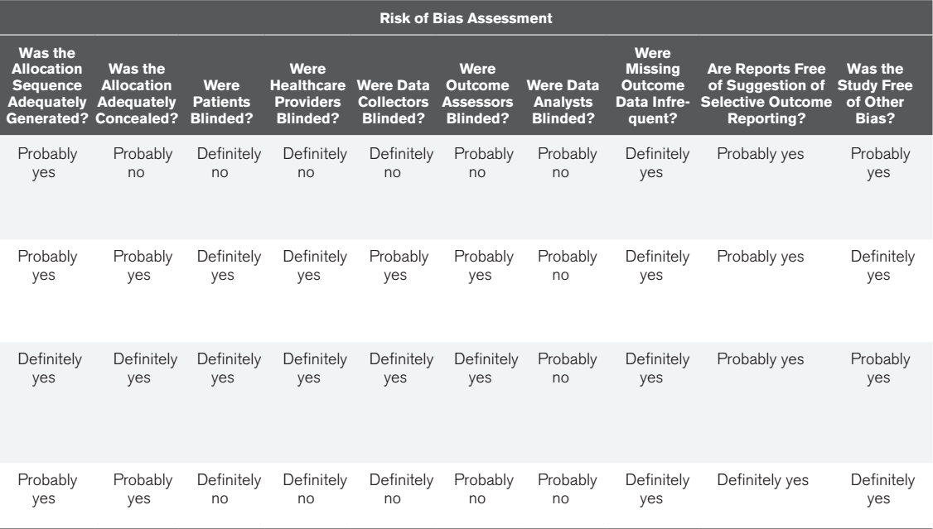

Slide 14
Did the review address possible explanations of between study difference in results?
yes

Slide 15
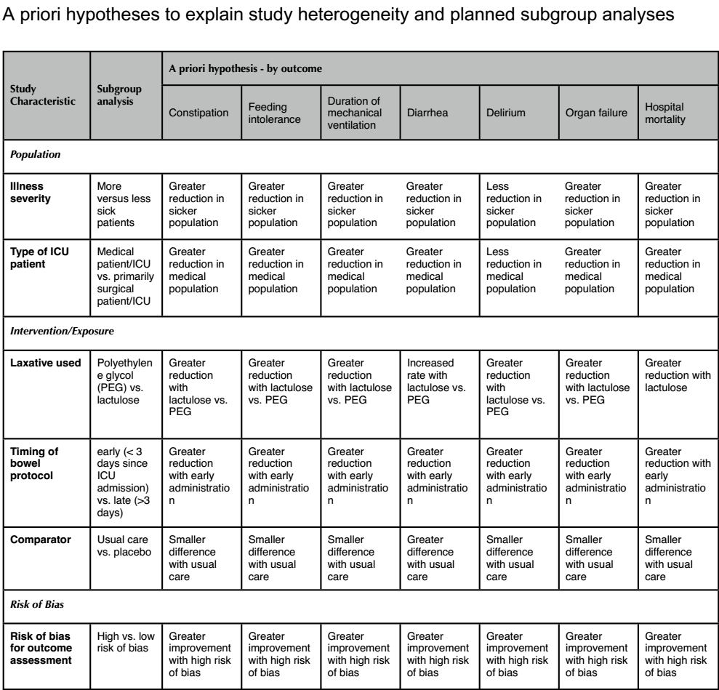

Slide 16
Did the review address confidence in effect estimates?
Yes
GRADE approach was used

Slide 17
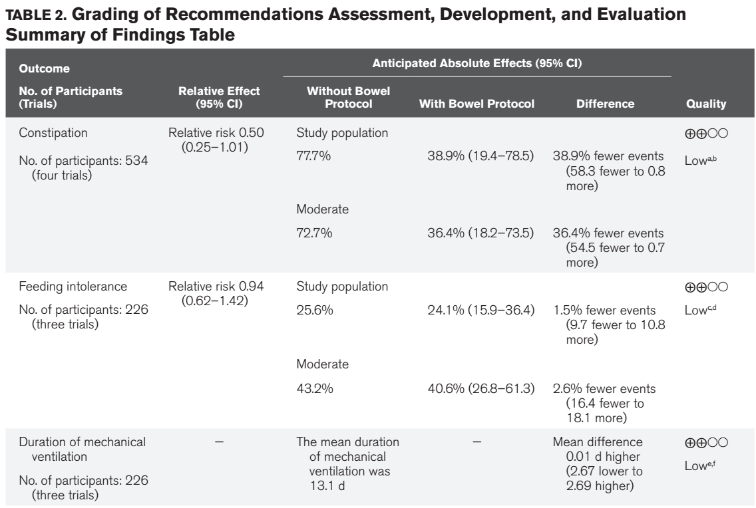

Slide 18
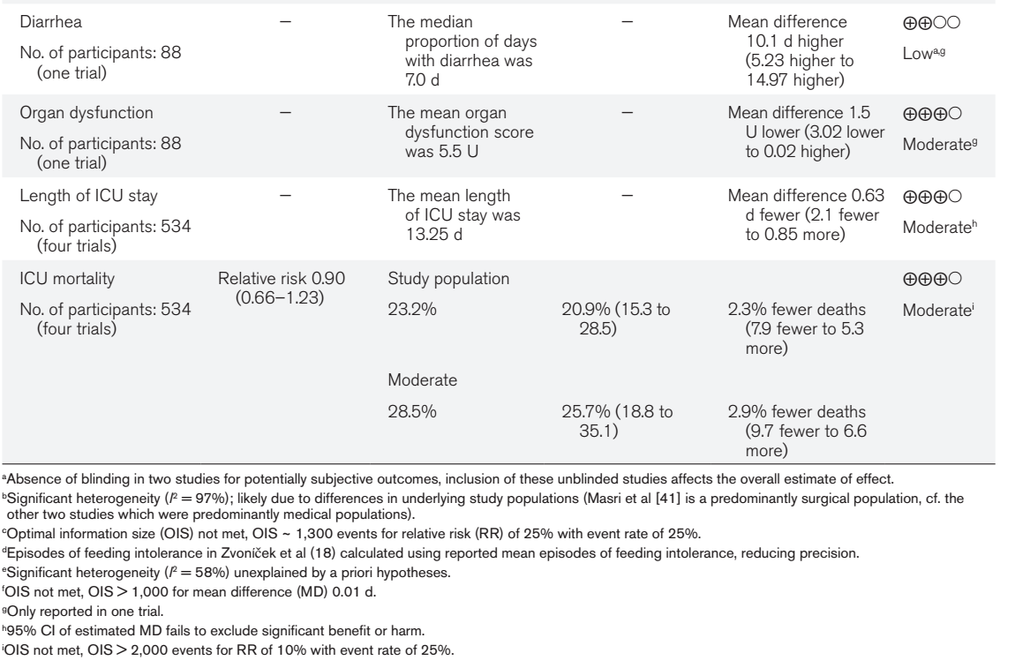

Slide 19
Statistical Analysis
Summarized outcomes (mean difference for continuous variable and relative risk for dichotomous variable)
95% CI were calculated
Statistical heterogeneity was assessed for each outcome using I2 calculation and chi square statistic.

Slide 20
Results

Slide 21
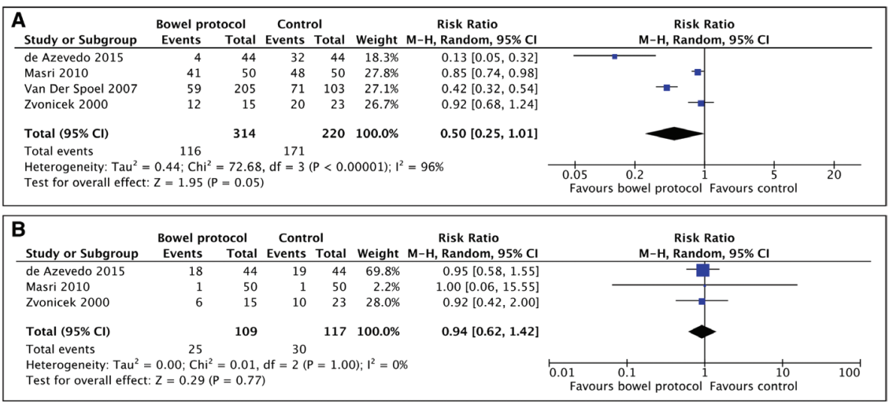
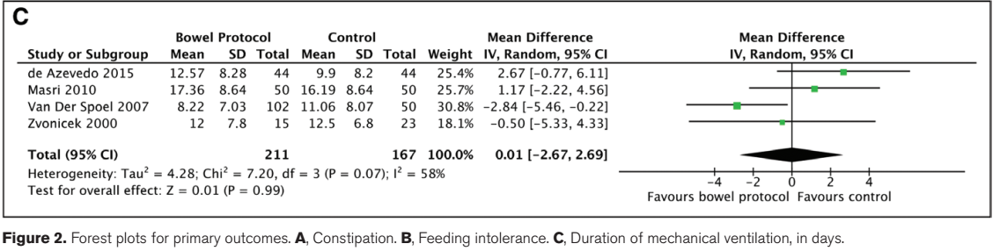

Slide 22
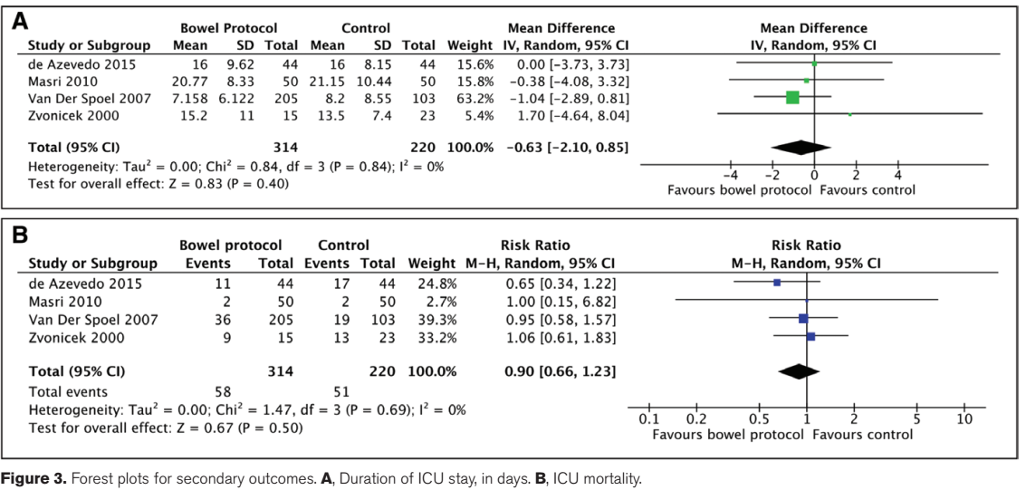

Slide 23
What is the risk of bias across all studies?
  moderate
Do the systematic review population, intervention, comparison and outcomes fit the patient in hand?
  yes

Slide 24
Would your decision differ if boundary of the confidence interval represented the truth?
  no
Are the results inconsistent across studies?
  no

Slide 25
Is there high likelihood of publication bias?
  Not assessed by funnel plot: only 4 RCT’s and no sub group analysis
Do you consider the magnitude of treatment effect large?
  No, in none of the primary outcomes measured was there a RR of >2 or less than <0.5

Slide 26
Conclusions and limitations
Overall quality of evidence is low to moderate in the 4 RCT’s analysed
Limitations include imprecision due to the small numbers in the studies
Lack of consistent definitions of gut motility disorders

Slide 27
Thank you

