Slide 1
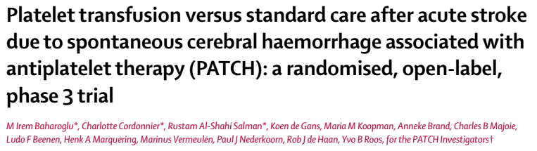
17/12/2018

Slide 2
Background
Haemorrhagic strokes account for 11-22% of incident strokes , half stroke deaths and 42% of DALY lost due to stroke.
Antiplatelet therapy might slightly increase the incidence of intracerebral haemorrhage.
Platelet transfusion has been used prophylactically and therapeutically in many clinical settings, for active bleeding disorders.

Slide 3
Methods
Multi centre, randomised, open label, parallel group trial.
60 hospitals
Netherlands, UK, France.

Slide 4
P: Acute intracerebral haemorrhagic stroke
I: platelet transfusion + standard care
C: standard care
O: shift towards death or dependence on the mRS
T: February 4th 2009- October 8th 2015

Slide 5
Inclusion criteria
Aged 18 years and above
Non traumatic supratentorial intracerebral haemorrhage
GCS : 8-15
In whom platelet transfusion could be initiate within 6 hrs of onset and 90 minutes of brain imaging
Antiplatelet therapy : COX inhibitor ( aspirin/ carbasalate calcium), adenosine diphosphate receptor inhibitor (clopidogrel), or adenosine reuptake inhibitor (dipyridamole) : for at least 7 days prior to stroke
Pre stroke Mrs of 0 -1

Slide 6
Exclusion criteria
SDH, EDH, underlying aneurysm or AVM
Planned surgical evacuation within 24 hours
Intraventricular bleed
Previous adverse reaction to platelet transfusion
Known use of Vitamin K antagonists
History of coagulopathy
Thrombocytopenia < 1,00,000

Slide 7
Statistical analysis
Sample size:
  190 participants
  70% of frequency of primary outcome in standard care group with 2% absolute reduction to 50% in intervention group.
  80% power and two sided level of significance of 0.05
  Power increases to 91% To detect a common OR of 0.43 in ordinal logistic regression analysis

Slide 8
How serious was the risk of bias?

Slide 9
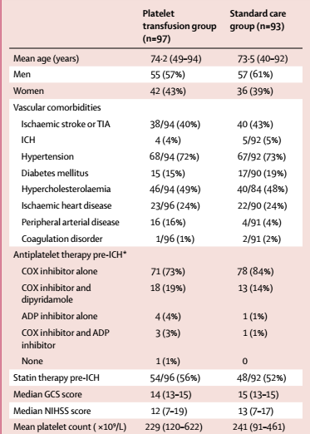
Did intervention and control groups begin the study with similar prognosis?

Slide 10

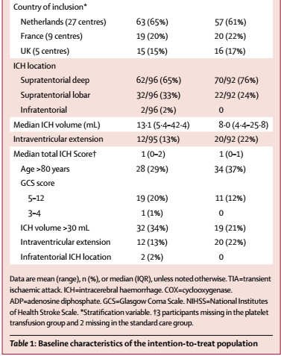

Slide 11
Were patients randomized?
Randomly assigned in 1:1 ratio
Done by investigators via a secure, web based computerised randomisation system.
Stratified by study hospital, type of antiplatelet therapy.

Slide 12
Was randomization concealed?
yes

Slide 13
Were patients similar at baseline with respect to known prognostic factors?
Patient’s in the standard care group had a larger percentage of peripheral vascular disease, lower ICH volume at admission with higher intraventricualr extension.

Slide 14
Was prognostic balance maintained as the study progressed?
Were patients, caregivers, collectors of the outcome data, adjudicators of outcome and data analysts aware of the group allocation?
Participants and local investigators giving interventions were not masked to allocation
Outcome assessors and investigators analysing data were blinded to the allocation.

Slide 15
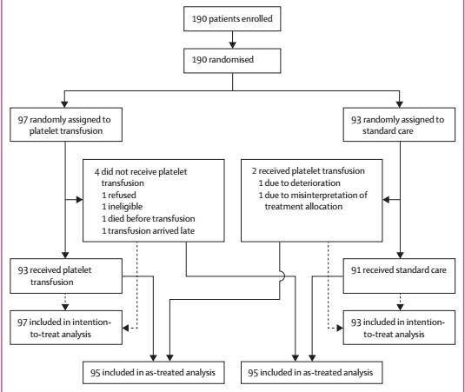
Were the groups prognostically balanced at the study’s conclusion?
Was follow up complete?

Slide 16
Was the trial stopped early for benefit?
No
Were patients analyzed in the groups that they were randomized?
Yes

Slide 17
Did the investigators guard against unwarranted conclusion on inferiority?
Was the effect of the standard treatment preserved?
Yes
Did the investigators analyse patients based on the treatment they received and the groups to which they were assigned?
Yes

Slide 18
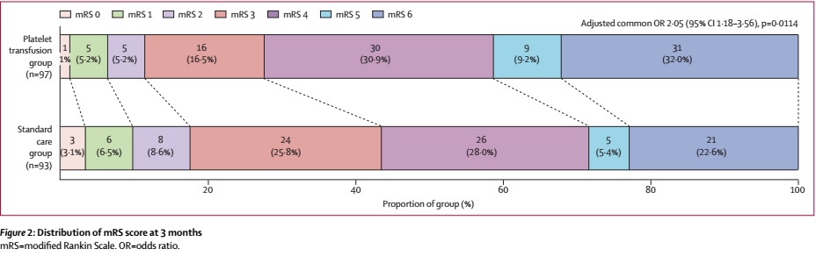
What are the results?
Primary outcome: difference in functional outcome at 3 months as assessed by mRS
Odds of a shift towards death or dependence at 3 months significantly higher in the intervention group than in standard care
  Unadjusted OR 1.84, 95% C.I. 1.1-3.08, p=0.02
  Adjusted OR 2.05, 95% C.I. 1.18-3.56, p=0.01

Slide 19
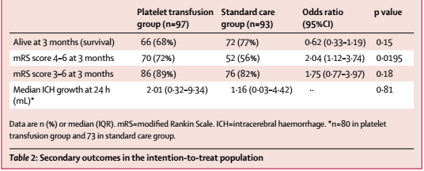
Secondary outcomes
Comparing intervention vs. control groups
  Alive at 3 months: 68% vs. 77%, OR 0.62 (0.33-1.19), p=0.15
  mRS score 4-6 at 3 months: 72% vs 56%, OR 2.04 (1.12-3.74), p=0.02,
  mRS score 3-6 at 3 months: 89% vs 82%, OR 1.75 (0.77-3.97), p=0.18
Median ICH growth at 24 hr (ml) 2.01 vs. 1.16 , p=0.81,

Slide 20
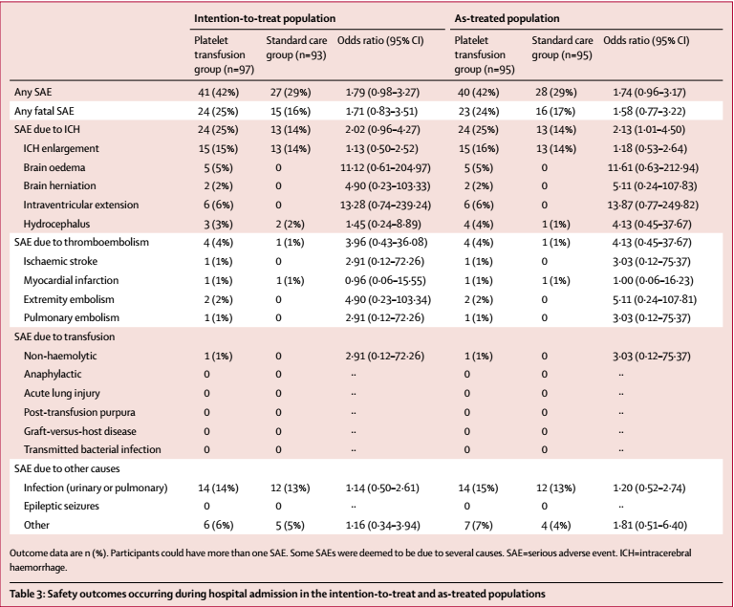
  Overall: 42% vs. 29%, OR 1.79 (95% C.I. 0.98-3.27)
  Thromboembolism: 4% vs. 1% OR 3.96 (95% C.I. 0.43-36.08)
  Complication of ICH: 25% vs. 14% (OR 2.02 (95% C.I. 0.96-4.27)

Slide 21
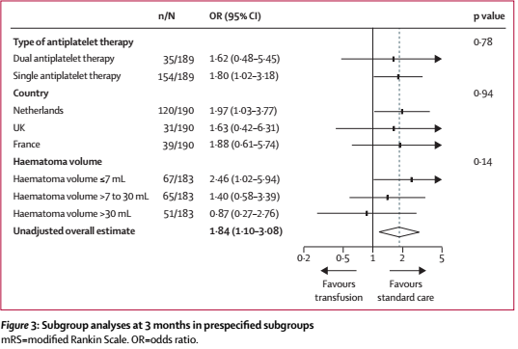
Pre-specified sub-group
  Haematoma volume
    <7ml: OR 2.46 (95% C.I 1.02-5.94)
    7-30ml: OR 1.4 (95% C.I 0.58-3.39)
    >30ml: 0.87 (95% C.I. 0.27-2.76)
    (Odds ratio of >1 favours control group, where as OR <1 favours transfusion)

Slide 22
How can I apply the results to my patients?
Were the study patients similar to my patients?
Only European countries included in this trial.
Percentage of patients with diabetes as risk factor probably more in out country

Slide 23
Were all patient important outcomes considered?
yes

Slide 24
Are the likely benefits of the novel treatment worth the potential harm?
No, showed harm .

Slide 25
Limitation
Small sample size
Duration of antiplatelet therapy has not been studied
Investigators administering the intervention were not blinded

Slide 26
Conclusions
Platelet transfusion for patients with acute intracerebral haemorrhage is inferior to standard care and causes harm.

