Slide 1
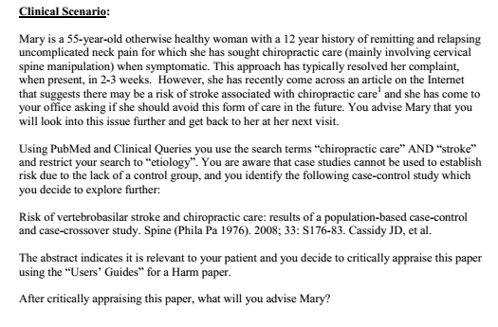

Slide 2
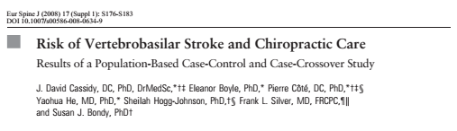

Slide 3
BACKGROUND
Neck pain is a common problem associated with considerable comorbidity, disability, and cost to society.
Approximately 12% of American and Canadian adults seek chiropractic
care annually and 80% of these visits result in spinal manipulation.
2 deaths in Canada from vertebral artery dissection and stroke following chiropractic care in the 1990s
  Attracted much media attention
  Neurologists adviced to avoid neck manipulation for acute neck pain..

Slide 4
BACKGROUND
Many published case reports linking neck manipulation to vertebral artery dissection and stroke.
Prevailing theory is that extension and/or rotation of the neck can damage the vertebral artery, particularly within the foramen transversarium at the C1–C2 level.

Slide 5
OBJECTIVE
To investigate the association between chiropractic care and Vertebrobasilar artery (VBA) stroke and compare it to the association between recent Primary physician (PCP) care and VBA stroke using two epidemiological designs.

Slide 6
Hypothesis
Evidence that chiropractic care increases the risk of VBA stroke would be present if the measured association between chiropractic visits and VBA stroke exceeds the association between PCP visits and VBA strokes.

Slide 7
Patient: All residents of Ontario (109,020,875 person-years of observation over 9 years) covered by the publicly funded Ontario Health Insurance Plan (OHIP).
Cases: All incident VBA strokes resulting in an acute care hospital admission
Controls:
  Case control- 4 age and sex-matched controls were randomly selected from the Registered Persons Database.
  Case crossover study- 4 control periods were randomly chosen from the year before the VBA stroke date, using a time-stratified approach.
Outcome- association between chiropractic visits and VBA stroke versus association between recent PCP care and VBA stroke
Time= 1 month prior to the VBA stroke (Index event)

Slide 8
Inclusion criteria
All incident vertebrobasilar occlusion and stenosis strokes resulting in an acute care hospital admission from April 1, 1993 to March 31, 2002
Patients who were insured by publicly funded Ontario Health Insurance Plan
(OHIP).

Slide 9
Exclusion criteria
Cases that had previous stroke or TIA.
Cases residing in long-term care facilities were also excluded.
Controls were excluded if they previously had a stroke/TIA or were
residing in a long-term care facility.

Slide 10
METHODOLOGY
2 epidemiological study designs
Case control design
  Cases
  Controls from the same source population as the cases.
Case cross over design
  Cases served as their own control by sampling control periods before the study exposures.
Index date was defined as the hospital admission date for the VBA stroke.
Notes:
his design is most appropriate when a brief exposure (e.g., chiropractic care) causes a transient change in risk (i.e., hazard period) of a rare-onset
disease (e.g., VBA stroke).
It is well suited to our research questions, since within person comparisons control for unmeasuredrisk factors by design, rather than by statistical modeling. Thus the advantage over the case control design is better control of confounding.

Slide 11
METHODOLOGY
All reimbursed ambulatory encounters with chiropractors and PCPs were extracted for the one-year period before the index date from the OHIP database.
Different hazard periods studied
  1 day,
  3 days
  1 week
  2 weeks
  1 month before the index date

Slide 12
For the chiropractic analysis, the index date was
included in the hazard period, since chiropractic treatment
might cause immediate stroke and patients would not normally
consult a chiropractor after having a stroke. However, the index day was excluded from the PCP analysis, since patients
might consult these physicians after experiencing a stroke. We
tested

Slide 13
also measured the effect of cumulative numbers of chiropractic and PCP visits in the month before the index date by
computing the odds ratio for each incremental visit
estimates were similarly stratified by age and by diagnostic codes
related to headache and/or neck pain.

Slide 14
STATISTICAL ANALYSIS
Conditional logistic regression was used to estimate the association between VBA stroke after chiropractor and PCP visits.
Stratification done for
  Age (<45 years and >/= 45 years)
  Visits with or without head and neck pain using diagnostic codes.
Confidence intervals were estimated by accelerated bias corrected bootstraps with 2000 replications using the variance-covariance method.

Slide 15
Results
Cases of VBA stroke- 818
  337 (41.2%)- Basilar occlusion and stenosis
  443 (54.2%)- Vertebral occlusion and stenosis
  38 (4.7%)- had both codes
Controls- 3272 matched------------------------------- 3164
  31 excluded because of prior stroke
  1 died before the index date
  76 were receiving long-term care

Slide 16
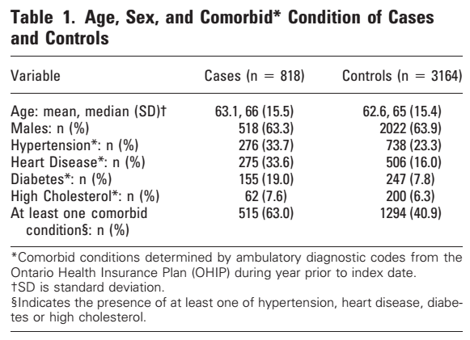
Are the results valid?
Did the experimental and control groups begin the study with a similar prognosis?

Slide 17
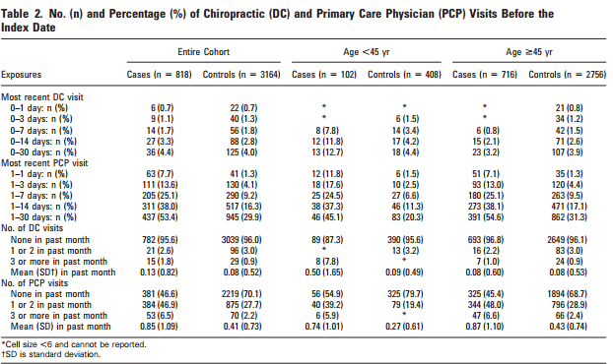

Slide 18
Are the results valid?
Did the investigators demonstrate similarity with respect to all known determinants of outcome?
  No
Did they adjust for differences in the analysis?
  No

Slide 19
Are the results valid?
Were exposed patients equally likely to be identified in the two groups?
  Yes
  Misclassification bias
  Possibility of bias in assignment of VBA-related diagnoses.

Slide 20
Did experimental and control groups retain a similar prognosis after the study started?
Were the outcomes and exposures measured in the same way in the groups being compared?
  Yes
Was the follow-up sufficiently complete?
  Yes

Slide 21
What are the results?
How strong is the association between exposure outcomes?
How precise is the estimate of risk?

Slide 22
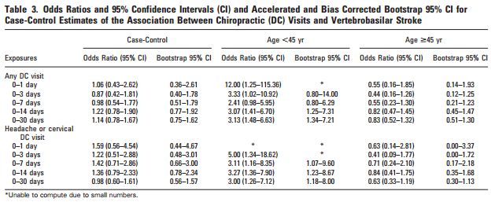

Slide 23
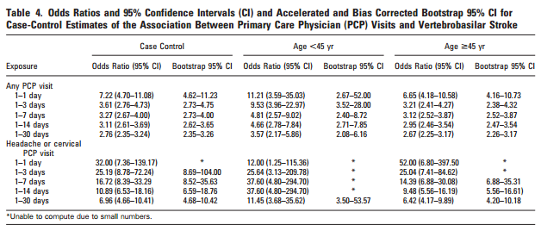

Slide 24
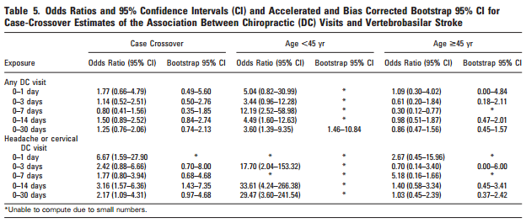

Slide 25
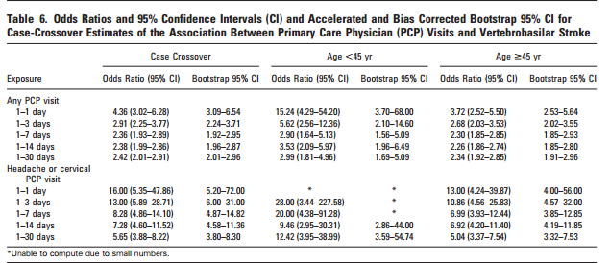

Slide 26
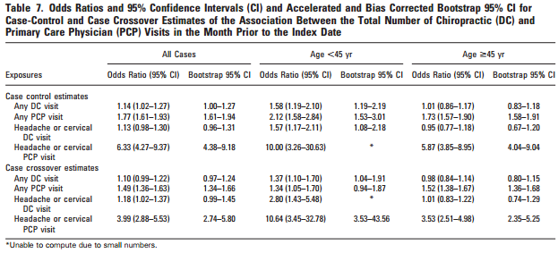

Slide 27
How can I apply the results of patient care?
Were the study patients similar to my patient?
  Racial differences
Was the duration of follow-up adequate?
  Yes
Should I consider my patient to be at risk for VBA stroke?
  No

