Slide 1
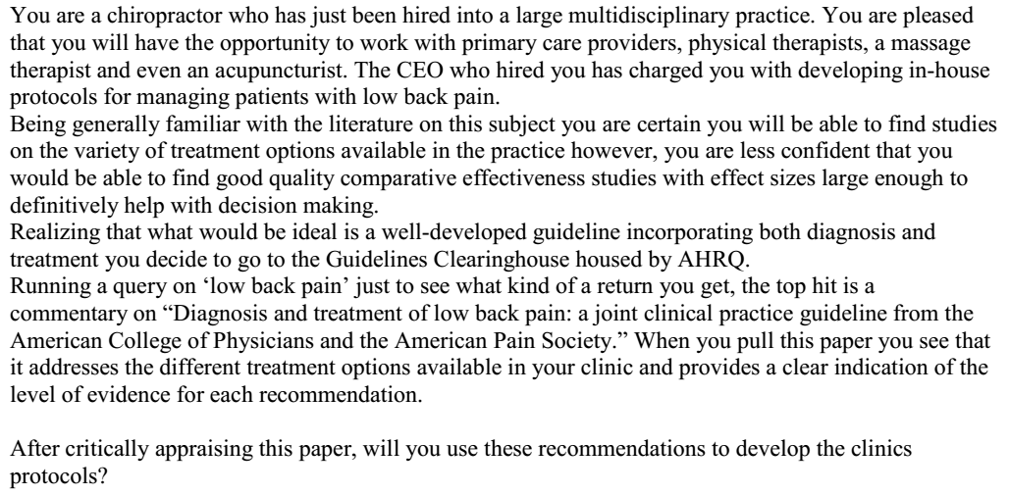

Slide 2


Slide 3
AGREE II
Domain 1. Scope and Purpose
Domain 2. Stakeholder Involvement
Domain 3. Rigour of Development
Domain 4. Clarity of Presentation
Domain 5. Applicability
Domain 6. Editorial Independence

Slide 4
Domain 1. Scope and Purpose
Are the overall objectives of the guideline are specifically described?
  Purpose of this guideline was to present the available evidence for evaluation and management of acute and chronic low back pain in primary care setting.
Health intent- Diagnosis and management in primary care setting.
Expected benefit- Approach to LBP
Targets
  Audience- All clinicians caring for patients with low (lumbar) back pain of any duration, either with or without leg pain.
  Population- Adults with acute and chronic low back pain not associated with major trauma
Score- 7

Slide 5
Are the health questions covered by the guideline specifically described?
  Yes
  Evaluation and management of lower back pain.
Target population- mentioned
Intervention- mentioned
Health care setting or context- mentioned
Score- 7.

Slide 6
Are the population (patients, public, etc.) to whom the guideline is meant to apply specifically described?
  Yes
Target population- Mentioned
Gender and age- Mentioned
Clinical condition- mentioned
Severity/stage of disease- Mentioned
Excluded population- Children and adolscents, pregnant women, back pain following major trauma, or back pain due to systemic illnesses.
Score- 7

Slide 7
Domain 2. Stakeholder Involvement
Does the guideline development group include individuals from all relevant professional groups?
Name- mentioned
Discipline/content expertise- Not mentioned
Institution- Not mentioned
Geographical location- Not mentioned
Description of the member’s role in the guideline development group- not mentioned
Score-3

Slide 8
Have the views and preferences of the target population (patients, public, etc.) been sought?
  No
Score- 1

Slide 9
Are the target users of the guideline clearly defined?
  Yes
  All clinicians caring for patients with low (lumbar) back pain of any duration, either with or without leg pain.
Clear description of intended guideline audience- Yes
Description of how the guideline may be used by its target audience- Yes
Score- 7

Slide 10
Domain 3. Rigour of Development
Were systematic methods used to search for evidence?
  Studies from MEDLINE (1966 through November 2006), Cochrane Database of Systematic Reviews, Cochrane Central Register of Controlled Trials, and EMBASE.
  The literature search included all English-language articles reporting on randomized, controlled trials of non pregnant adults (age 18 years) with low back pain.
Not included other languages
Not reviewed conference proceedings
Time period searched- till 2006.
Search terms- specified.
Full search strategy- not mentioned
Not mentioned regarding conflict resolution.
Score- 5

Slide 11
Were the criteria for selecting the evidence clearly described ?
  Only RCTs were included
  Articles published in English were only included
The relevant population, management startegies were described in general but not in specific for each question.
Not compared one treatment strategy with the other
Score- 3.

Slide 12
Were the strengths and limitations of the body of evidence clearly described ?
  No
Study design- RCTs
Study methodology limitations (sampling, blinding, allocation concealment, analytical methods)- Not mentioned
Consistency of results across studies- Not mentioned
Direction of results across studies- Not mentioned
Magnitude of benefit versus magnitude of harm- Not mentioned
Score- 4

Slide 13
Were the methods for formulating the recommendations clearly
described?
  No
Quality of evidence for each have been mentioned.
But details of how the panellist reached the recommendations are not clear.
Score- 4

Slide 14
Have the health benefits, side effects, and risks been considered in formulating the recommendations?
  No
Adverse effects not mentioned
Comparison between various treatment options are mentioned- not clear.
Score- 4.

Slide 15
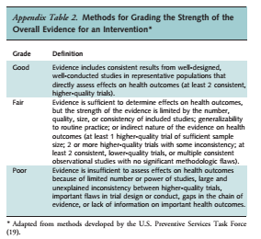
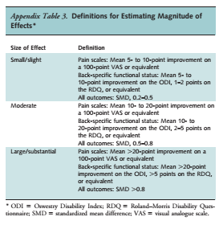

Slide 16
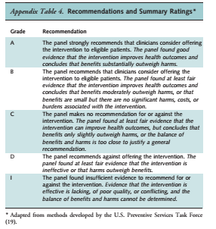

Slide 17
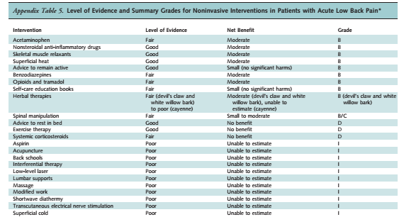

Slide 18
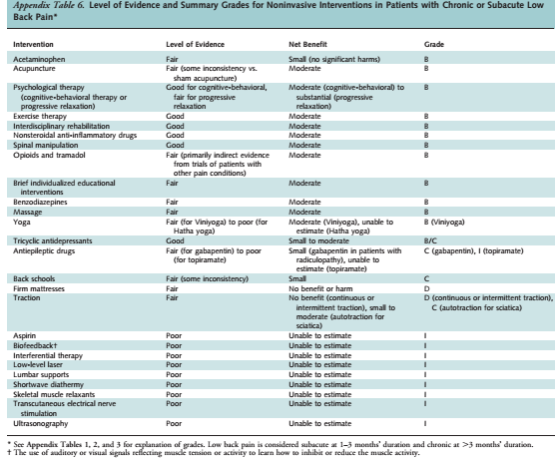

Slide 19
Is there an explicit link between the recommendations and the
supporting evidence?
  References for supporting evidence for each recommendation are mentioned and easily identifiable for the user.
Score- 5.

Slide 20
Has the guideline been externally reviewed by experts prior to its
publication?
  Not mentioned.
Score- 1

Slide 21
Is there a provision for updating the guideline?
  All ACP clinical practice guidelines are considered automatically withdrawn or invalid 5 years after publication or once an update has been issued.
  Yes
Score- 7

Slide 22
Domain 4. Clarity of Presentation
Are the recommendations specific and unambiguous?
  Mentioned to do imaging ONLY if serious neurological deficits present.
  Again mentioned to do imaging ONLY if planning for surgery or ESI.
Score- 4.

Slide 23
Are the different options for management of the condition or health issue clearly presented?
  Yes
Score- 6

Slide 24
Were the key recommendations easily identifiable?
  Yes
  Summary given.
Score- 7

Slide 25
Domain 5. Applicability
Does the guideline describes facilitators and barriers to its application ?
  Not mentioned
  No pilot study done
Score-1
Notes:
• identification of the types of facilitators and barriers that were considered
• methods by which information regarding the facilitators and barriers to implementing recommendations were
sought (e.g., feedback from key stakeholders, pilot testing of guidelines before widespread implementation)
• information/description of the types of facilitators and barriers that emerged from the inquiry (e.g.,
practitioners have the skills to deliver the recommended care, sufficient equipment is not available to ensure all
eligible members of the population receive mammography)
• description of how the information influenced the guideline development process and/or formation of the
recommendations

Slide 26
Does the guideline provide advice and/or tools on how the
recommendations can be put into practice?
  Guidelines summary mentioned.
  Flow diagram enclosed for how to manage LBP.
  Not mentioned doses of medications.
  No manuals on techniques of exercise
  No pilot test done.
Score- 5.

Slide 27
Have the potential resource implications of applying the recommendations have been considered?
  Not mentioned.
Score- 1
Notes:
• identification of the types of cost information that were considered (e.g., economic evaluations, drug
acquisition costs)
• methods by which the cost information was sought (e.g., a health economist was part of the guideline
development panel, use of health technology assessments for specific drugs, etc.)
• information/description of the cost information that emerged from the inquiry (e.g., specific drug acquisition
costs per treatment course)
• description of how the information gathered was used to inform the guideline development process and/or
formation of the recommendation

Slide 28
Does the guideline present monitoring and/or auditing criteria?
  Not mentioned
Score- 1.
Notes:
dentification of criteria to assess guideline implementation or adherence to recommendations
• criteria for assessing impact of implementing the recommendations
• advice on the frequency and interval of measurement
• descriptions or operational definitions of how the criteria should be measured

Slide 29
Domain 6. Editorial Independence
Has the views of the funding body influenced the content of the guideline?
  Financial support for the development of this guideline came exclusively from the ACP and APS operating budgets.
  Douglas K Owens- Author, member of the clinical efficacy assessment committee of ACP and also of member of ACP.
Score- 1

Slide 30
Has competing interests of guideline development group members been recorded and addressed?
  Not mentioned at all.
Score- 1

Slide 31
RATE THE OVERALL QUALITY OF THE GUIDELINE
4
I would recommend the guidelines with modifications.

