Slide 1
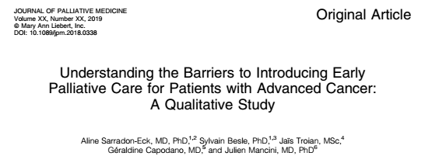

Slide 2
Introduction
Palliative care is underutilized or initiated late in the course of life-threatening illness such as cancer in many countries.
Communication barriers between the various health teams.
Patient and family related barriers
  Reluctance to accept referral due to patient/family misinformation.
  Idea that palliative care is equivalent to terminal care

Slide 3
Definition of Palliative care
Palliative care refers to the holistic approach
  Including management of the physical symptoms
  Providing psychosocial support
  Clarifying patients’ understanding of their prognosis
  Establishing their end-of-life preferences.

Slide 4
EPIC trial
  a randomized multicenter clinical trial (NCT02853474).
  Launched in France in 2017.
  Objective was
    To estimate the benefits of EPC in patients with metastatic upper gastrointestinal cancer
    To determine whether the findings obtained in France are consistent with those obtained in North American trials.

Slide 5
Aim
To describe French oncologists’ perceptions of early palliative care (EPC) and their effects on referral practices before a clinical EPC (EPIC) trial was launched.

Slide 6
P= Oncologists and Palliative care specialists (PCS)
Outcome- To describe French oncologists’ perceptions of early palliative care (EPC).
Design- Qualitative study
  Semi-structured face to face interview with oncologists and PCSs.

Slide 7
Was the choice of participants explicit and comprehensive?
No
Included only 13 oncologists and 19 PCSs.
Not included
  Internist
  Surgeons
  Gynaecologists

Slide 8
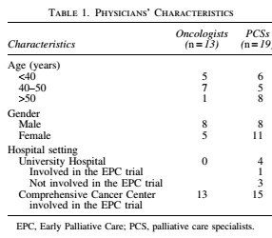

Slide 9
Was data collection sufficiently comprehensive and detailed?
Yes

Slide 10
Principal investigator
  Medical anthropologist
  Not working with the participants
  Did not have any clinical activities in the oncology wards.
Approached the participants by e-mail and conducted the interviews at physicians’ offices INDIVIDUALLY to prevent bias.
Semistructured interview guide used covered the following areas:
  Physicians’ perceptions of palliative care.
  Communicating prognoses.
  Current referral practices.
  Perceived barriers to patients’ access to EPC.
  Physicians’ opinions about the EPIC trial.
Interviews were audio-recorded and transcribed.
All personally identifiable information was removed from the transcripts.

Slide 11
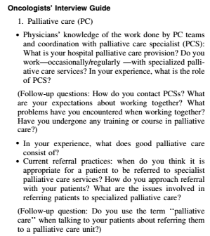
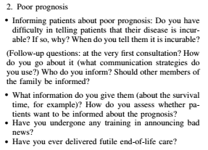

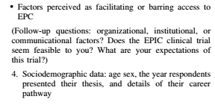

Slide 12
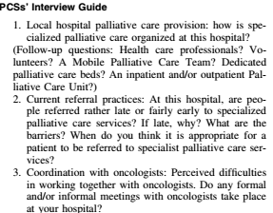
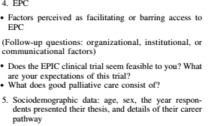

Slide 13
Were the data analyzed appropriately and the findings corroborated adequately?

Slide 14
Data Analysis
1st author conducted a qualitative analysis of each interview manually, using the Grounded Theory coding method.
To assure the robustness of the analysis, the following strategies were used:
  Saturation, reflexivity, and a peer review.
Data collection and analysis were conducted simultaneously until no further new items emerged (theoretical saturation was reached).
Notes:
"grounded theory" refers to theory that is developed inductively from a corpus of data. If done well, this means that the resulting theory at least fits one dataset perfectly. This contrasts with theory derived deductively from grand theory, without the help of data, and which could therefore turn out to fit no data at all.
The basic idea of the grounded theory approach is to read (and re-read) a textual database (such as a corpus of field notes) and "discover" or label variables (called categories, concepts and properties) and their interrelationships. The ability to perceive variables and relationships is termed "theoretical sensitivity" and is affected by a number of things including one's reading of the literature and one's use of techniques designed to enhance sensitivity.
Of course, the data do not have to be literally textual -- they could be observations of behavior, such as interactions and events in a restaurant. Often they are in the form of field notes, which are like diary entries

Slide 15
Core categories and themes were discussed at interdisciplinary team meetings
  Included a sociologist, a sociopsychologist, a PCS, and a Public Health researcher.
  To spot any inaccuracies and misinterpretations.
Preliminary results were presented at two research conferences (the EAPC 2017 World Congress and the SFAP 2018 Congress) to obtain feedback from peers, which was positive

Slide 16
What are the results of the study?
Both oncologists and PCSs stated that palliative care is thought by patients and their families to mean imminent death, hospice care, and end-of-life care.
Impacted the process of communication and patient’s referral to palliative care services.
The word ‘‘palliative’’ was said to hold negative connotations for patients, which make it difficult for oncologists to use it when talking to them.
Most patients felt that they will stop being treated or be abandoned.
Using the word palliative with patients not in the terminal phase of the disease constitutes a form of ‘‘violence’’.

Slide 17
All the oncologists interviewed said they would be more likely to refer patients for palliative care at an earlier stage if it was renamed ‘‘supportive care’.
They would not present the EPIC trial to eligible patients as a ‘‘palliative care’’ investigation, but rather as a ‘‘supportive care’’ investigation.
Oncologists interviewed admitted that they had not been trained to deliver bad news, apart from their on-the-job training.

Slide 18
Does the study offer helpful theoretical conclusions?
Yes
Stigma associated with Palliative care.
Reasons for late referral to palliative care.

Slide 19
Does the study help me understand the context of my practice?
Yes
Need for early initiation of EPS helps in better supportive care for patients with advanced cancer.

Slide 20
Does this study help me understand my relationships with patients and their families?
Yes.

