Slide 1
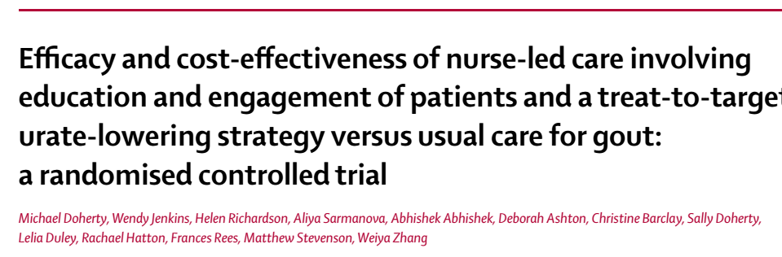

Slide 2
BACKGROUND
Gout is the most common inflammatory arthritis worldwide.
In UK the prevalence has risen from 1∙5% in 1997 to 2∙5% in 2012.
Why should we treat Hyperuricemia?
  Can cause extremely painful gout flares or attacks
  Associated with various comorbidities
  Increased mortality
  Reduced quality of life.
Despite good understanding of the disease and the availability of curative treatment, gout care remains suboptimum.

Slide 3
Inthe UK, gout is managed predominantly in primary care by general practitioners (GPs).
  But less than half of patients receive urate-lowering therapy.
  Poor titration of dose and adherence to medication is poor.
In the UK, community-based nurses manage many chronic conditions.
Randomised controlled trials have shown that nurse-led care has been similar or superior to physician care.

Slide 4
OBJECTIVE OF STUDY
To compare the efficacy, including patient centred outcomes, and cost effectiveness of nurse-led care with usual GP-led care of patients with gout over 2 years.

Slide 5
PICOT
P=
  Adults > 21 years of age
  With a diagnosis of gout as per 1977 ACR gout classification criteria in their database
  With atleast 1 gout flare in the previous 12 months .
I= Nurse led care
C= GP led care
O= Percentage of patients who had achieved serum urate concentrations less than
360 µmol/L (6 mg/dl) at 2 years
T= 2 years
Design- Parallel arm, non-blinded randomised controlled trial

Slide 6
INCLUSION CRITERIA
Adults aged 21 and over with a GP given diagnosis of gout.
Confirmed following telephone interview
Participants should fulfil 1977 ACR criteria for gout.
At least one acute attack of gout in the previous year.

Slide 7
EXCLUSION CRITERIA
Inability to give informed consent.
Patients with terminal or mental illness

Slide 8
OUTCOMES
PRIMARY OUTCOME
  Percentage of patients who had achieved serum urate concentrations less than 360 µmol/L (6 mg/dl) at 2 years.

Slide 9
SECONDARY OUTCOME
  Percentage of patients who had achieved serum urate concentrations of
    <360 µmol/L at 1 year,
    <300 µmol/L at 1 and 2 years
    Group mean serum urate concentrations at 1 and 2 years)
  Frequency of gout flares during years 1 and 2
  Percentage of patients with tophi overall
    Median number of tophi.
    Maximum diameter of the largest tophus at 1 and 2 years among patients with tophi at baseline.
  Quality of life (physical and mental components)
  Gout Impact Scale at 1 and 2 years;
  Cost effectiveness, calculated as cost per quality-adjusted life-year (QALY) gained.

Slide 10
Methodology
Study done in urban and rural population in the Nottingham area.
Recruitment
  From collaborating GPs.
  Via advertisements/promotion in the media.
  Posters placed on noticeboards.
Respondents who fulfilled inclusion criteria and showed willingness were given information on the study.
Explained that nurses successfully manage many long-term conditions in primary care.

Slide 11
Nurses received training about gout and its management.
As part of an individualised package of care, the nurses provided patients with holistic assessment, discussion of illness perceptions, and full information on gout
(nature, causes, associations, consequences, and treatment options), and encouraged them to share in decision making.
Patients were given the Arthritis Research UK gout information booklet.
Follow-up assessments and measurement of serum urate concentrations were done as often as required by the nurse.
Telephone contact could be substituted for face-to-face visits, and home visits were permitted (eg for older patients).

Slide 12
First-line treatment was oral allopurinol
  Started at 100 mg once per day.
  Titrated upwards in 100 mg increments every 3–4 weeks according to serum urate concentrations
  Maximum of 900 mg once per day.
Second-line options
  Febuxostat could be started at 80 mg and if required increased to the maximum dose of 120 mg once per day.
  Benzbromarone could be started at 50 mg and titrated up in 50 mg ncrements to a maximum of 200 mg once per day.
  Combination urate-lowering therapy (xanthine oxidase inhibitor plus uricosuric) could be used as the final treatment option.

Slide 13
Colchicine as prophylaxis against gout flares could be considered.
If the nurses had question about gout management, they could seek advice from a study rheumatologist .
All contacts with participants were logged.

Slide 14
Patients assigned to continue usual GP-led care were given the gout information booklet from Arthritis Research UK.
Treatment of flares could be discussed by the research nurse at baseline and at yearly assessments.
But if participants enquired about other aspects of management they were advised to ask their GP.

Slide 15
Randomisation
Web based system.
Assigned 1:1 to receive nurse-led care or GP-led usual care in randomly permuted blocks of 2, 4, or 6.
Patients were told their allocation by the nurse and their GP was informed by letter.

Slide 16
SAMPLE SIZE
Power- 90%
Significance of 0.05 (two- tailed)
Sample size based on pilot study
  Primary outcome- Percentage of patients with urate < 360 μmol/L= 20
  Difference in the frequency of acute flares= 166
  Difference in quality of life= 648
Due to slow recruitment, Power of study reduced to 80%
  Sample size changed
  Primary outcome of percentage of patients with urate < 360 μmol/L= 16
  Difference in the frequency of acute flares= 124
  Difference in quality of life= 486
Considering 10% dropout over 2 years
  Sample size recruited= 512

Slide 17
TRIAL PROFILE

Slide 18
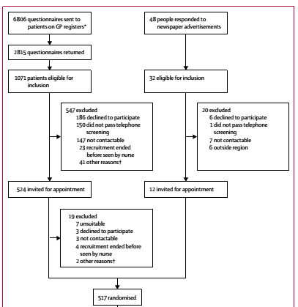
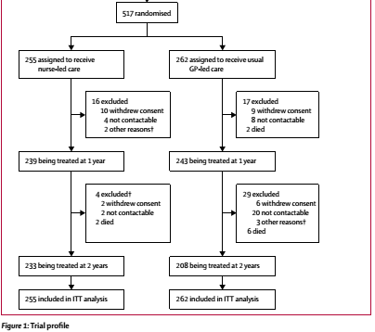
93%
85%

Slide 19
BASELINE CHARACTERISTICS

Slide 20
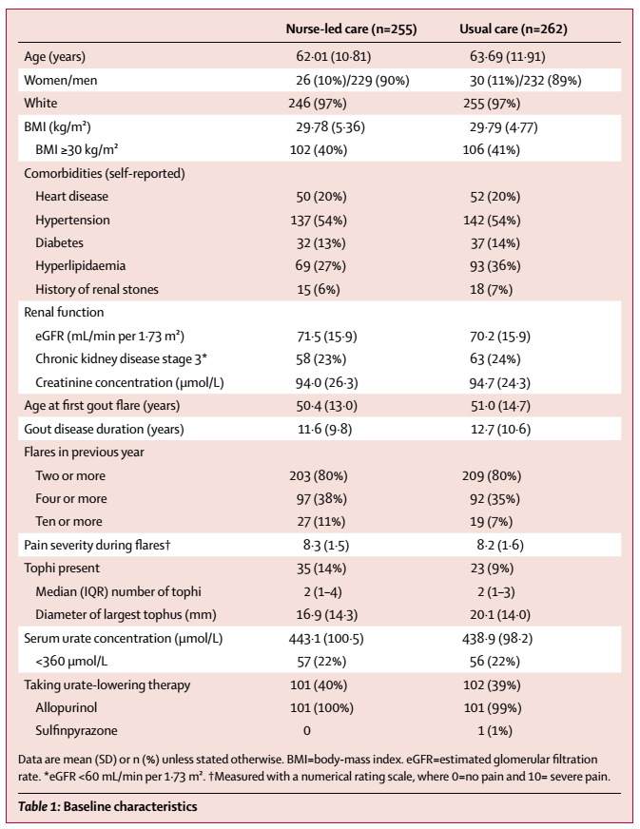

Slide 21
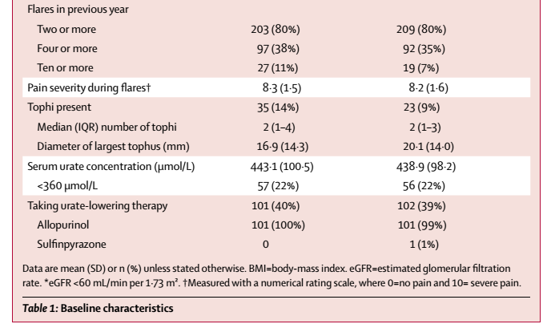
Notes:
The mean dose at baseline was 227 mg/day (SD 101) and
only seven (7%) patients were taking more than
300 mg/day.

Slide 22
RESULTS

Slide 23
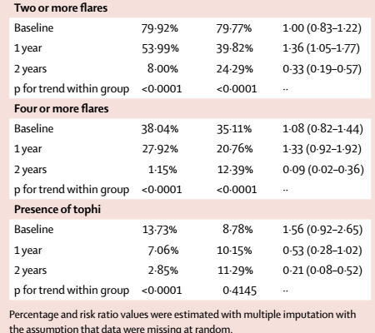
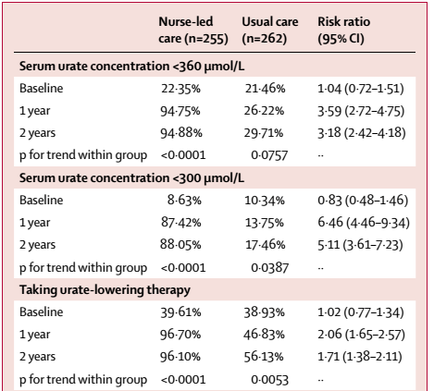
DICHOTOMOUS EFFICACY OUTCOMES

Slide 24
ARR= 94.88%- 29.71%= 65.17%
NNT= 100/ARR= 100/ 65.17= 1.5

Slide 25
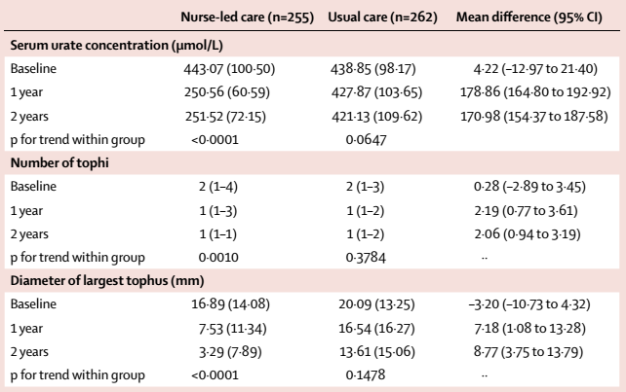
CONTINUOUS EFFICACY OUTCOME

Slide 26
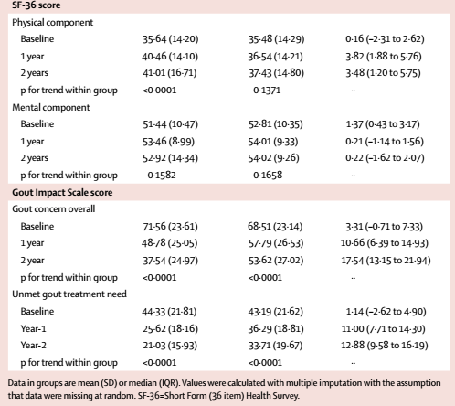

Slide 27
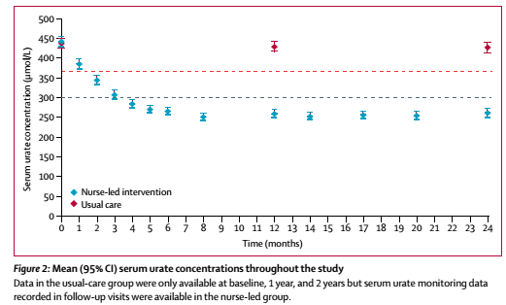

Slide 28
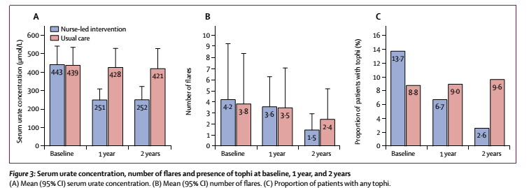
Participants in the nurse-led group
  Attended a mean of 9∙3 visits (SD 2∙2)
  Mean of 8∙3 (3∙2) telephone calls about gout.
Patients in the usual-care group
  visited GPs a mean of 0·6 times (SD 1·4).

Slide 29
Are the results valid?
Did the investigators adopt a sufficiently broad view point?
  Yes
  Community based approach
Are results reported separately for relevant patient subgroups?
  Looked at different ranges of serum uric acid concentration.
  Looked at other associated comorbidities- Obesity, CV disease, CKD stage 3- mentioned but data not shown.

Slide 30
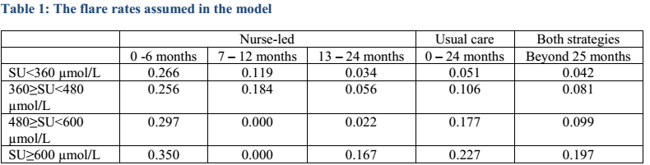

Slide 31
Is there a systematic review and summary of evidence linking options to outcomes for each relevant question?
Yes.

Slide 32
Were costs measured accurately?
  Yes
  Estimated from National institute for Health and Care Excellence (NICE) review of treatment.
  Cost per gout flare was taken as £ 295. (Rs 26,234)
  Medication cost estimated from BNF.
Did investigators consider the timing of costs and consequences?
  Yes
  Patients were followed by till 2 years.
  Both costs and health were discounted at a rate of 3.5% per annum as recommend by the National Institute for Health and Care Excellence (NICE).

Slide 33
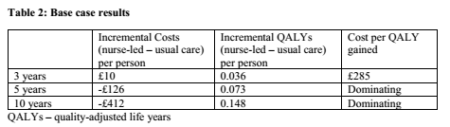
What are the results?
What are the incremental costs and effects of each strategy?
  Nurse-led approach was estimated to cost £84 more per person.
  Producing a QALY gain of 0.0165 per person
  Resulting in a cost per QALY gained of £5066.
This value is well below the reported level of £20,000 per QALY gained reported in the NICE methods guide
Do incremental costs and effects differ between subgroups?
  Not mentioned.

Slide 34
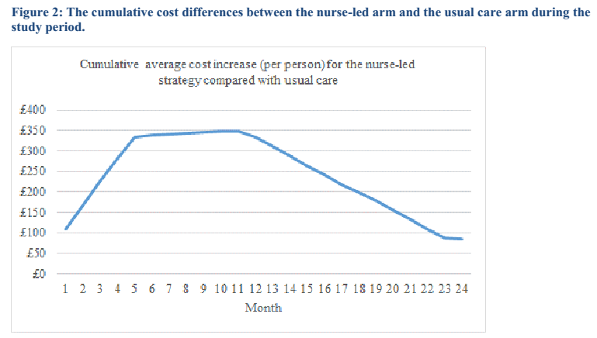

Slide 35
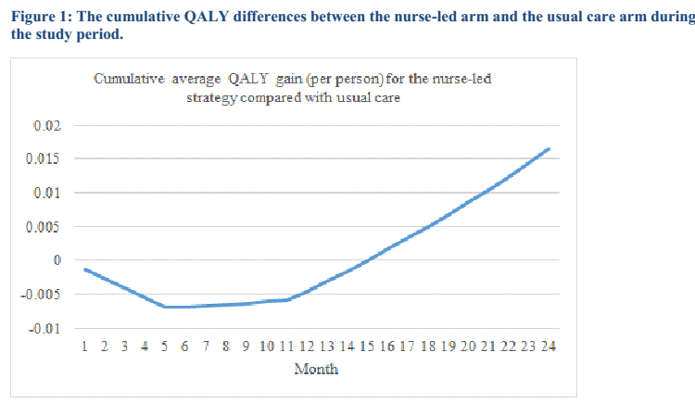
Notes:
The QALYs are negative for the initial year as
there are more flares in the nurse-led arms, but QALYs progressively increase beyond 12 months. The nurse-led
approach was associated with additional cost throughout the study period, although the incremental costs were
falling beyond 12 months due to the reduced rate of flares.

Slide 36
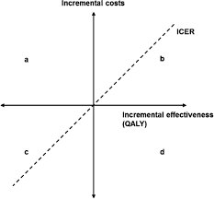
£12,052

Slide 37
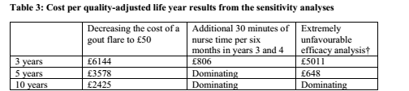
How much does allowance for uncertainity change the results?
  Reducing the cost of a flare to £50 changed the estimated cost to £199 per person, and thus the ICER to £12,052.

Slide 38
How can I apply the results to patient care?
Are the treatment benefits worth the risks and costs?
  Yes
  NNT= 1.5
  Cost per QALY gained= £5066
Can I expect similar costs in my setting?
  Yes.

