Slide 1
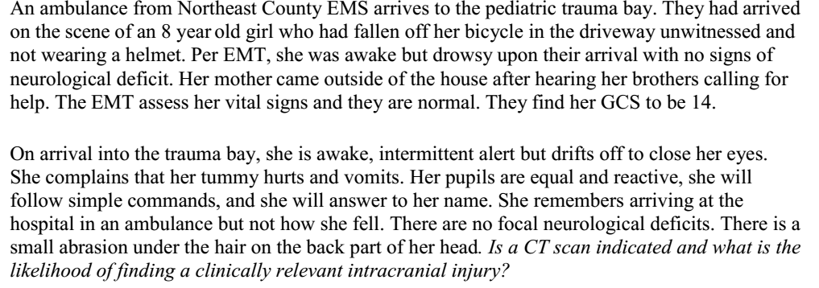

Slide 2
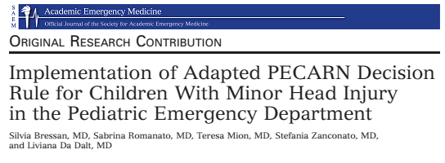

Slide 3
Introduction
Minor head injuries (MHI) continue to be a major problem in paediatrics.
One of the most common reasons for visits in PED.
Balancing the need of head CT scan for intracranial injury (ICI) identification on one hand, and of limiting the radiation and sedation associated risk.
Recent Pediatric Emergency Care Applied Research Network (PECARN) rule, derived and validated decision rule for mild head injuries.

Slide 4
AIM
Aims of this study were to
  Describe the implementation of an adapted version of the PECARN rules for the management of children with MHI in a tertiary care academic PED in Italy
  Evaluate implementation success, in terms of medical staff adherence and satisfaction, as well as the effects on clinical practice.

Slide 5
PICOT
P=
  Children presenting to the PED within 24 hours of blunt head trauma
  Glasgow Coma Scale (GCS) >/= 14
  Between June and November 2010.
I= Adapted PECARN rule.
C=
  Children evaluated in the PED for MHI 6 months prior to the implementation of the adapted PECARN rule
  Between November 2009 and April 2010.
O= Evaluation of medical staff adherence to adapted PECARN rules.
T= 6 months.
Design- Observational before–after study.

Slide 6
Primary outcome
Evaluation of medical staff adherence to adapted PECARN rules, defined as the proportion of children managed according to the new rules, in relation to risk group stratification.
Secondary outcomes
  CT scan rate in the pre- and postimplementation periods
  ciTBrates in the pre- and postimplementation periods
    ciTBI was a priori defined as death from TBI, neurosurgery, intubation for more than 24 hours due to TBI or hospital admission of two nights or more associated with brain injury on CT)
  Return visits for symptoms and ⁄ or signs potentially related to MHI.
  Safety of adapted PECARN rules application to clinical practice.
    Proportion of all patients experiencing a ciTBI who received head CT scan
  Efficacy of adapted PECARN rules application to clinical practice.
    Proportion of all patients not experiencing a ciTBI who did not receive head CT scan

Slide 7
Methodology
Carried out in the PED of Padova Children’s Hospital
  academic hospital
  primary and secondary care for a metropolitan area of
  350,000 people
  Tertiary care for a regional and extraregional population
  with approximately 25,000 PED visits per year.
Both attending physicians and residents in pediatrics provide patient care in the PED.
Decisions on CT scan taken in accordance with the PED consultant, independently of the level of training of the residents.

Slide 8
Protocol
Internal protocol
  Complex structure
  Impractical for rapid consultation and decision making in the ED.
  No separate rule for younger children.
PECARN rule categories
  CT recommended- High risk
  Observation versus CT on the basis of other clinical factors- Moderate risk
  CT not recommended- Low risk

Slide 9
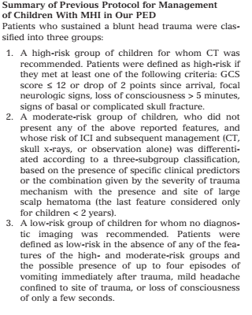

Slide 10
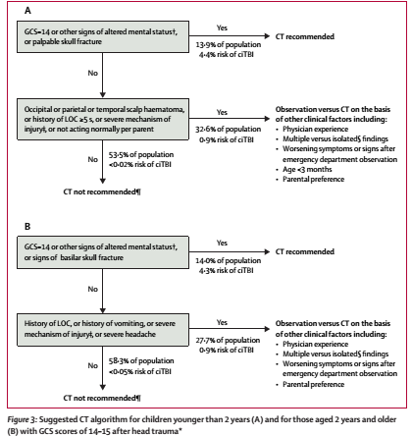

Slide 11
Training of staff
Dedicated teaching sessions
E-mailing of teaching material, as well as the adapted PECARN rules
Posters explaining the algorithms in the PED
Availability of the new protocol for online consultation in the intranet.
Ample supply of pocket cards, including the pediatric GCS to the physicians working in the PED.
Periodic reminders to on-call physicians were also performed by the study investigators.

Slide 12
Controls
Patients assessed for MHI during the preimplementation period were identified through the electronic PED database.
Medical charts were then reviewed for inclusion ⁄ exclusion criteria and data abstraction.

Slide 13
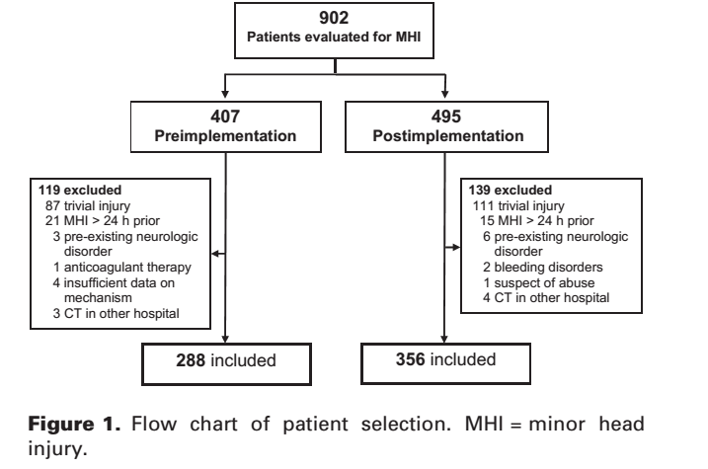

Slide 14
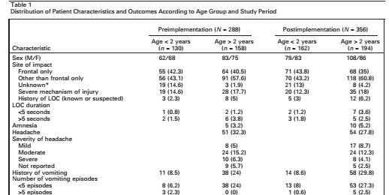

Slide 15
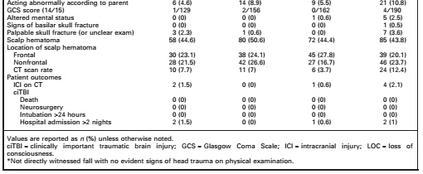

Slide 16
CRITICAL APPRAISAL OF DECISION RULE

Slide 17
Were all important predictors included in the derivation process?

Slide 18
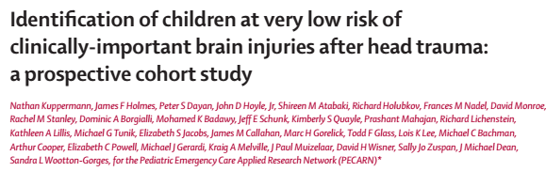

Slide 19
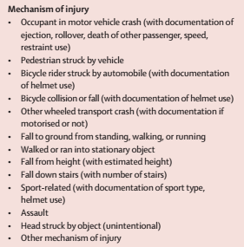
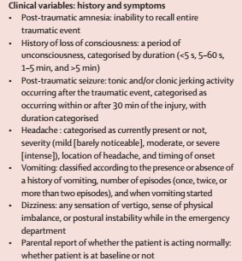
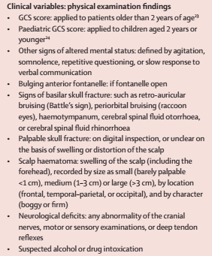
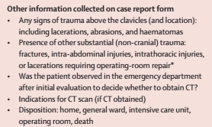

Slide 20
Were all important predictors present in a significant proportion of the study population?

Slide 21
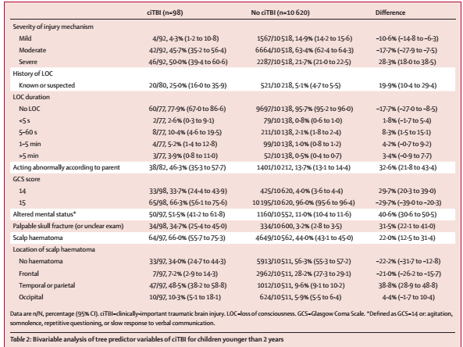

Slide 22
Does the rule make clinical sense?
Yes

Slide 23
Did the patients represent a wide spectrum of severity of disease?
No
Inclusion criteria
  Children presenting to the PED within 24 hours of blunt head trauma
  Glasgow Coma Scale (GCS) >/= 14

Slide 24
How were the predictors applied?
Examining physicians had to report clinical data in medical records.
Data abstractors then abstracted the data from MRD.
  Were not blinded to the study outcomes.
  Periodic meetings with the senior study coordinator were held to discuss conflicting, ambiguous, or missing data, as well as review of inclusion and exclusion criteria
CT scans were independently interpreted by site faculty radiologists
unaware of this study.

Slide 25
Was there an explicit and accurate interpretation of the predictor variables and the actual rule without knowledge of the outcome?
No blinding done.

Slide 26
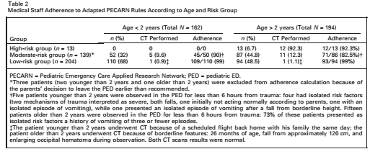
Adherence to the adapted PECARN rule was 93.5%.
Doesnot mention adherence % to the old protocol.

Slide 27
Ct scan rate
  No differences between the pre- and postimplementation periods for children younger than 2 years (7.7% vs. 3.7%, p = 0.219)
  Children older than 2 years (7% vs. 12.4%, p = 0.132).

Slide 28
For how long patients were followed?
Upto 90 days from PED discharge.
Follow up- 78%

Slide 29
Were outcomes objective?
Primary outcome was adherence to the PECARN decision rule
Yes

Slide 30
How powerful is the rule ?
Efficacy- 92.3%
95% CI = 89 to 95

Slide 31
What were the actual outcome rates in the low risk groups in the two studies?
Adherance in older protocol- 51%
Adherance for adapted PECARN rules- 96%
P < 0.0001.

Slide 32
CONCLUSION
New PECARN decision rule resulted in a low CT scan rate that was unchanged compared to previous clinical practice, and showed excellent safety and efficacy profiles.

