Slide 1
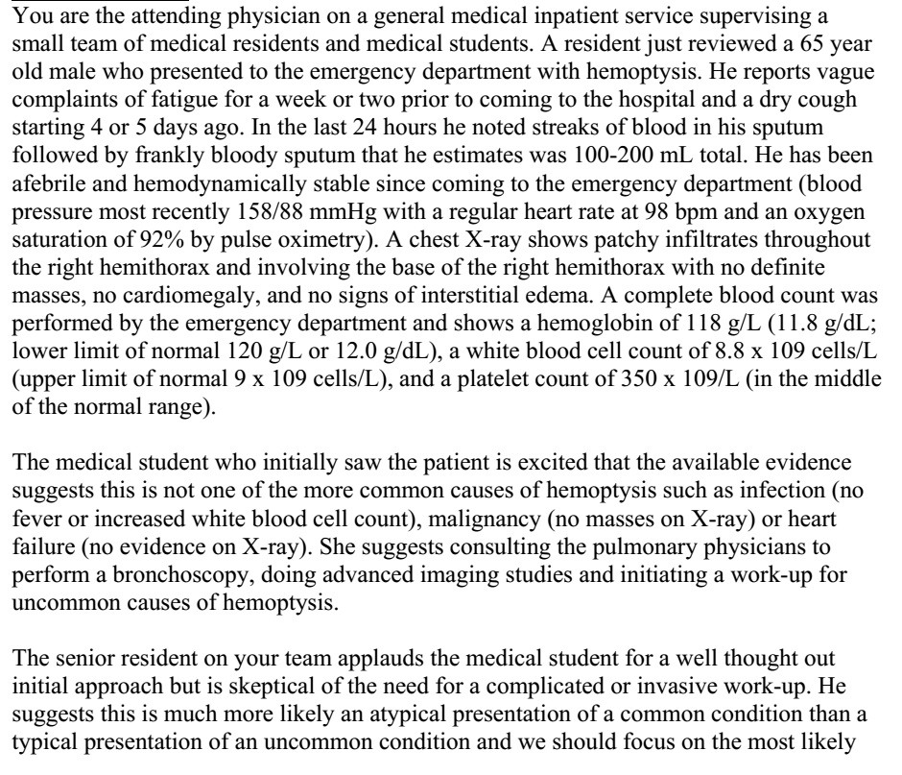

Slide 2
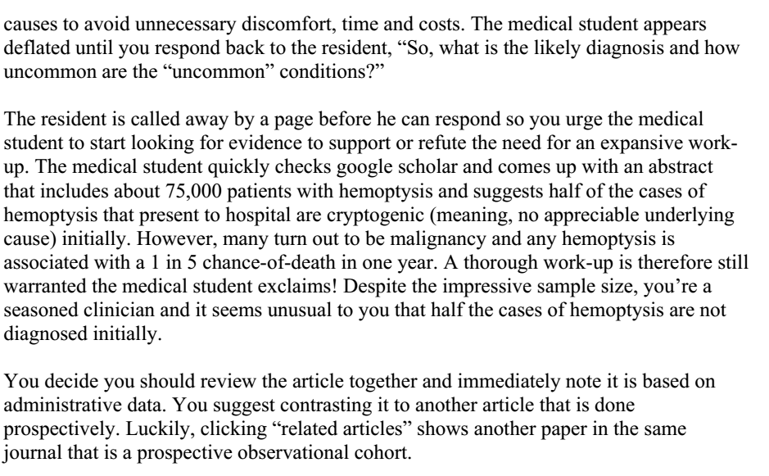

Slide 3
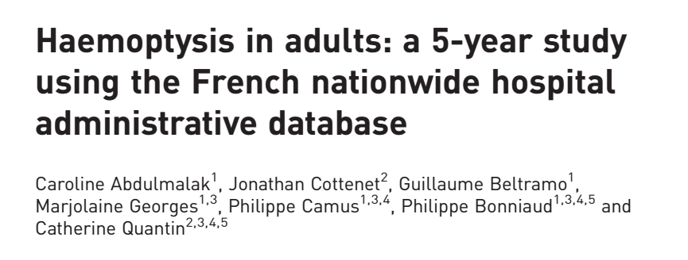
29/12/2018

Slide 4
Background
Haemoptysis is a symptom varying in its seriousness.
A number of aetiologies are described in the literature.
A retrospective study in Israel, the main aetiologies were infectious respiratory disease (34%), followed by
bronchiectasis (20%) and lung cancer (19%).
A French retrospective study that included >6000 patients, found that bronchial carcinoma accounted for 14.9% of cases and was the leading cause of haemoptysis.
The objectives of our study were to provide an epidemiological update on haemoptysis in France.
  to assess outcomes in patients presenting with this symptom
  to determine the benefit of close follow-up extended investigations when first-line examinations are normal.

Slide 5
Material and methods
The national administrative database: PMSI
Diagnoses identified during hospital stays are coded according to the tenth edition of the International Classification of Diseases (ICD-10).
This study was a retrospective multicentre study based on nationwide PMSI data collected between
January 2008 and December 2012.
Inclusion :
  patients aged >18 years
  admitted to hospital with haemoptysis during this period.

Slide 6
Variables
Potential aetiologies of haemoptysis when the diagnosis reported was the main, related or associated diagnosis.
geographical distribution
seasonal distribution
long-term outcomes in patients with respect to:
  Recurrence
  therapeutic embolization
  hospital mortality during 3 years of follow-up for patients admitted

Slide 7
Statistical analysis
For bivariate analyses of qualitative variables, we used the Chi-squared test to compare percentages.
Mean values of quantitative variables were compared using linear regressions.
p-values <0.05 were considered to be statistically significant.

Slide 8
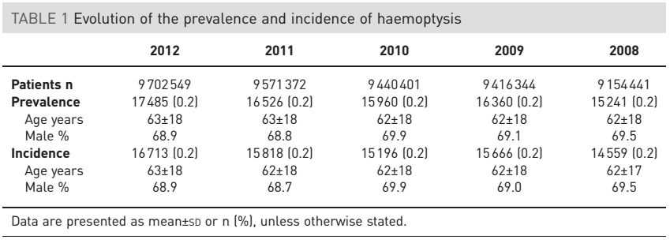
How serious is the risk of bias?
Did the study patients represent the full spectrum of those with this clinical problem?
Notes:
During the period January 2008 to December 2012, ∼15 000 (range 14 559–16 713) were admitted each year for haemoptysis or had
haemoptysis as a complication of their stay. This represents 0.2% of all patients hospitalised in France
during the period. The mean age of this population was 62 years. The
results for the prevalence and incidence of haemoptysis with regard to mean age and sex ratio were
superimposable (table 1). The mean duration of the initial hospital stay for haemoptysis was 8.0±12.5 days,
and during this stay 9.0% of these patients were admitted to an intensive care unit (7–10%). One-third of
the patients had a computed tomography scan. Almost half of the patients underwent an endobronchial
intervention, but the PMSI database did not distinguish between diagnostic and interventional procedures
(online supplementary table S2). During their hospital stay, 1% of the patients underwent thoracic surgery,
but we do not know if the surgery was performed to treat the haemoptysis or if this symptom was a
consequence of the

Slide 9
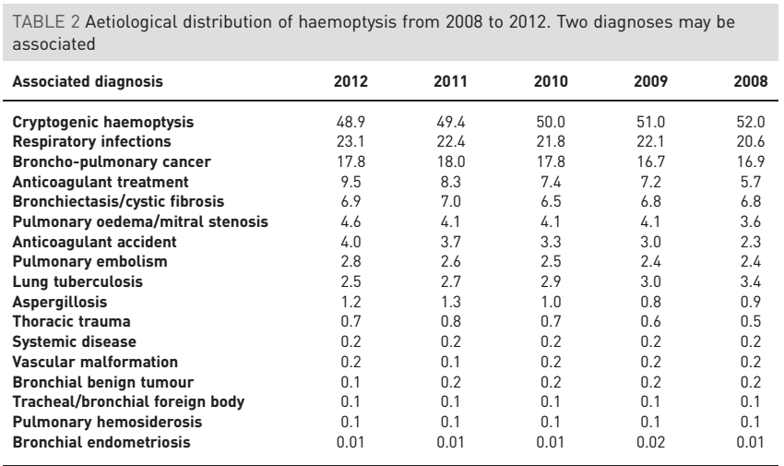

Slide 10
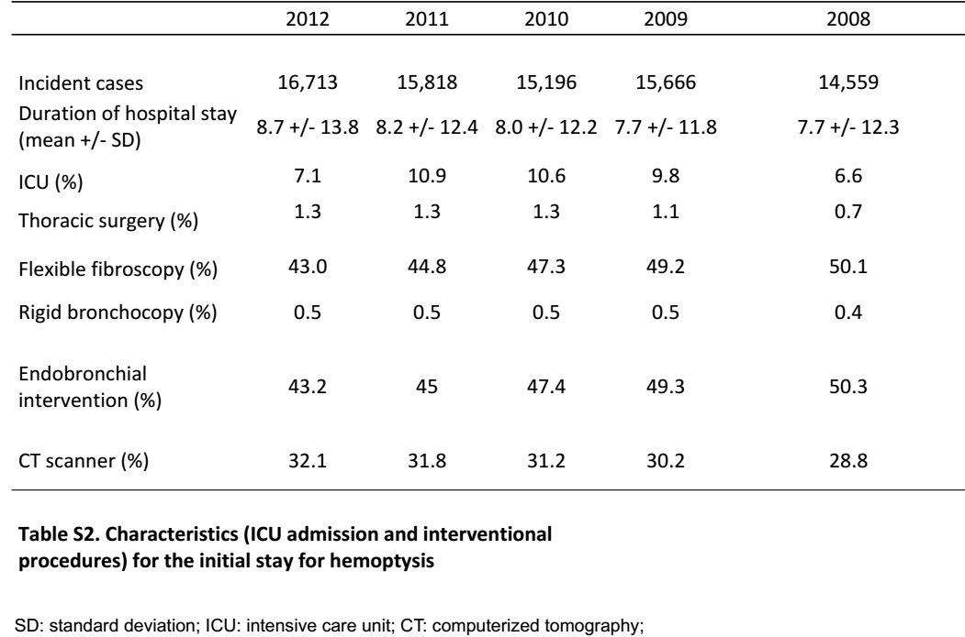
Was the diagnostic evaluation definitive?

Slide 11
What are the results?
What were the diagnoses and their probabilities?

Slide 12
How precise are the estimates of disease probability?

Slide 13
How can I apply the results to patient care?
Are the study patients and clinical settings similar to mine?
  Yes
Is it unlikely that the disease possibilities or probabilities have changed since this evidence was gathered?
  no

