Slide 1
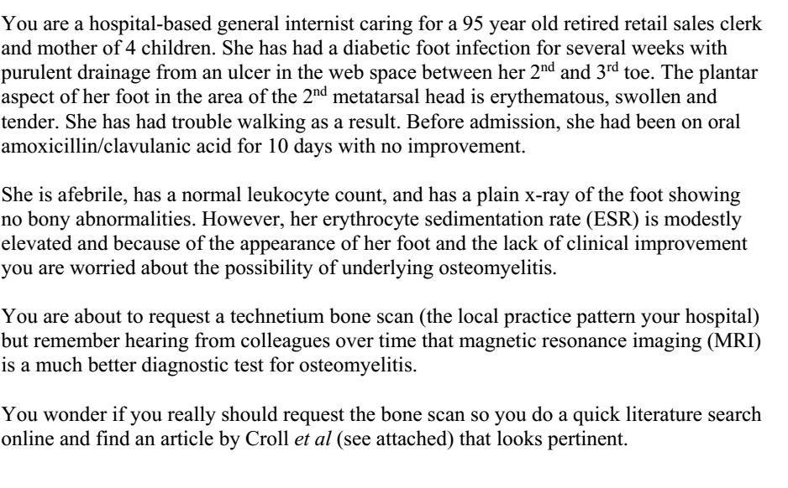

Slide 2
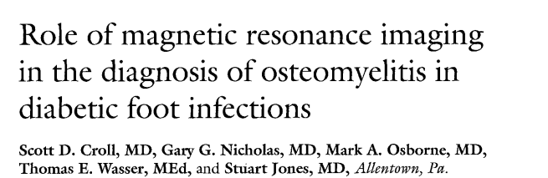
28/12/2018

Slide 3
Background
Diabetic foot infections account for 20% hospital admissions among patients with diabetes and 80% of infectious amputations each year.
Diabetic foot infections represent a significant problem, causing disability, suffering and medical expense.
Traditionally plain radiograph and nuclear scanning are standard for diagnosing OM.

Slide 4
AIM
To determine the accuracy of MRI for diagnosing OM in diabetic patient’s feet and compare this with traditional modalities.

Slide 5
Methods
P: Patients admitted to Lehigh Valley hospital with diabetic foot infections
Test: MRI of the foot
Standard: Plain radiograph and nuclear scans
O: Osteomyelitis on surgical specimen
T: November 1991 to December 1992

Slide 6
Inclusion criteria:
  Diabetic foot infections
Exclusion criteria
  Fetid foot needing immediate surgery
  Only cellulitis and no break in integrity of the skin

Slide 7
Cost of each study , included cost of performing study and physicians cost was also estimated.
Bone scans were performed for all patients : either Technetium 99 (22) or Leukocyte scanning (19)
Plain radiograph : 27.
All patients underwent MRI scanning with a 1.5 tesla Signal system
The bone submitted for pathologic examination was determined by the surgeon on the basis of clinical examination and the results of the diagnostic studies performed.
Gross and microscopic evaluations were performed on all bone and soft tissue excised or amputated.
The diagnosis of osteomyelitis was based on:
  histologic findings of sub periosteal new bone formation,
  lytic areas of bone loss
  the presence of fibrosis
  infiltration of polymorphonuclear leukocytes and lymphocytes.

Slide 8
Interpretation of the studies was done by staff radiologists and nuclear medicine specialists and was reviewed by the clinicians.
The physicians were not specifically blinded to the results of the other diagnostic studies, but none was aware of the pathologic end point of the presence or absence of osteomyelitis before submitting their reports.

Slide 9
How serious is the risk of bias?
Did participating patients constitute a representative sample presenting with a diagnostic dilemma?
  Implications of underlying osteomyelitis can be large, however unwarranted surgery for patients without proven OM needs to be minimised.
Did the investigators compare the test to an appropriate , independent reference standard?
  Yes

Slide 10
Were those interpreting the test and reference standard blind to the other results?
  The clinicians were blinded to the final histopathological diagnosis , but were not blinded to the results of the other tests.
Did all patients receive the same reference standard irrespective of the results of the test results?
  yes

Slide 11
What are the results?
27 patients (19 men and 8 women)
Their mean age was 66 years (range 34 to 82 years)
mean duration of diabetes was 20 years.
The mean HbA1C was 8.1% with a range of 5.1% to 13%.
Seven patients had undergone previous vascular bypass procedures.
Six patients were active smokers.
Presenting signs:
  cellulitis (70%)
  Sero-purulent drainage (67%)
  leukocyte count greater than 10,000/mm: 3 (33%),
  absent dorsalis pedis and posterior tibial pulses (44%),
  neuropathy (67%).

Slide 12
The diagnosis of osteomyelitis was confirmed or refuted by pathologic specimen (n = 18,67%) or bone culture (n = 3, 11%) or was excluded by
response to medical management (n = 6, 22%).
Osteomyelitis was present in 9 of the 21 specimens of bone examined.
The data were analyzed statistically for overall diagnostic precision with a
two-tailed Fisher's exact test. MRI was the only test that was statistically significant (p < 0.01).

Slide 13
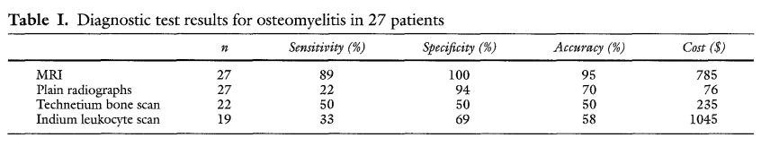
What likelihood ratios were associated with the range of possible test results?

Slide 14
How can I apply the results to patient care?
Will the reproducibility of the test results and its interpretation be satisfactory in my clinical setting?
  yes
Are the study results applicable to patients in my practice?
  yes

Slide 15
Will the test results change my management strategy?
  no
Will patients be better off as a results of the test?
  Not necessarily

Slide 16
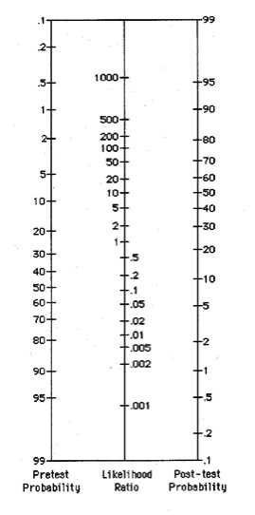

Slide 17
