Slide 1
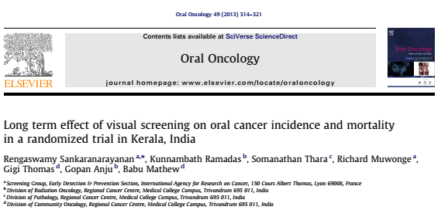

Slide 2
Background
High incidence of oral cancer in Indian subcontinent.
Due to high prevalence of pan/tobacco chewing in the population and smoking.
5-year survival exceeds 80% following diagnosis and treatment of early, localized (stages I and II) oral cancer.
Drops to less than 20% with advanced clinical stages (III and IV).

Slide 3
In 2005, this group reported a 34% reduction in oral cancer mortality in high-risk individuals with tobacco chewing or smoking or alcohol drinking habits following three rounds of oral visual screening at 3-year intervals in a cluster-randomized controlled trial.
Current study- data from 15 years of follow up.

Slide 4
PICOT
P=Apparently healthy adults >/= 35 years of age with no past history of oral cancer.
I= 3 rounds of screening consisting of oral visual inspection by trained health workers at 3 year intervals.
C= Standard care
O= Oral cancer incidence and mortality in the study groups.
T= 1996 to 2010

Slide 5
Methodology
HWs
  Non-medical university graduates
  Trained for visual inspection of the oral mucosa and identify potential precancerous lesions and oral cancer.
Two HWs were assigned to each cluster to visit households to identify and interview the eligible subjects during each round.
Screening was repeated every 3 years for four rounds
All rounds were completed in 2008.
Findings were recorded as
  Normal
  Referable lesions suggestive of potentially malignant disorders, or suspicious ulcer
  Growth suggestive of cancer.
Screen-positivity was defined as the presence of referable lesions.

Slide 6
All screen-positive subjects were referred to a weekly clinic in the study project office.
Dentists and oncologists, with special training and several years of experience in the diagnosis of oral lesions, clinically examined them using standardized criteria.
Assessed the oral cavity and documented the findings as
  Normal
  Benign lesions
  Oral precancerous lesions
  Invasive cancer.
Punch or incision or excision biopsies were directed from oral precancerous lesions with a high degree of clinical suspicion of cancer and all growths.
Biopsy specimens were processed at the RCC and histological findings were reported by one pathologist (ST).

Slide 7
Reference standard
Reference investigation for final diagnosis of
  Oral precancerous lesions was clinical examination by doctors
  Invasive oral cancers- Biopsy.

Slide 8
Control arm
Eligible subjects in the control clusters were not screened but
continued to receive routine health-care during the years 1996–
2005.
Once significant oral cancer mortality reduction following
three rounds of screening among the high-risk subjects in the
intervention arm was confirmed, the control subjects were offered
screening during the years 2006–2008.

Slide 9
Collection of data
Obtained information on the incident oral cancer cases in the study clusters from
  Trivandrum population-based cancer registry
  Hospital cancer registry of the RCC
  Medical records departments of other hospitals treating oral cancer patients
This information was collected without being aware of study group assignment of cases.
Information on all deaths among the subjects was collected from
  Municipal and district death registers
  Hospital medical records
  Death records of churches and mosques
  House visits by the population cancer registry staff and by project HWs

Slide 10
Cause of death in each oral cancer case was assessed on a case-by-case basis by three physicians (KR, GT, ST)
  Blinded to the study group allocation
Deaths were attributed to oral cancer if
  Patient had histologically or clinically confirmed oral cancer, lymph nodes or distant metastasis at the time of death
  Or had died due to complications of oral cancer treatment.

Slide 11
Sample size calculation
Power- 80%
5 % significance level.
Assuming 35% reduction in cumulative mortality rate of oral cancer between intervention and control groups.
Death rate from oral cancer in those aged 35 years or older has been estimated at about 20 per 100 000.
Yearly dropout of 5%.
Sample size of 15,000.

Slide 12
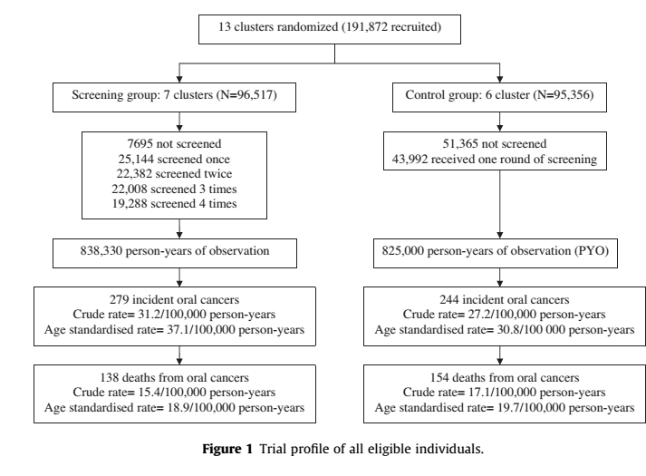

Slide 13
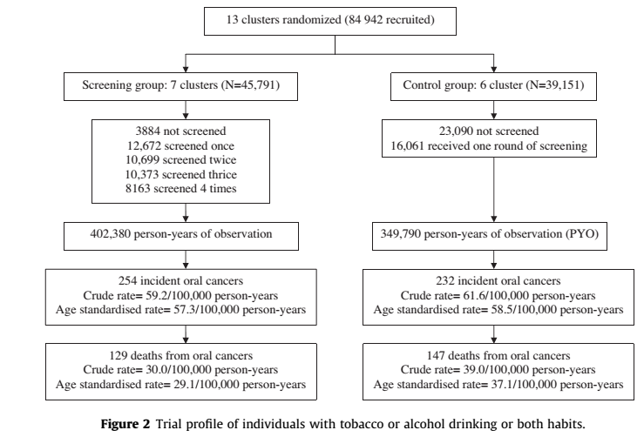

Slide 14
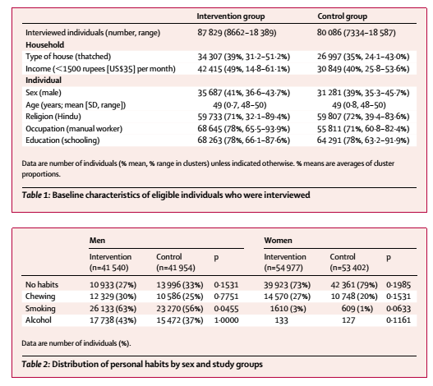

Slide 15
Are the recommendations valid?
Is there randomized controlled trial evidence that the intervention benefits people with asymptomatic disease?
  Yes
Were the data identified, selected, and combined in an unbiased fashion?
  RCT
  Data analysis team were blinded to the randomisation.
  Chance of migration of study population??
  Participants are not blinded

Slide 16
What are the recommendations and will they help you in caring for your patients?
What are the benefits?

Slide 17
Screen-positivity rate was
  7.3% (3589/49,179) in the first.
  2.6% (1475/55,993) in the second.
  2.1% (1395/64,898) in the third.
  2.2% (932/43,014) in the fourth rounds.
The detection rate of oral precancerous lesions and oral cancer in the
  1st round- 2.83%
  2nd round- 1.19%
  3rd round- 1.16%
  4th round- 0.39%
In the control arm, 43,992 (46.1%) had one round of screening during 2006–2008 and 1163 (2.6%) were positive.

Slide 18
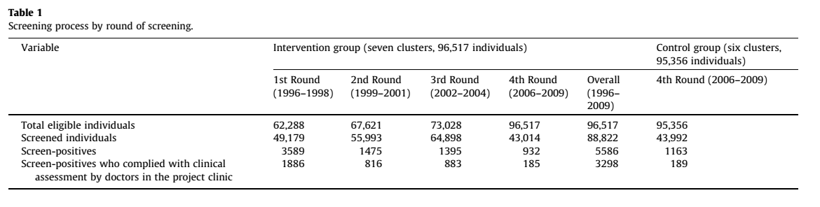

Slide 19
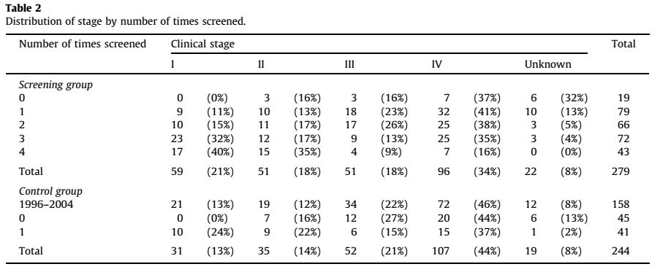
39.4% of the cases in the intervention arm were in stages I or II compared with 27.0% cases in the control arm (p = 0.002).

Slide 20
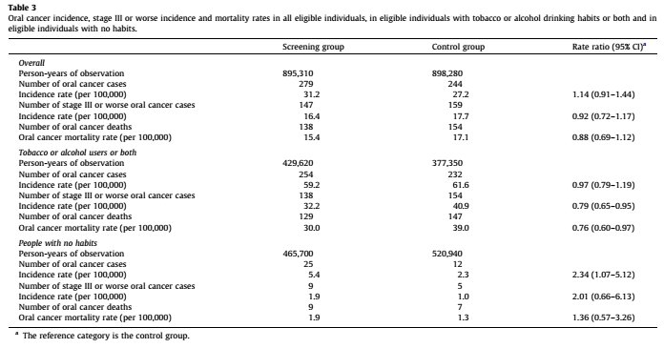

Slide 21
In the tobacco or alcohol or both arm
Significant 21% reduction in the incidence of advanced oral cancers
NNT= 100/21= 4
Significant 24% reduction in oral cancer mortality
NNT= 100/24= 4.16

Slide 22
5 year and 10 year survival
5-year survival- 55.5% vs.43.4%
10-year survival- 48.3% vs. 30.6%
P = 0.003.

Slide 23
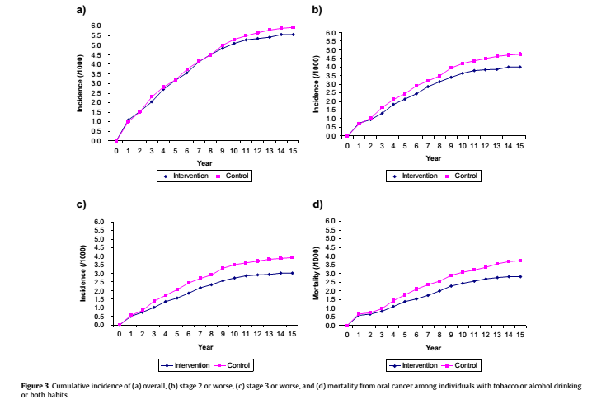
Overall
Stage 2 or worse
Mortality from oral cancer among individuals with habits.
Stage 3 or worse

Slide 24
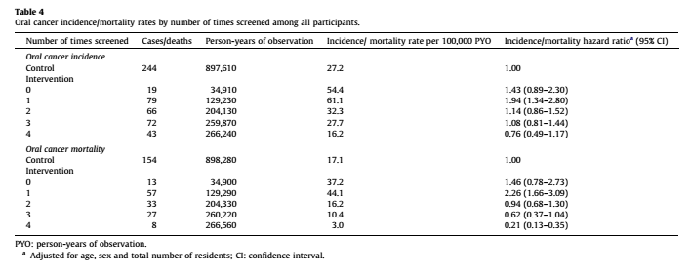

Slide 25
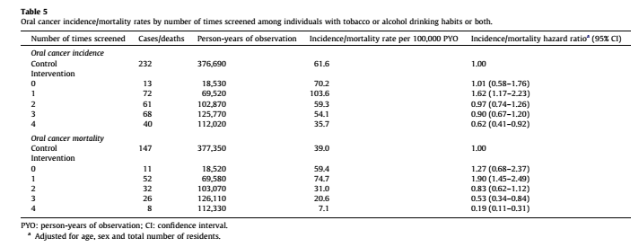

Slide 26
What are the harms?
  No major adverse effects.
  One episode of bleeding following biopsy which required sutures.
  8 patients complained of pain following biopsy.

Slide 27
How do these compare in different people and with different screening strategies?
  Subgroup analysis done.
  No other screening strategies assessed.

Slide 29
What is the impact of people’s values and preferences?
  Not mentioned.

Slide 30
What is the cost-effectiveness?
  Oral visual screening cost- US $6/ person (Rs 423)
  Incremental cost per life-year saved was
    US$ 835 for all eligible individuals. (Rs. 58,896)
    US$ 156 for tobacco and/or alcohol users. (Rs. 11,003)

Slide 31
Conclusion
Routine use of oral visual screening can reduce oral cancer mortality among the high-risk group of users of tobacco or alcohol or both in the general population, in addition to primary prevention efforts to reduce and prevent tobacco and alcohol use.

